Slide 1
International collaborations and interaction with the European HFM
Presentation to the MDP TAC
Soren Prestemon
For the MDP Team

Slide 2
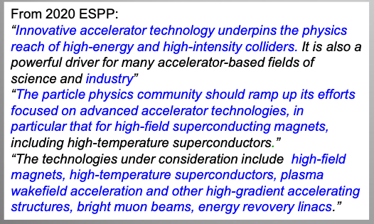
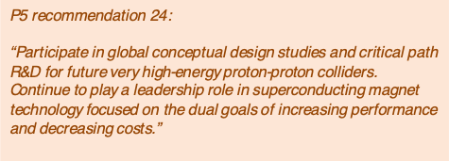
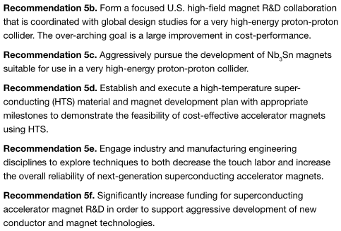
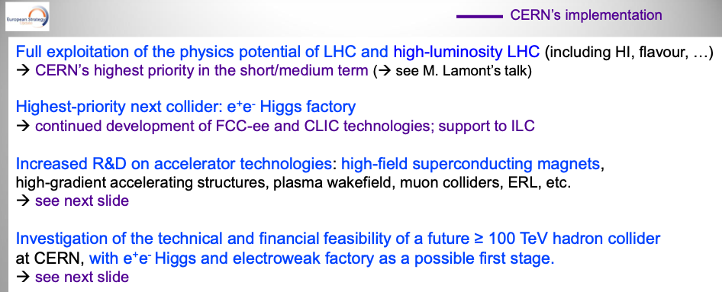
Physics motivation and strategic planning
The physics drivers for a future hadron collider are well documented by community planning, e.g.
  US “Snowmass” process - ongoing
  European Strategy for Particle Physics
Last US “P5” report ~2014
HEPAP Accelerator R&D Subpanel recommendations
Fabiola Gianotti (CERN), LHCP, 7 June 2021

Slide 3

R&D efforts for accelerator magnet technology are becoming more structured
DOE created the US Magnet Development Program (MDP) in ~2016
Europe is in the process of forming the High Field Magnet program (HFM)
  Led by the Laboratory Director’s Group (LDG)
  Working to define roadmaps and coordinate activities by collaborating institutions
The programs strive to coordinate efforts to more rapidly advance technology development
General R&D - programmatic
(ex: US MDP)
Directed R&D
(Technology readiness)
(ex: LARP)
Directed R&D
(Technology readiness)
Project
Project
(ex: HL-LHC AUP)
The US DOE approach balances long-range R&D and project preparation

Slide 4
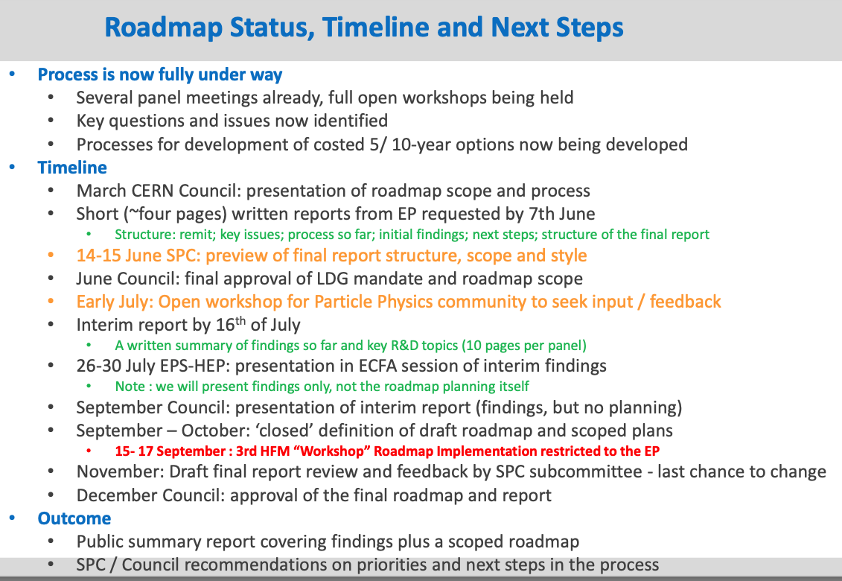
European HFM roadmap development process nearing completion
MDP involvement:
  SP on the LDG Expert Panel
  Strong list of contributions to the “State of the Art” workshop
    Apr. 14-16, 2021
    https://indico.cern.ch/event/1012691
  G7 met with Luca Bottura in May to discuss process, status
  G7 invited to attend “Roadmap Planning” workshop June 1-3, 2021
    https://indico.cern.ch/event/1032199
  SP attended “Roadmap Implementation” workshop Sept. 15-16, 2021
Luis García-Tabarés , Bernhard Auchmann, Amalia Ballarino, Bertrand Baudouy, Luca Bottura, Philippe Fazilleau, Matthias Noe, Soren Prestemon, Etienne Rochepault, Lucio Rossi, Carmine Senatore, Ben Shepherd

Slide 5
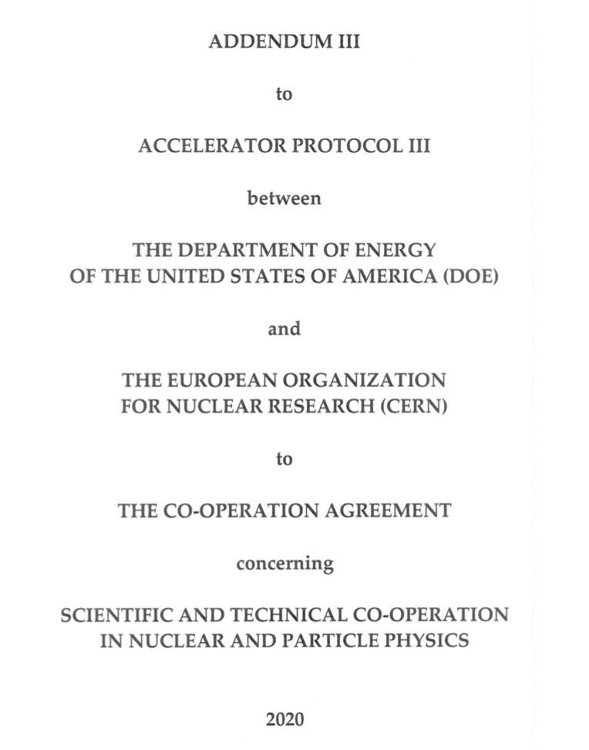
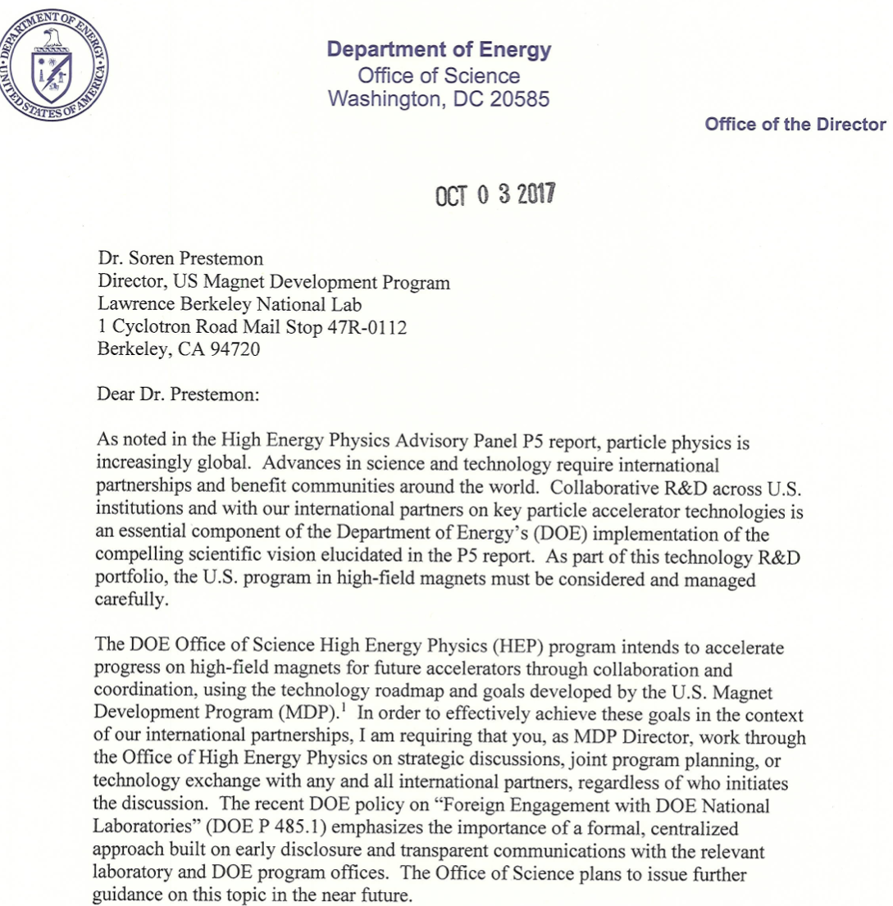
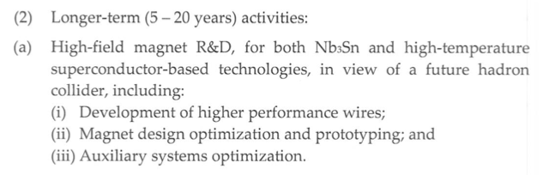
DOE-OHEP provided guidance on international collaborations

Slide 6
Our current process for collaborations
We maintain a “living” document of ongoing collaborations
  Updated regularly to reflect active elements
Process:
  1. Staff who are considering initiating a collaboration effort provide a synopsis:
  - Scope of collaboration
  - Points of contact from each institution
  - Estimate of cost and schedule
  - Relevance and importance to MDP goals
  SP discusses with Ken Marken for concurrence on value and appropriateness
  If agreed, staff are allowed to proceed, and progress updates folded into General Meeting updates
Existing agreements between DOE and CERN are sufficient to enable ongoing collaborations (from US perspective)
An MOU between MDP and CERN, residing under “Addendum III”, is under development
  Hopefully it will enable collaboration with nascent Euro High Field Magnet program (HFM) more broadly
Notes:
MDP has made strong progress in bringing in junior staff, typically with significant support from “adjacent” projects and short-term funded projects. A challenge is to provide them sufficient opportunity to focus on MDP research to enable their careers to evolve well. The influx of junior staff bodes well for our field.
Students (undergrad and grad) – attracting student from local Universities, DOE should support local universities through Accelerator Stewardship Program, example: an undergrad working with X.Xu on Nb₃Sn ECA
Lack of postdocs for MDP – independent funding for 2-3 postdoc positions
Young researchers’ time – a strong competition with the projects. This creates disbalance between R&D involvement (R&D time) of the young scientist and engineers and older researchers

Slide 7
Considerations for healthy collaborations
Collaborations should not negatively impact any program’s ability to deliver on its goals
The purpose/value should be evident - transparency in our goals/intentions/concerns
Open sharing of information between scientific/technical staff is critical
Management should streamline the process – if a collaboration topic has been deemed valuable, staff should be minimally impacted by “procedure” so they can focus on research
Example: possible categorizing collaboration items:
1a) elements where HFM expends money, with no, or less, return on investment (example: Bi2212 cable testing at Twente)
1b) elements where MDP expends money, with no, or less, return on investment (for example, if we make large strand-count Rutherford cables for CERN)
2) elements where there is perceived mutual benefit (example: MDP might provide acoustic sensors, or designs for them, and CERN would provide us access to resulting test data)

Slide 8
MDP Strategy in Community Planning
Send a consistent message to Snowmass:
  MDP is a mature, effective, and productive national program
  We are actively engaged in international planning and collaboration
  We provide critical insight into accelerator magnet technologies for future colliders
Positioning MDP for P5 and beyond
  Identify potential growth areas for MDP for Hadron colliders
  Be open and receptive to new ideas, concepts, and opportunities
  Identify magnet technology needs for other collider concepts, e.g. Muon colliders
    And clarify possible expanded roles for MDP relevant to HEP
  Provide DOE guidance on:
    project risks in terms of magnet technology
    priorities for further magnet R&D

