Slide 1
HTS Test Facility Dipole Magnet Wire Specification Review
Wire Specification and LBNL Procurement Experience
Ian Pong (ipong@lbl.gov)
Staff Scientist
Lawrence Berkeley National Laboratory

Slide 2
Outline
Wire procurement strategy
Specifications and performance of the wire (to be) procured
LBNL procurement experience

Slide 3
Wire Procurement: 3-step Strategy
Charge 4
Development cable wire (2019-2020)
  108/127 HiLumi spec at 1.1 mm procured by LBNL
  162/169 high I_{C}, low-Cu-ratio, standard-Sn “FCC-target” style procured by CERN
Prototype cable wire (2020-2021)
  162/169 TFD prototype wire spec procured by LBNL
Production cables (including spare coils) wire (2021-2023)
  162/169 TFD production wire spec, LBNL procurement to proceed with approval by TFD management after review

Slide 4
Wire Specifications – Development Cable
To establish a baseline and an alternative design
Main options were
  108/127 HiLumi-style versus 162/169 “FCC-class”
  High (~1.1 ± 0.1) versus low (0.9 ± 0.1) Cu ratio
  1.1 mm versus 1.0 mm diameter
Some of the goals of this round of procurement were
  Checking the cable fabricability
  Verifying the cable parameters
  Determining the cable windability
  Estimating the cabling degradation
Target: 30+ m total in sections to explore parameters window

Slide 5
CO11S Specification – Development Cable
Contributed by CERN (thanks again) CO11S20235A04U, 3.117 km
Technical Specification IT-4363 “DEM-1.1”, geared towards FCC model coils and EDIPO2
Minimum J_{C} of 1000 A mm⁻² is comparable to HL-LHC spec, but there is a non-contractual high J_{C} target of 1200 A mm⁻² at 16 T
Layout was not specified but the d_{eff} pointed towards 169-stack
RRR >150 after HT on round wire
Cu ratio 0.7-1.1
Minimum piece length 215 m
The type and grade of Nb alloy was not imposed

Slide 6
WO11S Specification – Development Cable
No formal technical specification
Sole-sourced from BOST their RRP® strand “of AUP spec but at 1.1 mm diameter”
~3 km total of wire for a 44-strand cable (no minimum piece length specified)
J_{C} and RRR requirement was “at least matching AUP spec”
Required wire to be twisted (but initially no pitch length specified)
WO11S00545A02U, 3.117 km also (!)

Slide 7
Development Cable Wire Performance
Charge 3
For the 162/169 wire,
  see S. Hopkins’ talk on general CO11S statistics
  see J. Lu and D. Turrioni’s talks on TFD Verification QC (so-called “V” QC)
  see N. Cheggour’s talk on I_{C} (ε) Characterisation
For the 108/127 wire, we only received 1 spool WO11S00545A02U (limited meaningful statistics)
  Supplier QC data (so-called “S” QC)
    I_{C} at 4.2 K: 834 A (14 T), 681 A (15 T), 544 A (16 T) – RW and 15% rolled essentially the same
    n value: 49-60 (RW), 40 (15% rolled)
    RRR: 294-336 (RW); 282 (15% rolled)
  No “V” QC

Slide 8
Development Cables
W12OL1302 – using the CERN wire CO11S20235A04U
Pre-cabling annealed – residual twist of cable is ~15°/m at 24 kg
Cable parameters (as-fabricated, before HT)
  W12OL1302A (“1302-A”): 25.9 mm wide, 1.93 mm thick (at 14 MPa by CME)
  W12OL1302B (“1302-B”): 25.9 mm wide, 1.91 mm thick (at 14 MPa by CME)
  W12OL1302C (“1302-C”): 26.1 mm wide, 1.91 mm thick (at 14 MPa by CME)
Facet period is comparable to MQXFA cables
Metallographic results are very promising
Publication: https://doi.org/10.1109/TASC.2021.3094410

Slide 9
Metallography: Sheared Subelements
<15% sheared subelement
(4 sheared lines at 45°)
Based on AUP experience
this matches the kink RRR
well with 15% rolled RRR
Example micrograph: 1302-B

Slide 10
Wire Specifications – Prototype Cable
Based on the experience with the Development Cables, target was a piece of Prototype Cable for a practice coil that is not intended to be cold tested. Length of coil was not yet finalized, so the initial RFQ called for (a) >200 m minimum lengths; (b) 400 m integer lengths; (c) 500 m integer lengths; later re-quoted for 425 m integer lengths
The procurement of wire for this Prototype Cable was to be used as an exercise to establish the baseline for technical requirements as well as procurement schedule and cost

Slide 11
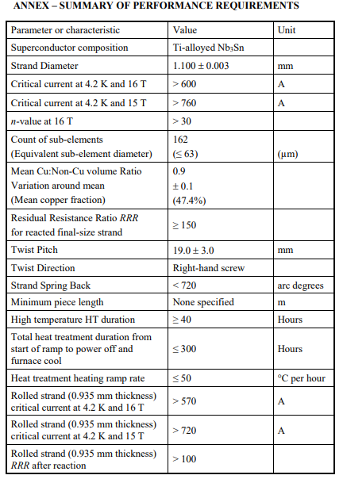
Wire Specifications – Prototype Cable
Charge 2, 3
Key specification parameters:
  Strand diameter: 1.1 m
  Critical current at 4.2 K
    >600 A at 16 T (“S” QC = 668 A ± 19 A as measured)
    >760 A at 15 T (“S” QC = 838 A ± 21 A as measured)
  Cu:non-Cu ratio: 0.9 ± 0.1
  RRR (RW): >150*(BOST asked for 10% be 100-150)
  RRR (15%): >100* (BOST asked for 10% be 75-99)
  162-stack
  Twist pitch: 19.0 ± 3.0 mm
DF-1000-0602
Approved and signed on Windchill

Slide 12
Prototype Cable Wire Performance
Charge 3
5 Billets (9 spools total) received on 2021 10 15
  “S” QC
    Billet-averaged Round Wire I_{C} at 4.2 K: 845 A (15 T), 675 A (16 T)
    15% Rolled: 1 billet had ~9% degradation; the other 4 had ~2% degradation
    n value: 30-54 (RW), 31-45 (15% rolled)
    RRR: 182-320 (RW); 159-233 (15% rolled)
  “V” QC (see GianLuca’s talk on the quality plan)
    under contract with FNAL (8)
  XS QC (see GianLuca’s talk on the quality plan)
    cable to be made ~Christmas 2021 (8)
    under contract with FNAL

Slide 13
Prototype Cable Wire Performance

Slide 14
Wire Specifications – Production Cable
Charge 3
Based on the TFD Prototype Wire procurement experience (total ~20 km) and CERN’s DEM-1.1 (>50 km), we have sufficient confidence with the vendor’s capability to delivery this wire design at the target amount of TFD Production Wire.
We will be asking for ~110 km of the wire with essentially the same specification as the TFD Prototype Wire.
The main differences between the Prototype and Production wire specification are
  Production requires pieces of 410 m and 425 m integer lengths (50-50 split)
  The RRR exception is considered acceptable

Slide 15
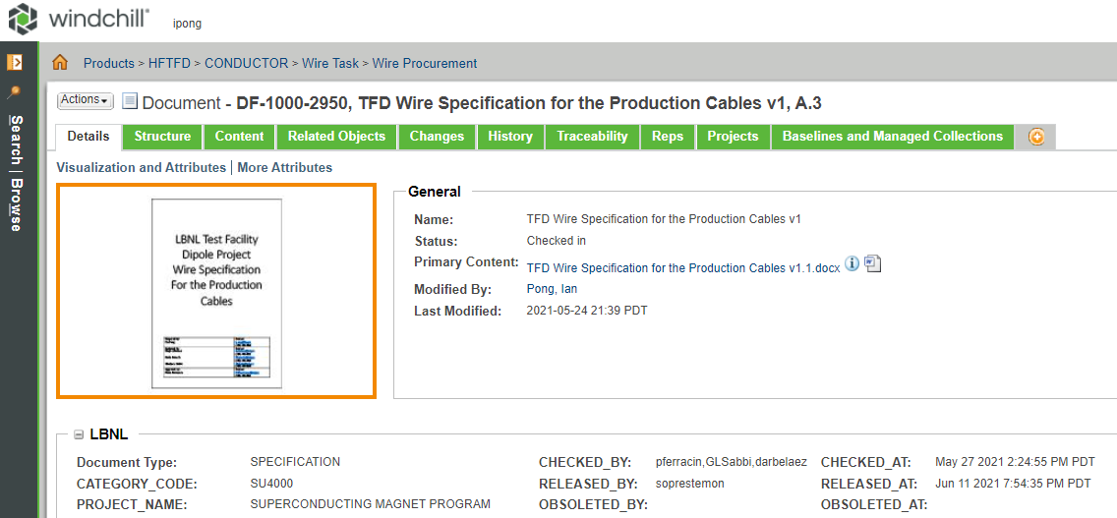
Wire Specifications – Production Cable
DF-1000-2950 v1, A.3 released on Windchill

Slide 16
Production Wire Requirements for the Magnet
Charge 1
Minimum cable lengths for the coils are not fully finalized, but indicatory values are:
  Cable length in the inner coil 352 m → wire length in spec 410 m
  Cable length in the outer coil 365 m → wire length in spec 425 m
I_{C}, n value, RRR, Cu-ratio etc. are specified according to conceptual design and based on Development Cable wire (CO11S) production data and Prototype Cable wire specification.

Slide 17
LBNL Procurement Experience
The key members of the TFD team have relevant experience in the procurement and production monitoring of both HEP and FES superconducting wires
Technical team is backed up by LBNL procurement specialist (Brian Zatkow) who has been the procurement representative for AUP, CPRD, and the recent TFD superconducting wire PO

Slide 18
LBNL Procurement Experience – TFD Specific
Wire for Development Cable (LBNL PO 7509895)
  RFQ: 2019 09 04 (request); 2019 10 21 (quote)
  PO: 2019 11 12
  Wire delivery: 2019 12 23 (received); 2020 01 13 (accepted)
Wire for Prototype Cable (LBNL PO 7576493)
  AAA: 2020 08 27
  RFI: 2020 10 20 – 2020 11 09
  RFQ: 2020 11 09 (initial request); 2021 02 04 (1st quote);
    2021 02 12 (revised request); 2021 02 26 (2nd quote)
  PO: 2021 03 18
  Wire delivery: 2021 10 14 (received); 2021 10 20 (accepted)
> 2 months
~ 2 months
~ 5 months
> 6 months

Slide 19
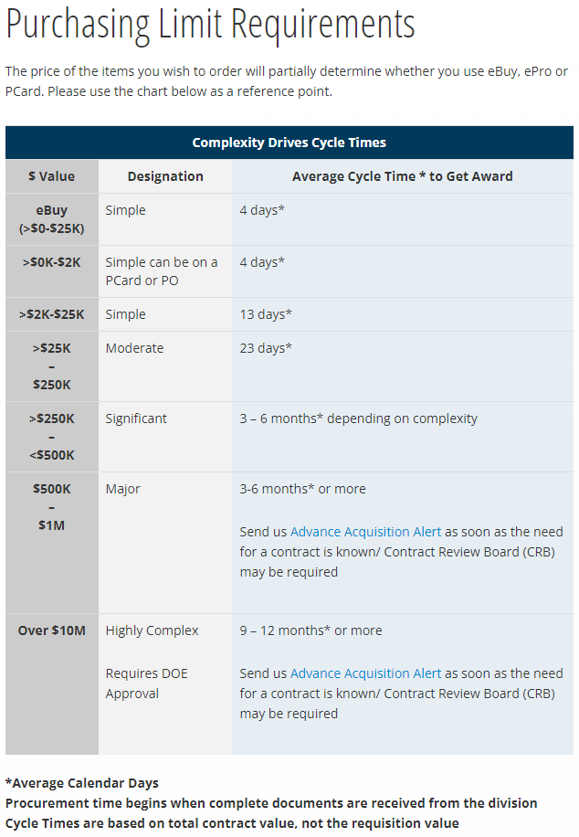
Procurement Cycle Time
The procurement cycle time is very much in line with expectation according to the level of complexity
Delivery by BOST after receipt of order (“ARO”) is considerably faster than expected (typical: 9 months)

Slide 20
Schedule Rationale
The Prototype Cable will be fabricated in the coming months
The Prototype Coil is expected to begin in 2022 March
The high value strand will take many months to deliver (Production Wire quotation: first 30 km in first half of 2022, remainder 80 km in first half of 2023; might be delivered early)
Funds are available to proceed with requisition and PO for the Production Wire

Slide 21
Summary
We applied a 3-step strategy to build confidence in the technical performance, manufacture parameters, and procurement experience
Vendor has demonstrated capability to deliver according to specification, and Development Cable fabrication experience suggests the specification for the production wire is appropriate
An early procurement of the production wire is important for the project to deliver in good time
LBNL have a strong technical and procurement team with appropriate experience, and are ready to proceed

