Slide 1


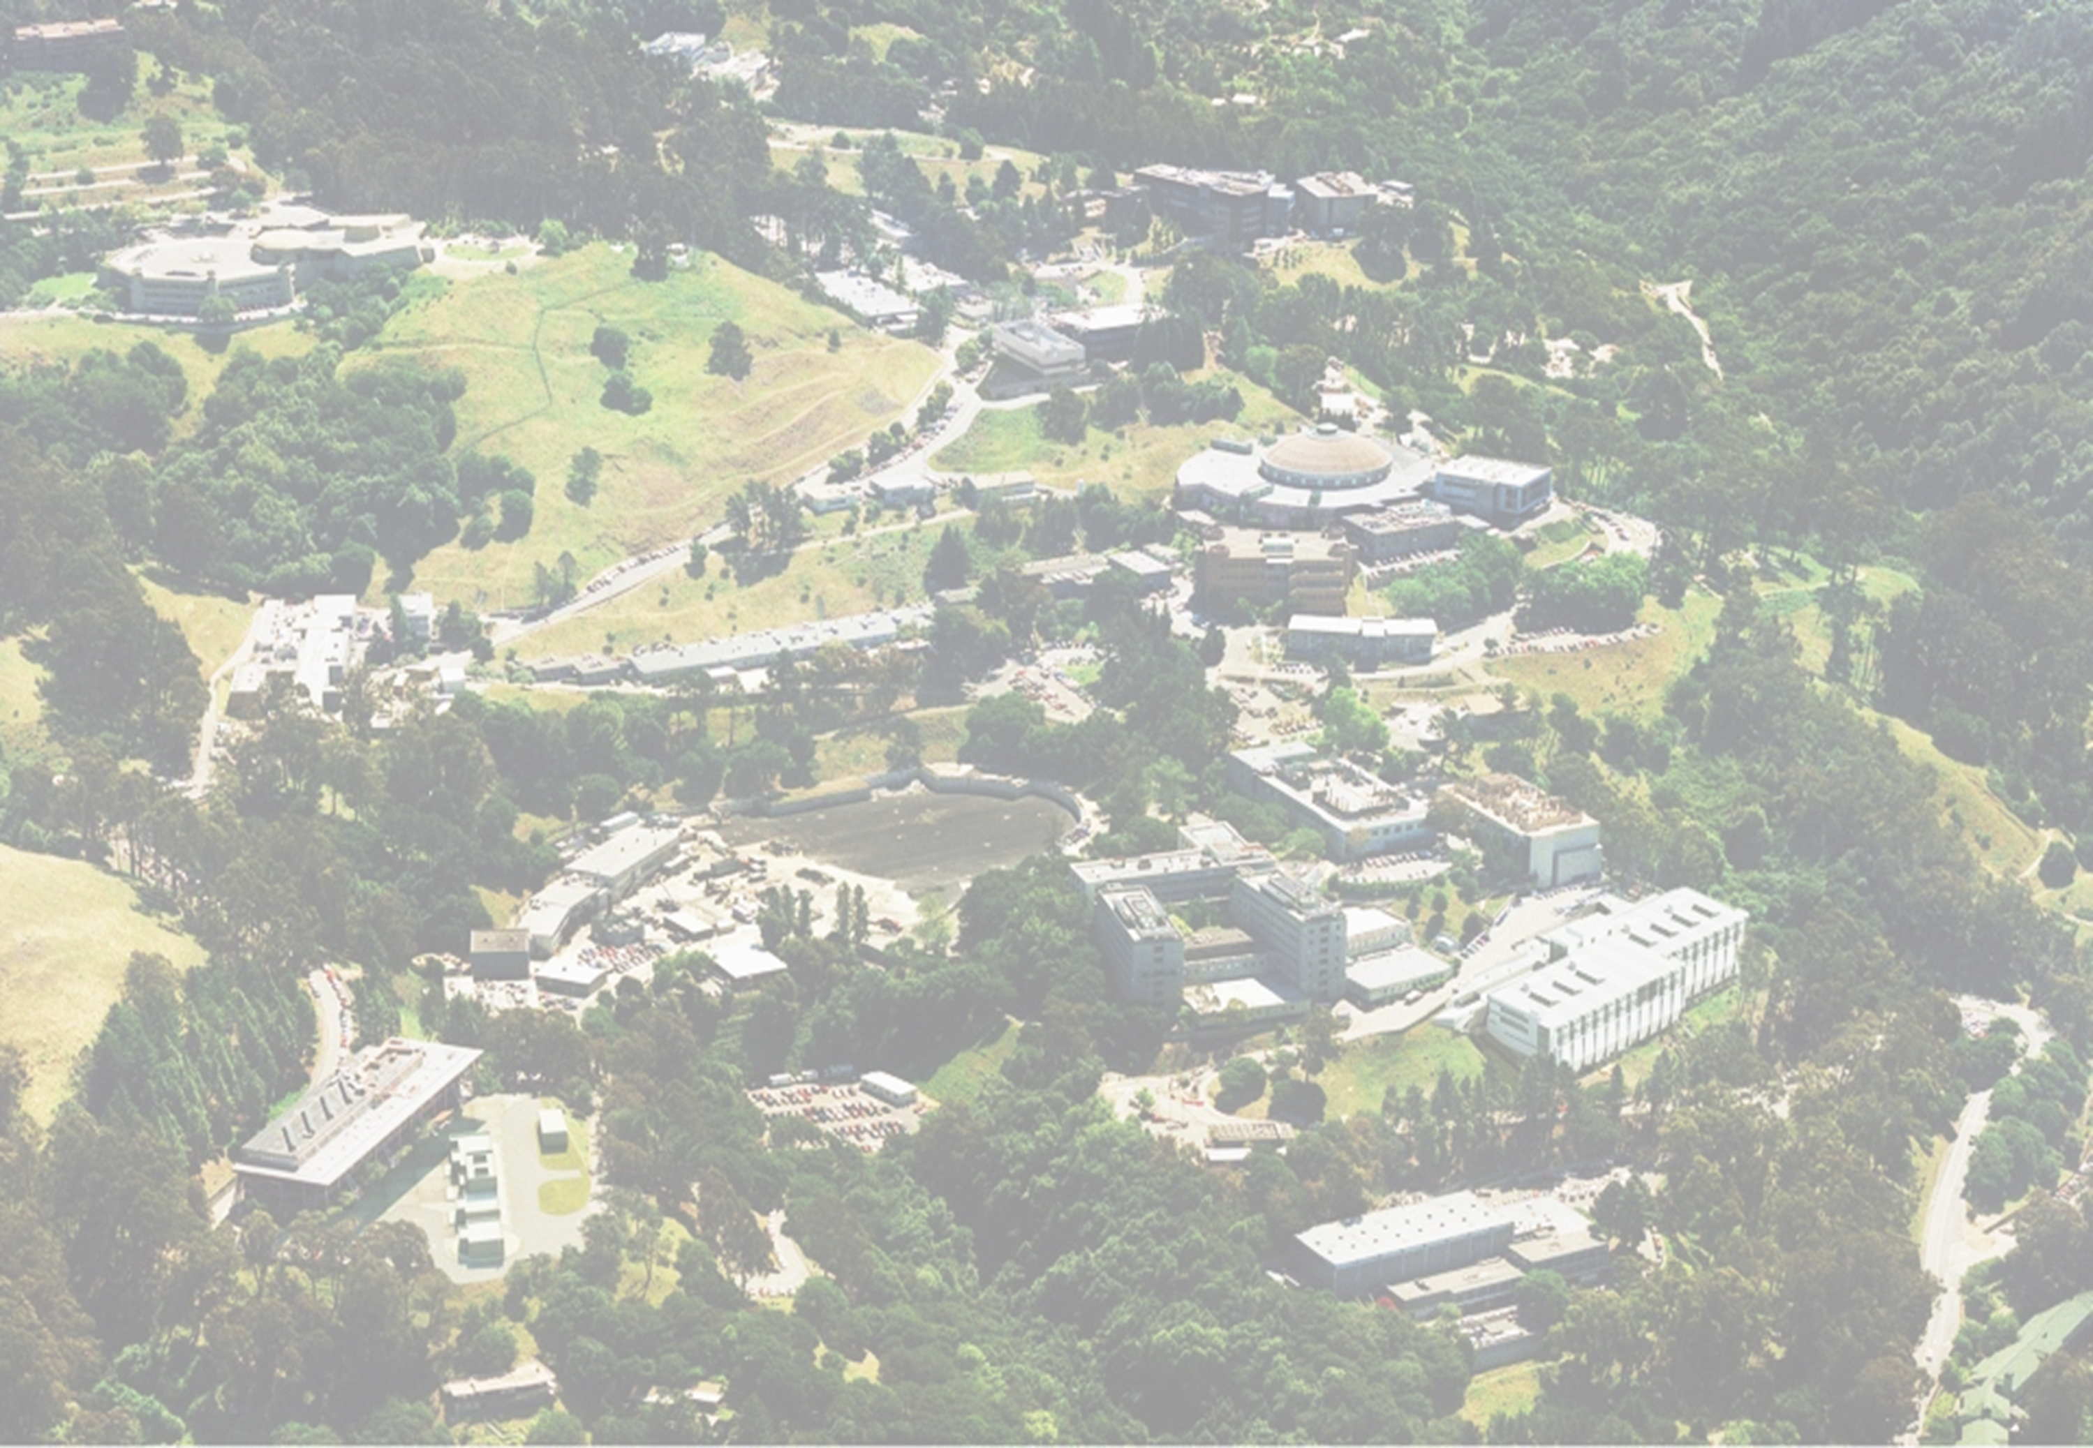
G. Sabbi, LBNL
TFD Wire Specification Review
October 28, 2021
Magnet Design and Conductor Requirements

Slide 2
Presentation Outline
Magnet requirements
Technical background: large bore, high field Nb₃Sn dipole development for HEP and FES
  Recent design studies and TFD approach
Performance targets, design drivers, main features and optimization strategy
Magnet design: cable and coil parameters, magnetic, mechanical, quench protection
CDR feedback and follow-up
Wire and cable development and characterization
Summary

Slide 3
Test Facility Dipole Magnet Requirements
Two main sources:
HEPdipo study (EDIPO upgrade at PSI)
US user survey
Key US input on applied magnetic field (§2)
“Highest possible field”: ≥15 T with Nb₃Sn at 1.9 K
Test well geometry:
Aperture: minimum 140x90 (HxV) mm (150x100 mm preferred) with superimposed round 106 mm diam.
Uniform (1%) length: 0.6-1 m
Superimposed AC field and fast-ramped background field are not a priority

Slide 4
Technical Background
The Test Facility Dipole design is based on studies and development of large aperture, high field dipoles over the past 15+ years:
  LARP studies of HL-LHC “Dipole First” IR (LBNL/FNAL/BNL, 2003-04)
  EFTA Dipole (EDIPO) Design Study (EFDA/CEA/CRPP/FZK/LBNL, 2004-06)
  LD1 magnet design (2009-12) at LBNL
  FRESCA2 design fabrication and test (CERN/CEA/EuCARD, 2010-2018)
  HEPdipo design study (CERN/PSI/F4E/LBNL, 2017+)
We are taking full advantage of these efforts and experience to accelerate the TFD development and decrease risk in a broad range of areas, in particular:
  Winding layout (HD/LD1, FRESCA2, HEPdipo)
    Wire and cable parameters
  Coil tooling, parts, and fabrication process (FRESCA2, LD/HD)
  Magnetic, mechanical, protection analysis and validation (FRESCA2, HEPdipo)
However, while building on this experience we are also optimizing the design to reflect the specific TFD requirements, in particular the higher field target

Slide 5
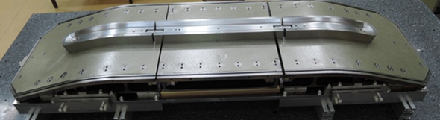
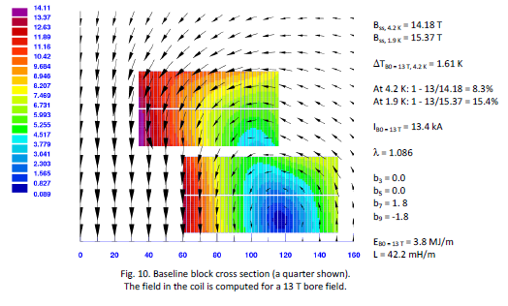
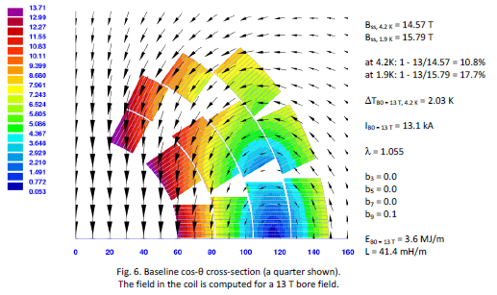
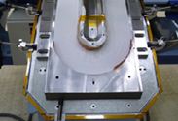
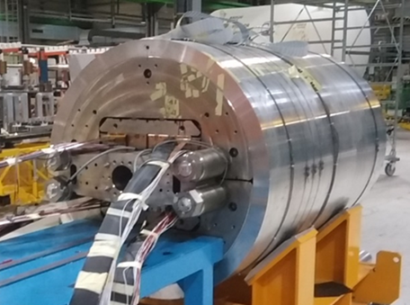
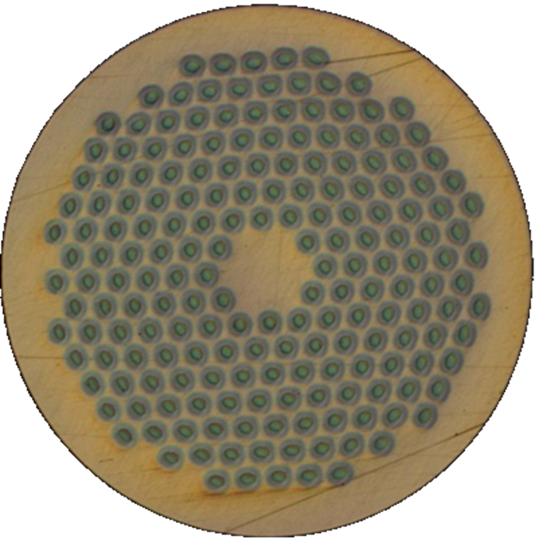
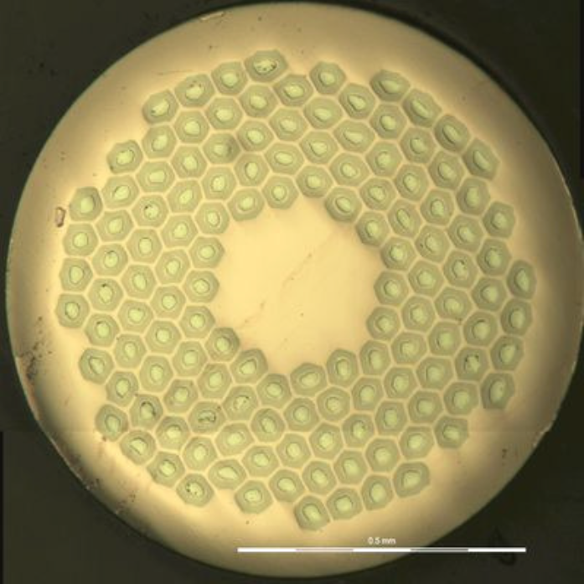
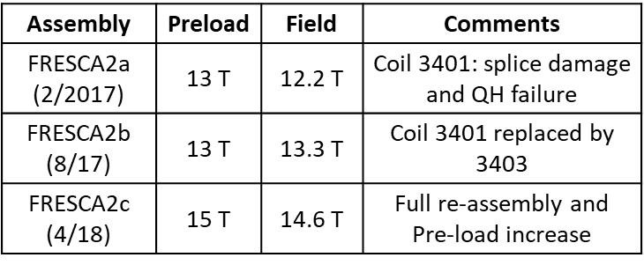
FRESCA2 Design and Development
Goal: upgrade of FRESCA facility at CERN
Round bore 100 mm diameter; 13-15 T field
Block-coil design after detailed analysis and comparison with cosθ:
Magnet fabrication:
CEA: coil winding; CERN: coil reaction and impregnation, structure/assembly
Included axial gaps for coil reaction
Wire:
RRP (132/169) and PIT (192)
Strand diameter: 1 mm
Cable:
40 strands
W 20.90 mm T 1.82 mm (bare)
Braided insulation 0.16 mm
PIT
Test results:
RRP

Slide 6
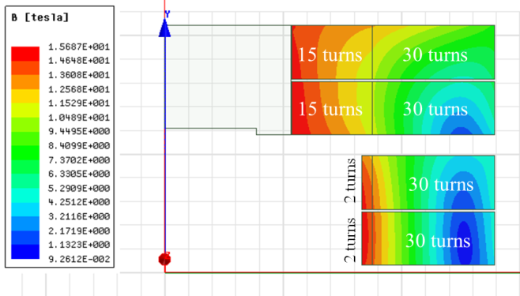
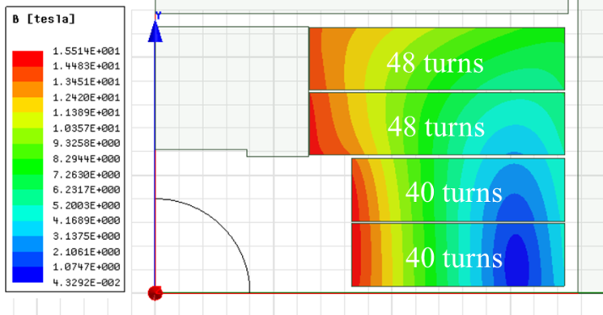
HEPdipo Conceptual Design Study (2018)
Design goals and features:
EDIPO replacement/upgrade with 14-15 T field
Block-coil based on FRESCA2 design choice and further supported by rectangular vs. round bore
Considered both graded and non-graded coil
Wire and cable:
Wide cable (>26 mm) required by vertical aperture with 4-layer (two double-layers) block-coil layout
Large wire diameter (>1mm) required to keep aspect ratio within established limits (HD2)
Use of existing wire/cable (LD1, QXF) considered for the graded design
Converged on non-graded design and “DEM 1.1” wire (CERN/FCC procurement) w/ 44 strand cable
Protection analysis showed low copper ratio is ok
Graded (A_{sc}=64 cm²)
Non-Graded (A_{sc}=105 cm²)
Reference: P. Bruzzone et al., “Conceptual Design of a Large Aperture Dipole for Testing of Cables and Insert Coils at High Field”, IEEE TASC Vol. 28, No. 3, April 2018, Art. # 4005505

Slide 7
TFD Design Targets and Approach
Field: 16 T design target with >15% margin on the load line at 1.9 K
  Based on user’s interest we fully optimize the design for the highest field
  A conservative pre-load target (e.g. 14 T) will be implemented in the first assembly cycle and optimized as needed based on test results
  15 T is used as reference for operation
Coil layout: block-type, non-graded coil
  Block-coil based on EDIPO/LD1/FRESCA2, and rectangular bore
  Non-graded coil compatible with target and reduces development time/risk
  Field quality target at the ~20 unit level for consistent optimization
Coil engineering, parts, tooling and fabrication procedures based on FRESCA2
  Some improvements required for reaction gaps design/implementation
Mechanical design: shell based structure with axial pre-load (HD, LD, FRESCA2)
  Mechanical performance was the main driver in the design optimization including coil geometry, conductor, bore structure, inter-coil spacers etc.
  Mechanical optimization is specific to TFD due to larger/rectangular aperture and higher field relative to FRESCA2 and HEPdipo

Slide 8
TFD Design Features and Optimization
Wire: RRP 162/169 based on field/margin requirements, design analysis and procurement experience (~50 km CERN/FCC and ~20 km TFD prototype coil)
Cable: 44 strands, 1.1 mm based on HEPdipo/TFD studies and experience with TFD development cable fabrication and characterization
  An alternative 48 strands, 1 mm diam. was presented to the CDR as a backup option but is not being pursued given the good results obtained
Coil layout: block-coil, non graded, two double-layers with “LD” geometry
  L3-L4 are shifted toward the pole relative to L1-L2. Selected over the “FRESCA2” (aligned) layout because of lower coil stress (magnetic efficiency is similar)
Coil design: cross-section and length optimized for minimum conductor volume
  Length of cable in each coil: 352 m (L1-L2); 365 m (L3-L4)
Mechanical design: safe coil stresses at all steps and all structural components within established limits with 16 T preload
Quench Protection: energy extraction is sufficient for safe magnet discharge
  CLIQ included in the baseline plan for redundancy, but no quench heaters

Slide 9
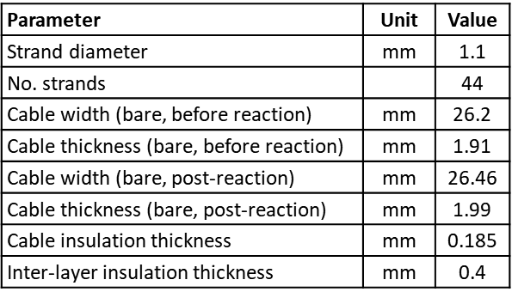
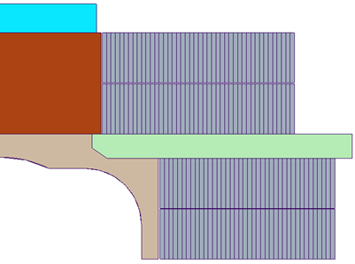
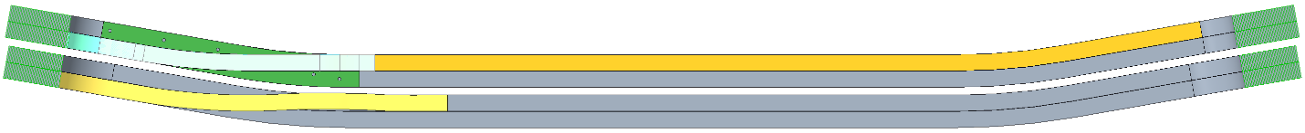
TFD Cable and Coil Design Parameters
Cable and Insulation
2D Coil geometry
R_{min}:
54 mm
Layer 4: 44 turns
Coil 2
Layer 3: 44 turns
Layer 2: 40 turns
Coil 1
Layer 1: 40 turns
3D Coil geometry
Flare angle: 10 degrees; minimum HW bend radius (layer 4): 1 m
Reference: TFD Coil and Structure Parameters, DF-1000-4369, A.4, 2021-10-22
Note: parameters are still being adjusted as we get feedback from design, analysis and development

Slide 10
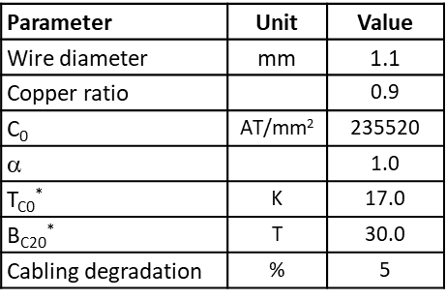
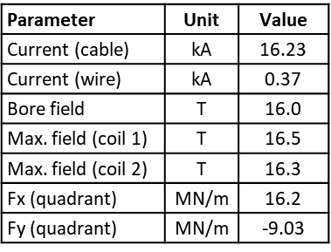
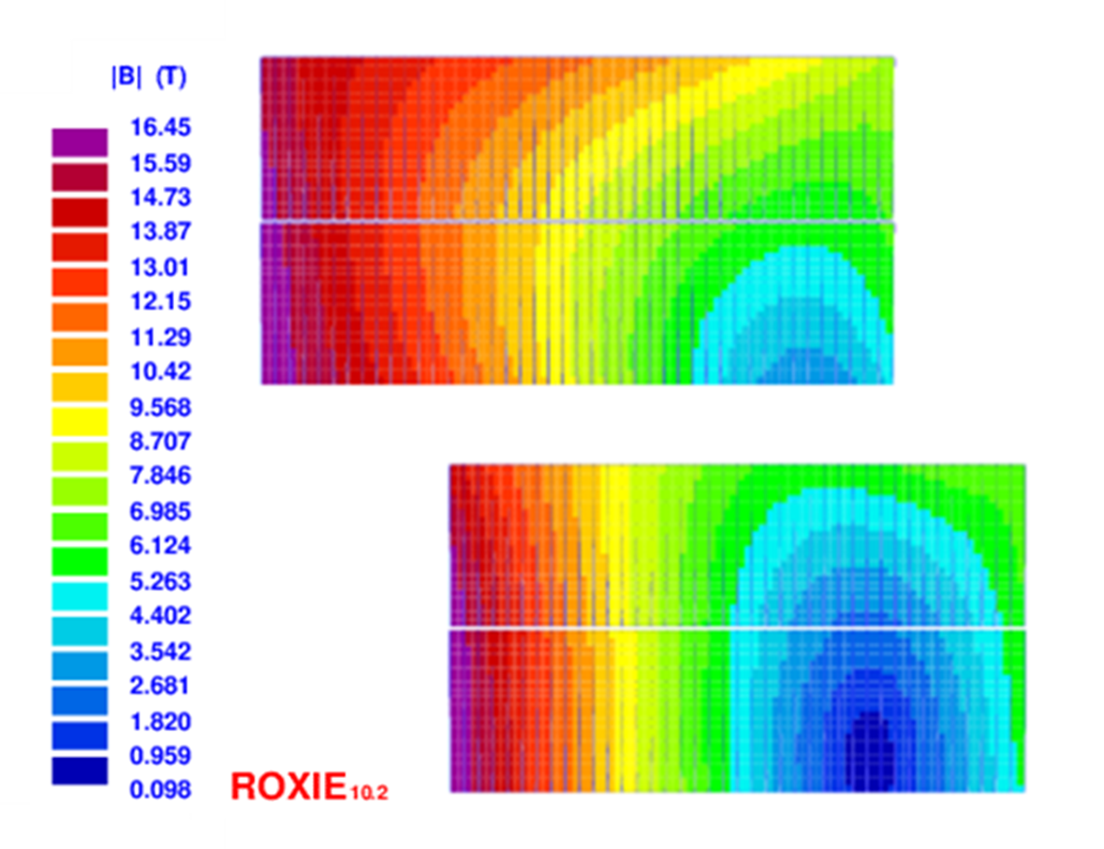
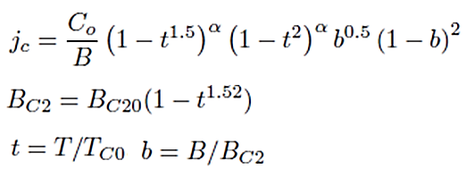
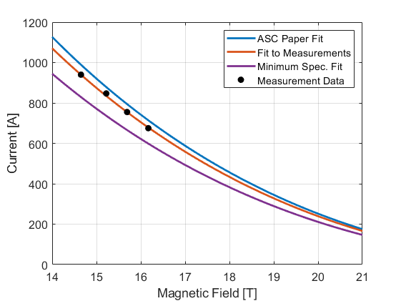
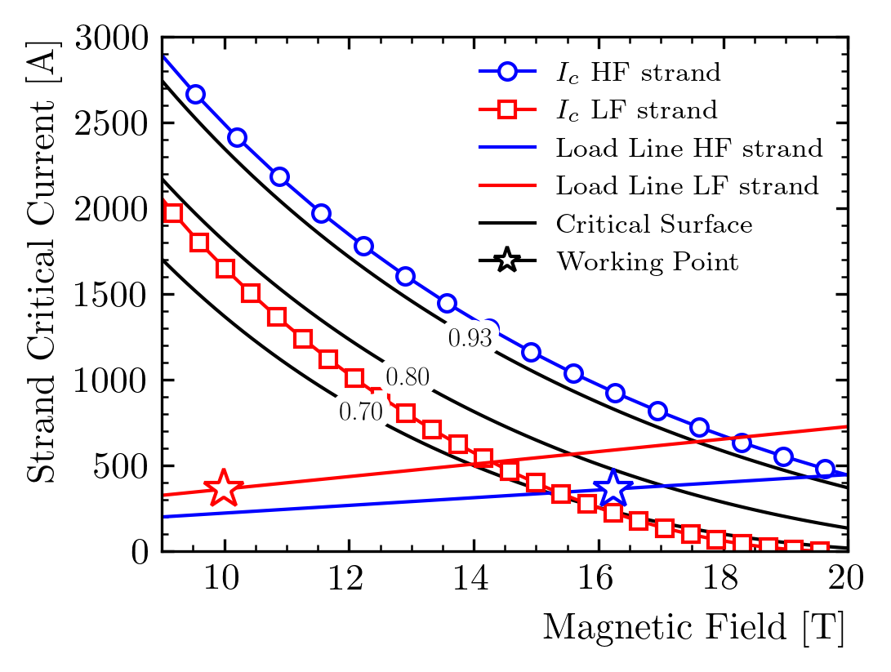
Magnetic Design and Performance
Critical current parametrization
Field map and performance parameters at 16 T
Operating current (16T) vs. SSL current:
Measured I_{c}: 81-82 %
Min. spec I_{c}: < 85 %
Short sample limit calculation w/strain
(see talk by G. Vallone)
Margin is not impacted by I_{c} degradation due to strain in the reversible regime
At 15 T: 5% additional margin
Cabling degradation:
Assumed: 5%, measured: 2%
Field quality:
< 0.3% at 50 mm radius

Slide 11
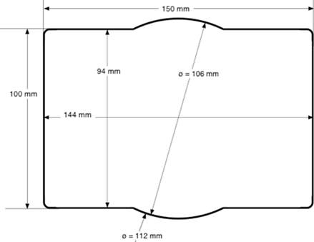
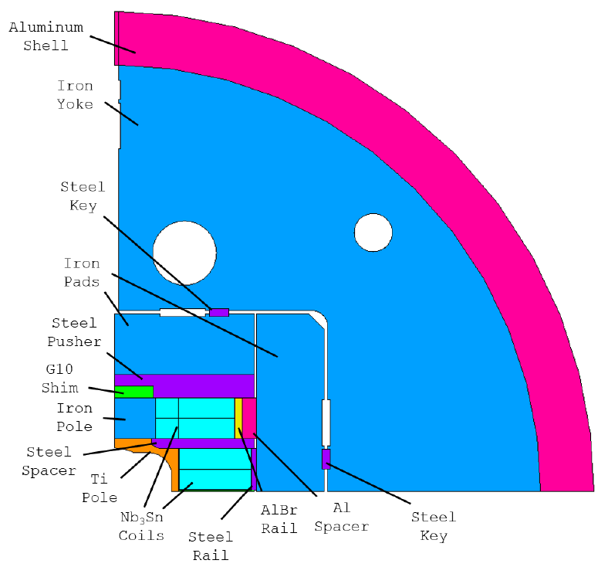
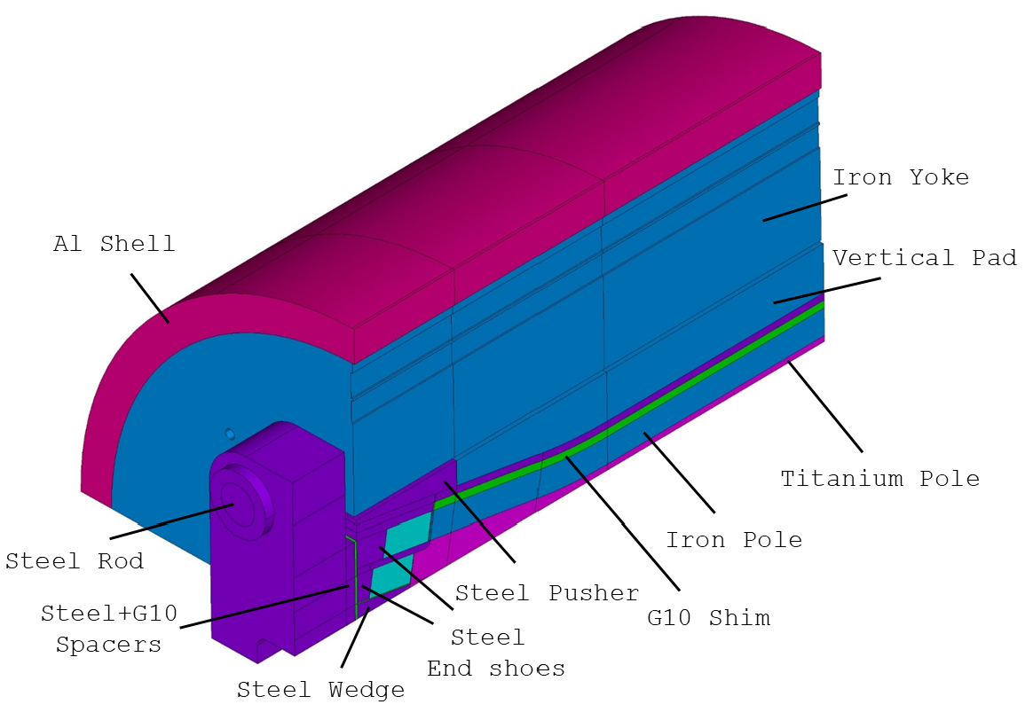
Mechanical Design
Shell-based structure with axial pre-load (HD, LD, FRESCA2, HEPdipo)
Design features introduced to control the coil stress:
Key position defined to limit the max. tension at the pole/coil interface
Al. bronze rail with Al shim
Inner and outer coil individually shimmed
30 mm radius of the inner pole
G10 shim above the pole
Test well profile
D. Arbelaez, P. Ferracin, R. Hafalia, D. Martins Araujo, G. Vallone et al.

Slide 12
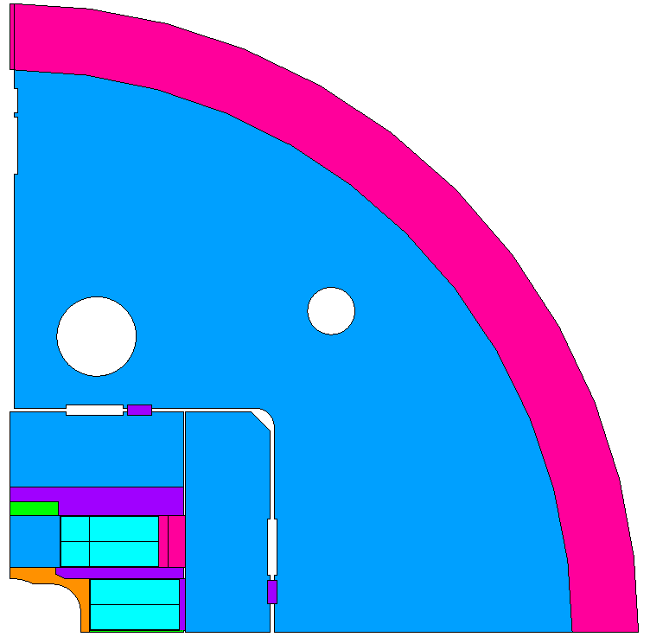
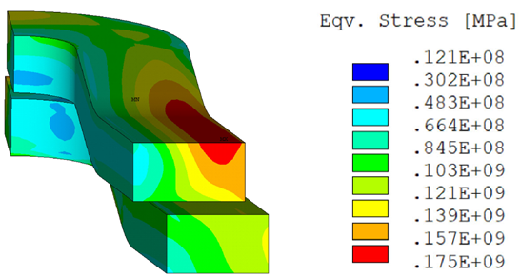
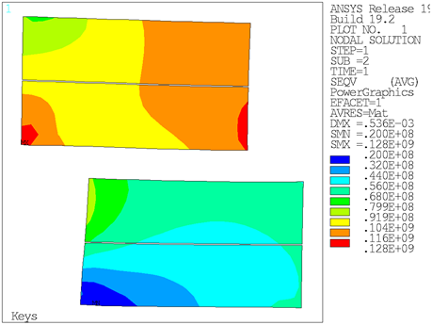
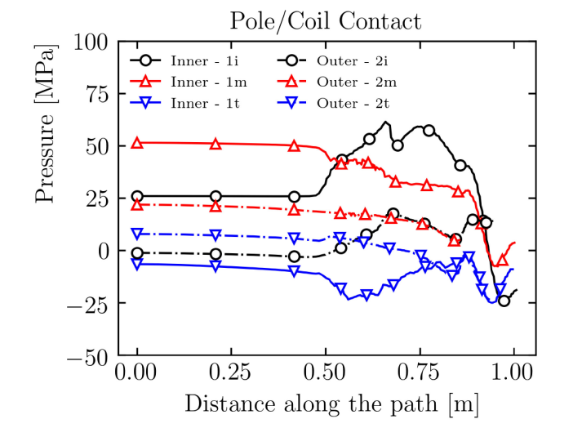
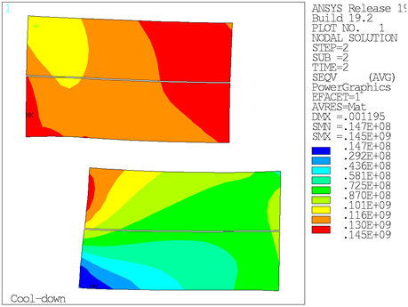
Mechanical Analysis
2D coil stress (assembly, cool-down, 16T)
3D Coil stress and contact pressure at 16 T
Max stress at R.T.: 128 MPa
Max stress at cold: 145 MPa
Max stress at 16 T, in high field region: 131 MPa
Max stress at 16 T, in low field region: 166 MPa
3D Field:
Magnetic length: 1.7 m
Field homogeneity: <1% over 1 m

Slide 13
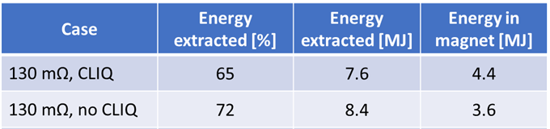
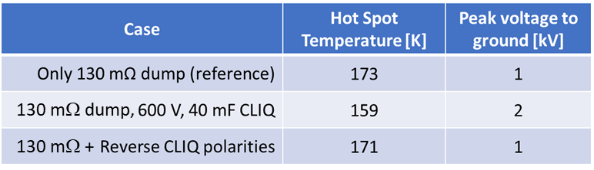
Quench Protection - Reference Case
Protection analysis and parameters:
Magnet design and quench conditions:
  Magnetic length: 1.7 m
  Field and current: 16 T, 15.5 kA
  Stored energy: 12 MJ
  Inductance : 97.2 mH (57.2 mH/m)
Analysis performed with STEAM-LEDET
  Accounts for coupling current effects
Voltage limit: ±1 kV with symmetric ground
  Dump resistor: 130 mΩ (2 kV)
CLIQ parameters: 40 mF, 600 V (AUP unit)
No Quench Heaters
Detection + validation time: 15 ms
Conductor parameters:
  RRR=100
  Copper fraction: 0.8
  Twist pitch (strand/filament): 14 mm
  Cable transposition length: 109 mm
  Matrix cross resistance: 10 µΩ
Main results:
Energy extraction is sufficient to provide a safe discharge
Hot-spot temperature 173K (vs. HiLumi 250K target/350K limit)
However, in case of extraction failure magnet will not survive
Need fully redundant extraction system, or a second system
Baseline plan is to include CLIQ together with extraction
We maintain the same voltage limit of ±1 kV
With this constraint, T_{HS} is not improved when adding CLIQ but CLIQ will protect the magnet in case of extraction failure, although T_{HS} is higher (327 K, similar to HiLumi failure cases)
V. Marinozzi, D. Arbelaez, E. Ravaioli, et al.

Slide 14
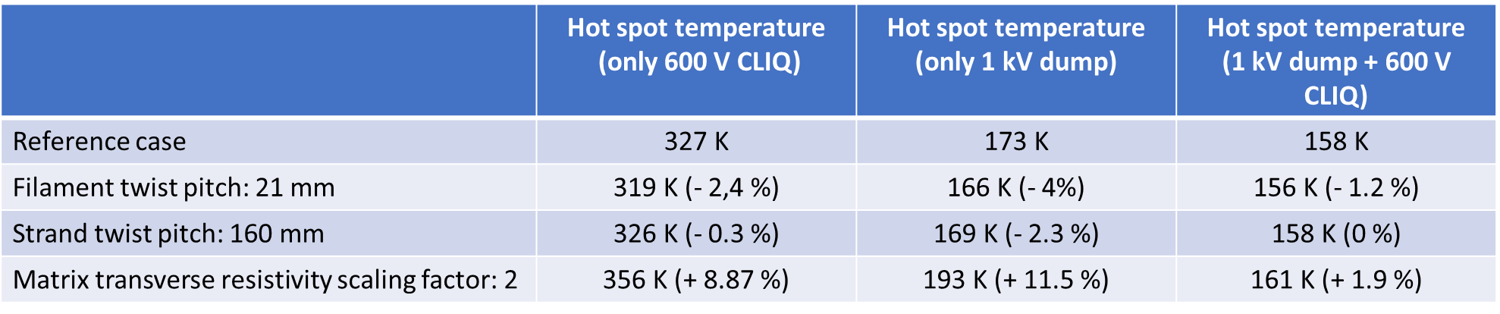
Quench Protection - Sensitivity Analysis
Parameter | Unit | Ref. Analysis | Range studied | Spec | Notes
Copper ratio |  | 0.8 | 0.8-1.2 | 0.9 | T_{HS} about 30-40 K lower for Cu/NCu=1.2 vs 0.8
Detection time | ms | 15 | 15-45 | 15 | T_{HS} about 25-30 K higher for 45 ms
R_{dump} | μΩ | 150 | 75-150 | 150 | Half voltage but T_{HS} may increase up to 50-100K
CLIQ Voltage | V | 600 | 300-1000 | 600 | 300 V insufficient. 1000 V performance is equivalent to dump but increases voltage and requires a special unit
Twist pitch | mm | 14 | 14-21 | 19 ± 3 | Slight improvement in T_{HS} for longer twist pitch
Transp. length | mm | 109 | 109-160 | 155 | Slight improvement in T_{HS} for increased transp. length
RRR |  | 100 | 100-200 | >100 | T_{HS} ~20 K lower for RRR 300 vs.100 (HEPdipo study)
Transv. Res. | µΩ | 10 | 10-20 | 10 | No significant effect for combined dump + CLIQ. 20-30K increase of T_{HS} for dump only or CLIQ only
V. Marinozzi, FNAL

Slide 15
Conceptual Design Review Feedback
Requirements and interfaces
Clarify magnet and facility requirements and get stakeholder approval
=> In progress with input of IPT and EOC committees and HEP/FES community
Conductor and cable:
Some preference for higher sub-element design for stability in large diameter wire
=> Selected 162/169 vs. 108/127 (although mainly driven by higher I_{c})
Consider a cable with more strands (48 vs 44) and a smaller wire (1 mm vs. 1.1 mm)
=> Insufficient resources/infrastructure to pursue two alternatives in parallel
=> No issues found cabling the 1.1 mm strand - 44 strand cable is preferred
Magnet design:
Alternatives have been properly considered and selected design minimizes risk
Main elements of the design fully endorsed by the committee: block coil, non-graded layout, shell-based structure
=> Confirmed key design choices and started design optimization
https://conferences.lbl.gov/event/359/

Slide 16
Conceptual Design Review Feedback
Magnet design (cont.):
Consider increased margin to quench (conductor properties and magnetic design)
=> Significant improvement with 1.1 mm 162/169 wire
=> Magnetic design optimization to balance performance margin and coil size
Consider increased shell thickness for margin (relative to using LD1 shell)
=> Available margin on outer diameter allows to increase shell thickness
Include CLIQ protection system for added robustness and redundancy
=> Detailed protection analysis performed to optimize CLIQ configuration
=> Baseline test facility design and operation plan includes CLIQ
Design tools, resources and collaboration:
Team expertise and analysis capabilities are fully adequate
Continue strong collaboration with FRESCA2/HEPdipo teams and US conductor Labs
=> Conductor characterization at NHMFL, FNAL, CERN (details in next talks)
=> FRESCA2engineering feedback, CAD models from CEA and CERN
https://conferences.lbl.gov/event/359/

Slide 17
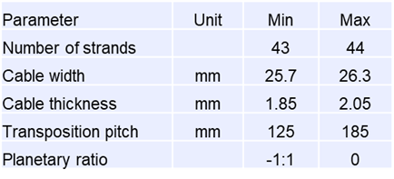
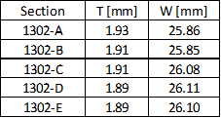
Cable Development
TFD “development cable” run (November 2020) using 3 km of RRP 108/127 wire procured by LBNL, and 3 km of 162/169 wire procured by CERN
108/127 used for initial feedback and broader exploration of parameter space
Tests performed: residual twist, winding properties, micrographs
  Final ~25 m long section was sent for insulation at NEEW
  Cable and parts/tooling ready for a double-layer winding test (8+8 turns)
Followed by 162/169: 4 main sections with different width and thickness
  Used for detailed mechanical and electrical characterization (see next slide)
Parameter ranges considered
162/169 sections
Next step: full-length “prototype cable” for fabrication of TFD “prototype coil”
D. Arbelaez, R. Hafalia, H. Higley, D. Martins Araujo, I. Pong, M. Naus et al.

Slide 18
Wire and Cable Characterization
The following tests were carried out on the development (162/169) wires and cables:
LBNL: winding tests (next slide); metallography of extracted strands (I. Pong presentation)
FNAL: I_{c} and RRR of virgin and extracted strands at 4.2K and 2.1K, for 665C and 680C reaction; field sweeps (0-10T-0) at >1kA, 4.2K and 2.1K to check stability (D. Turrioni presentation)
NHMFL: I_{c} and RRR of virgin and extracted strands at 4.2K, 665C reaction (J. Lu presentation)
NHMFL: strain characterization for both CERN and LBNL procured wire as a function of reaction temperature (N. Cheggour presentation)
CERN: selected 1.9K tests to confirm scaling of 4.2K/2.1K results (S. Hopkins presentation)
The following tests are planned for the prototype and production wires, cables and coils:
Supplier QC as detailed in the wire specification – results are available for the ~20 km TFD prototype wire order (I. Pong presentation) and 50 km CERN order (S. Hopkins presentation)
Verification tests (50% of S, 1/billet) and cable characterization (4 virgin+4 extracted): at FNAL for prototype wire/cable (contract in place); at NHMFL and FNAL for production wires/cables
Mechanical QC: post-production cable samples
  residual twist, 10-stack (bare and insulated) and metallography
I_{c} and RRR of coil witness samples (virgin and extracted) to check reaction

Slide 19
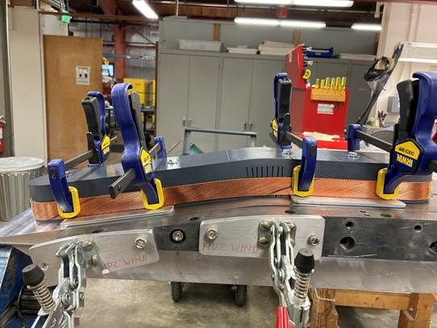
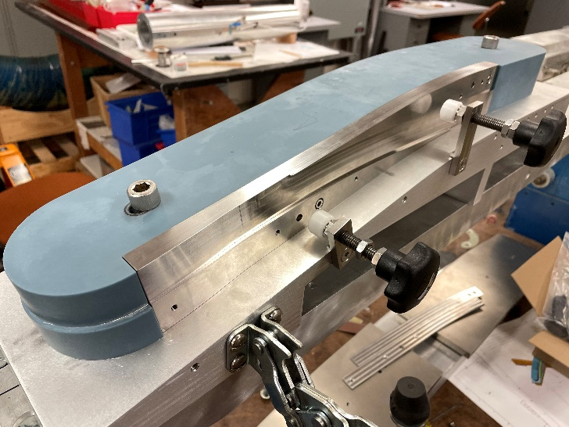
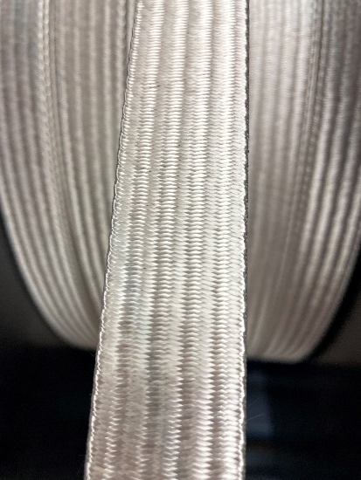
Coil Winding Tests
Several winding tests were performed using (short) sections from the development cable run
  All sections could be wound without any significant issues, independent of compaction
  Even the 43 strand section could be wound (although it is clearly not a viable option)
  Bending radii at the coil ends are very large compared with accelerator magnets
HW bend at the end flares is the most critical – several tests and detailed CMM measurements and analysis were performed to conform the design to the optimal curvature for the cable
Conclusion: cable design can be optimized for minimal I_{c}/RRR degradation
Next step: double-layer winding test with optimized HW bend and incorporating layer transition
Single-layer, ~2 turns
Double-layer, 8+8 turns
Insulated cable
R. Lee, P. Mallon, J. Rudeiros Fernandez, J. Swanson et al.

Slide 20
Summary
Magnet performance targets and design constraints have been defined based on user input and in agreement with the Fermilab test facility team
Magnet design full advantage of the extensive technical background provided by previous design and development of large aperture, high field Nb₃Sn dipoles
  Analysis of different options for magnet and conductor/cable design
  Design of coil (parts, tooling, and fabrication processes) and shell-based structure
Building on this past work, we have been able to make further improvements in critical areas, in particular to avoid degradation due to coil stress
  Strain degradation is not expected to impact the magnet performance (G. Vallone)
Magnet requirements are fully incorporated in the wire specification
  Magnetic design and operating margins
  Capability to fabricate cables with desired mechanical and electrical characteristics
  Quench protection
Experience from two significant procurements at LBNL (I. Pong) and CERN (S. Hopkins)
Detailed characterization confirms that selected wire meets requirements for cabling, magnet fabrication and operation (D. Turrioni, J. Lu, N. Cheggour)

