Slide 1




TFD Nb₃Sn wire verification testing
Jun Lu and Jeremy Levitan, MagLab
and GianLuca Sabbi, Berkeley Lab
TFD review meeting (Online)
7-28-2021

Slide 2
Outline
NHMFL Nb₃Sn wire test facility
TFD wire Ic test probe design
Ic and RRR test results
Summary

Slide 3

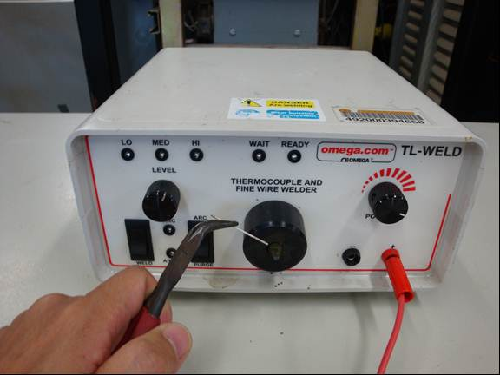
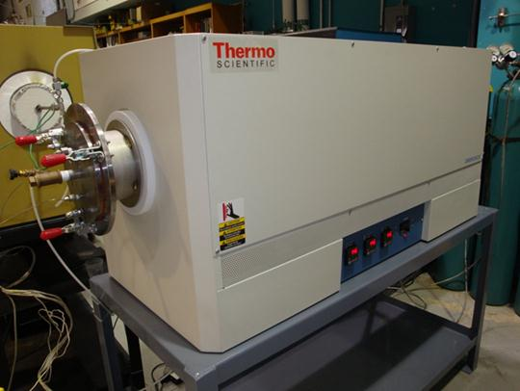
Heat treatment facility
Spot weld wire ends
Four Lindberg Blue M, 3 zone 6” X 36” tube furnace.
Ar pump-purge, then Ar flow 100 SCCM.
LabVIEW data monitoring. 3 thermocouples over 12” central zone.
HT furnaces
210C/48h + 400C/48h + 665C/50h in Ar

Slide 4
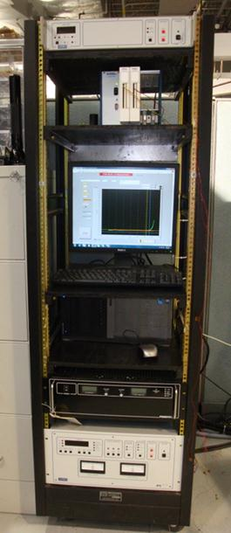
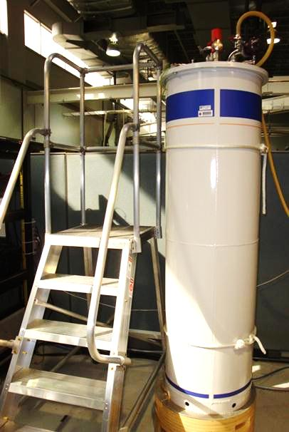
I_{c} measurement facility
Oxford Instruments 52 mm bore, 15/17 T magnet, 0.1% homogeneity.
Instrumentation: Ametek 0-2200 A DC, NI SCXI-1000, LabVIEW program.
Facility qualitied by ITER Nb₃Sn benchmarking.
NI SCXI
Oxford 15/17 T
I source
Magnet power

Slide 5
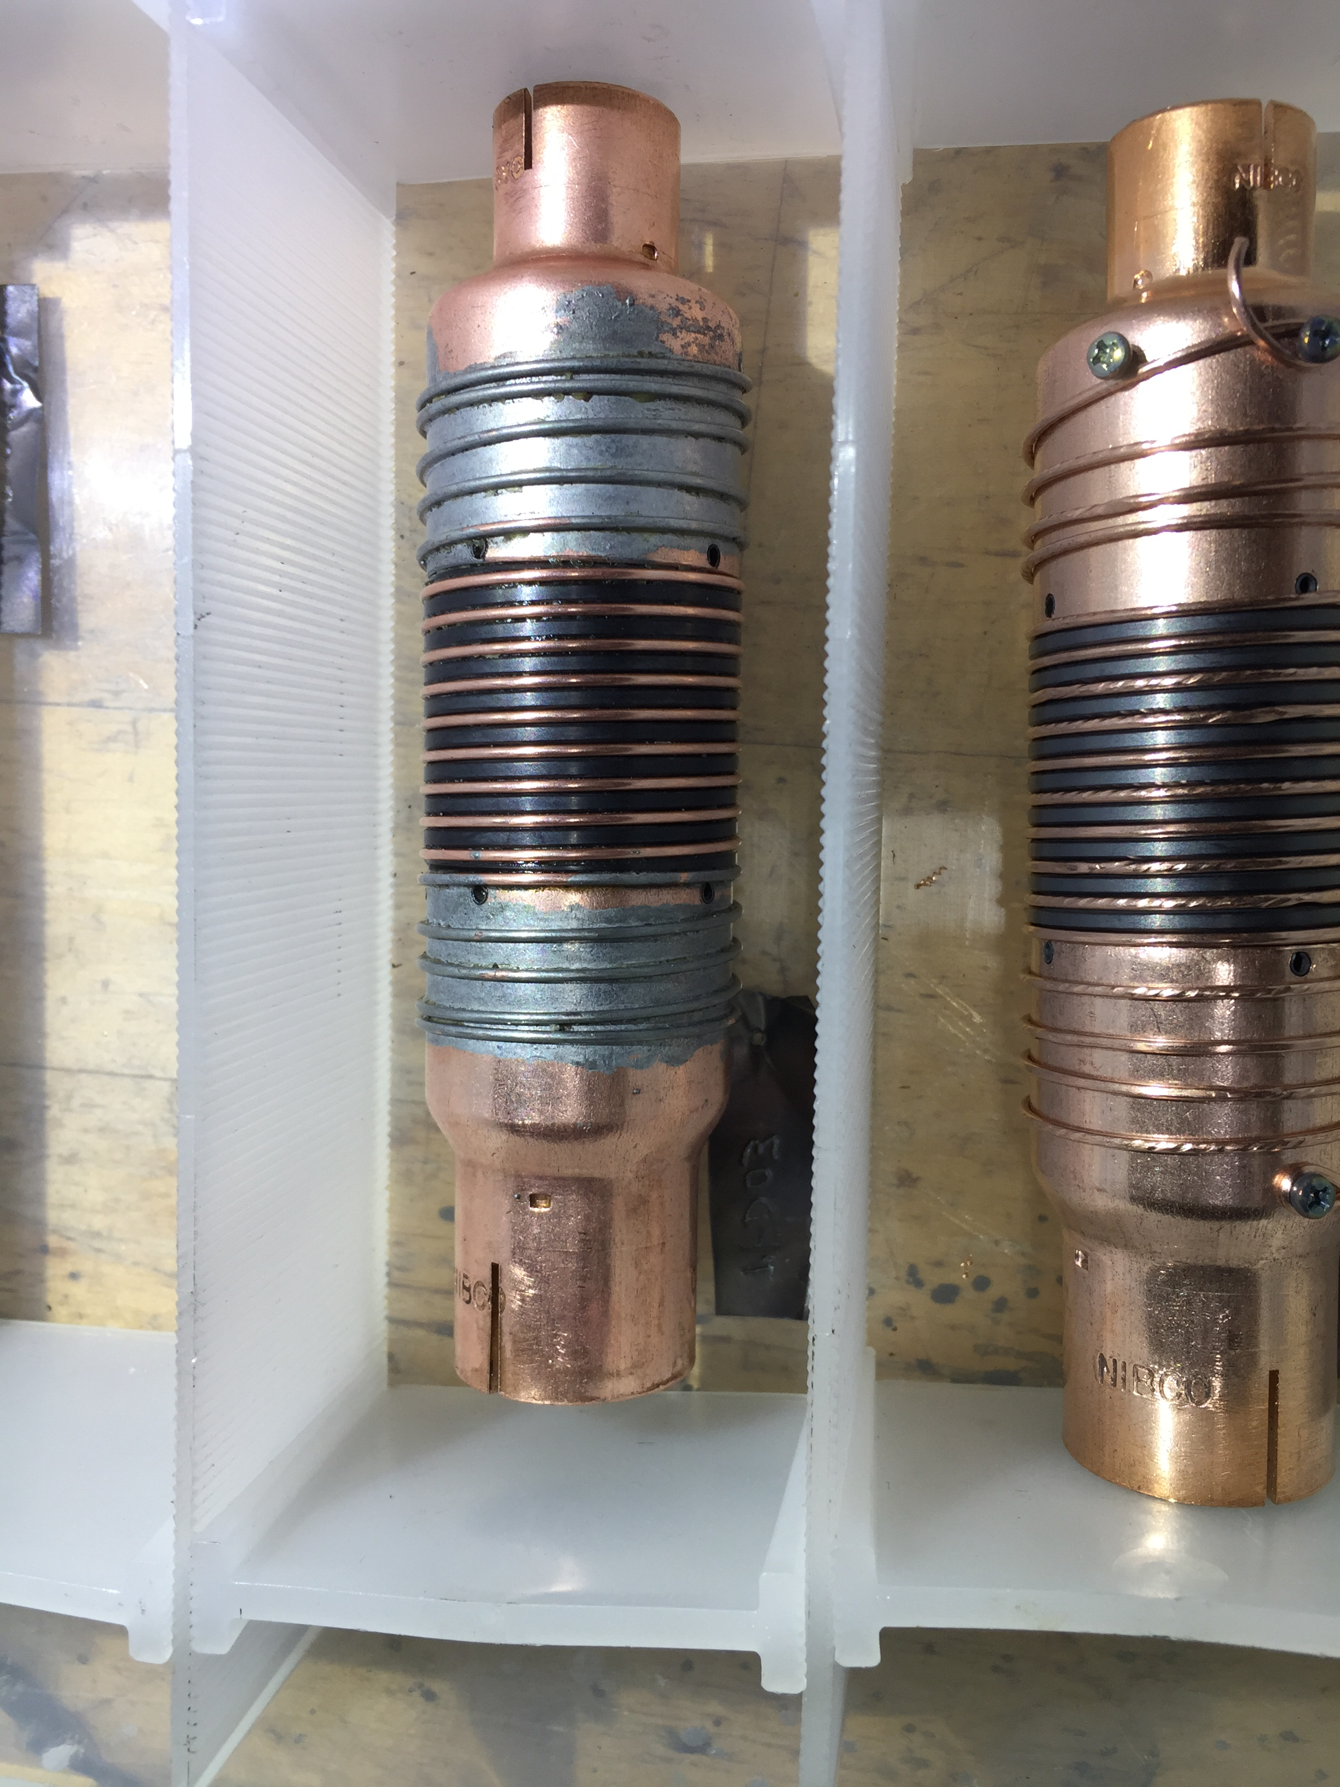
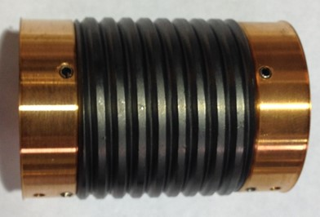
Test mandrel for TFD wires
1. The same Ti barrel and ITER.
2. Increase the length of the Cu terminals to facilitate the current transfer from copper to superconductor. Plumbing copper reducers (LBNL style) was adapted to attach to Ti barrel with roll pins. The terminal length increases from 9 mm of ITER design to about 24 mm.
Cu plumbing reducer
ITER standard

Slide 6
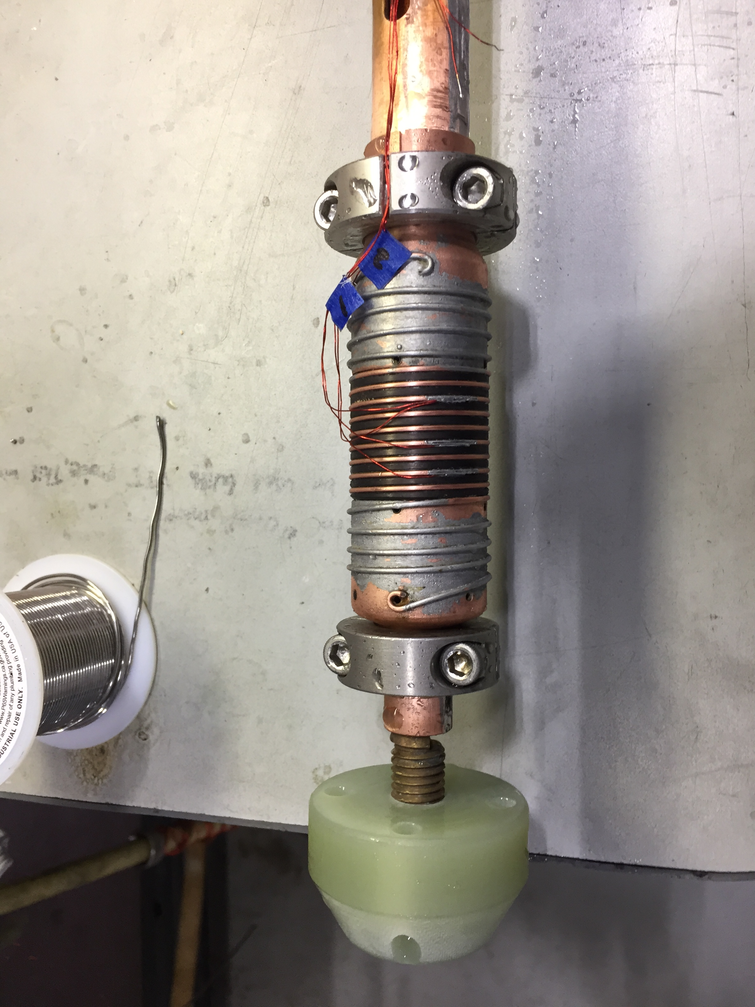
TFD wire test probe
Copper coax tube design.
Two REBCO tapes are soldered on each of the outer and inner Cu tube
Pressure contacts by collar clamps
Challenge of high current: Joule heating at the terminals needs to be minimized.

Slide 7
Electrical field vs. current curve
B = 15 T

Slide 8
Critical current at 4.2 K
Sample ID | State | 15 T Ic/n | 14 T Ic/n | 13 T Ic/n | 12 T Ic/n
CO11S20235A04A | Original | 774/Q | 944/Q | 1099/Q | 1225/Q
CO11S20235A04A | Original | 823/50 | 1009/55 | 1205/Q | 1379/Q
CO11S20235A04A | Original | 815/42 | 1004/42 | 1213/49 | 1447/50
W12OL1302AA12A | Extracted | 755/32 | 865/Q
W12OL1302AA12A | Extracted | 783/48 | 957/Q | 1146/Q | 1347/Q
W12OL1302AA12A | Extracted | 759/40 | 908/31 | 1100/40 | 1221/Q
CO11S20235A04A | Original | 818/41 | 1008/55 | 1219/55 | 1382/Q
Q: quenched before making a transition
Improvements on the mandrel design are needed

Slide 9
Critical current vs. magnetic field
The dashed lines are simulation of Kramer scaling
F_{p} ∝ b^{0.5}(1-b)²
F_{p} = Ic X B
b = B/B_{c2}*
B_{c2}*= 26.6 T

Slide 10
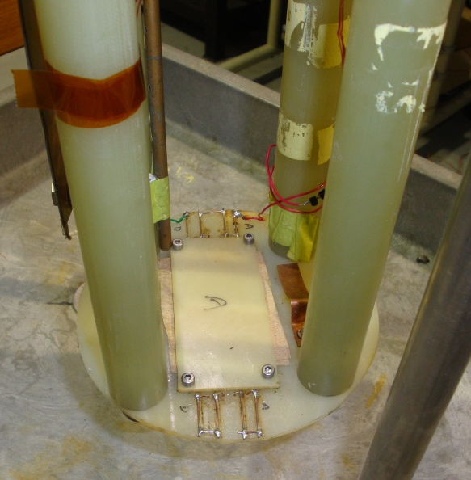
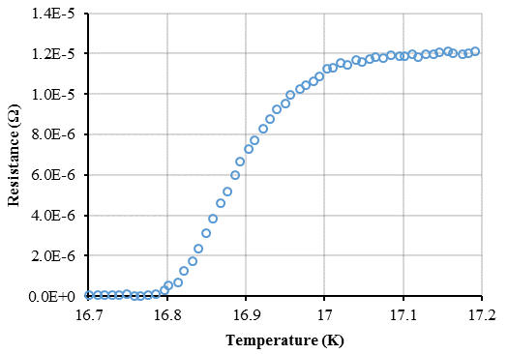
Residual Resistance Ratio (RRR)
Four-leads resistance measurement with +/- 1A current input.
Cool down to 4.2 K, take measurements continuously while samples warming up.
Eight 150 mm straight sample in contact with a horizontal G-10 plate.
A Cernox temperature sensor glued on the G-10 plate. Warm up rate < 20 mK/s.
R vs. T data are analyzed to obtain R_{295K}/R_{IEC} (Hi-Lumi)
RRR probe
Samples
Cernox
Strand Production Readiness Review, 22 Aug 2019
Notes:
Z:\MS&T\Materials Development and Characterization\Physical Properties\Other projects\Other data\Resistance measurements\RRR\ACE 2mm 11-14-05
Z:\MS&T\Materials Development and Characterization\Physical Properties\Other projects\Other data\Resistance measurements\ITER Copper Perer Bauer

Slide 11
RRR
Virgin strands
Extracted strands

Slide 12
Summary
NHMFL Nb₃Sn testing facility is presented.
I_{c} test mandrels and a probe have been designed and made for TFD.
Heat treated and tested 4 virgin strands and 3 strands extracted from a cable.
Improvement on the I_{c} test mandrel design is needed.

