Slide 1
Wire Test Results FNAL
Daniele Turrioni
TFD Wire Specification Review
28 October 2021

Slide 2
Outline
FNAL Test Facility
Scope of Work
Samples Tests and Results
Next Steps
Conclusions

Slide 3
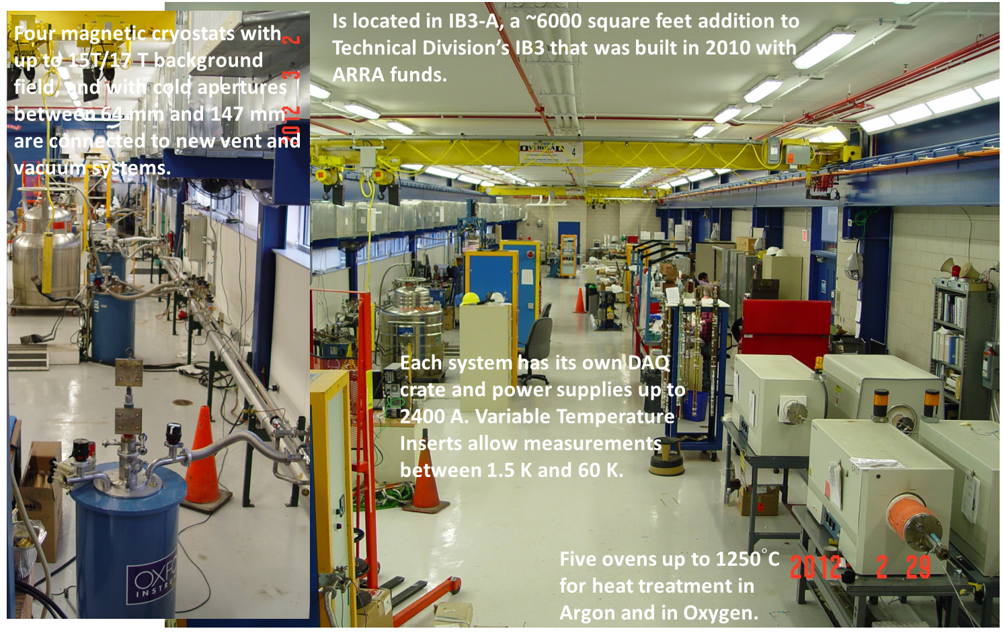
Superconducting R&D Lab at Fermilab

Slide 4
Test Facility Description
Teslatron 1 (T1) Cryostat with 15T/17T 64 mm cold aperture solenoid, 2000 A Power Supply w/ 49 mm Variable Temperature Insert (VTI) for testing between 1.5 K to 300 K.
Tube furnaces 6’’ diameter for heat treatment in Argon.
Same facility used for characterization and testing of AUP samples ( coil witness and extracted from cable)

Slide 5
Scope of Work
Goal of this effort is to characterize virgin and extracted strands from TFD cables.
Critical current measurements from extracted strands will be compared with those from virgin strands to assess degradation. RRR and stability measurements will also be performed.
For each cable type, two sets of measurements for different reaction schedules are planned to check the effect of heat treatment.

Slide 6
Wire Specification For the Production Cables
6 ELECTRICAL AND MAGNETIC REQUIREMENTS AND ELECTROMAGNETIC TESTING
6.1 Critical Current:
6.1.1 The strand critical current Ic shall exceed 600 amperes at 16 T field and 4.2 K temperature.
6.1.2 The strand critical current Ic shall exceed 760 amperes at 15 T field and 4.2 K temperature.
6.1.3 The strand critical current Ic shall exceed 570 A at 16 T, 4.2 K, and also exceed 720 A at 15 T, 4.2 K, after rolling to 0.935 mm thickness (i.e. 15% reduction).
6.2 Residual Resistance Ratio, RRR:
6.2.1 The value of RRR shall exceed 150 for final size strand after full reaction.
6.2.2 In addition, the value of RRR shall exceed 100 for a final size strand rolled to a thickness of 0.935 mm, i.e. 15% reduction, also after full reaction.

Slide 7
Task 1: Development cable assessment (665C HT)
Sub-task 1: Development cable assessment (665C HT)
i. Prepare 6 samples for reaction at 665C/50 hrs. as follows:
• 2 extracted strands from TFD development cable 1302 version A
• 2 extracted strands from TFD development cable 1302 version C
• 2 virgin strands from wire piece used for TFD development cable 1302 (from end of run). Note: since a single wire length was used for this cable, there is no need to match extracted wires to virgin wire from the same section.
Page 2
ii. Perform Ic measurements at 4.2K, in the field range of 12 to 15 T
iii. Perform Ic measurements at 2.2K or 1.9K for a sub-set of the samples
iv. Perform RRR measurements for all samples
v. Perform a field sweep (e.g. 0-10T loop) at constant current (1kA) and 1.9K (or 2.2K). If needed, field range and rate of change can be adjusted so avoid overheating.
Sub-task 2: Development cable assessment (680C HT)
i. Prepare 8 samples for reaction at 680C/50 hrs. as follows:
• 2 extracted strands from TFD development cable 1302 version A
• 2 extracted strands from TFD development cable 1302 version C
• 2 virgin strands from wire used for TFD development cable 1302 (from end of run). Note: since a single wire length was used for this cable, there is no need to match extracted wires to virgin wire from the same section.
• 2 virgin strands from spool #20506-4A (sample from TFD prototype cable order)
ii. Perform Ic measurements at 4.2K, in the field range of 12 to 15 T
iii. Perform RRR measurements for all samples
iv. Perform a field sweep (e.g. 0-10T loop) at constant current (1kA) and 4.2 K for one of the virgin strands from spool #20506-4A
i. Prepare 6 samples for reaction at 665C/50 hrs. as follows:
2 extracted strands from TFD development cable 1302 version A
2 extracted strands from TFD development cable 1302 version C
2 virgin strands from wire piece used for TFD development cable 1302 (from end of run). Note: since a single wire length was used for this cable, there is no need to match extracted wires to virgin wire from the same section.
ii. Perform Ic measurements at 4.2K, in the field range of 12 to 15 T
iii. Perform Ic measurements at 2.2K or 1.9K for a sub-set of the samples
iv. Perform RRR measurements for all samples
v. Perform a field sweep (e.g. 0-10T loop) at constant current (1kA) and 1.9K (or 2.2K). If needed, field range and rate of change can be adjusted so avoid overheating.

Slide 8
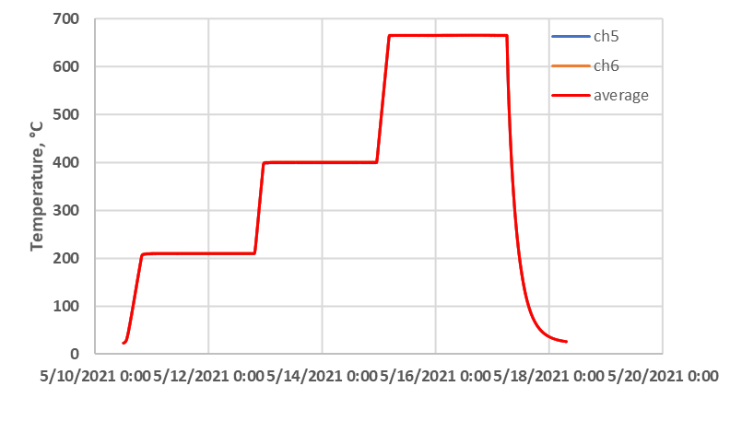
Task 1, Heat treatment
Nominal HT
48 hr @ 210 °C, 48 hr @ 400 °C, 50 hr @ 665 °C
Samples reacted in Argon Atmosphere

Slide 9
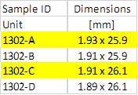
Task 1, Results
Wire ID | CO11S20235A04A |  |  |  | CO11S20235A04A |  |  |  | CO11S20235A04A |  |  |  | CO11S20235A04A |  |  |  | CO11S20235A04A |  |  |  | CO11S20235A04A
Cable ID | W12OL1302EA08V, #1 |  |  |  | W12OL1302EA08V, #2 |  |  |  | W12OL1302A, #1 |  |  |  | W12OL1302A, #2 |  |  |  | W12OL1302C, #1 |  |  |  | W12OL1302C, #2
Field [T] | Ic | n | T, K | Comment | Ic | n | T, K | Comment | Ic | n | T, K | Comment | Ic | n | T, K | Comment | Ic | n | T, K | Comment | Ic | n | T, K | Comment
16 | 638 | - | 4.2 | Scaled | 652 | - | 4.2 | Scaled | 639 | - | 4.2 | Scaled | 628 | - | 4.2 | Scaled |  | - | 4.2 |  | 646 | - | 4.2 | Scaled
15 | 792 | 51 | 4.2 |  | 807 | 50 | 4.2 |  | 792 | - | 4.2 |  | 779 | - | 4.2 |  | 796 | 55 | 4.2 |  | 798 | 58 | 4.2
14 | 976 | 58 | 4.2 |  | 992 | 57 | 4.2 |  | 971 | - | 4.2 |  | 961 | - | 4.2 |  | (961) | - | 4.2 | Transition started | 982 | - | 4.2
13 | 1184 | 58 | 4.2 |  | 1198 | - | 4.2 |  | 1174 | - | 4.2 |  | 1167 | - | 4.2 |  | (1148) | - | 4.2 | Transition started | 1189 | - | 4.2
12 | 1423 | 84 | 4.2 |  | 1437 | 82 | 4.2 |  | 1411 | - | 4.2 |  | 1397 | - | 4.2 |  | (1317) | - | 4.2 | quench | 1419 | - | 4.2
16 | 905 | - | 2.115 | Scaled |  |  |  |  |  | -
15 | 1084 | 49 | 2.115 |  |  |  |  |  | 1069 | - | 2.115
14 | 1287 | 57 | 2.115 |  |  |  |  |  | 1252 | - | 2.115
13 | 1520 | - | 2.119
Wire ID | CO11S20235A04A | CO11S20235A04A | CO11S20235A04A | CO11S20235A04A | CO11S20235A04A | CO11S20235A04A
Cable ID | W12OL1302EA08V, #1 | W12OL1302EA07V, #2 | W12OL1302A, #1 | W12OL1302A, #2 | W12OL1302C, #1 | W12OL1302C, #2
RRR @ 20 K | 183 | 195 | 182 | 187 | 197 | 185
RRR IEC | 195 | 209 | 193 | 200 | 211 | 197
Ic @ 15 T, 4.2 K > 760 A for all samples
Ic @ 16 T, 4.2 K > 600 A for all samples
RRR >150 / 100 for all samples – yes / yes
Ic_extracted (15T) > 0.98 Ic_virgin (15T)
Cable Geometry

Slide 10
Task 1, I_{c} vs. B Plot
Data at 16 T scaled using
ESE Spreadsheet

Slide 11
Task 2: Development cable assessment (680C HT)
Sub-task 1: Development cable assessment (665C HT)
i. Prepare 6 samples for reaction at 665C/50 hrs. as follows:
• 2 extracted strands from TFD development cable 1302 version A
• 2 extracted strands from TFD development cable 1302 version C
• 2 virgin strands from wire piece used for TFD development cable 1302 (from end of run). Note: since a single wire length was used for this cable, there is no need to match extracted wires to virgin wire from the same section.
Page 2
ii. Perform Ic measurements at 4.2K, in the field range of 12 to 15 T
iii. Perform Ic measurements at 2.2K or 1.9K for a sub-set of the samples
iv. Perform RRR measurements for all samples
v. Perform a field sweep (e.g. 0-10T loop) at constant current (1kA) and 1.9K (or 2.2K). If needed, field range and rate of change can be adjusted so avoid overheating.
Sub-task 2: Development cable assessment (680C HT)
i. Prepare 8 samples for reaction at 680C/50 hrs. as follows:
• 2 extracted strands from TFD development cable 1302 version A
• 2 extracted strands from TFD development cable 1302 version C
• 2 virgin strands from wire used for TFD development cable 1302 (from end of run). Note: since a single wire length was used for this cable, there is no need to match extracted wires to virgin wire from the same section.
• 2 virgin strands from spool #20506-4A (sample from TFD prototype cable order)
ii. Perform Ic measurements at 4.2K, in the field range of 12 to 15 T
iii. Perform RRR measurements for all samples
iv. Perform a field sweep (e.g. 0-10T loop) at constant current (1kA) and 4.2 K for one of the virgin strands from spool #20506-4A
Sub-task 2: Development cable assessment (680C HT)
i. Prepare 8 samples for reaction at 680C/50 hrs. as follows:
• 2 extracted strands from TFD development cable 1302 version A
• 2 extracted strands from TFD development cable 1302 version C
• 2 virgin strands from wire used for TFD development cable 1302 (from end of run). Note: since a single wire length was used for this cable, there is no need to match extracted wires to virgin wire from the same section.
• 2 virgin strands from spool #20506-4A (sample from TFD prototype cable order)
ii. Perform Ic measurements at 4.2K, in the field range of 12 to 15 T
iii. Perform RRR measurements for all samples
iv. Perform a field sweep (e.g. 0-10T loop) at constant current (1kA) and 4.2 K for one of the virgin strands from spool #20506-4A

Slide 12
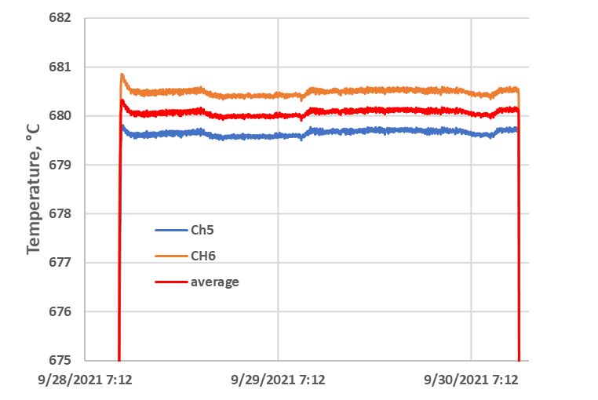
Task 2, Heat treatment
Nominal HT
48 hr @ 210 °C, 48 hr @ 400 °C, 50 hr @ 680 °C
Samples reacted in Argon Atmosphere

Slide 13
Task 2, Results
Wire ID | 20506-4A |  |  |  | 20506-4A |  |  |  | CO11S20235A04A |  |  |  | CO11S20235A04A |  |  |  | CO11S20235A04A |  |  |  | CO11S20235A04A
Cable ID | TFD prototype cable order, VIRGIN #1 |  |  |  | TFD prototype cable order, VIRGIN #2 |  |  |  | W12OL1302EA08V, VIRGIN #1 |  |  |  | W12OL1302EA08V, VIRGIN #2 |  |  |  | W12OL1302C, #1 |  |  |  | W12OL1302C, #2
Field [T] | Ic | n | T, K | Comment | Ic | n | T, K | Comment | Ic | n | T, K | Comment | Ic | n | T, K | Comment | Ic | n | T, K | Comment | Ic | n | T, K | Comment
16 | 676 | - | 4.2 | Scaled | 673 | - | 4.2 | Scaled | 680 | - | 4.2 | Scaled | 674 |  | 4.2 | Scaled | 664 | - | 4.2 |  | 670 | - | 4.2 | Scaled
15 | 826 | 67 | 4.2 |  | 822 | - | 4.2 |  | 832 | 65 | 4.2 |  | 824 | 74 | 4.2 |  | 814 | - | 4.2 |  | 817 | - | 4.2
14 | 1012 | - | 4.2 |  | 1005 | - | 4.2 |  | 1007 | - | 4.2 |  | 1002 | 74 | 4.2 |  | 992 | - | 4.2 |  | 995 | 73 | 4.2
13 | 1218 | - | 4.2 |  | 1205 | - | 4.2 |  | 1208 | - | 4.2 |  | 1203 | 95 | 4.2 |  | 1188 | - | 4.2 |  | 1193 | 84 | 4.2
12 | 1441 | - | 4.2 |  | 1410 | - | 4.2 |  | (1314) | - | 4.2 | quench | 1430 | 96 | 4.2 |  | (1325) | - | 4.2 | quench | 1414 | - | 4.2
Wire ID | CO11S20235A04A | CO11S20235A04A | CO11S20235A04A | CO11S20235A04A | 20506-4A | 20506-4A
Cable ID | W12OL1302EA08V, VIRGIN | W12OL1302EA07V, VIRGIN | W12OL1302C, #1 | W12OL1302C, #2 | VIRGIN #1 | VIRGIN #2
RRR @ 20 K | 133 | 142 | 130 | 121 | 197 | 185
RRR IEC | 138 | 148 | 135 | 126 | 211 | 197
Cable Geometry
Ic @ 15 T, 4.2 K > 760 A for all samples
Ic @ 16 T, 4.2 K > 600 A for all samples
RRR >150 / 100 for all samples – no / yes
Ic_extracted (15T) > 0.98 Ic_virgin (15T)

Slide 14
Task 2, I_{c} vs. B Plot
Data at 16 T scaled using
ESE Spreadsheet

Slide 15
Next steps
Task 3: Verification of vendor measurements for prototype wire order
  Prepare additional 8 virgin strand samples from TFD prototype cable production order for reaction at 665C/50 hrs. Samples are chosen to match specific billets/pieces for which vendor Ic/RRR measurements are available.
  Perform Ic measurements for 6 of the samples, at 4.2K, in the field range of 12 to 15 T.
  Perform RRR measurements for all samples.
  Compare with vendor results.
Task 4: Prototype cable assessment (680C or 665C HT)
  Prepare 8 samples for reaction as follows:
    4 extracted strands from TFD prototype cable run
    4 virgin strands from TFD prototype cable (from end of run)
  React at 665C or 680C (TBD based on development cable results, Task 1-2)
  Perform Ic measurements for 3 virgin and 3 extracted strands, at 4.2K, in the field range of 12 to 15 T. Note: virgin strands need to be matched to extracted strands (e.g. same billet and piece)
  Perform RRR measurements for all samples
  Perform a field sweep (e.g. 0-10T loop) at constant current (1.2 kA) and 4.2K for one of the extracted strands. In case of quench, repeat on a second extracted strand. Field range and rate of change can be adjusted so avoid overheating.

Slide 16
Conclusions
6 samples (2 Virgin and 4 extracted from TFD development cable) were reacted at a final step of 665°C for 50 hours and Critical current and RRR measured.
6 samples (4 Virgin and 2 extracted from TFD development cable) were reacted at a final step of 680°C for 50 hours and Critical current and RRR measured.
For all virgin samples, the critical current at 15 T exceeds the cable strand specifications of 760 A.
For all extracted samples, the critical current at 15 T exceeds the cable rolled strand specifications of 720 A.
The RRR of the virgin wire used in the TFD development cable heat treated at 680°C was the only one not meeting the specs of 150.

