Slide 1
Improvements in Horizontal Tube Furnace
Temperature Uniformity and Sealing
Mike Naus
Lawrence Berkeley National Laboratory
SMP Seminar – 30 Nov 2021

Slide 2
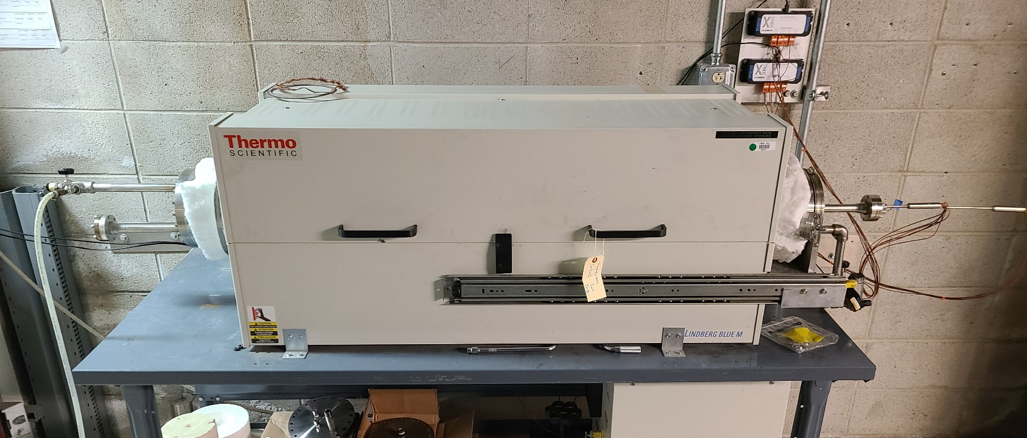
Furnace LK

Slide 3
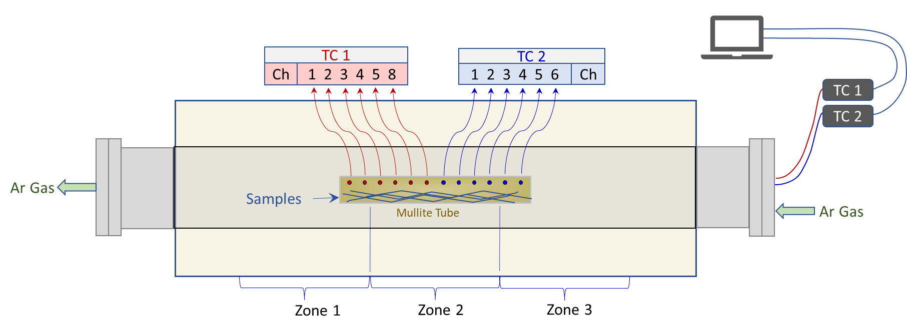
Furnace LK Set-Up
Two ‘Profile’ TC Probes: 6 TC junctions within each probe
Data
Loggers

Slide 4
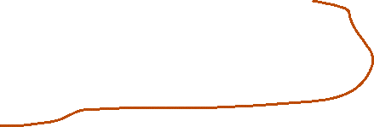
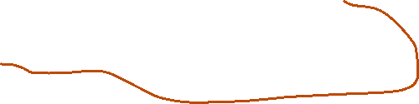

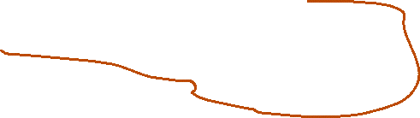


Profile TC Probes
To conserve space, two profile TC probes were/are used
  Each profile probe has 6 TC junctions
  12 junctions cover a length of 16.5” (41.9 cm)
    1.5” (3.8 cm) apart, starting at probe tip
Only junction at the tip can be calibrated using CL1201 drybox calibrator
→ Only 2 of 12 junctions

Slide 5
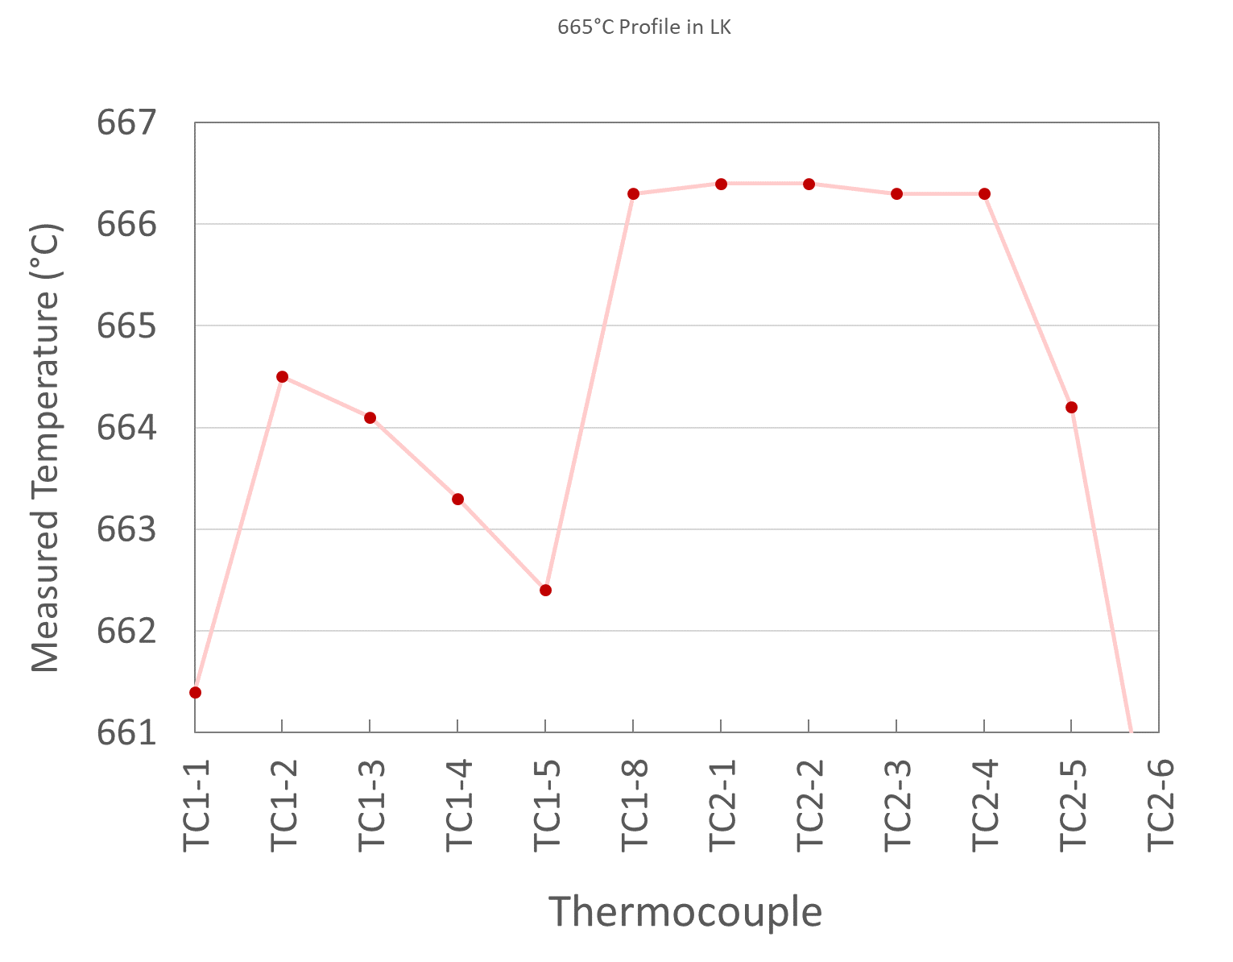
Previous System Characteristics
Non-uniformity along sample length
  Not due to furnace zone set-points
  Not fixable by adjusting set-points
Either…
  Furnace has very non-uniform heating
  TCs are inaccurate
Zone 1
Zone 2
Zone 3
10 of 12 TCs could not be calibrated

Slide 6
AUP Heat Treatment Requirements
AUP has specific temperature heat treatment requirements
  Doc 40, §8.2
Average temperature from all TCs: Nominal ± 5°C
Range between all TCs: ≤ 2°C
Calibration: TCs must be calibrated within 1°C of highest target temp.

Slide 7
Previous System Characteristics
Average Across Measured RRR Length (HT run LK200304)
  Spec: Target ± 5°C
Range Across Measured RRR Length (HT run LK200304)
  Spec: ≤ 2°C
Similar to ‘one foot in scalding water, one foot in ice water’
  On average, a comfortable temperature
Target Temp | 210°C | 400°C | 665°C
Actual Average | 211.5°C | 401.6°C | 664.2°C
ü
Target Temp | 210°C | 400°C | 665°C
Range | 3.6° | 4.4°C | 4.7°C
Ð

Slide 8
Previous System Set-up
Only probe tips calibrated
  Calibration curves for tip junction applied to all other junctions
TCs not removable for calibrating
  Crimped Ferrule
  Shafts bent to get through narrowing access tunnel
  TC fixtures welded in place and not removable
    Could not remove entire assembly
  Sheaths oxidized and not smooth
    Would not slide through fixtures without serious risk of damage
TCs were of the ‘grounded’ type: Junctions in contact with sheath
  Faster temperature change response (not really needed for our application)
  Risk of ground loops or other electrical issues

Slide 9
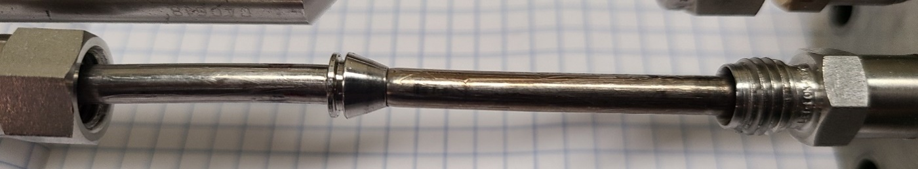
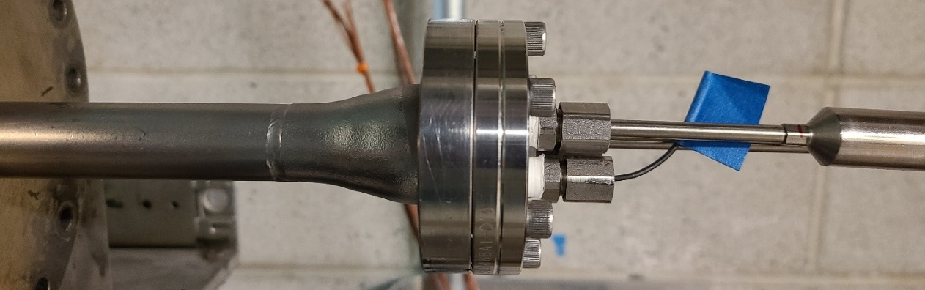
Previous System Set-up
Crimped-on ferule preventing inward motion of TC
Thermocouple
TCs rubbing at narrowed tube inhibiting movement in either direction
Access tube

Slide 10
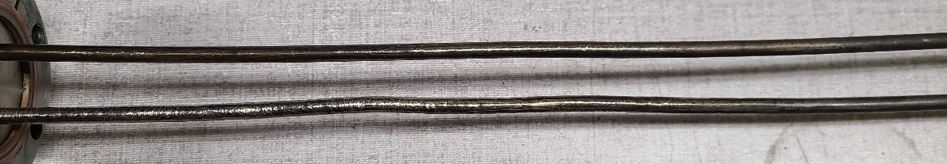
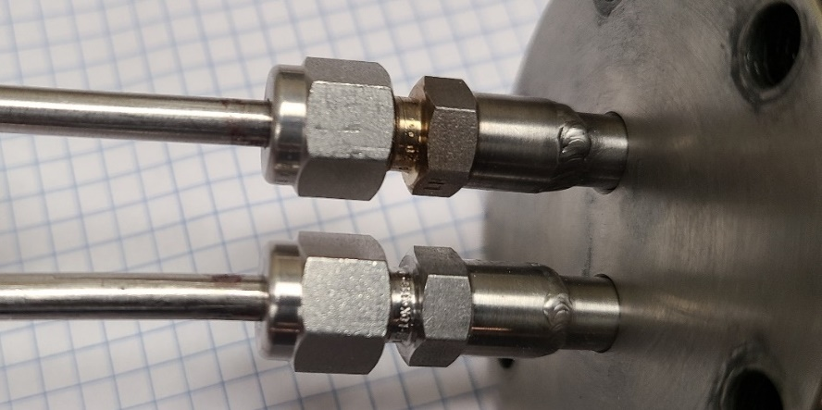
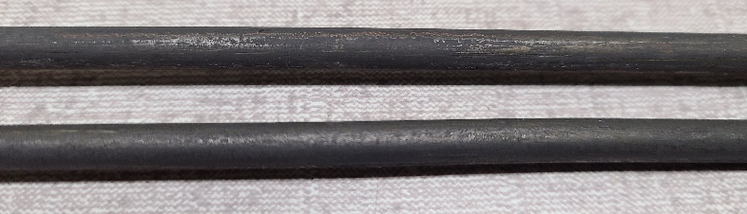
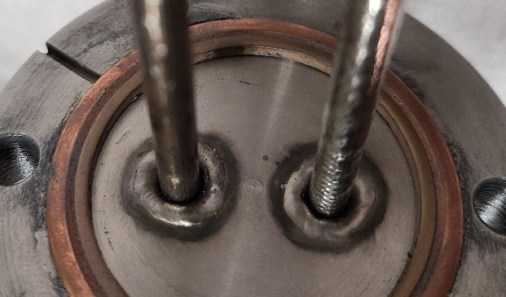
Previous System Set-up
Thermocouple
Thermocouple
Tight
TC fixtures welded into place
      Eliminating option to remove TC and fixture together as a unit
Surface oxide and inhomogeneities prevent sliding TCs out through fixtures

Slide 11
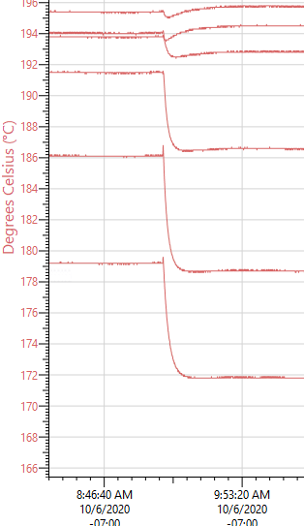
Temperature Shift Example
Temperature shifted when TCs are…
  Rotated slightly
    Even if returned to original orientation
  Touched
Symptoms indicate voltage issue
  Ground loops or similar

Slide 12
Goals of a New Set-Up
New profile probes
  For temperature resolution along sample & physical space considerations
TCs calibratable in situ
  → 3rd TC feed-through
Non-grounded junctions
Type N thermocouples
  Similar to Type K, but better stability over time at temperature
Better sheath (e.g., OmegaCladTM )
  Better temperature stability over time at temperature
  OmegaClad > Inconel > Stainless Steel

Slide 13
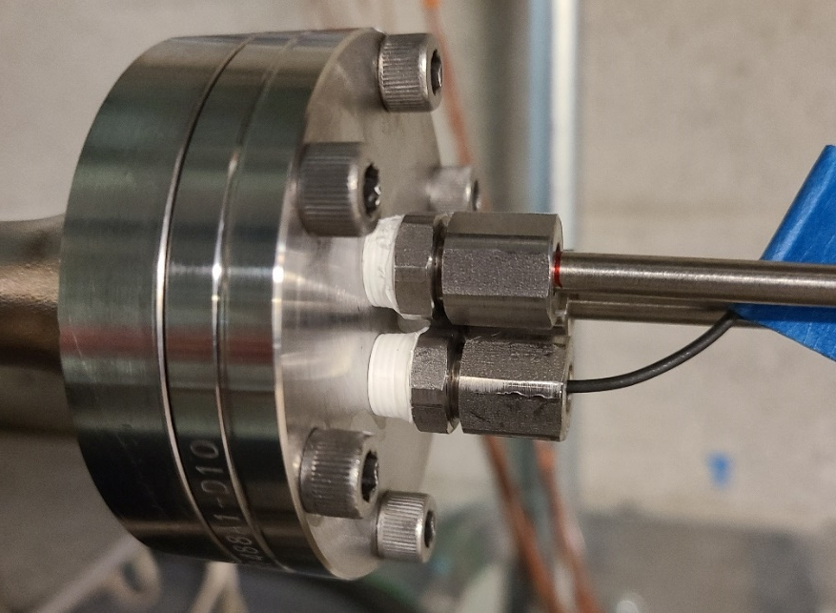
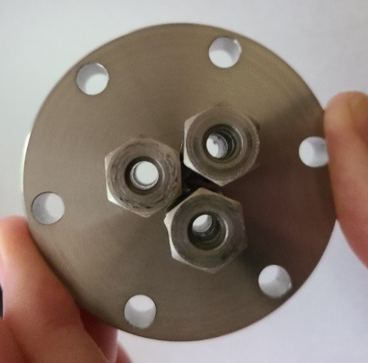
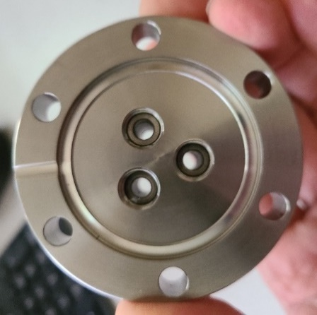
New TC Feed-Throughs
Teflon Wrap
As tight as possible
Thermocouples
Plug
Calibration
TC Fixture
Threaded feed-throughs allow for modularity
Teflon is appropriate heat treating at atmospheric pressures
  Melting point = 327°C

Slide 14
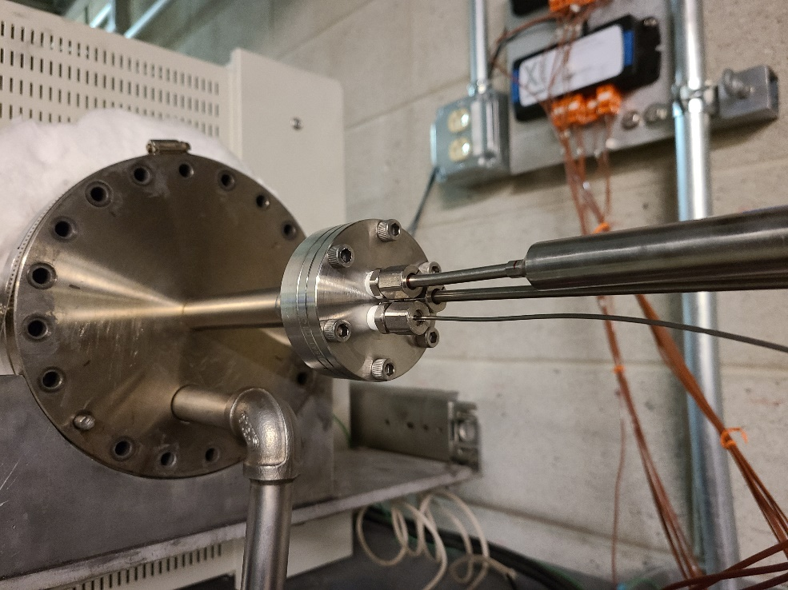
Finished Assembly
Data Loggers
TC1 & TC2
Cal Probe
New flange with new Type N, non-grounded profile probes
  With calibration probe in place

Slide 15
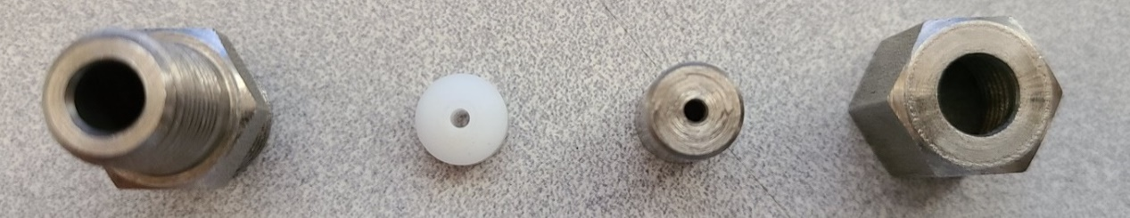
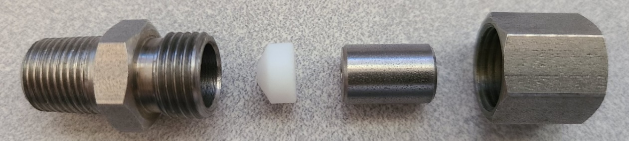
Calibration Probe Feed-through: Mix ‘n’ Match
Ø1/16” ID
Ø3/8”
Base
Ferrule
Sleeve
Nut
Part sizes mixed to ease Ø1/16” calibrated TC movement
  A 1/16” base will catch small deviations in TC straightness
Ø3/8” ID base with Ø1/16” ID ferrule and sleeve

Slide 16
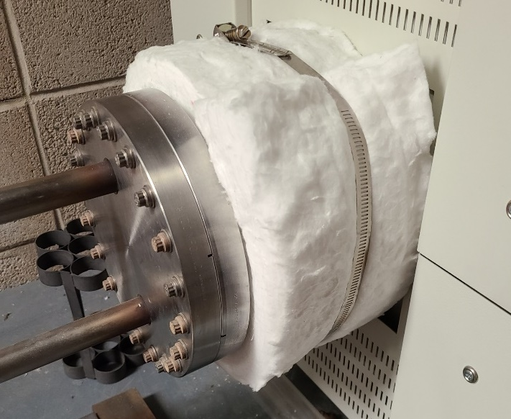
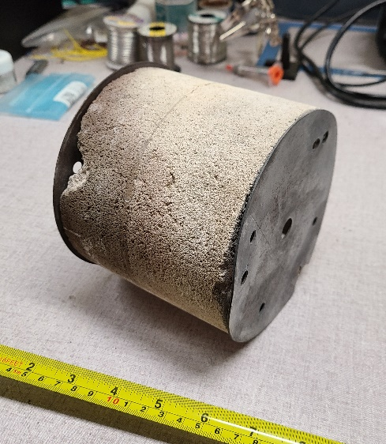
Insulation
External Insulation
Internal Insulation Block
Insulation added to retort ends to aid in temperature uniformity
  Anecdotal evidence that room temperature influences ends of hot zone
Retort has always had internal insulation block
  Only on non- sample-exchange side (left side)

Slide 17
Calibrating the Profile Probes
Slide ‘silver standard’ to line up with each junction in profile probe
AUP plateaus: 210°C, 400°C, 665°C
  Omega software only allows for 2 cal points
  Chose 400°C & 665°C, as these are most impactful to RRR
  210°C is then still a bit off due to extrapolation of cal curve

Slide 18
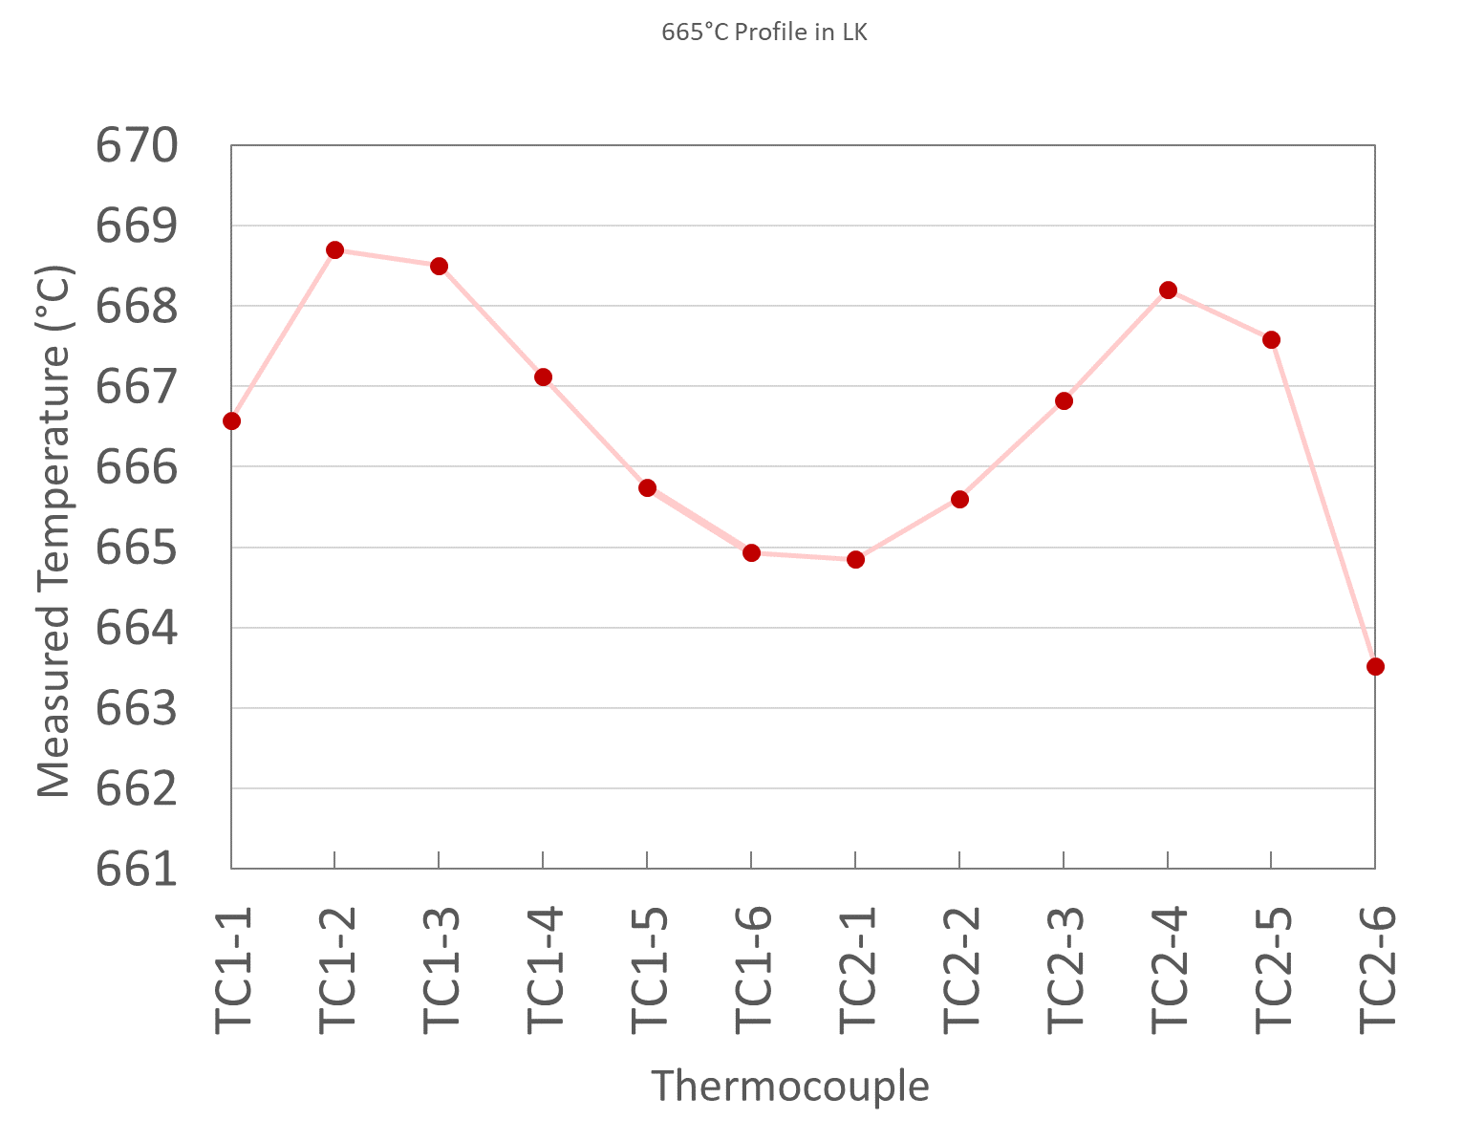
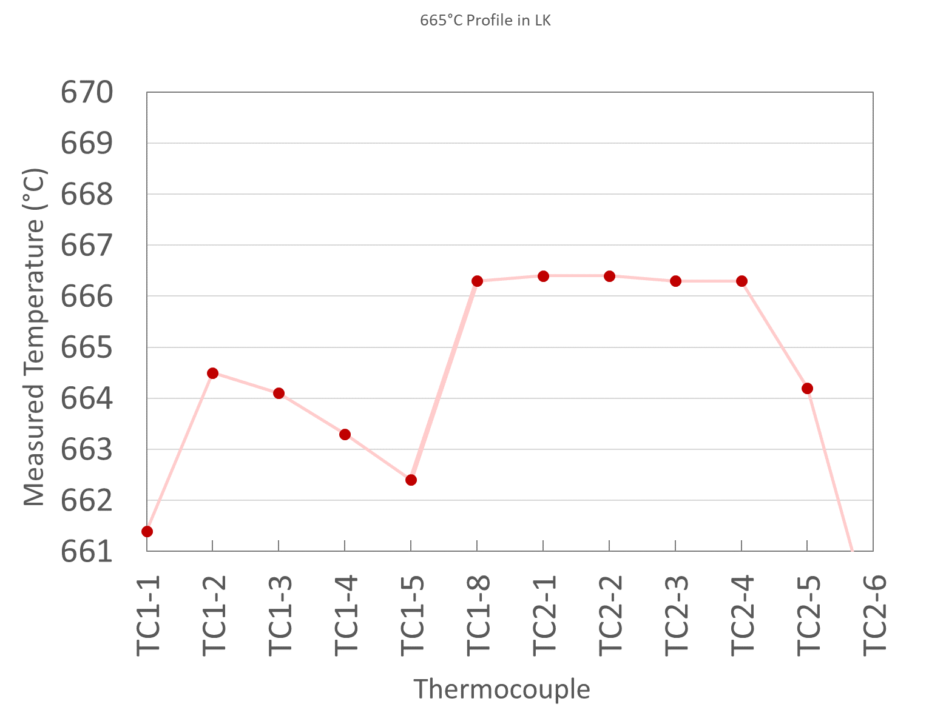
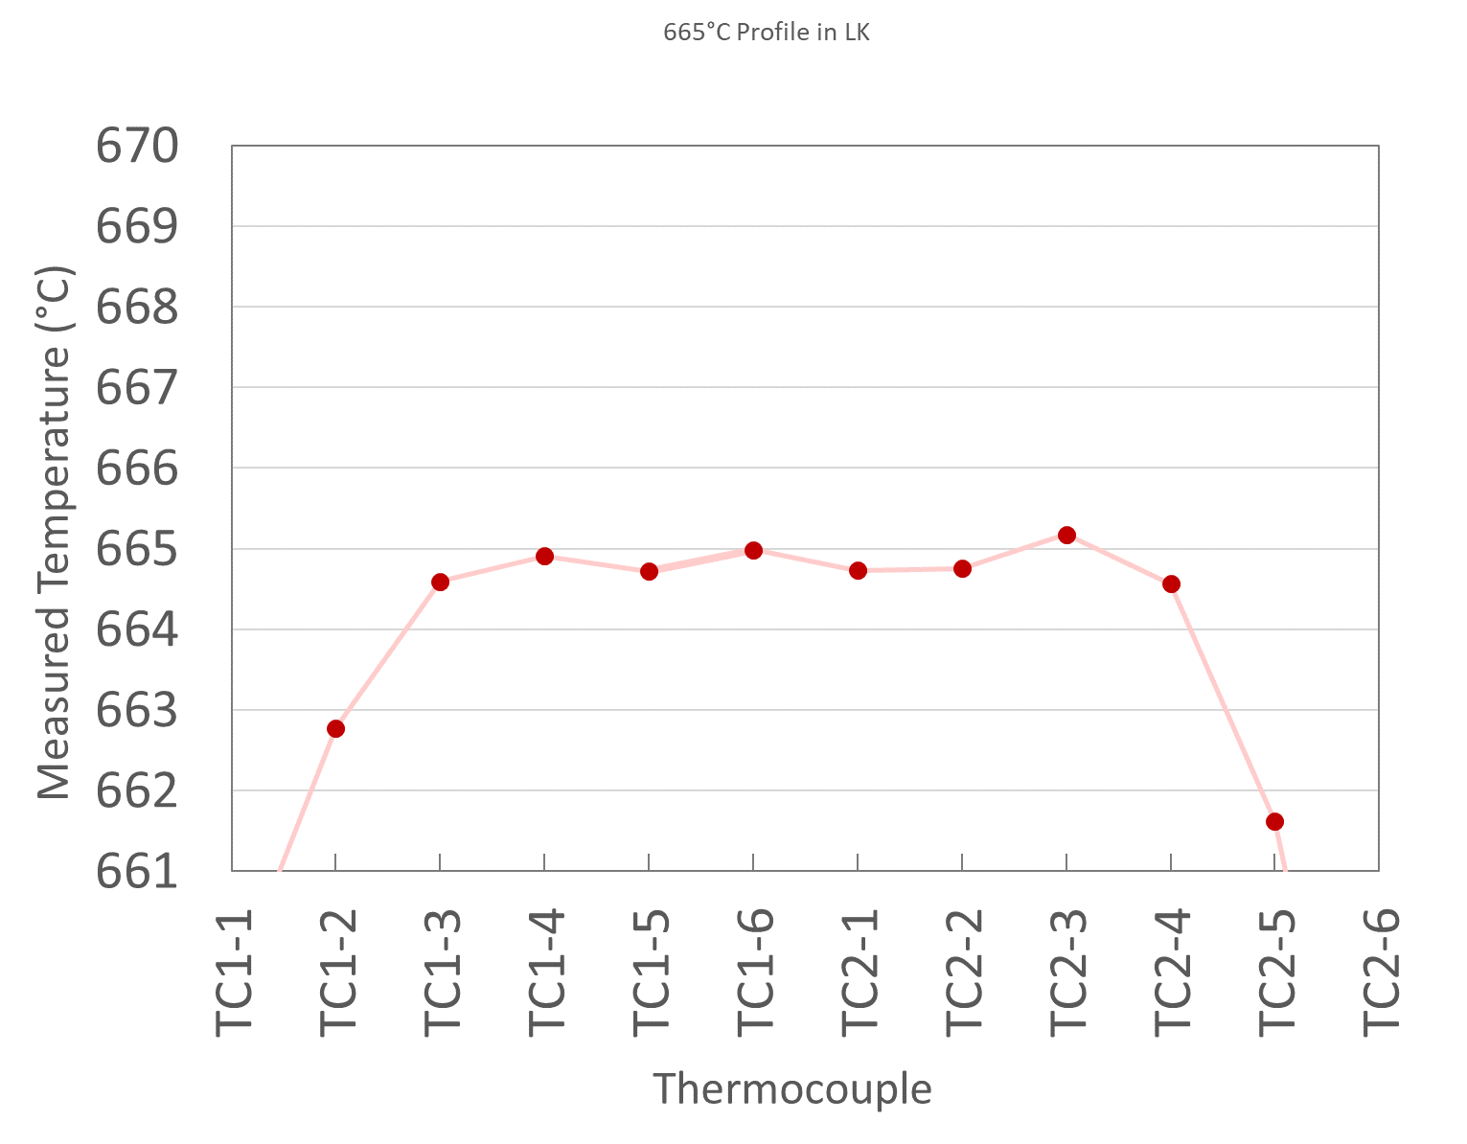
Furnace LK Temp Curves
First Run Post-Calibration
After Several Set-Point Adjustments
Zone 1
Zone 2
Zone 3
Zone 1
Zone 2
Zone 3
Much more symmetric temperature profile initially
  Allowed for zone set-point adjustments to create flat profile in middle zone
At 400°C & 665°C: Range ≤ ~1°C across ~25 cm

Slide 19
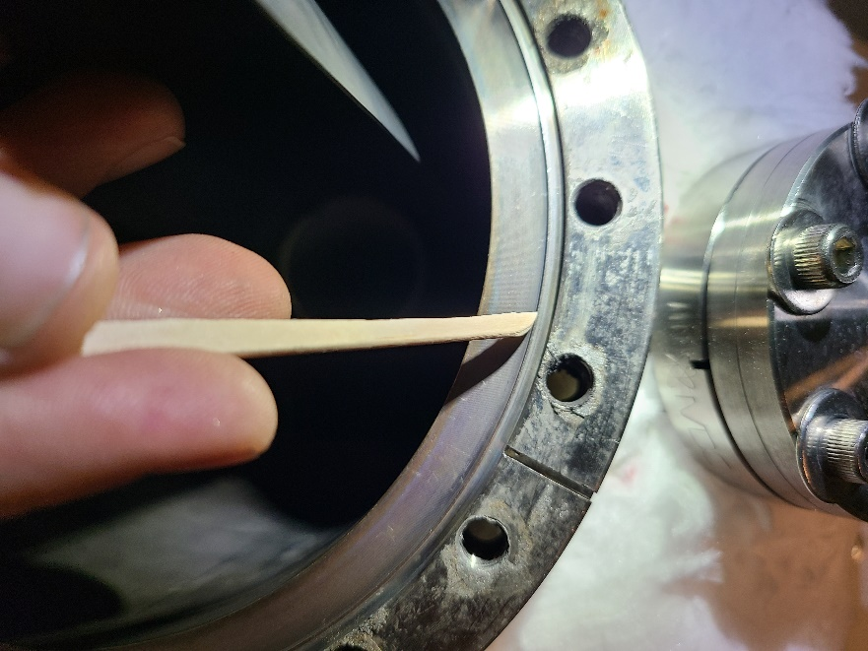
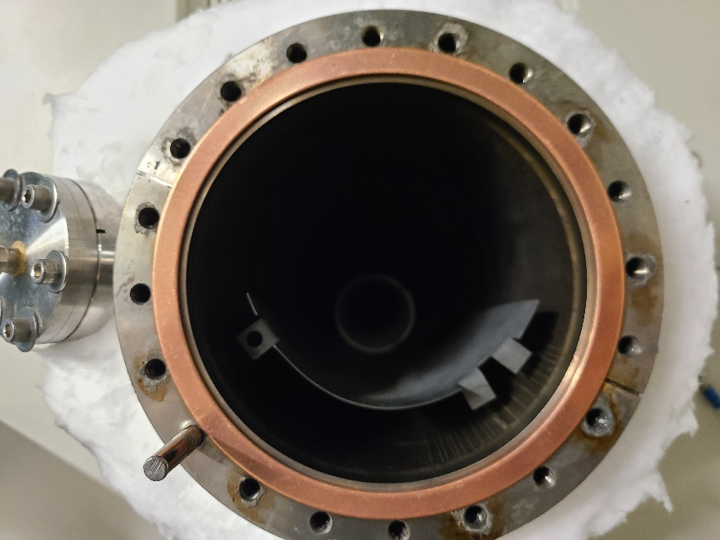
Air Sealing – Better Practices
Retort uses flanges that have ‘knife-edge’ for sealing into Cu gasket
When changing gaskets, clean debris from knife edges
  Tools softer than knife edge (e.g., wood dowel)

Slide 20
Air Sealing – Better Practices
If gasket stays on after opening, can reuse it
  Leak performance will degrade over time, however
  Can try sealing tighter with each closing, but that is limited
If gasket pops out after use, replace it
  Cu gasket will no longer be conformal to knife edge, creating leaks
  AUP RRR samples turned black after simply replacing a popped-off gasket
If Cu flange stays attached upon opening, it is still reasonably conformal to the SS knife edge
SS Knife Edge
Cu Flange
SS Knife Edge
If used Cu flange is reattached, it will likely be leaky
Cu Flange

Slide 21
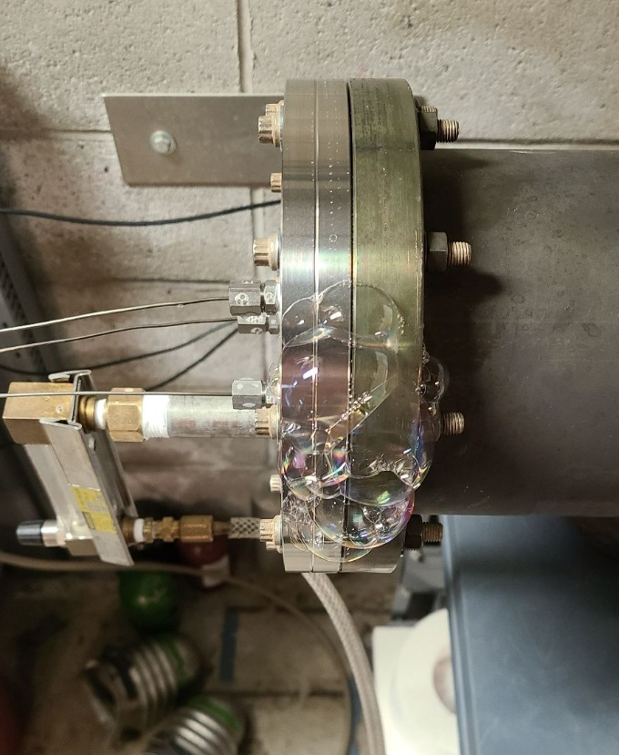
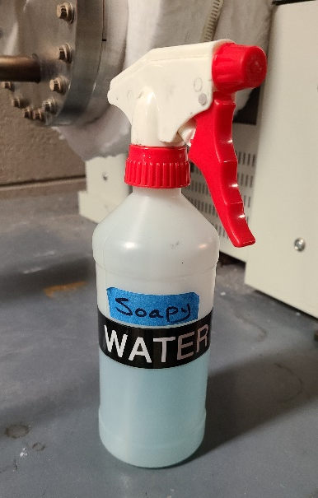
Leak Check
Argon outlet is often a hose ending in a bucket of water
Fill bucket with water to create some back pressure
Use soapy water at seals to look for bubbles

Slide 22
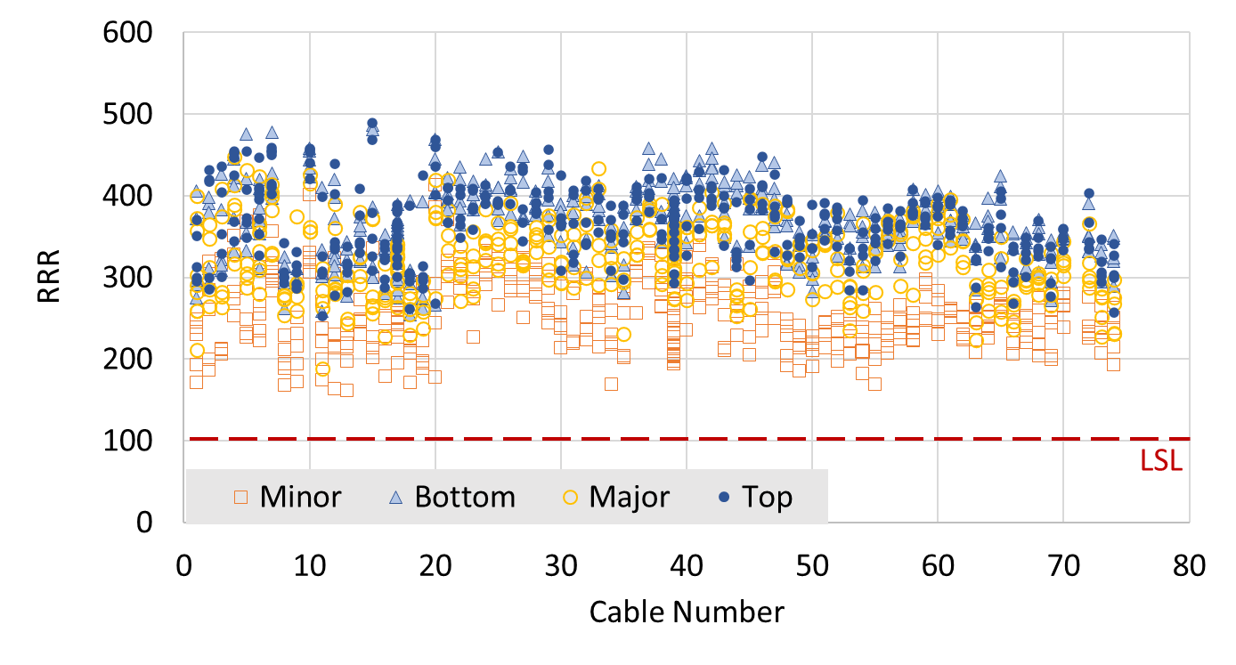
Air Sealing – Better Practices
RRR Trend
New v-tap design
Leak Fixed
New TC Set-up

Slide 23
END

Slide 24
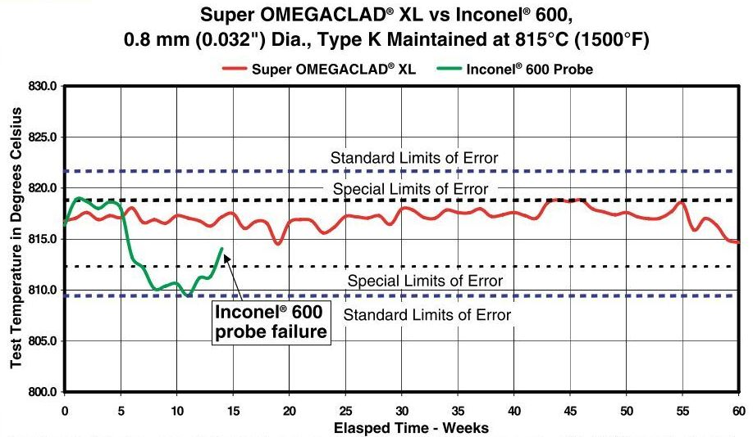

Slide 25
