Slide 1
Towards Advanced Superconducting Performance:
Exploring the Microstructure of APC Nb₃Sn Wires
Alice Moros (amoros@lbl.gov)
Lawrence Berkeley National Laboratory
SMP Seminar – 11th November 2021

Slide 2
Outline
Framework of the research study
Artificial Pinning Center (APC) Nb₃Sn Wires
Introduction to my work
Microstructural analysis and employed techniques
Summary and outlook
Alice Moros – SMP Seminar, 11th November 2021

Slide 3

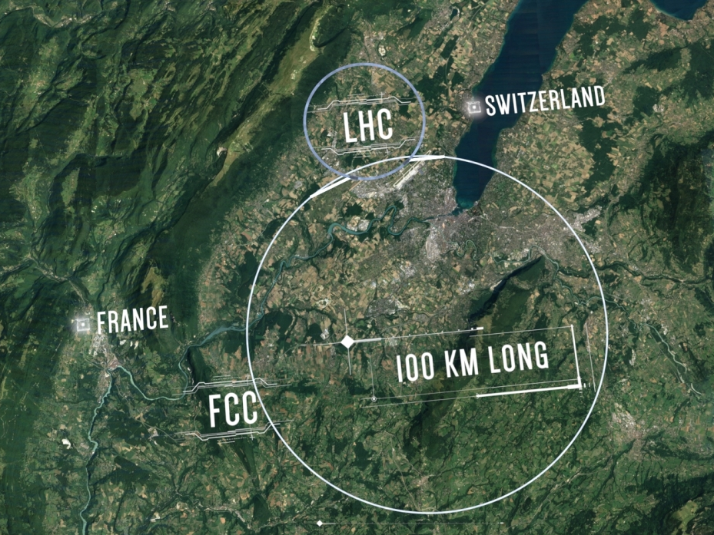

Aiming for the Future hadron Collider (FCC-hh)
Parameter | LHC | FCC-hh
Collision energy [TeV] | 14 | 100
Dipole field [T] | 8.33 | 16
Circumference [km] | 26.7 | 97.75
Beam current [A] | 0.58 | 0.5
Synchr. rad. power [kW] | 3.6 | 2400
J_{c} = 1.5 kA/mm² at 16 T & 4.2 K → Nb₃Sn
High-field dipole magnets
Alice Moros – SMP Seminar, 11th November 2021

Slide 4
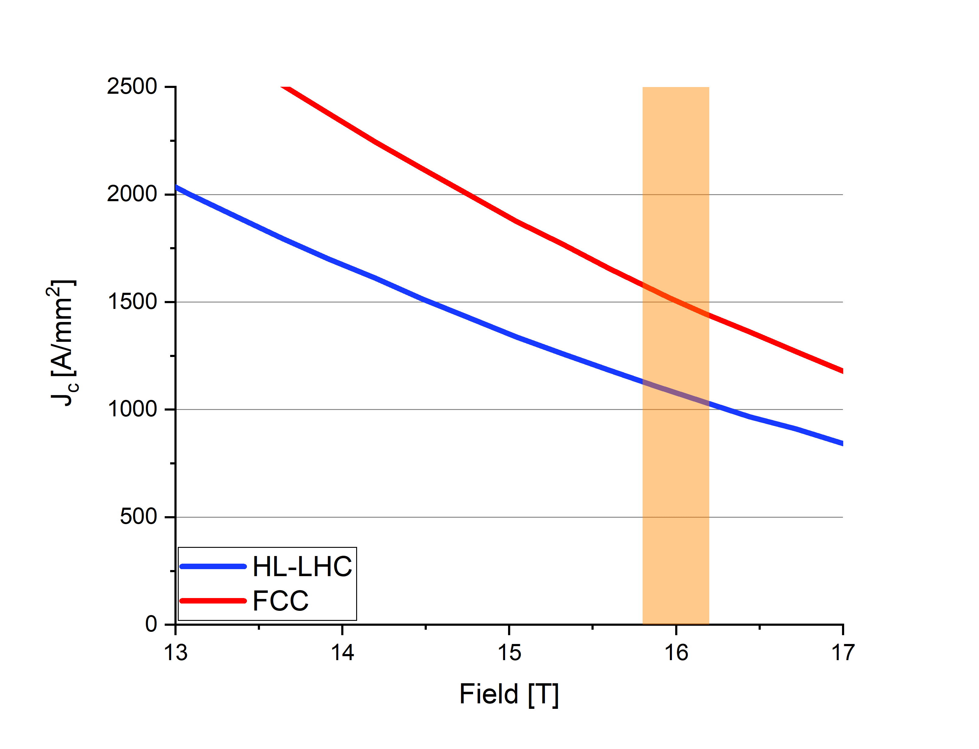
J_{c} Enhancement
J_{c}
Sn inhomogeneities
Grain size
Artificial defects
J_{C} = 1500 A/ mm²
J_{C} ~ 1000 A/mm²
APC Nb₃Sn wires have demonstrated their capability of meeting the FCC target and even exceeding it!
Xu, Xingchen, et al. "High critical current density in internally-oxidized Nb3Sn superconductors and its origin." Scripta Materialia 186 (2020): 317-320.
Xu, Xingchen, et al. "Ternary Nb3Sn superconductors with artificial pinning centers and high upper critical fields." Superconductor Science and Technology 32.2 (2019): 02LT01.
J_{c} = 1.5 kA/mm² at 16 T & 4.2 K → Nb₃Sn

Slide 5
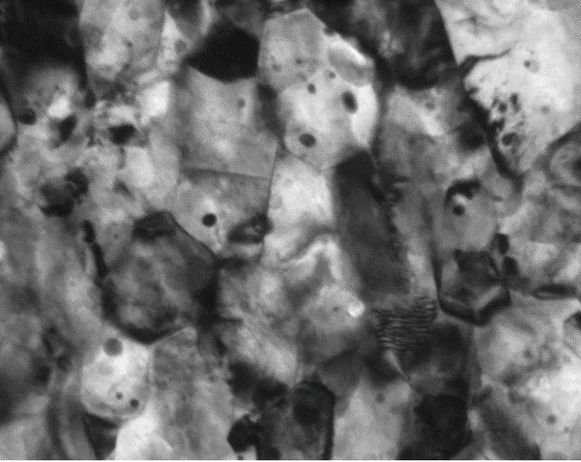

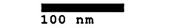
Artificial Pinning Center (APC) Nb₃Sn Wires
Xu, X., et al. "Refinement of Nb3Sn grain size by the generation of ZrO2 precipitates in Nb3Sn wires." Applied Physics Letters 104.8 (2014): 082602.)
Xu, Xingchen, et al. "Ternary Nb3Sn superconductors with artificial pinning centers and high upper critical fields." Superconductor Science and Technology 32.2 (2019): 02LT01.
Nb
Nb₃Sn
Standard PIT sub-element
HT
Sn source powders
Residual core
For APC:
SnO₂ powder as an O source
Nb-Zr/Hf alloy
Internal oxidation method
Grain boundary
Nb - 4at.%Ta - 1at.%Zr
Nb₃Sn with ZrO₂ /HfO₂
- 1at.%Hf
Intra-granular ZrO₂ particles
APC-PIT
sub-element
Sn source powders + Oxide
HT
Residual core
Inter-granular ZrO₂ particles
End 2018: From binary to ternary compounds
Alice Moros – SMP Seminar, 11th November 2021

Slide 6
Why APC (ternary) Wires?
ZrO₂/HfO₂ nanoprecipitates or point particles (PP) as additional pinning centres (intra and inter-granular)
PP as centres of inhibition of grain growth → A-15 grain size (GS) refinement → J_{c} enhancement
Ta addition to raise B_{irr} and B_{c2}
Physics behind PP formation, size, and distribution?
Alice Moros – SMP Seminar, 11th November 2021

Slide 7







Microstructural Study of APC Wires
Correlations between the size and density of PP and the performed HT
Wire recipe | T3935-675 x 380 | T3914-685 x 228 | T3912-700 x 71 | T3914-675 x 317 | T3914-700 x 120
Wire Ø [mm] | 0.84 | 0.71 | 0.71 | 0.84 | 0.71
Dopant | 4 at.% Ta, 1 at.% Zr | 4 at.% Ta, 1 at.% Hf | 4 at.% Ta, 1 at.% Zr | 4 at.% Ta, 1 at.% Hf | 4 at.% Ta, 1 at.% Hf
Heat treatment | 675 °C, 380 h | 685 °C, 228 h | 700 °C, 71 h | 675 °C, 317 h | 700 °C, 120 h
First 5 samples analyzed at TU Wien in 2020 → PP size & density investigation
Other 9 samples arrived to TU Wien in 2021 → size & density analyses almost completed
GS analysis ongoing
Alice Moros – SMP Seminar, 11th November 2021

Slide 8
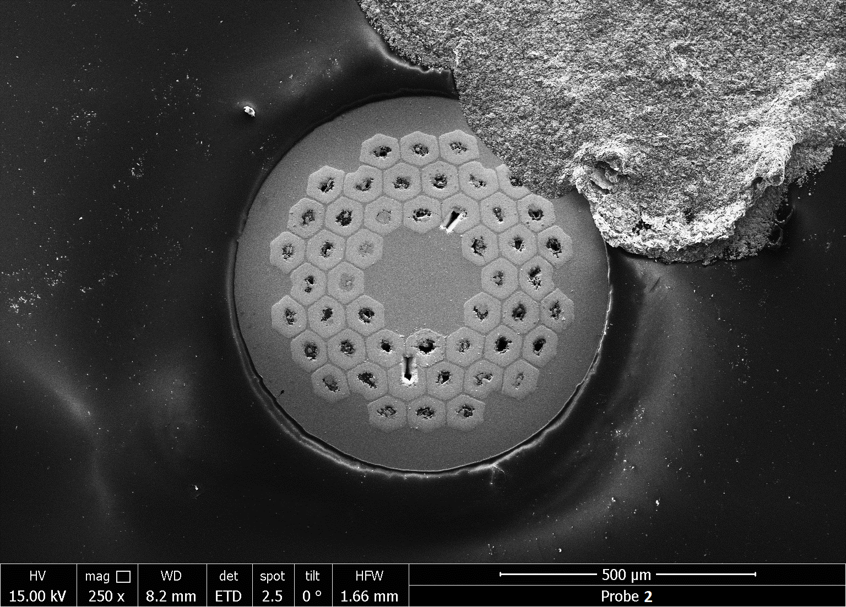
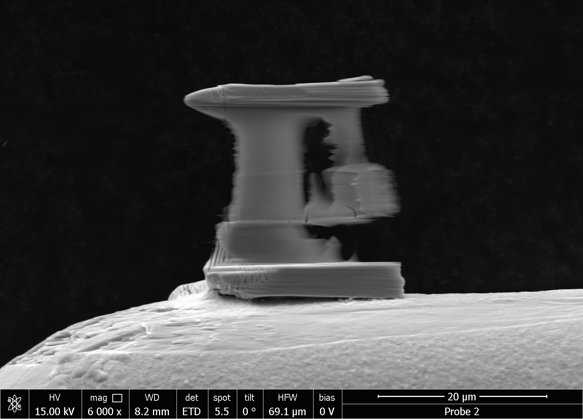
Towards TEM Investigation
Sample preparation
FIB Lamella
core
periphery
Finely thinned regions are those where the hole is located
Alice Moros – SMP Seminar, 11th November 2021

Slide 9
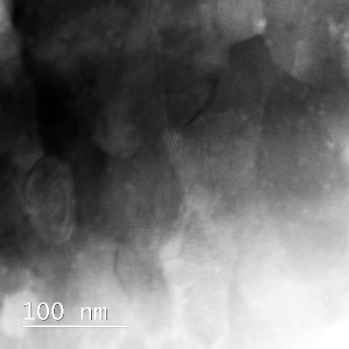
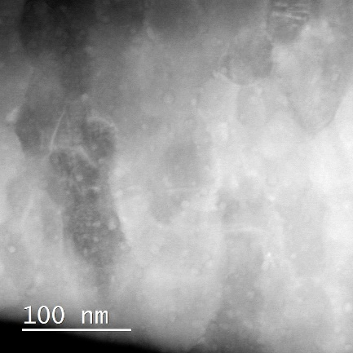
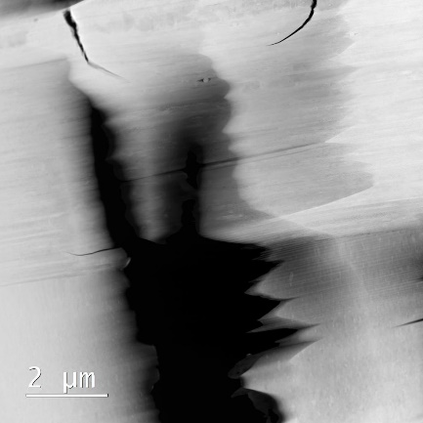
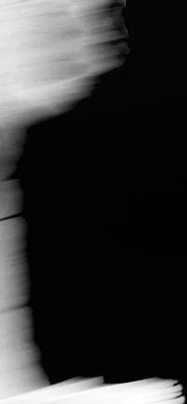
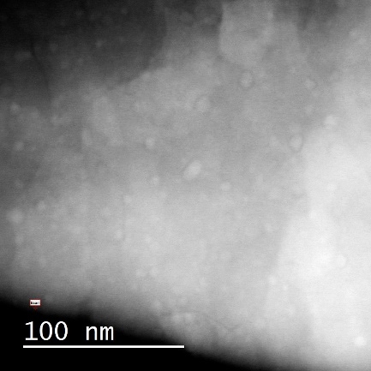
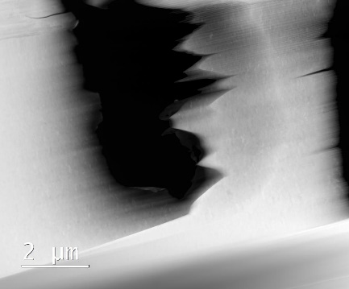
TEM Analysis – PP areas selection
Area 108
Area 107
108
107
FIB Lamella
core
Area 115
periphery
115
Chosen Areas:
107
108
115
101
Alice Moros – SMP Seminar, 11th November 2021

Slide 10
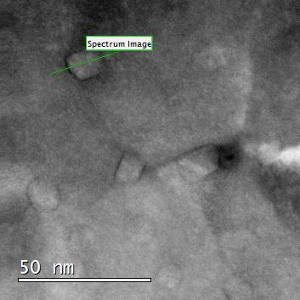
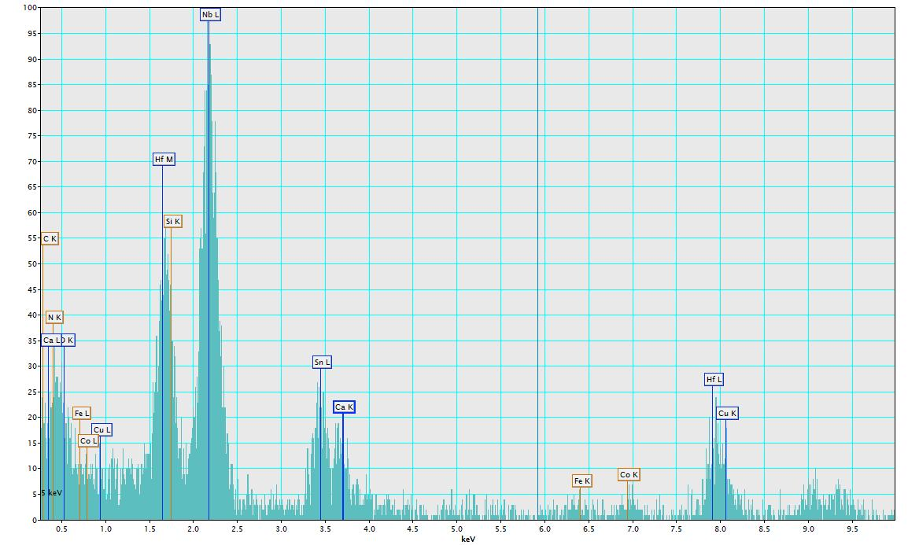
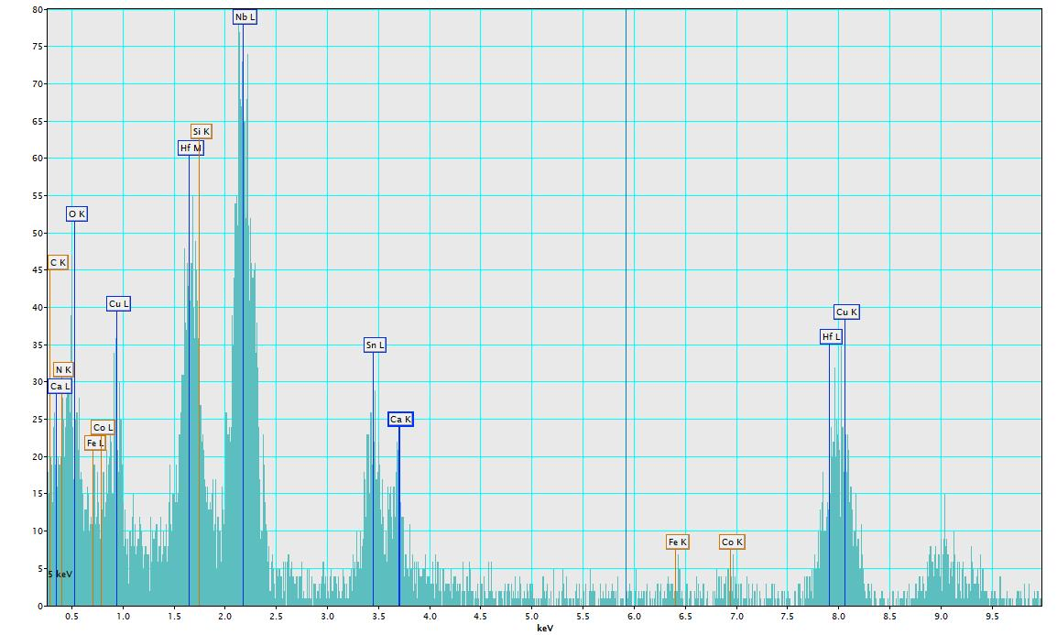
TEM-EDX: HfO₂ PP identification
Atomic number
Nb₃Sn = 43.25
HfO₂ = 29.33
ZrO₂ = 18.67
Cu L
Hf M
Cu L
Hf M
Alice Moros – SMP Seminar, 11th November 2021

Slide 11
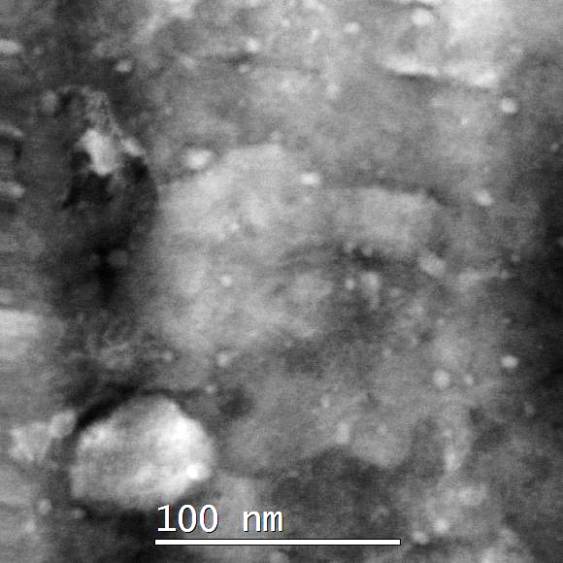
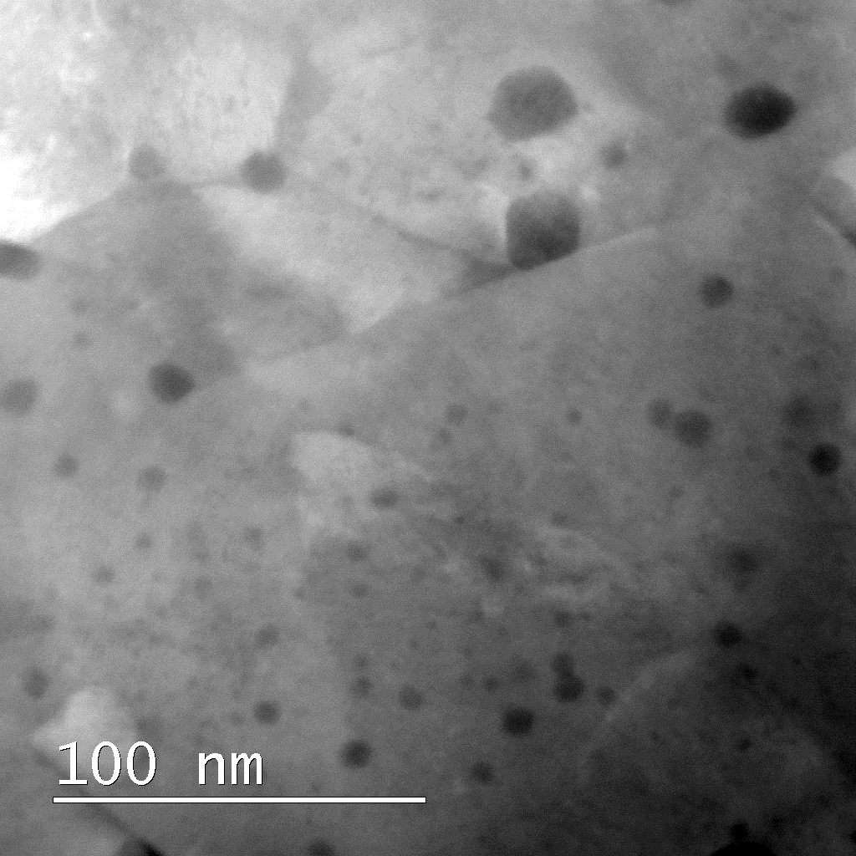
TEM imaging: HfO₂ vs ZrO₂

Slide 12
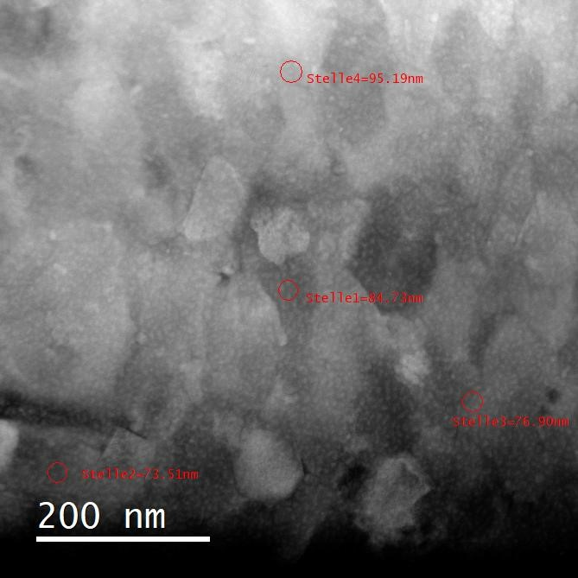
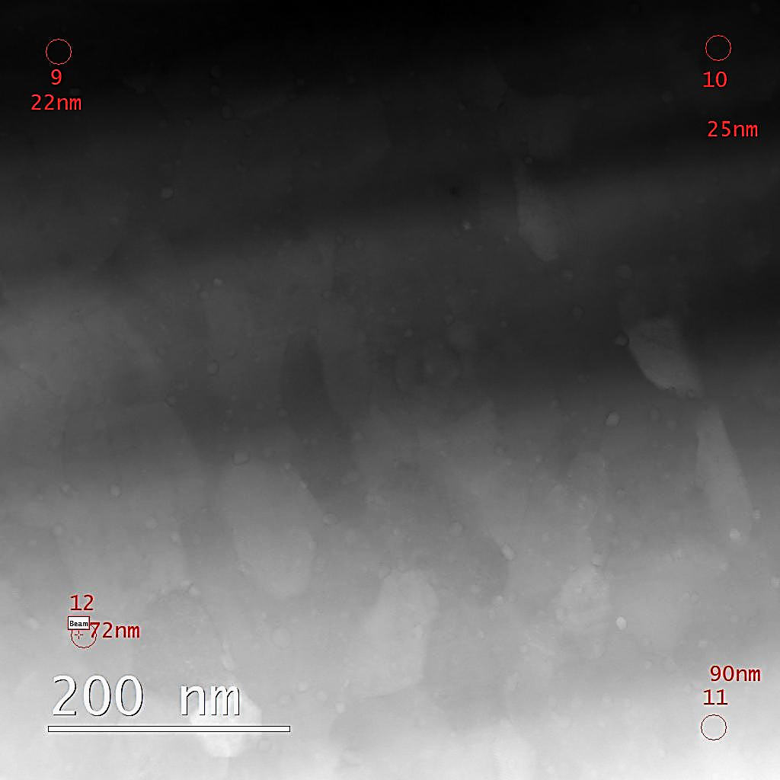
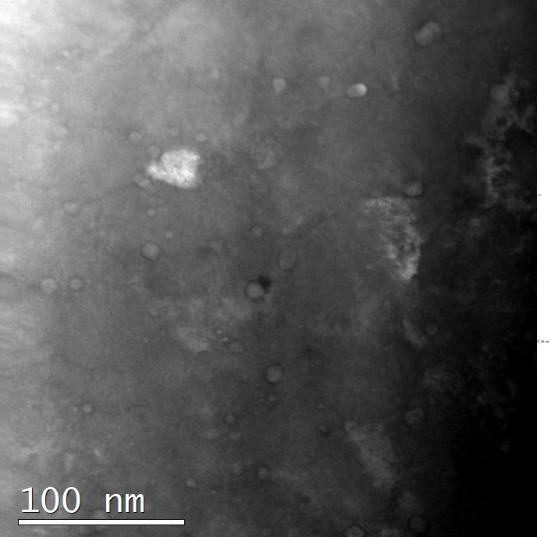
FIB damage in the image
PIPS refinement (with liquid nitrogen cooling) to reduce FIB damage
Alice Moros – SMP Seminar, 11th November 2021

Slide 13
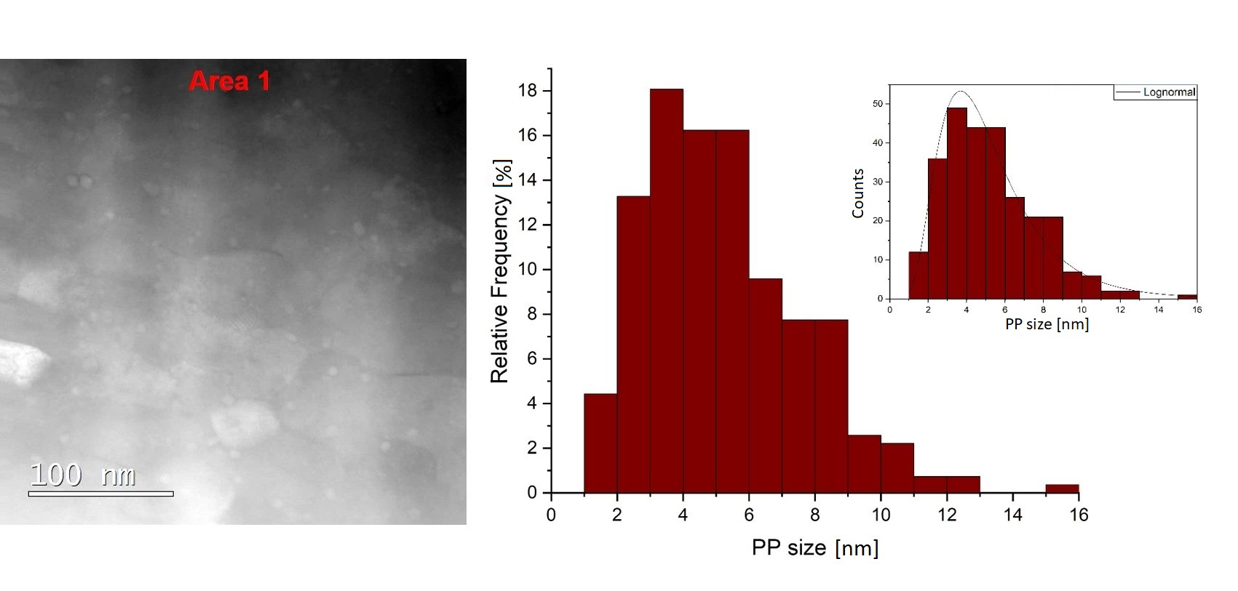
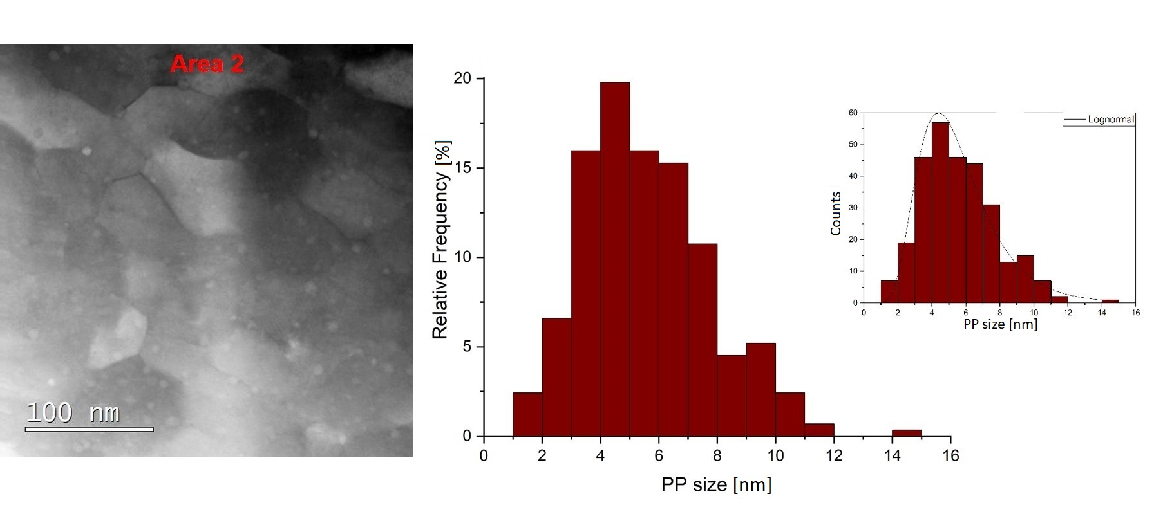
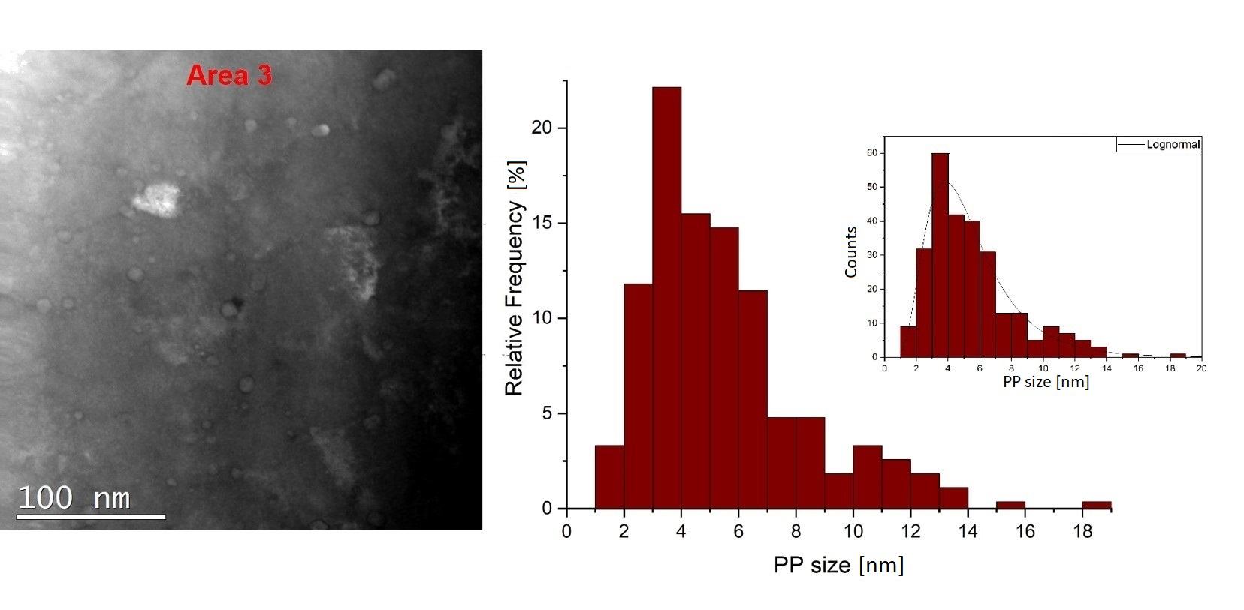
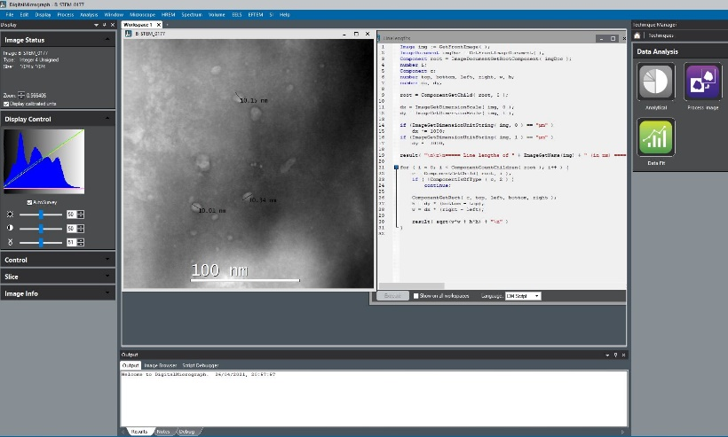
TEM Analysis HfO₂ – PS & PD
High Angle Annular Dark Field – Scanning TEM for PP size analysis and EELS measurements for density evaluation
Z contrast imaging
Gatan Microscopy Suite Software
HfO₂
Alice Moros – SMP Seminar, 11th November 2021

Slide 14
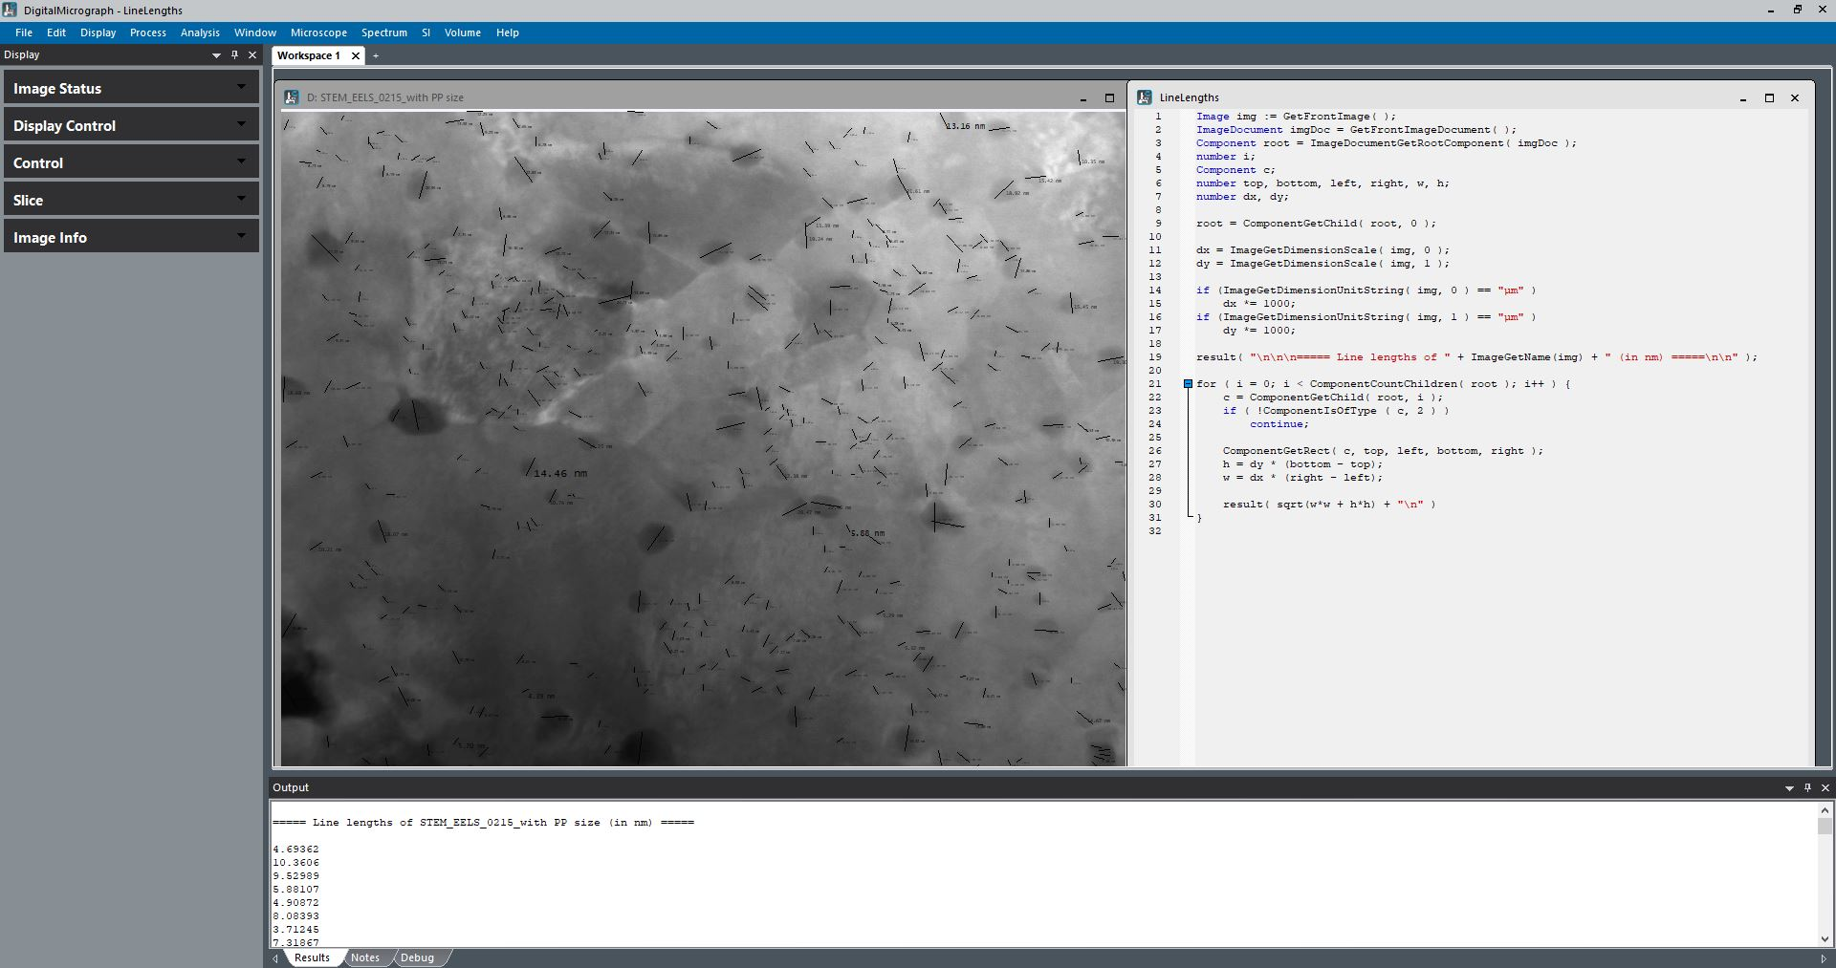
Counting PP Manually
Contrast, brightness, gamma adjustment for PP identification
Alice Moros – SMP Seminar, 11th November 2021

Slide 15
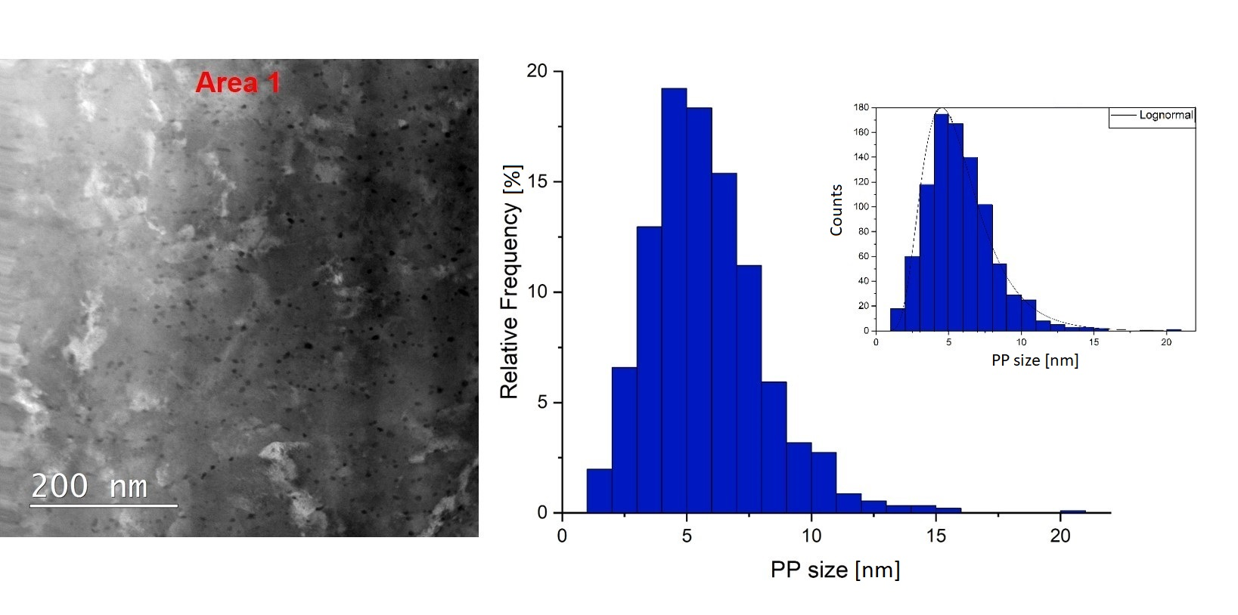
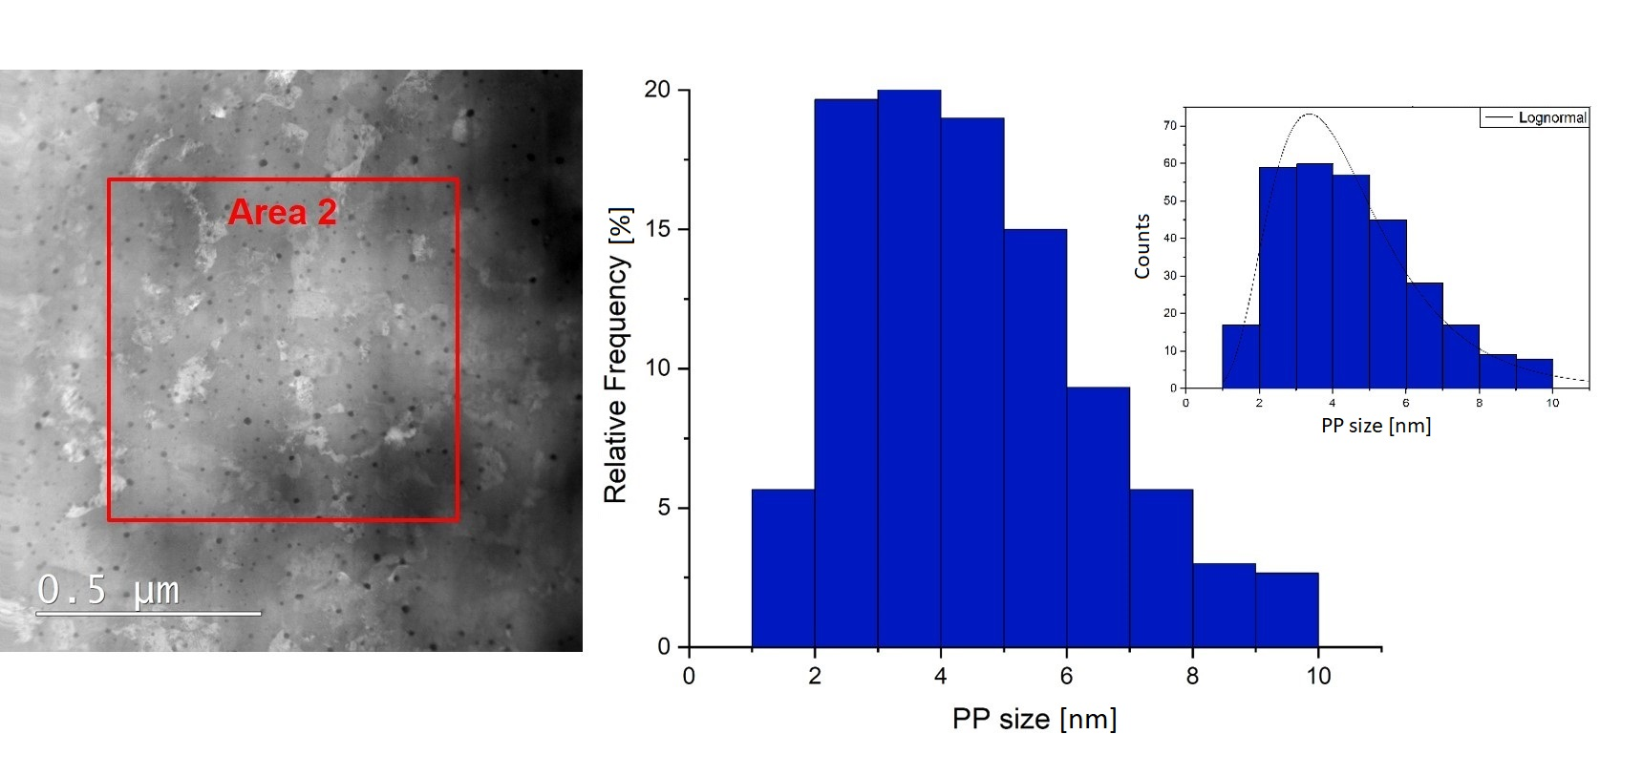
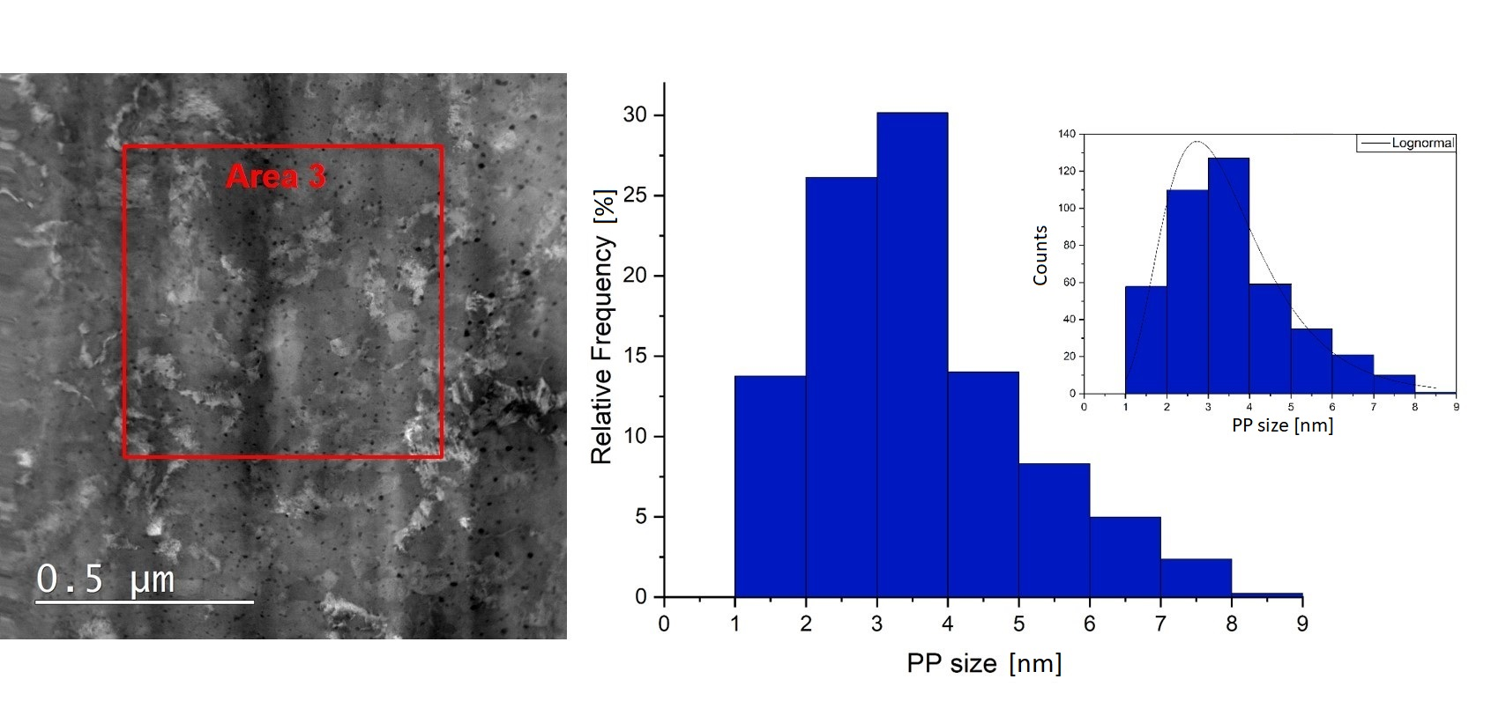
TEM Analysis ZrO₂ – PS & PD
HAADF-STEM for PP size analysis and EELS measurements for density evaluation
ZrO₂
Alice Moros – SMP Seminar, 11th November 2021

Slide 16
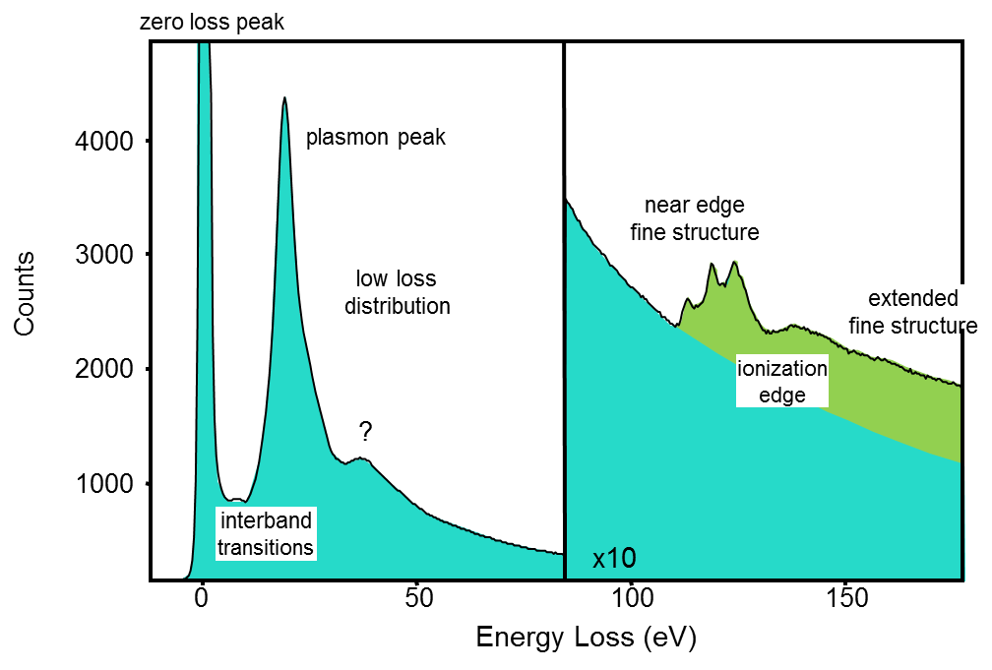
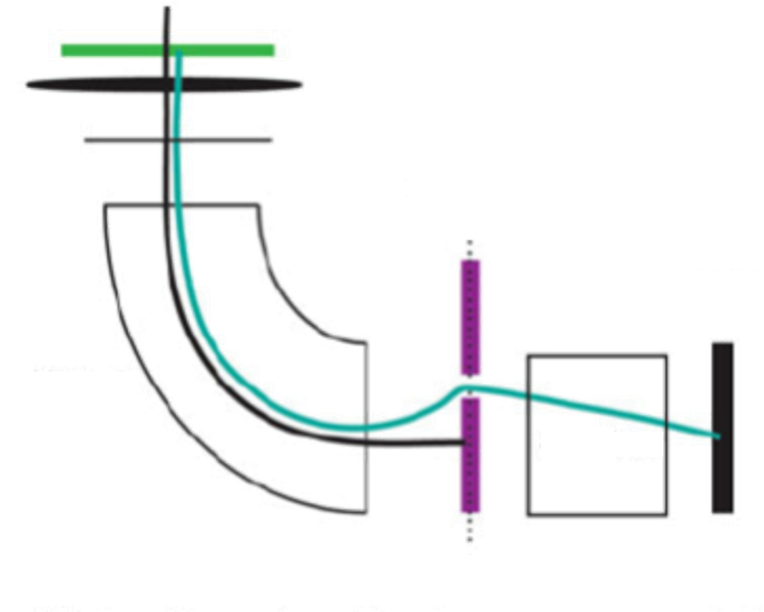
Electron Energy Loss Spectroscopy - EELS
Scheme of the EELS system in TEM
https://eels.info/about/overview
Sample
Lenses
TEM viewing screen
Selecting aperture
Scintillator
CCD camera
Magnetic
Prism
Specimen thickness – Zero-loss peak (ZLP) and total spectrum intensity
Valence/conduction electron density – Plasmon peaks
Optical response – Low-loss distribution
Band structure and interband transitions – Near zero-loss features
Elemental composition – Core-loss edges
Bonding and oxidation state – Near edge fine structure (ELNES)
Distribution of near neighbouring atoms – Extended energy loss fine structure (ExELFS)
Alice Moros – SMP Seminar, 11th November 2021

Slide 17
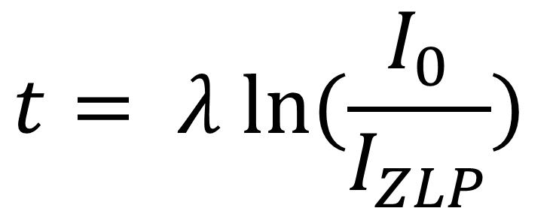
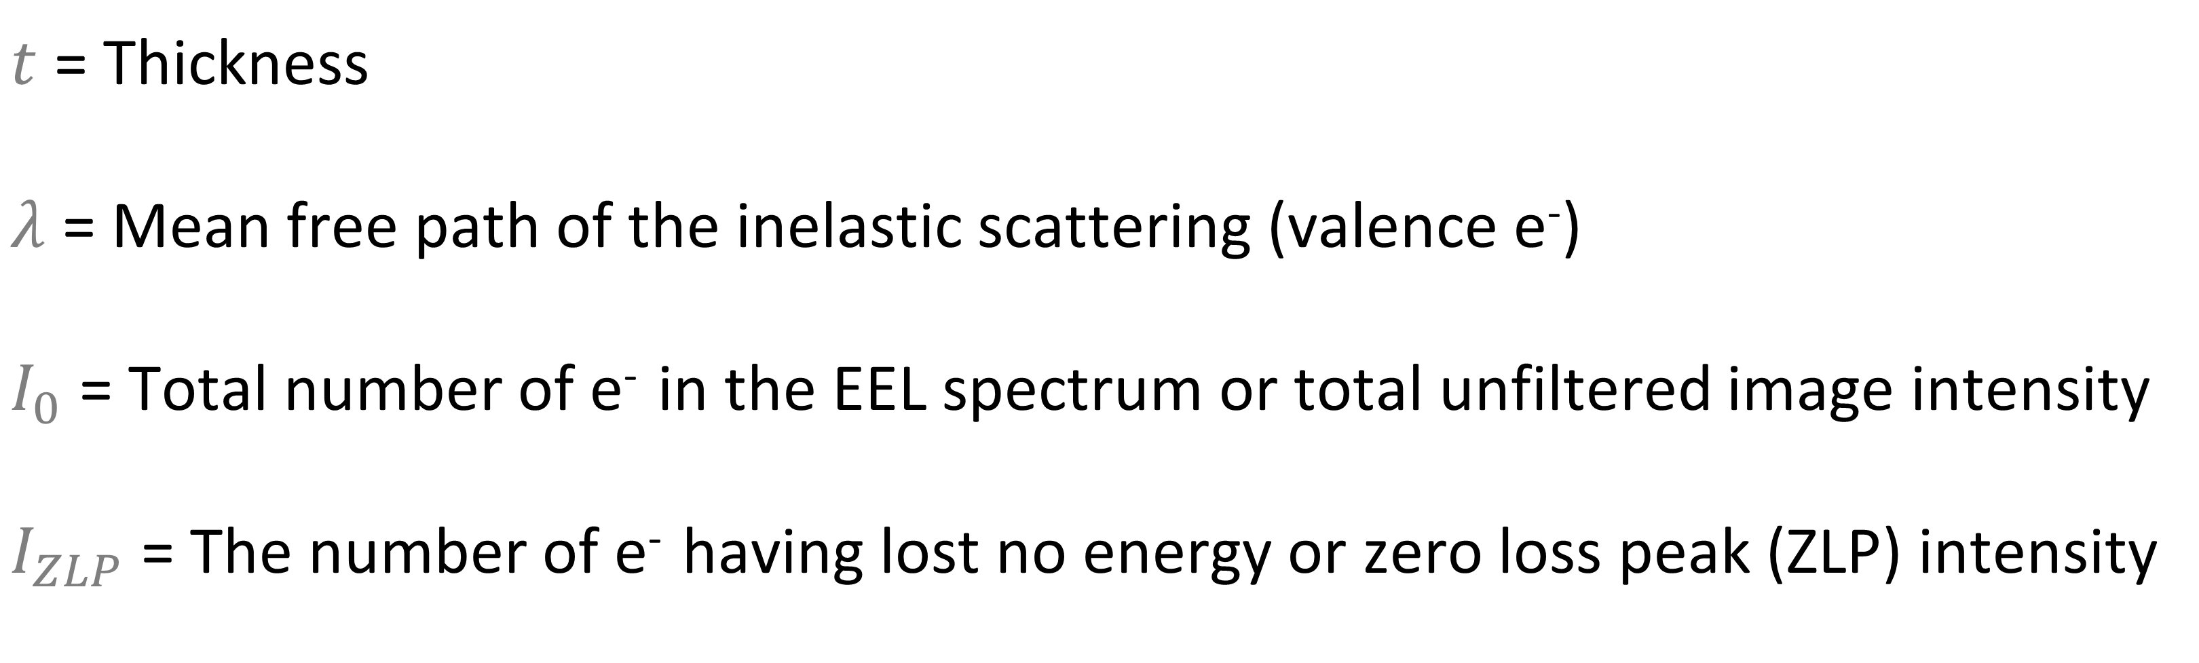
EELS for Thickness Evaluation
Specimen thickness – Zero-loss peak (ZLP) and total spectrum intensity
https://eels.info/about/overview
Log-ratio formula
$$t= λ ln⁡(\frac{I_{0}}{I_{ZLP}})$$
$t$ = Thickness
$λ$ = Mean free path of the inelastic scattering (valence e⁻)
$I_{0}$ = Total number of e⁻ in the EEL spectrum or total unfiltered image intensity
$I_{ZLP}$ = The number of e⁻ having lost no energy or zero loss peak (ZLP) intensity
Alice Moros – SMP Seminar, 11th November 2021

Slide 18
Elemental composition: EELS vs EDX
Complementary techniques:
- EELS sensitive to lighter elements → excitation edges sharp, experimentally accessible energy losses (signal very weak beyond about 3 keV energy loss)
- EDX sensitive to heavier elements
EELS able to “fingerprint” different forms of the same element
Different energy resolution:
- ~1 eV or better for EELS
- Few tens of eV for EDX
EDX easier to use
EELS Mapping on (APC) Nb₃Sn for measuring atomic composition?
Alice Moros – SMP Seminar, 11th November 2021

Slide 19
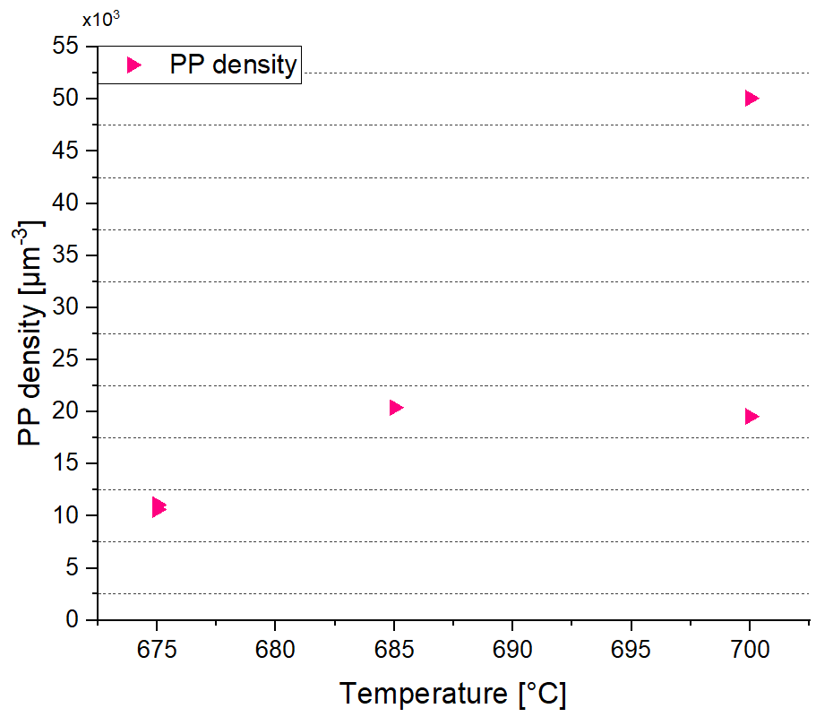
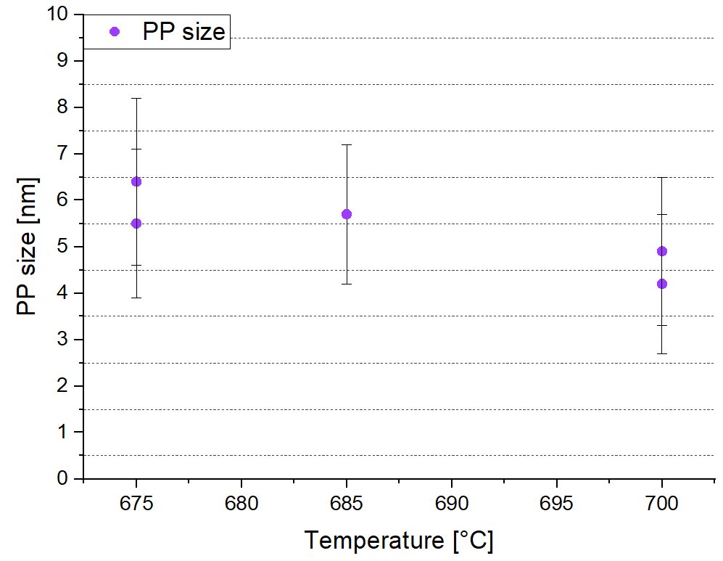
PS & PD – First Results
120 h
HfO₂
ZrO₂
380 h
317 h
HfO₂
228 h
HfO₂
HfO₂
120 h
228 h
71 h
ZrO₂
71 h
HfO₂
ZrO₂
HfO₂
317 h
ZrO₂
380 h
No direct relationship yet between PP size + density and heat treatment parameters
Alice Moros – SMP Seminar, 11th November 2021

Slide 20
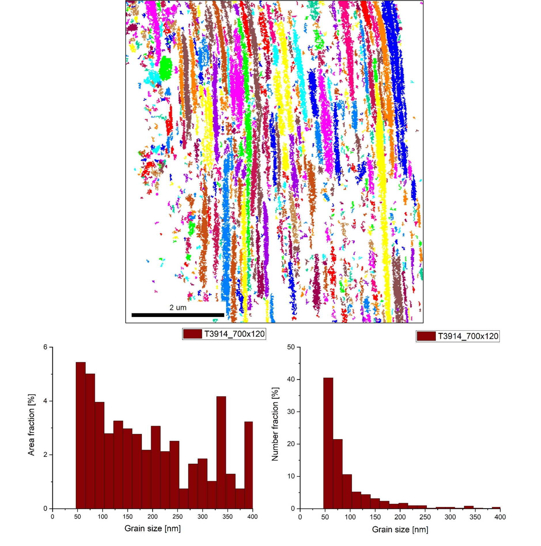
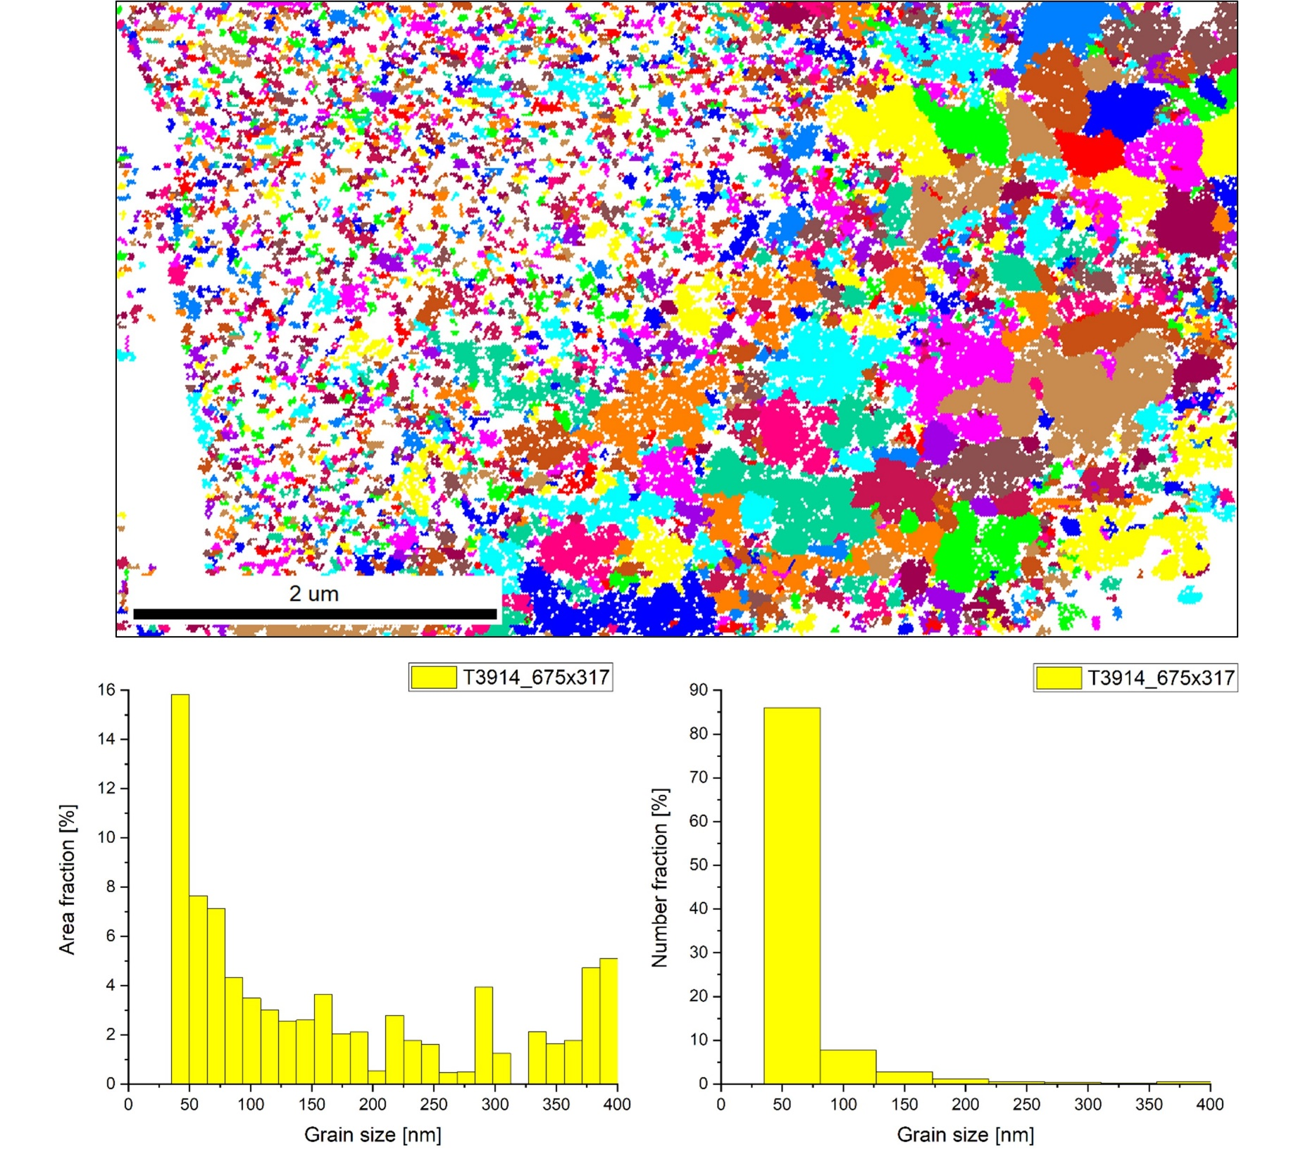
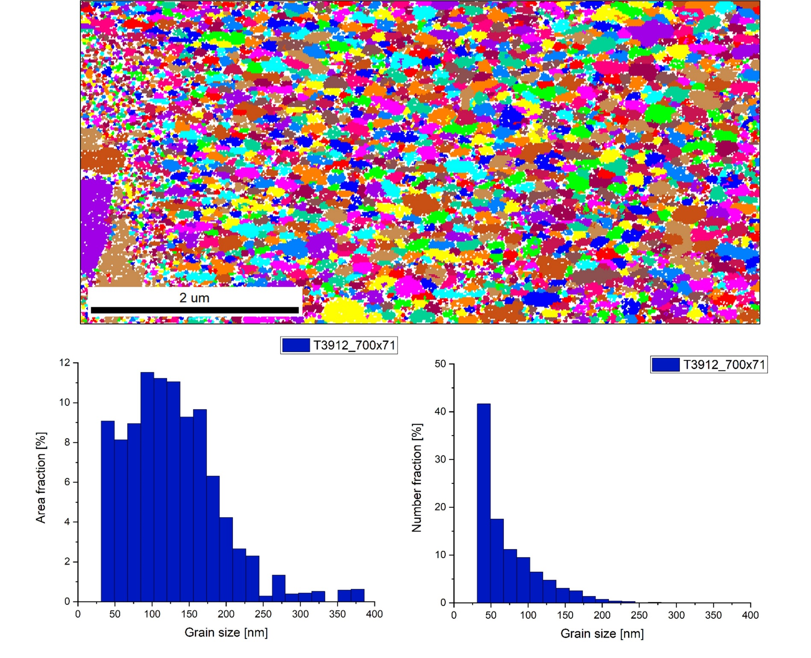
And What About GS Evaluation?
SEM Transmission Kikutchi Diffraction (TKD) or EBSD in transmission mode
T3914-700 x 120 HfO₂
T3912-700 x 71 ZrO₂
T3914-675 x 317 HfO₂
Alice Moros – SMP Seminar, 11th November 2021

Slide 21
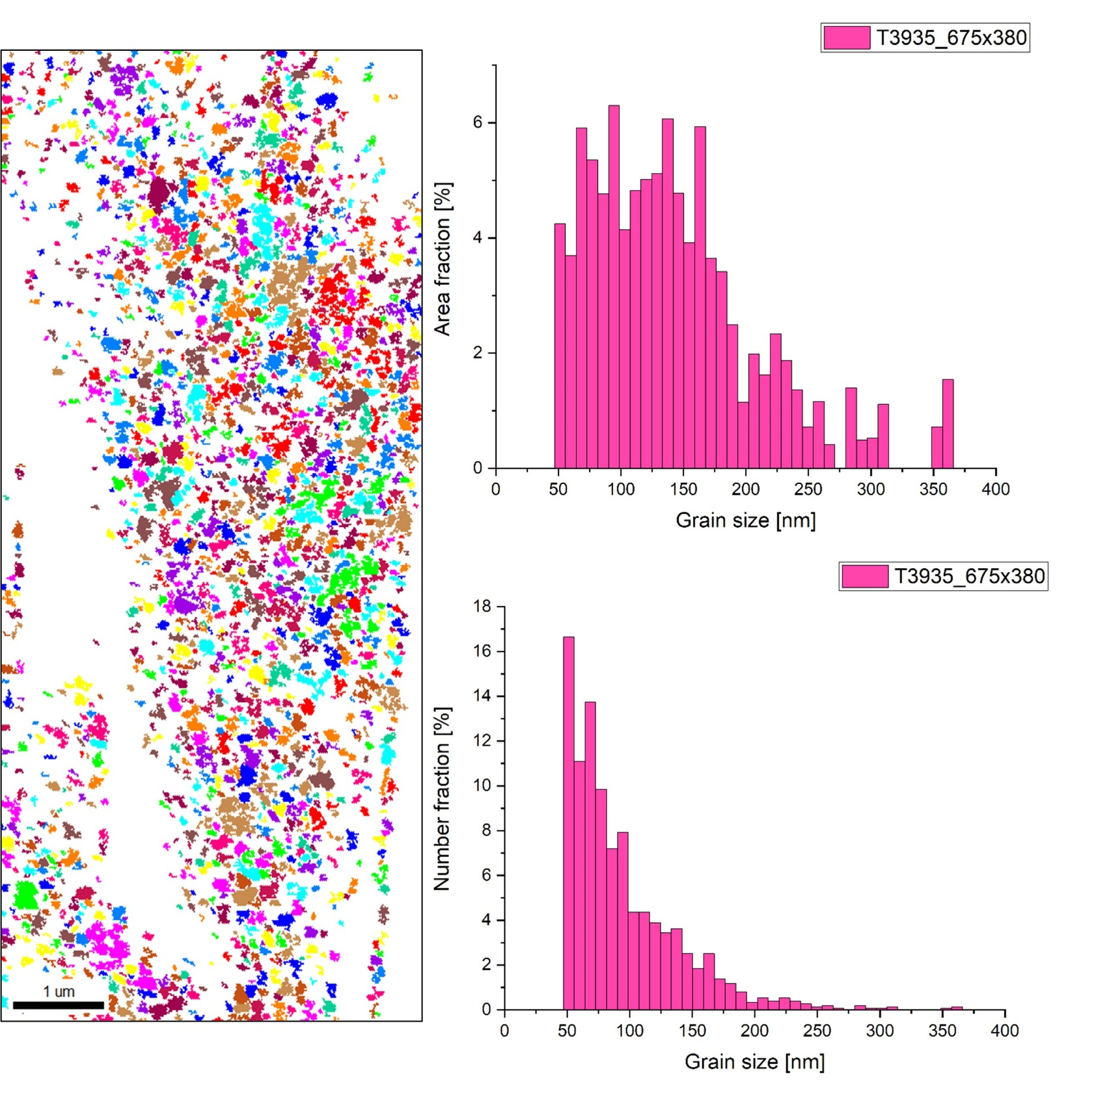
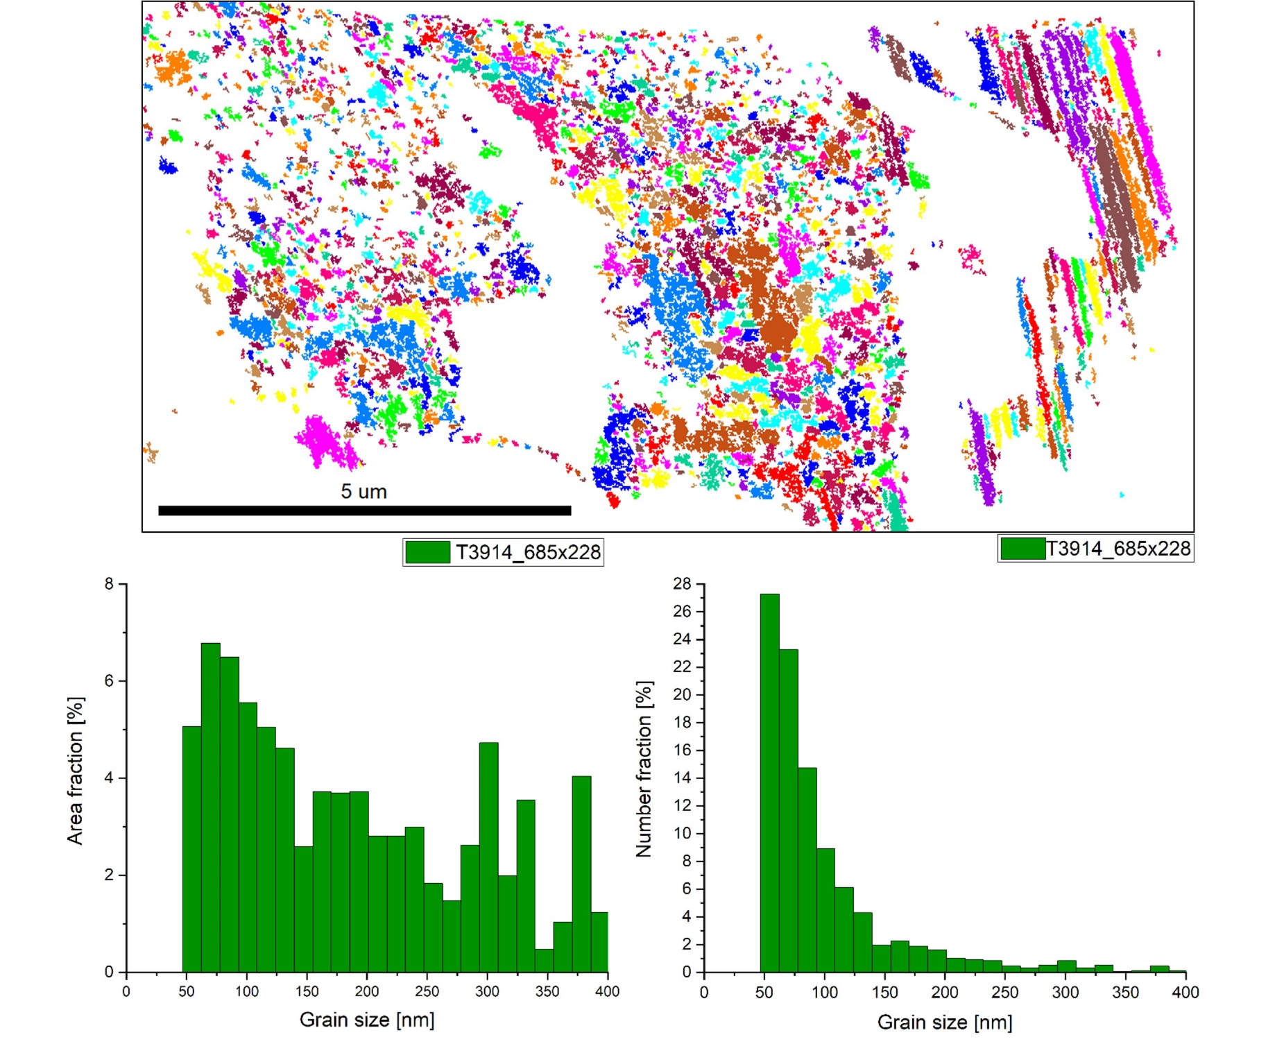
GS Evaluation: SEM-TKD Analysis
T3935-675 x 380 HfO₂
T3914-685 x 228 HfO₂
Wire recipe | T3935-675 x 380 | T3914-685 x 228 | T3912-700 x 71 | T3914-675 x 317 | T3914-700 x 120
NA [mm] | 96 ± 46 | 102 ± 76 | 73 ± 44 | 64 ± 53 | 111 ± 106
Modal value [nm] | 50 ± 5 | 55 ± 10 | 40 ± 10 | 60 ± 20 | 55 ± 10
Alice Moros – SMP Seminar, 11th November 2021

Slide 22
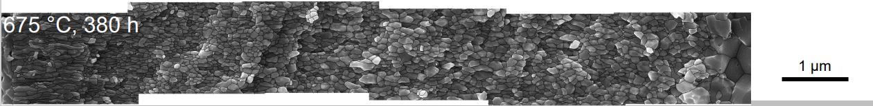

GS Evaluation: SEM-TKD Analysis
Wire recipe | T3935-675 x 380 | T3914-685 x 228 | T3912-700 x 71 | T3914-675 x 317 | T3914-700 x 120
NA [mm] | 96 ± 46 | 102 ± 76 | 73 ± 44 | 64 ± 53 | 111 ± 106
Modal value [nm] | 50 ± 5 | 55 ± 10 | 40 ± 10 | 60 ± 20 | 55 ± 10
Not possible to choose a precise location for GS mapping → sometimes signal is coming from very small portions
Sample preparation method and thickness uniformity
Lamella areas with unallocated points
Other techniques besides SEM-TKD?
- Fracture a wire, image the surface
Courtesy of J. Rochester, The Ohio State University
Alice Moros – SMP Seminar, 11th November 2021

Slide 23
Microscopy Investigation on APC - Summary
14 samples received at TU Wien: 5 analyzed in terms of PS & PD, 9 almost completed
No direct relationship between PP size + density and heat treatment parameters so far:
Looking into completing PS & PD data with the most recently arrived samples!
SEM-TKD measurements for GS evaluation on the first 5 samples produced unreliable results: analyses still ongoing for most of the samples → how PP type and HT impact on grain refinement
Alice Moros – SMP Seminar, 11th November 2021

Slide 24
Towards Further Exploration of APC Wires
What’s behind that PD gap?
Smarter PP counting methods
PS and PD evolution at different stages for different HTs
Comparing Zr and Hf samples with same HT → changes in PD and PS
PP analysis through wire length
GS evaluation: comparison between SEM-TKD and fracture a wire
Evaluation of Sn concentration gradient according to PP type and HT performed
Other techniques besides TEM?
Small Angle Neutron Scattering (SANS)
Small Angle X-ray Scattering (SAXS)
Research is needed!
Atom Probe Tomography (ATP)
Alice Moros – SMP Seminar, 11th November 2021

Slide 25
Thank you for your attention!
What’s behind that PD gap?
Smarter PP counting methods
PS and PD evolution at different stages for different HTs
Comparing Zr and Hf samples with same HT → changes in PD and PS
PP analysis through wire length
GS evaluation: comparison between SEM-TKD and fracture a wire
Evaluation of Sn concentration gradient according to PP type and HT performed
Other techniques besides TEM?
Small Angle Neutron Scattering (SANS)
Small Angle X-ray Scattering (SAXS)
Research is needed!
Atom Probe Tomography (ATP)
Alice Moros – SMP Seminar, 11th November 2021

