Slide 1
Tutorial on Applied Superconductors
Ian Pong (ipong@lbl.gov)
2021 08 31

Slide 2
Applied Superconductors
What is superconductivity?
Where can we find superconductors?
When was superconductivity discovered?
Relationship with magnetism
How superconductors are made
Who needs superconducting magnets?
Myth busters

Slide 3
What is superconductivity?
Superconductivity is a state of matter
Its existence depends on
  Temperature*
  Current density*
  Magnetic field*
  Pressure
  Composition
An interdisciplinary subject

Slide 4
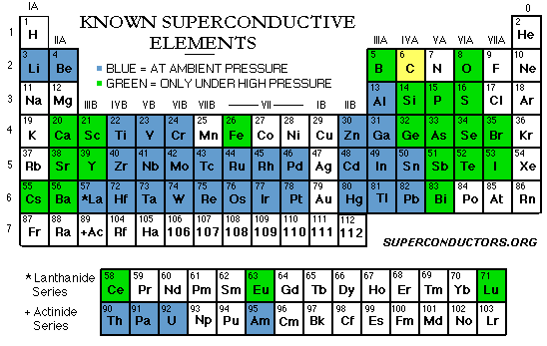
Where can we find superconductors?

Slide 5
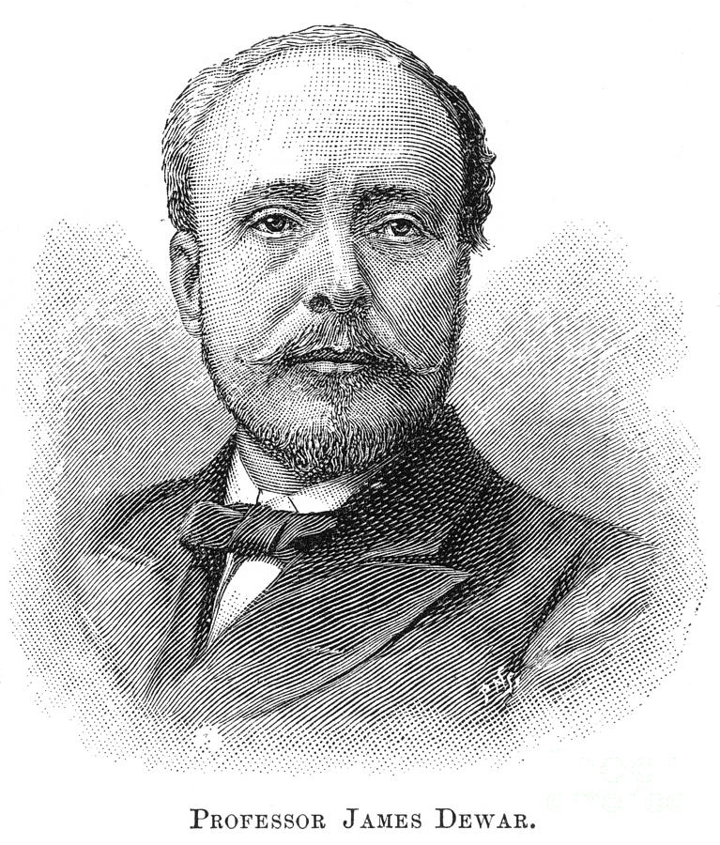
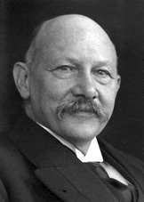
When was superconductivity discovered?
Heike Kamerlingh Onnes
http://images.fineartamerica.com/images-medium-large/sir-james-dewar-1842-1923-granger.jpg
http://www.nobelprize.org/nobel_prizes/physics/laureates/1913/onnes-bio.html

Slide 6
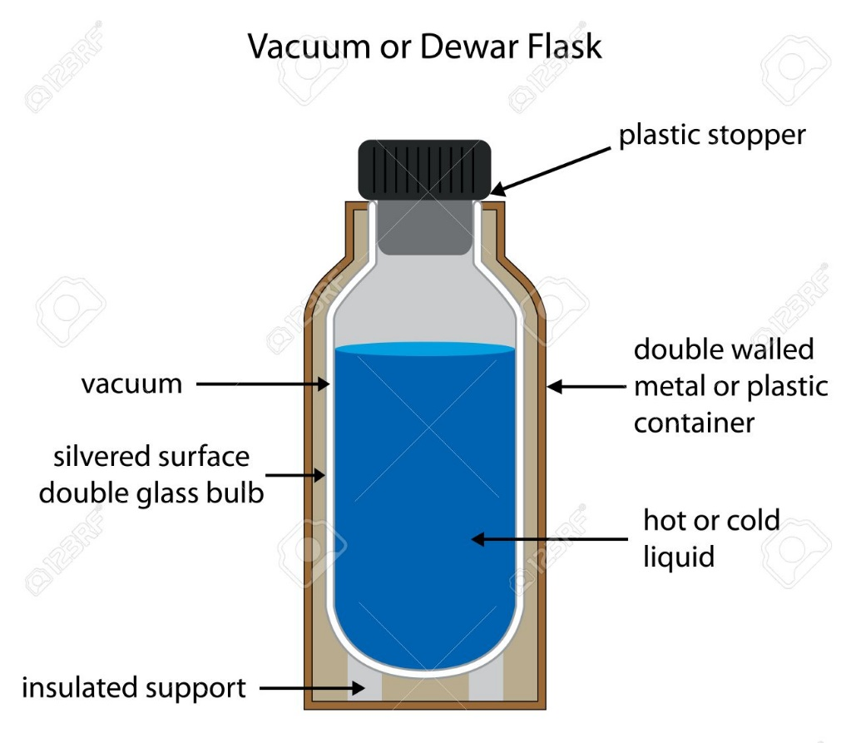
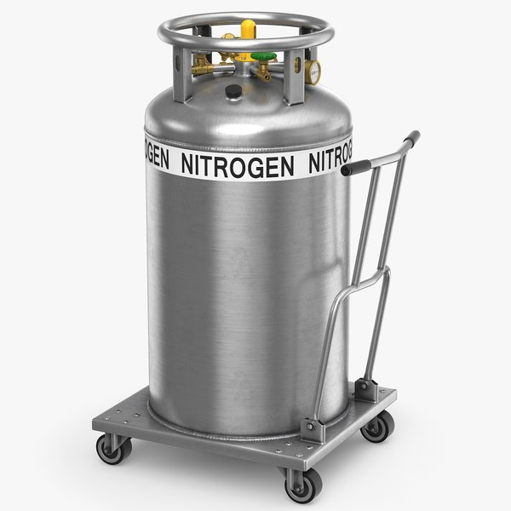
Heat Transfer
Conduction
Convection
Radiation

Slide 7
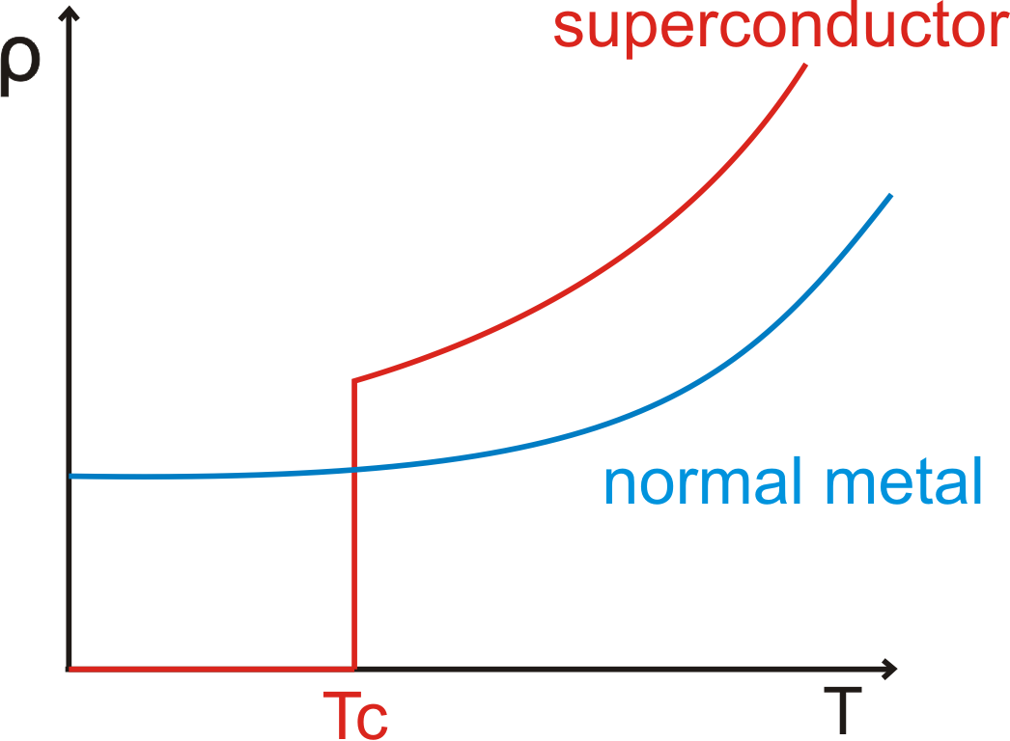
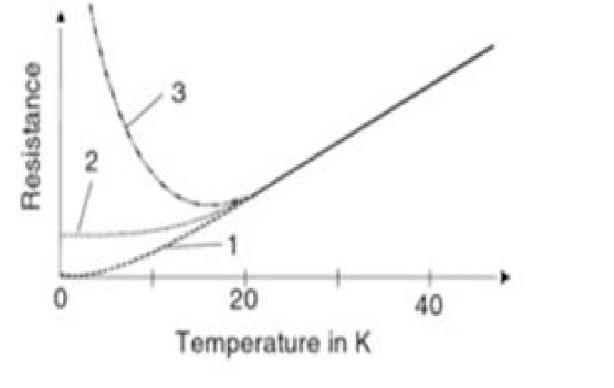
Superconductivity and Magnetism
Superconductivity was discovered because of low temperature physics
Its most important application to-date is realized in superconducting magnets, not power transmission
  MRI for medical use, NMR for biochemical research
  Accelerators and detectors for particle physics
  Plasma confinement for fusion energy
And a lot of other interesting things… (maglev demo)

Slide 8
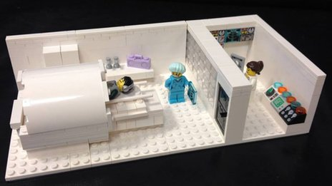
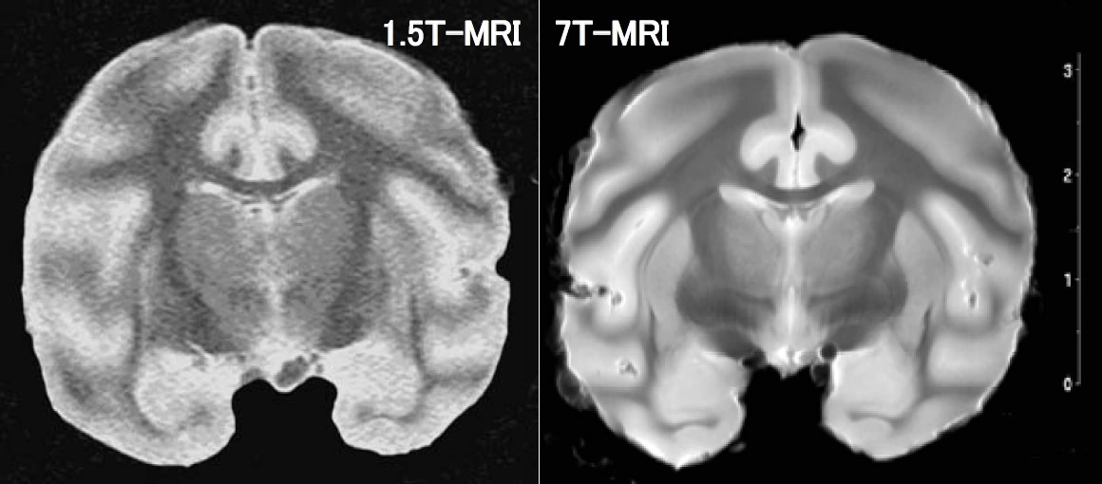
Superconducting MRI
http://bungelab.berkeley.edu/wp-content/uploads/2014/03/Lego-MRI-Image.jpg
H. Wada et al., IEEE Trans. Appl. Supercond. 20 115 (2010)

Slide 9
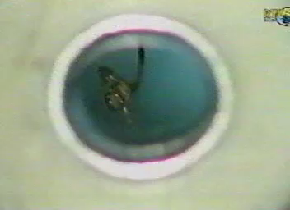
https://www.youtube.com/watch?v=A1vyB-O5i6E

Slide 10
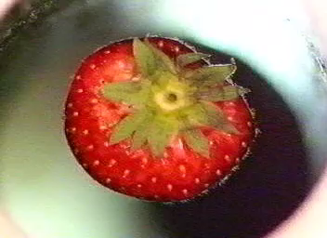
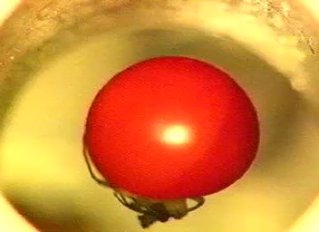
http://www.ru.nl/hfml/research/levitation/diamagnetic/

Slide 11
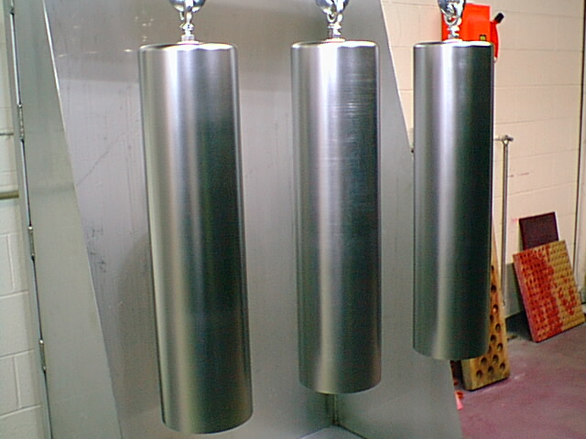
How NbTi strands are made
Images from P. Lee’s University of Wisconsin lecture slides on NbTi (2000/01)
Notes:
Monofilament billets, Ni or Nb wrapped, Cu-can, EB weld, hot extrusion, draw down.

Slide 12
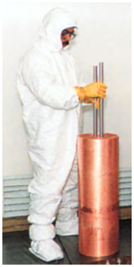
How NbTi strands are made
Images from P. Lee’s University of Wisconsin lecture slides on NbTi (2000/01)

Slide 13
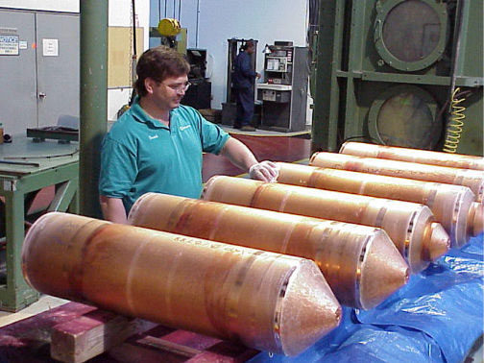
How NbTi strands are made
Image from Encyclopaedia of Materials: Science and Technology, Elsevier 2003
Notes:
Billet assembly, vacuum and EB weld, HIP, hot extrusion, bench draw, bull block drawn, HT, series draw, twisting, final draw

Slide 14
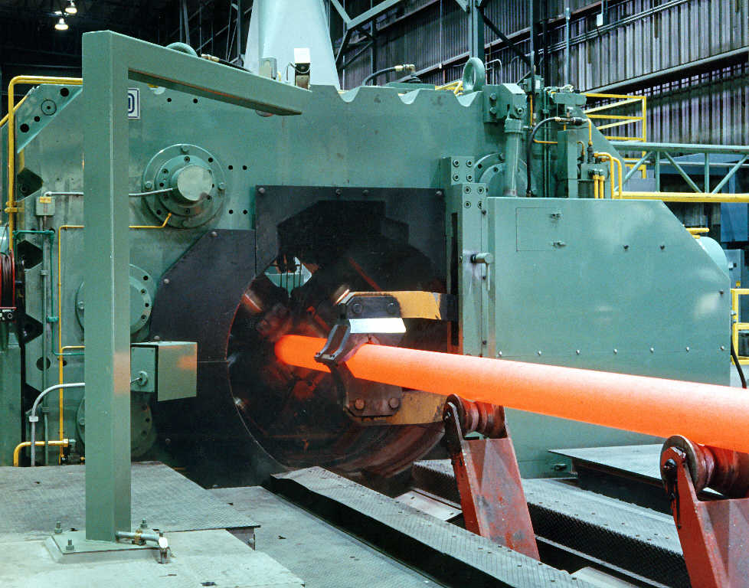
How NbTi strands are made
Image from P. Lee’s University of Wisconsin lecture slides on NbTi (2000/01)
Notes:
Billet assembly, vacuum and EB weld, HIP, hot extrusion, bench draw, bull block drawn, HT, series draw, twisting, final draw

Slide 15
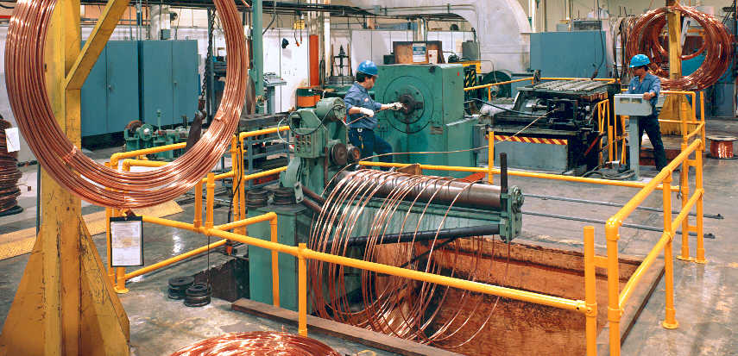
How NbTi strands are made
Image from P. Lee in Wire Journal International Feb. 2003
Notes:
Billet assembly, vacuum and EB weld, HIP, hot extrusion, bench draw, bull block drawn, HT, series draw, twisting, final draw

Slide 16
Rutherford Cabling
At CERN: https://www.youtube.com/watch?v=Uxg3ygONEwM

Slide 17
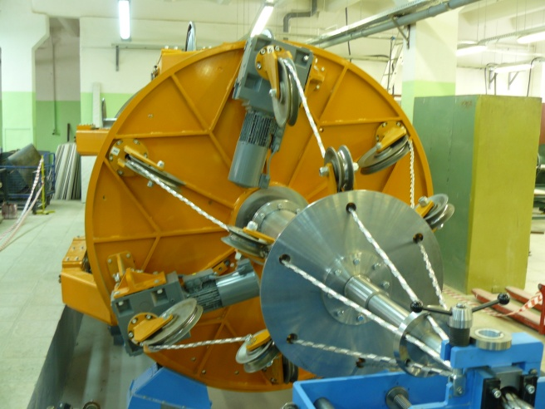
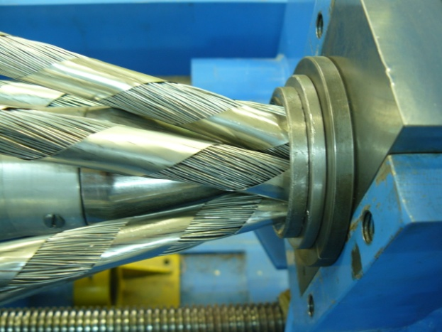
How Cable-in-Conduit-Conductors are made

Slide 18
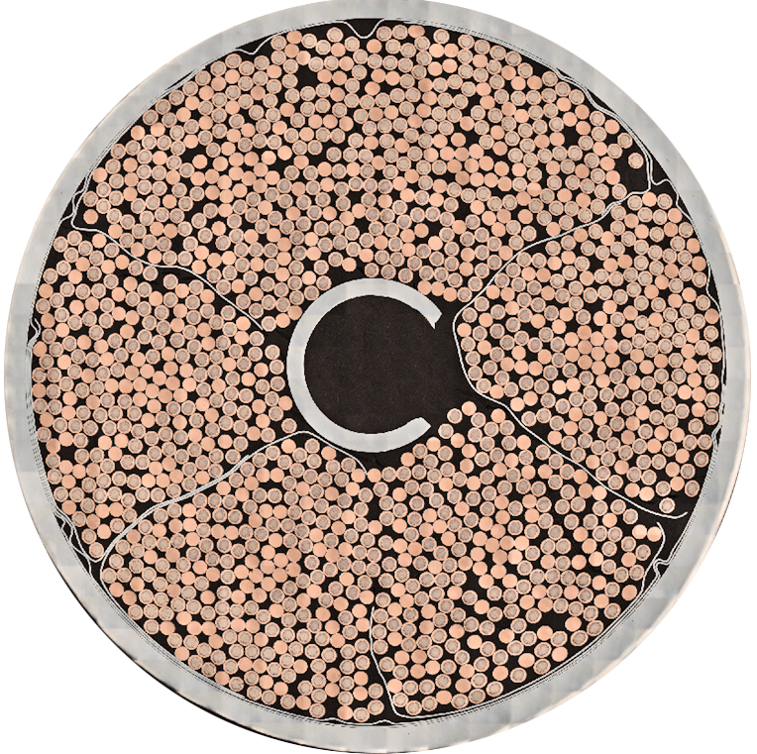
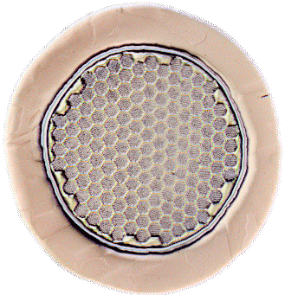

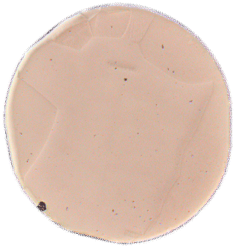

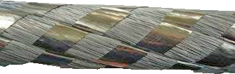



ITER CICC: Components
Stage 1 (inner triplet):
2x sc +1x Cu
Both sc and Cu strands used.
5 cable stages.
Stage 2: x3
Stage 3: x5
Stage 4 (petal): x5 around (3x4 Cu) core + stainless steel wrap
Stage 5: x6 around central cooling spiral + stainless steel wrap
Stainless steel wrap
Austenitic stainless steel
conduit tube
ITER TF Cable
Central Cooling Spiral
Peter J. Lee & Carlos Sanabria

Slide 19
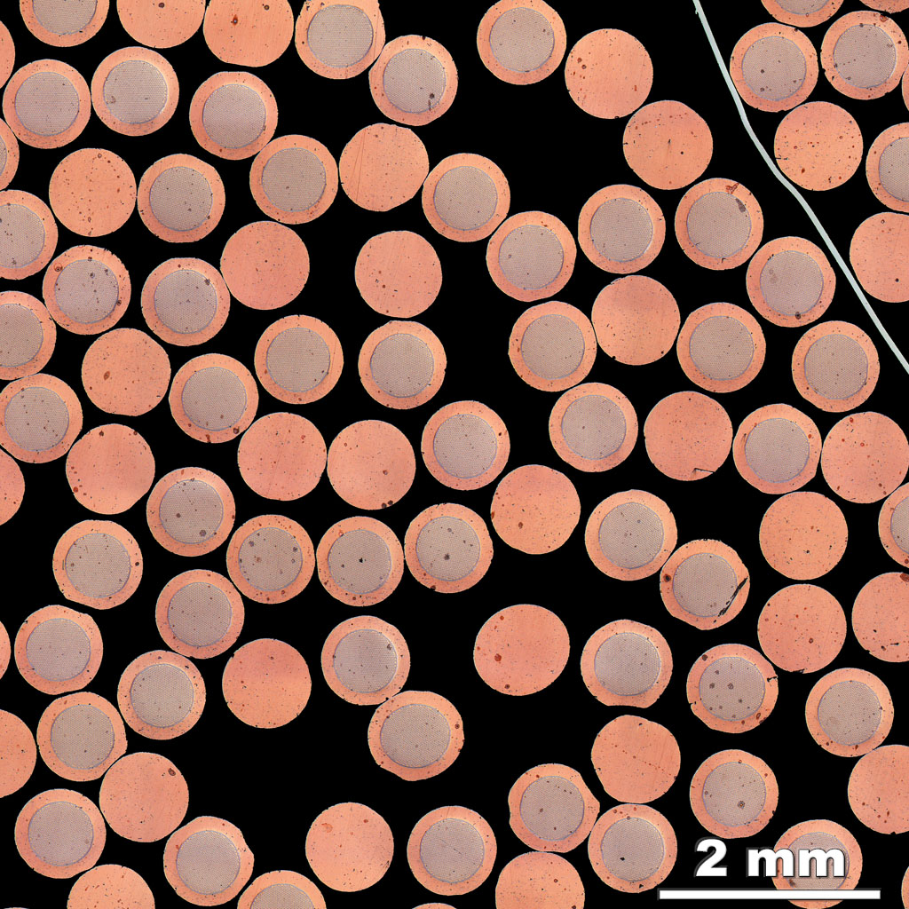
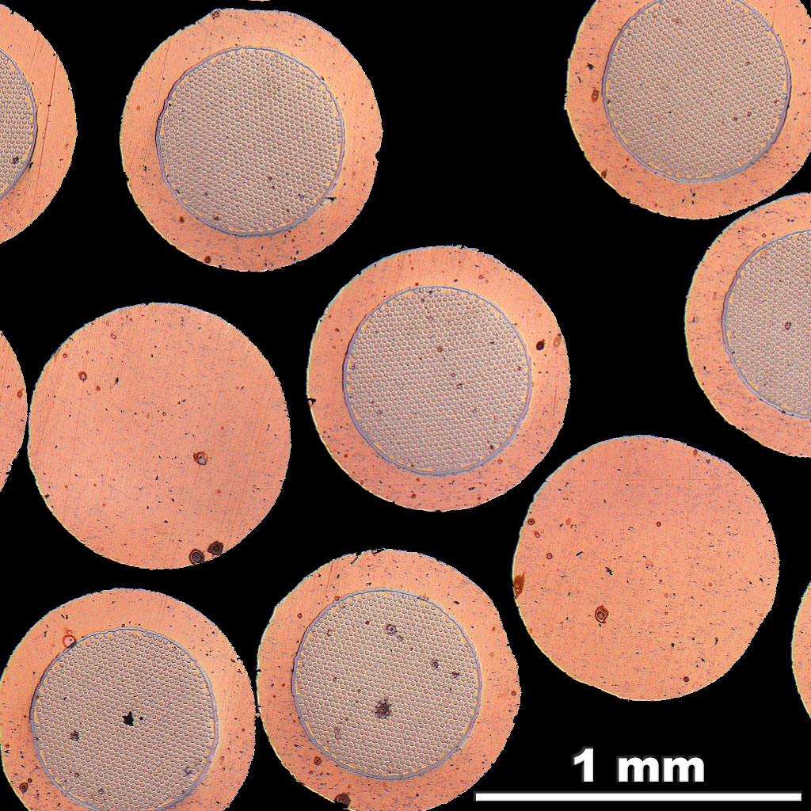
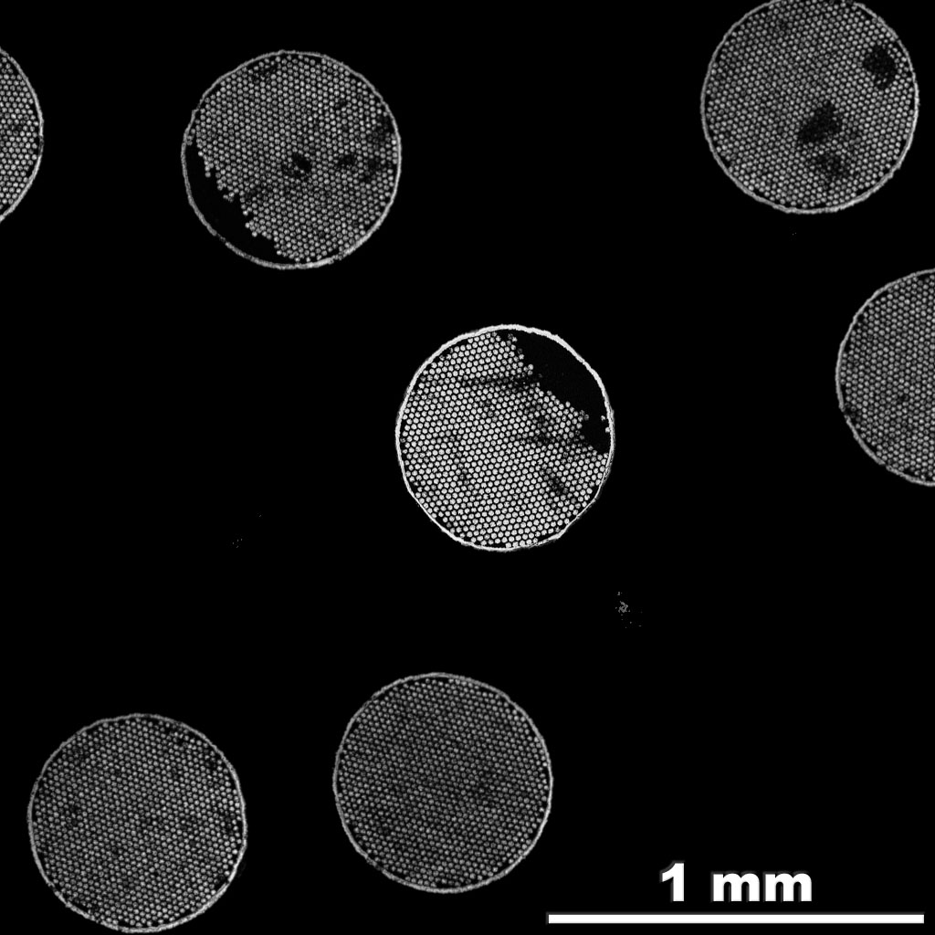
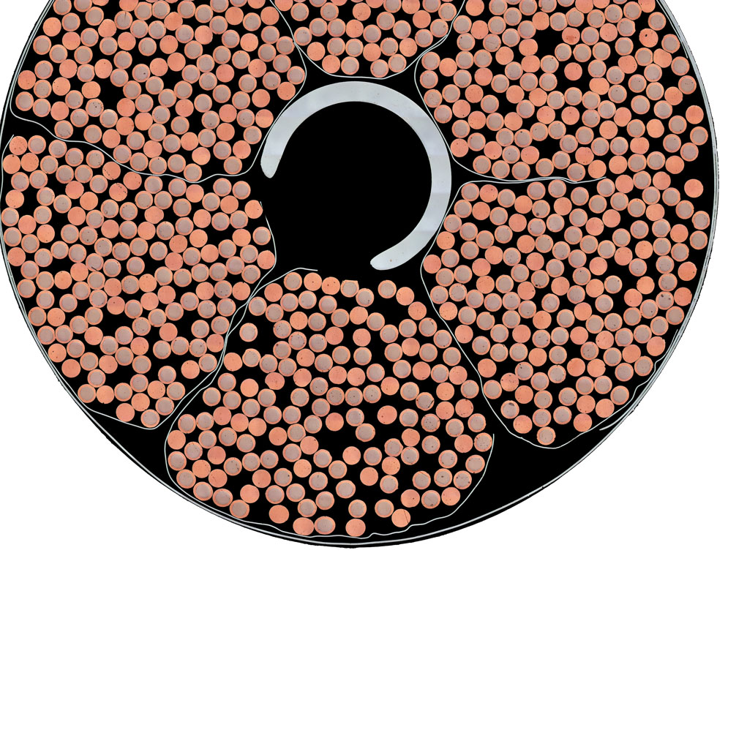
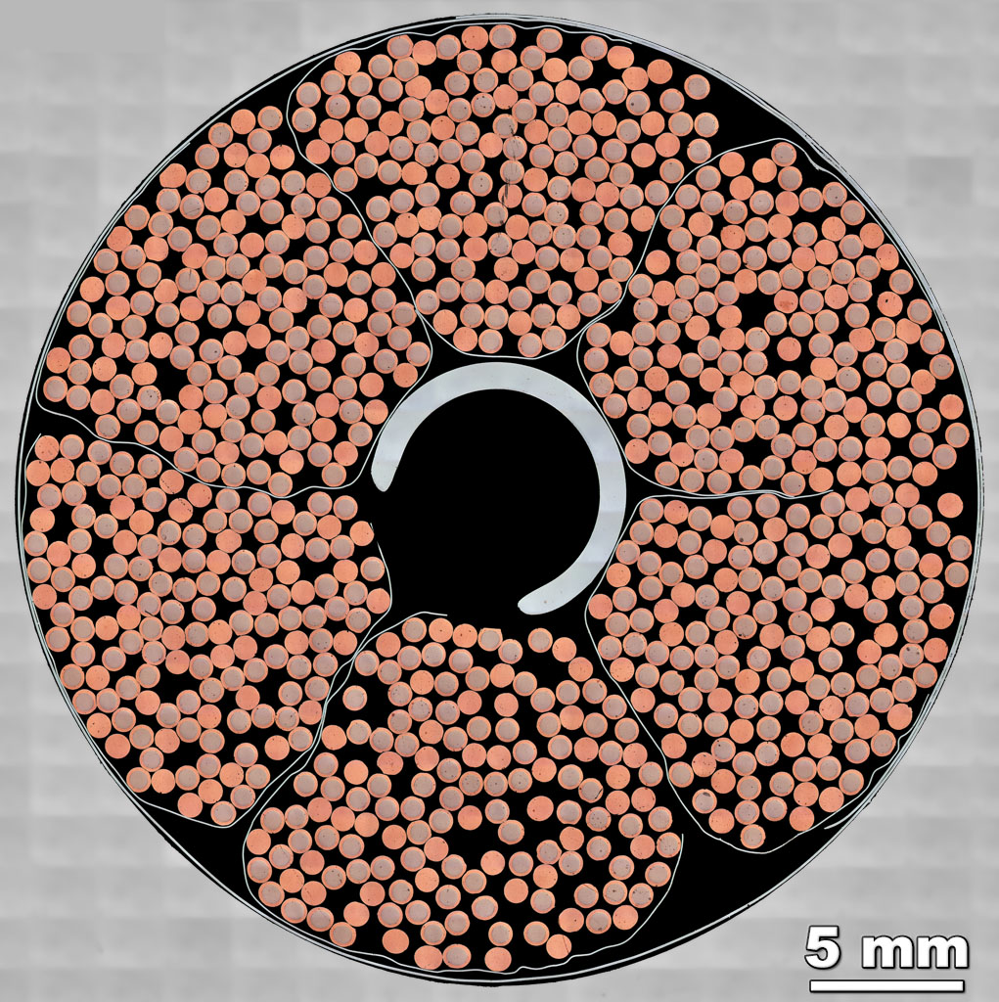
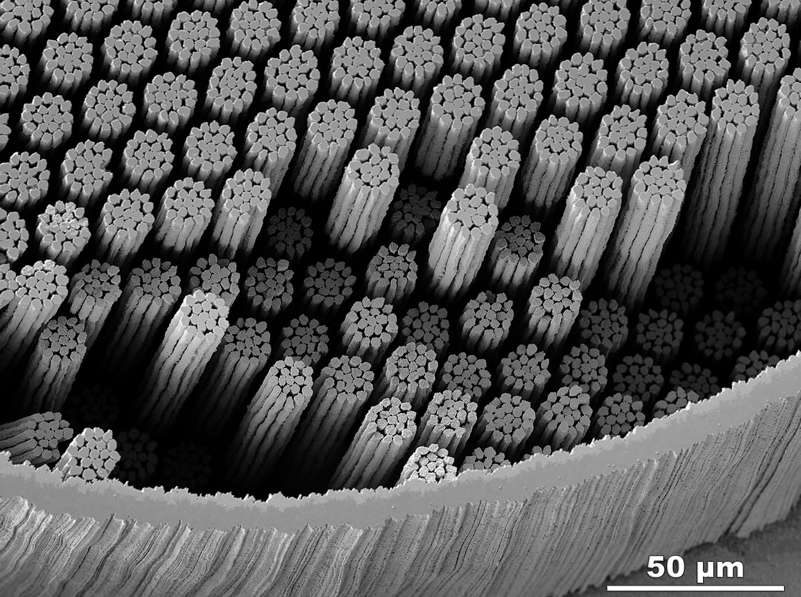
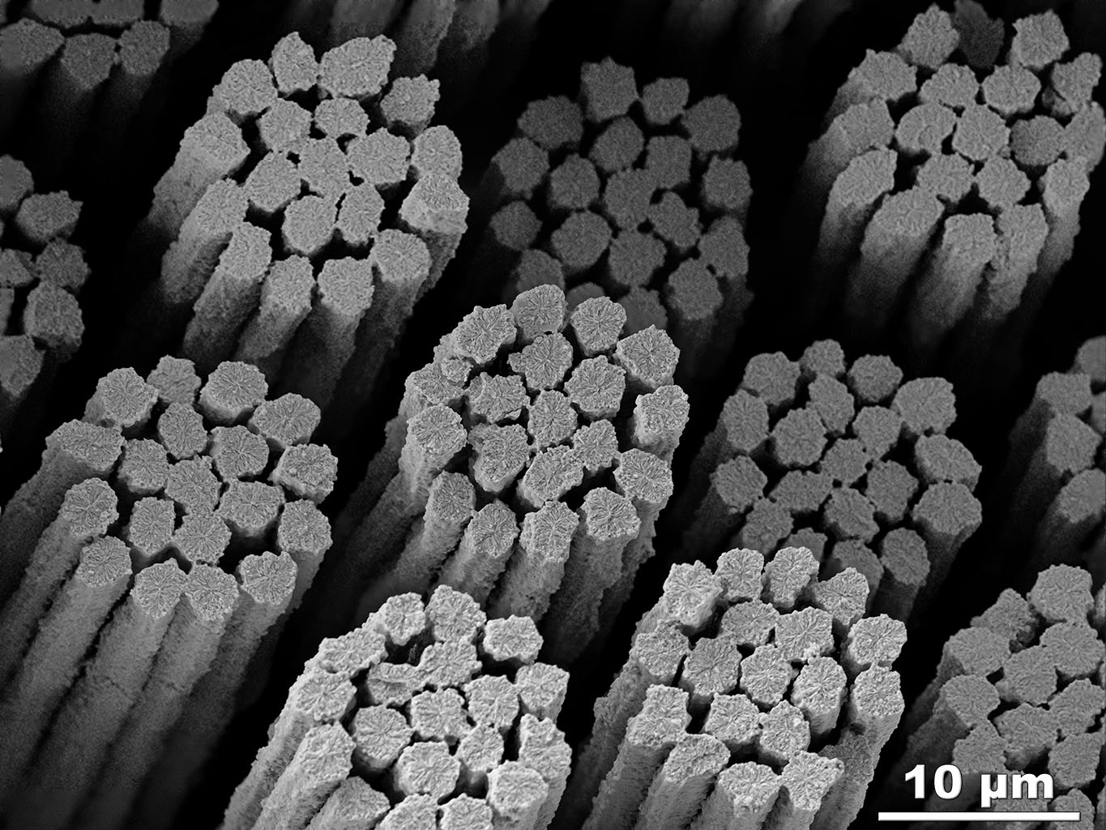
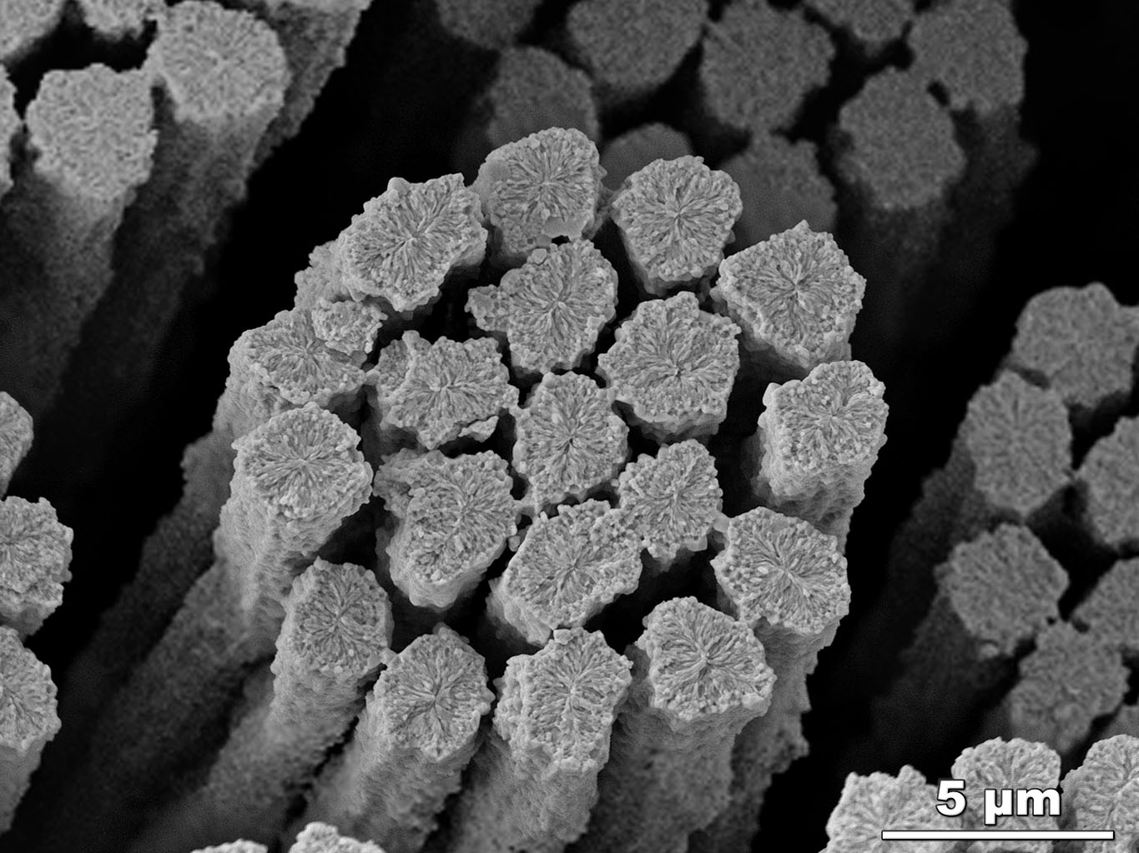
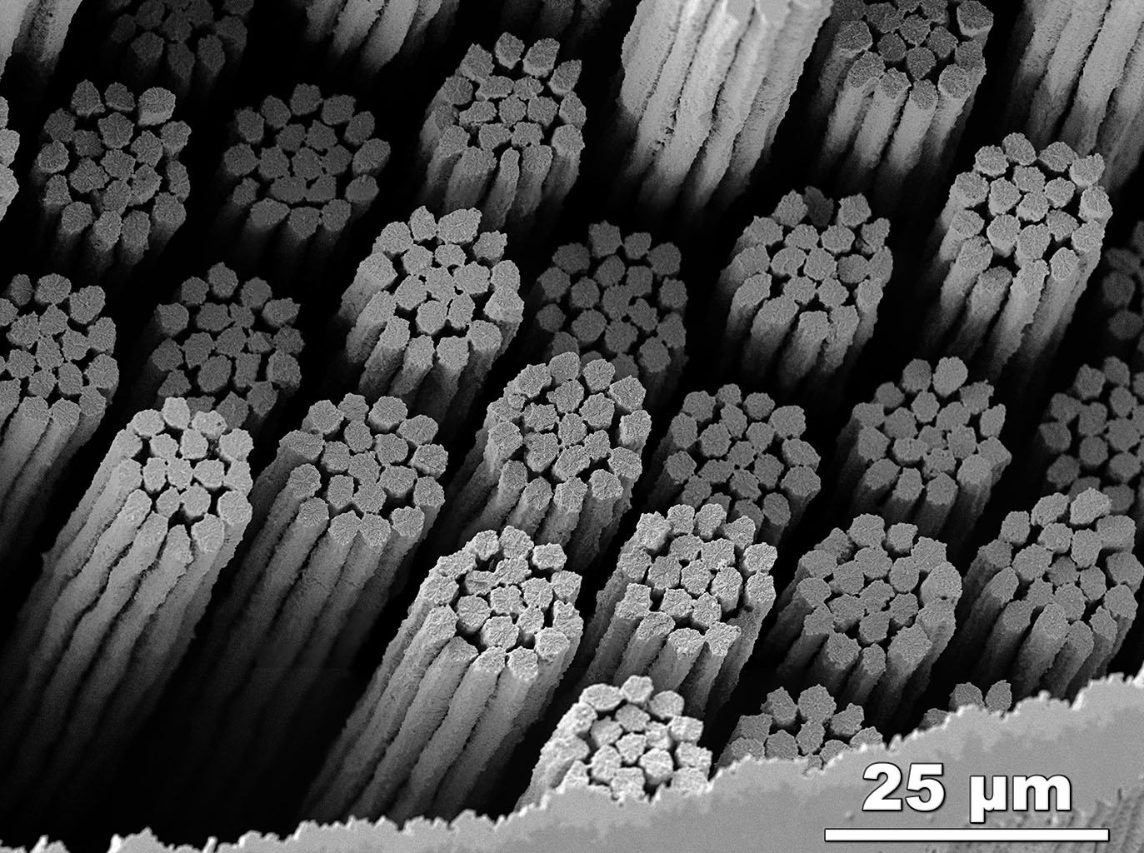
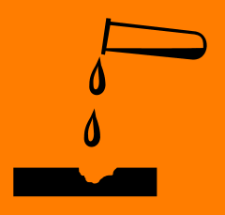


CSJA2
HFZ
The strands move in the direction of the Lorentz Force
Click for:
Extended Zoom into area with broken filaments
The Nb₃Sn fractures at the grain boundaries and thus we see the grain structure across the filaments.
Etching the Cu away allows broken filaments to fall out.
Filaments
fractured by strand bending
Opening up void space where strands can move more easily.
Lorentz Force
Peter J. Lee &
Carlos Sanabria
FESEM:
SE

Slide 20
Who needs superconducting magnets
Fusion devices such as ITER (see video)
Particle accelerators such as LHC at CERN (see video)

Slide 21
Myth Buster
High temperature superconductors
Why not for power transmission

Slide 22
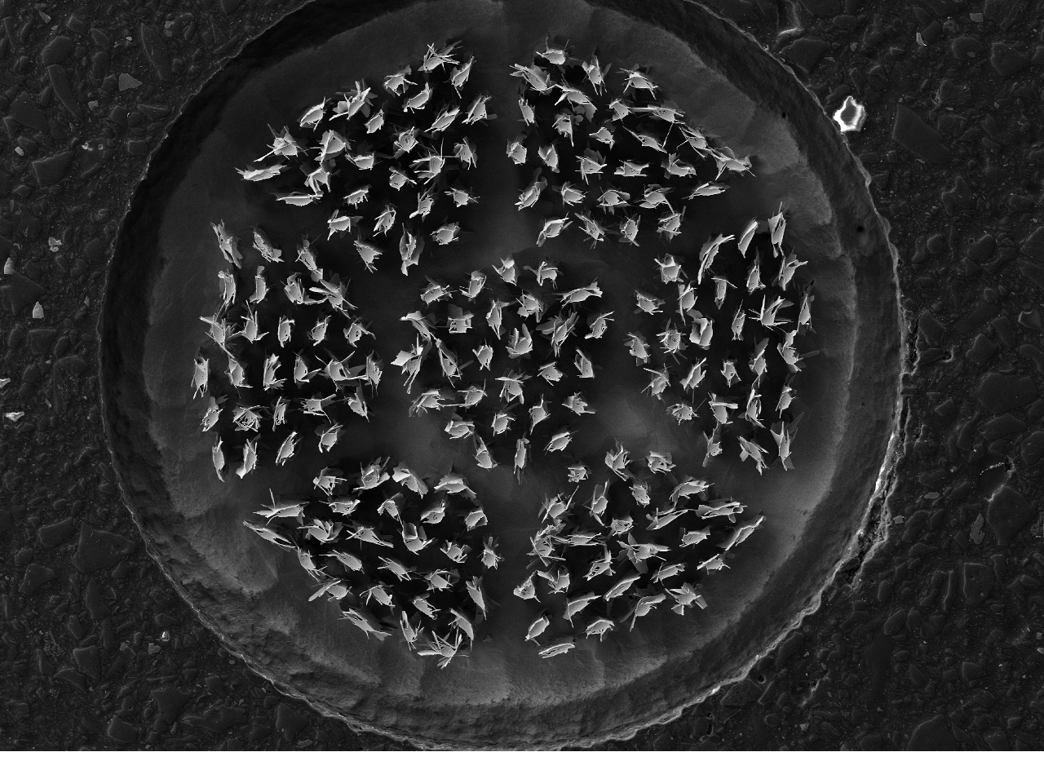
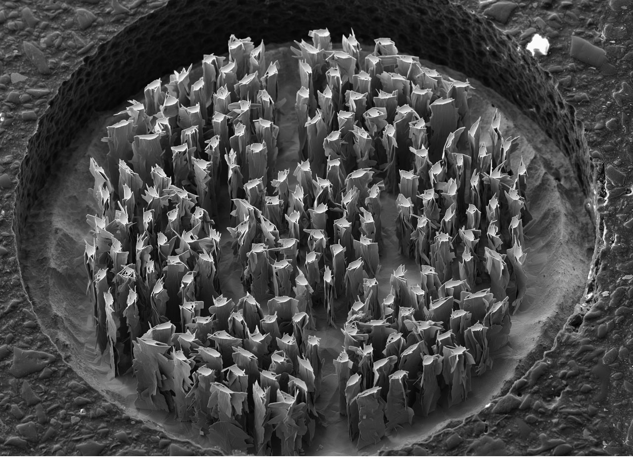
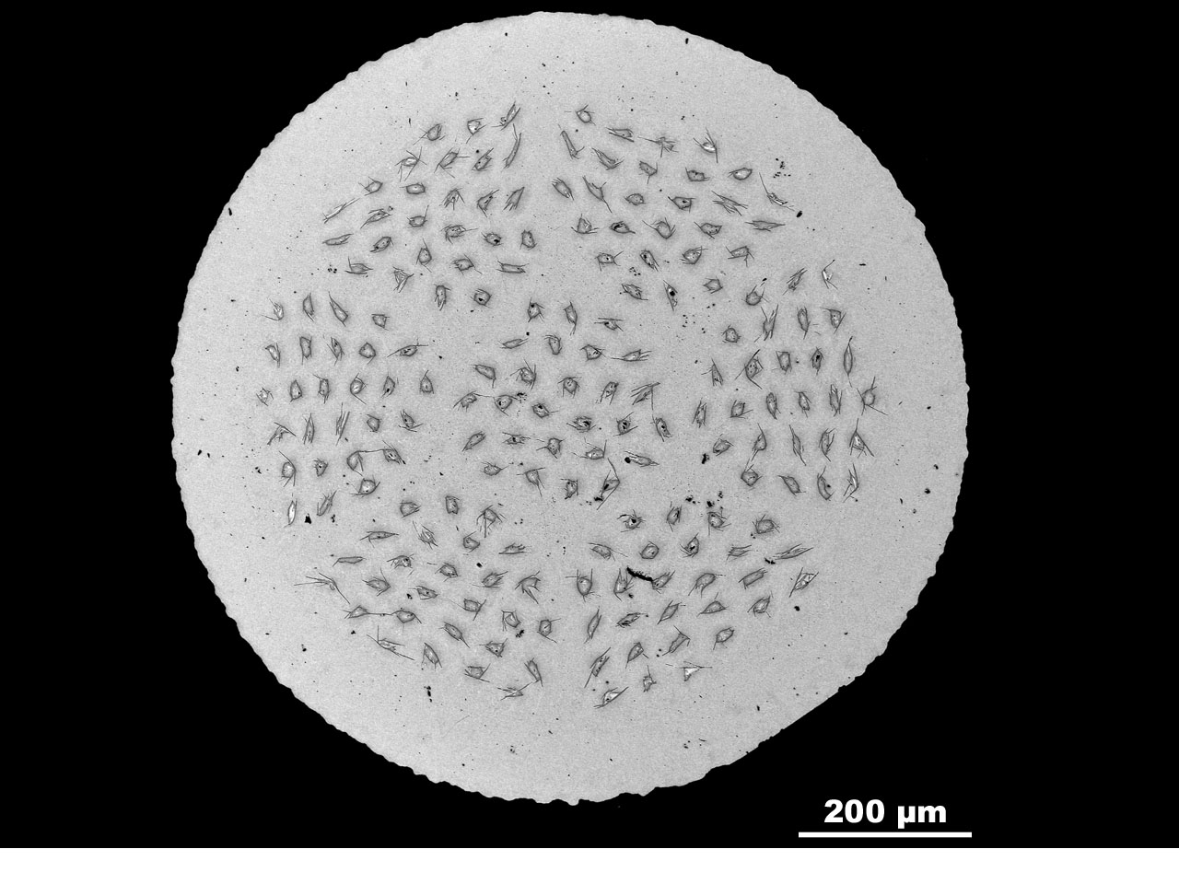
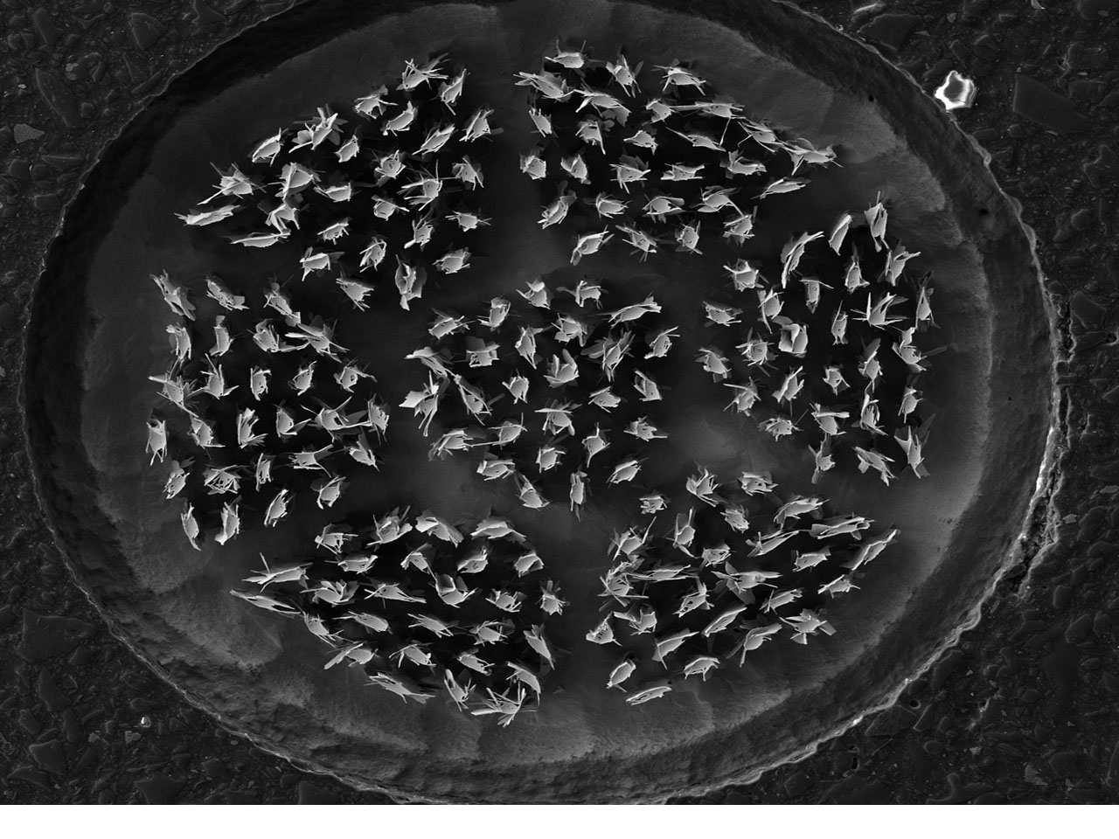
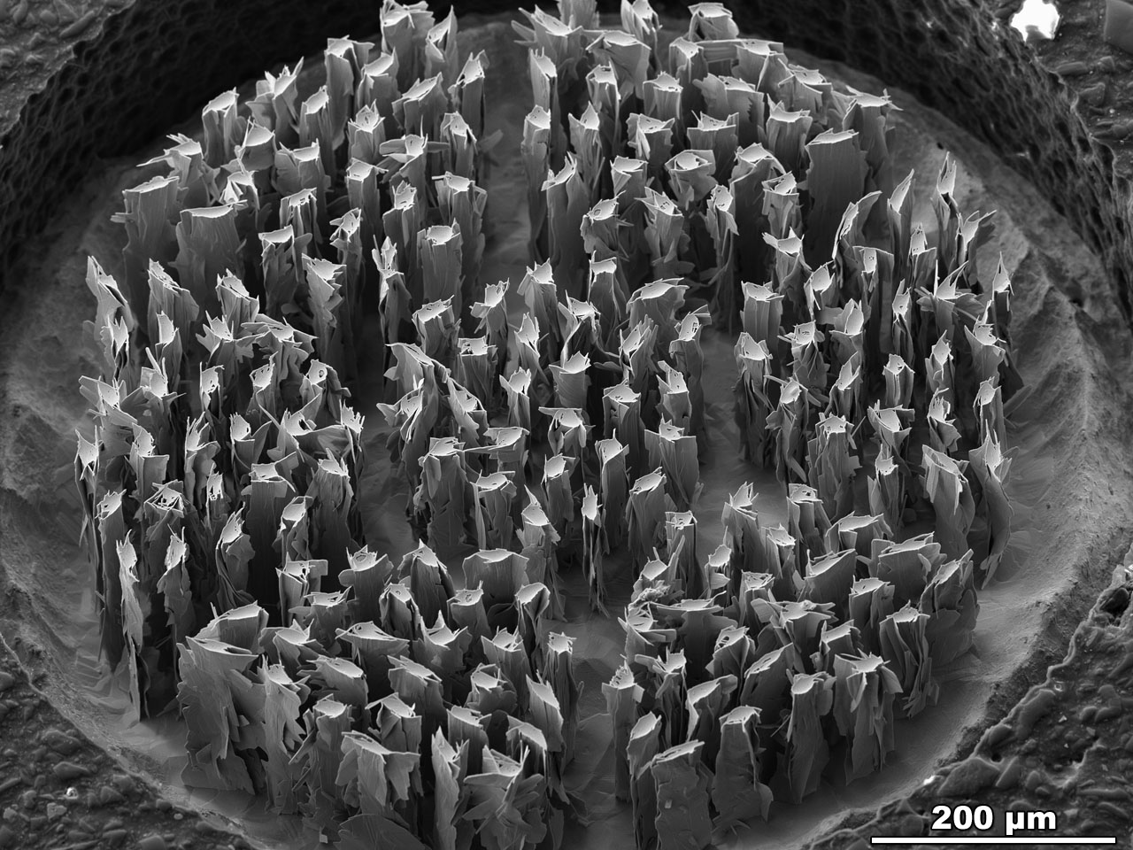
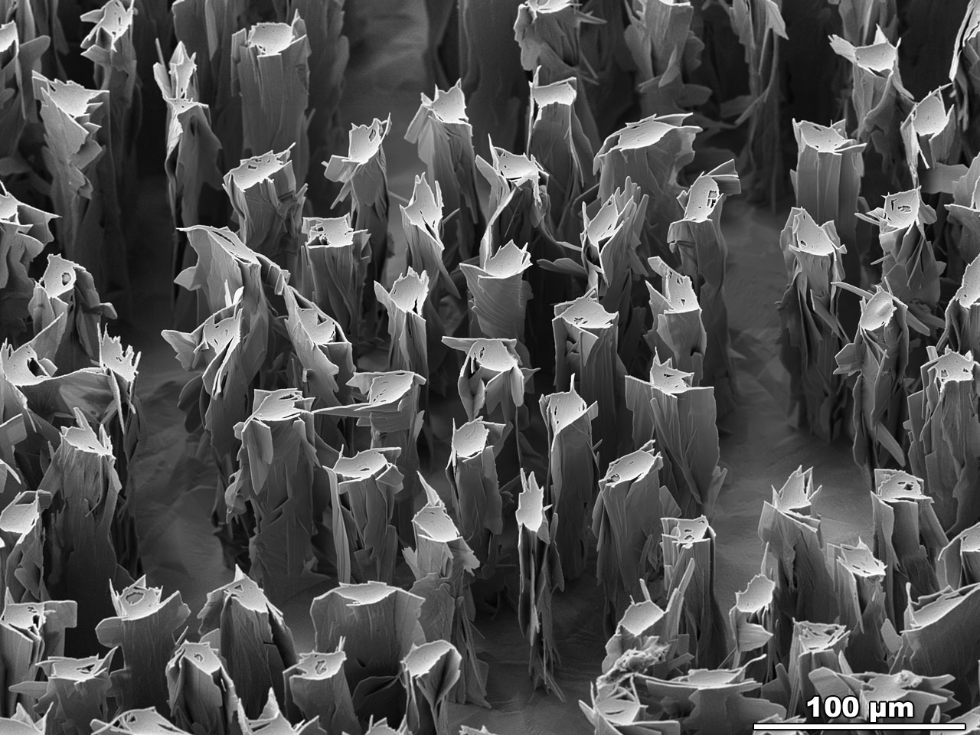
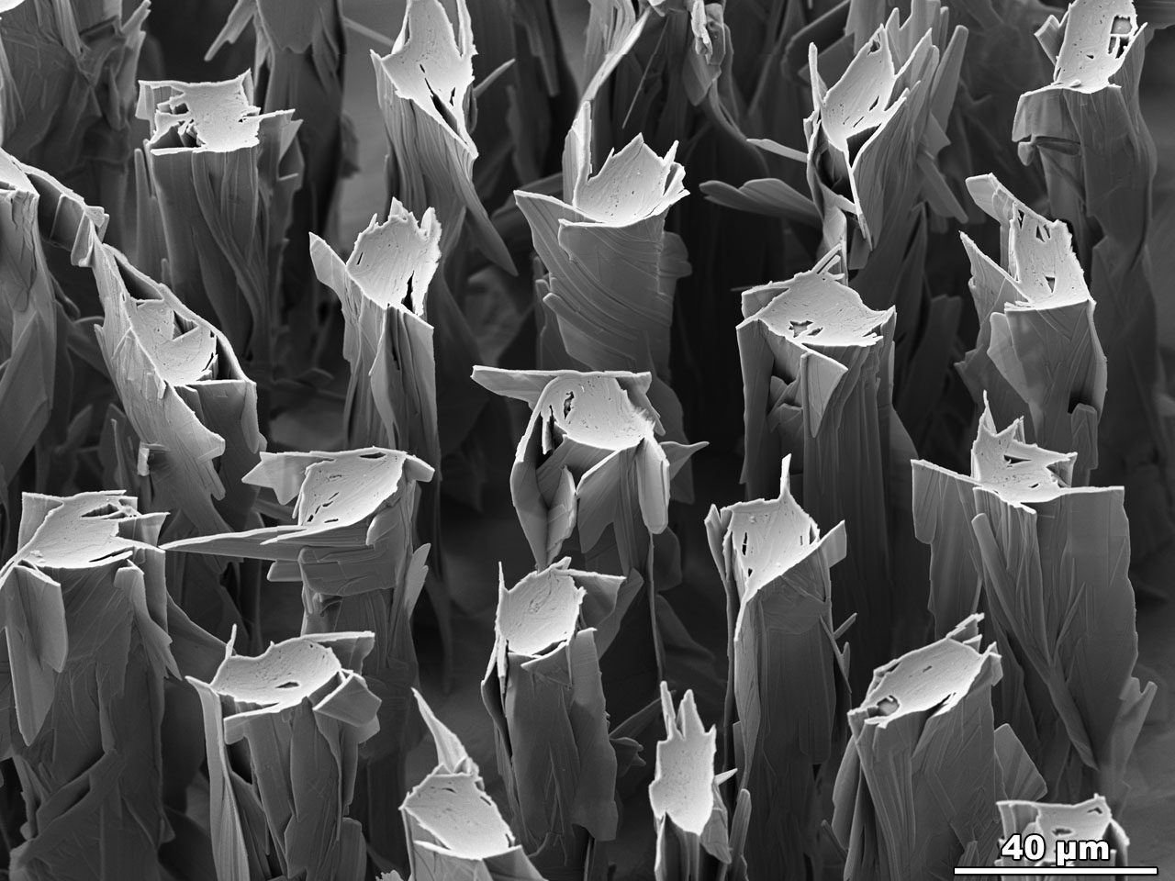
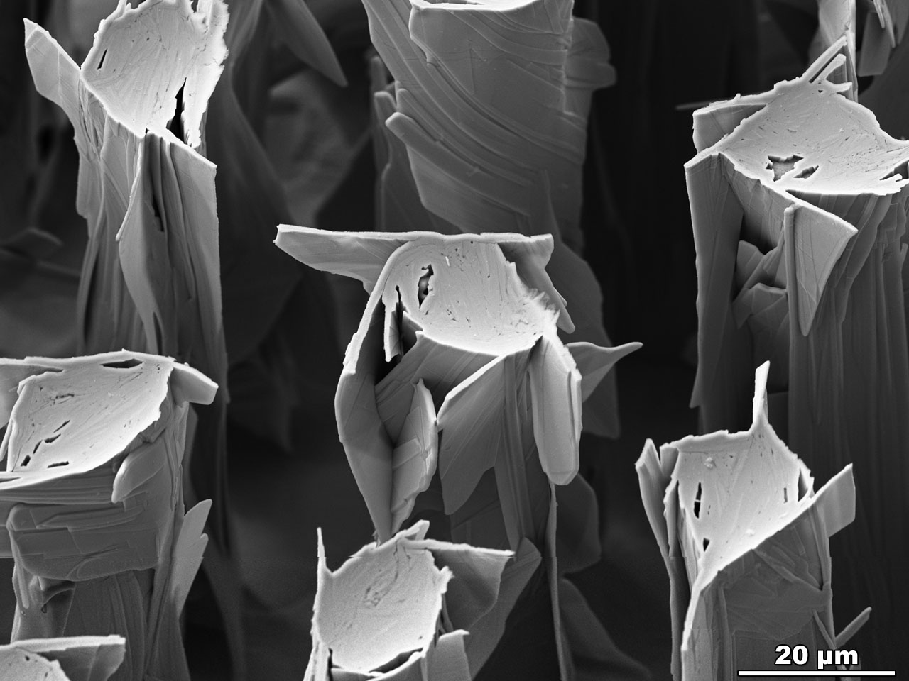
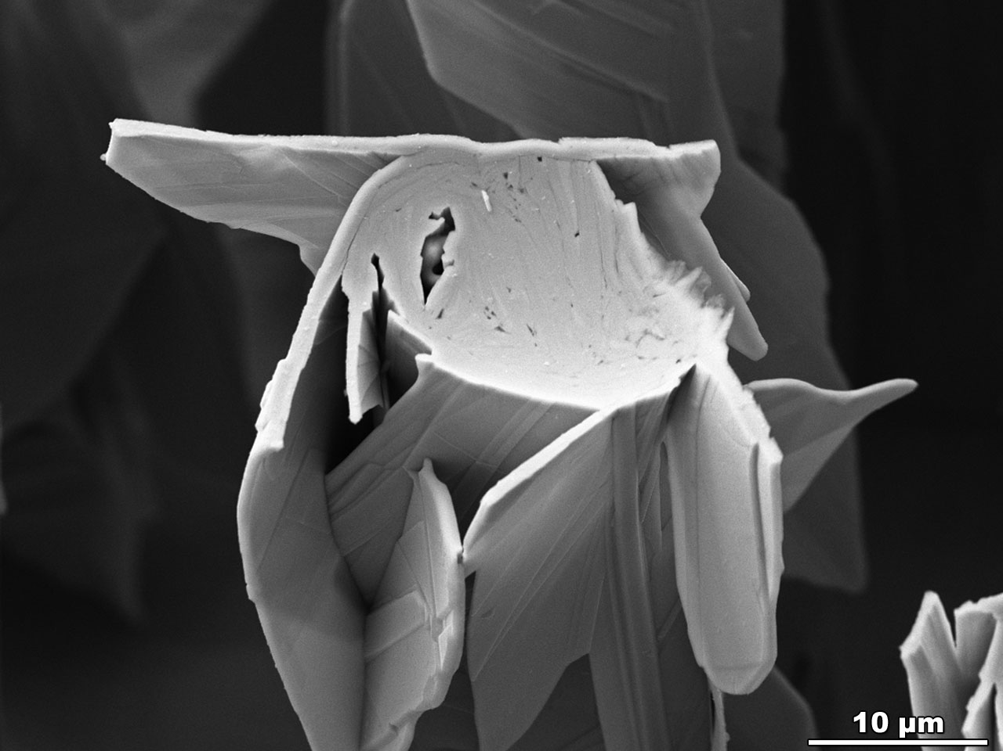

Transverse cross- section of a Bi-2212 round wire with 7 bundles of 27 filaments manufactured by OST. This wire was heat treated at 100 atm over-pressure to densify the filaments. The silver matrix was etched down to reveal the sub-surface filament structure.
Polished transverse cross- section of a Bi-2212 round wire with 7 bundles of 27 filaments manufactured by OST. This wire was heat treated at 100 atm over-pressure to densify the filaments.
FESEM-BSE Image by Jianyi Jiang, ASC, NHMFL
FESEM-SE2 Images (etched wires) by Maxime R. Matras, ASC, NHMFL

