Slide 1
Integrated Project Team Meeting 5:
Project overview and plans
Soren Prestemon
Director, US Magnet Development Program
Director, Berkeley Center for Magnet Technology
Lawrence Berkeley National Laboratory

Slide 2
Outline
Budget overview
Schedule update
Feedback from the first External Oversight Committee meeting
Plans for further external community feedback
Next EOC meeting
Possible user ”workshop” for feedback on cable testing capabilities

Slide 3
Budget overview
Funding to-date
Funds invested to-date: $8.99M – Thank you!
FES: $5.77M
HEP: $2.86M
Thanks to DOE funding, progress to-date has not been constrained by funding profile
FY22 considerations:
LBNL: major commitment of funds for conductor just made => will need additional funds soon (next couple of months) to maintain schedule
FNAL: Cryostat bids higher than anticipated
will need some additional funds to cover difference
In interim, request flexibility in use of existing funds
 | Office | FY19 | FY20 | FY21
LBNL | FES | $3,000,000 | $1,474,000
 | HEP |  | $350,000 | $1,000,000
FNAL | FES | $1,299,000
 | HEP | $250,000 | $650,000 | $962,500
Original budget estimate
Caveats:
Costs for advanced project management efforts are not included
“Contingency“ in the table are costed risk mitigation efforts; contingency for unknowns is not included

Slide 4
Magnet Schedule Comparison
EOC
✓
✓
Updated Dec. 2021

Slide 5
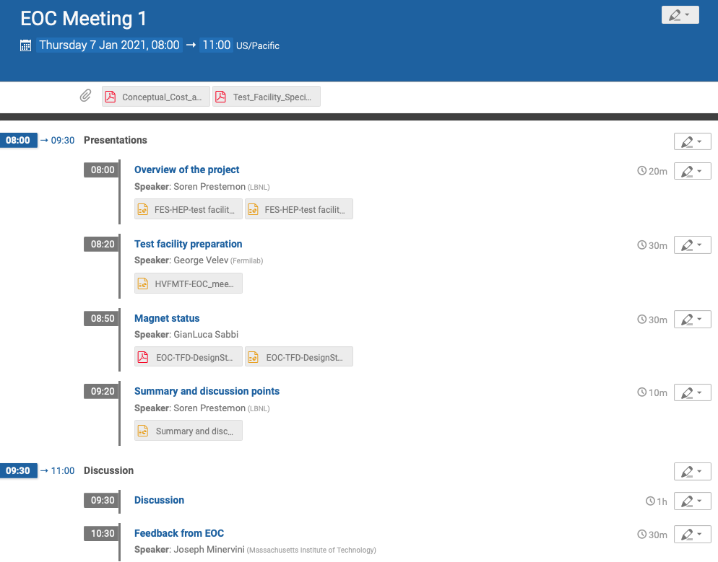
External Oversight Committee
Joe Minervini (Chair) Steve Gourlay (Co-chair / Backup) Luca Bottura
Luisa Chiesa Danko van der Laan Ruben Carcagno
Nicolai Martovetsky
Role of the Oversight Committee (OC):
Represent user interests in facility plans
Provide guidance and oversight for the overall facility development
Provide feedback on performance goals, overall design, and its implementation
Provide advice to the project management in terms of:
- Responsiveness to community needs
- Coordination and integration of efforts magnet/facility
- Balance of project risk and cost & schedule
Provide guidance on:
- Facility operational structure and user needs
- Collaboration and coordination with other laboratories
Provide feedback to sponsors on project team performance

Slide 6
External Oversight Committee met with project January 2021
Indico site with presentations: https://conferences.lbl.gov/event/513/
Four comments related to Project Management
Two comments related to 15T Magnet Design
Thirteen comments related to Facility Design
Two comments related to Facility Usage
Summary comments related to Budget and Schedule

Slide 7
Action items from EOC
“There was some discussion of prior and existing test capabilities and stations, but a detailed overview summary of these facilities, both defunct and still in operation, could be very useful. “
“The project should then … determine which capabilities might be redundant if included in the HFVMTF (High Field Vertical Magnet Test Facility). “
“Besides the U.S. facilities, the summary should include operating facilities in both Europe and Asia. There are substantial operating facilities either under design or operational in China, Japan, and South Korea.”
=> This is an action item for the team, for presentation at the next EOC
“The management structure is quite vague. There is a lot more to the project than calling meetings and reviews. Someone needs to be assigned primary responsibility for the day-to- day management of the project. For the next EOC meeting, a clear organization chart should be created with well-defined Roles, Responsibilities, Authorities, and Accountabilities.”
=> We will clarify R2A2’s. An organizational chart will be provided at the next EOC meeting. GianLuca is primary responsible for day-to-day project management at LBNL, and George Velev at FNAL.

Slide 8
Action items from the EOC (cont.)
“It might also be useful to add one additional member to the EOC from the NHMFL because of their long experience operating magnet user facilities and could bring a good idea of best practices.”
=> Advice from DOE is welcome. The EOC already consists of seven members.
“The project might benefit from a more rigorous approach to the Risk Management process, for example documenting identified risks in a Risk Register along with mitigation strategies. The project is already including substantial mitigation actions in their plan (e.g., planning for a long magnet iteration after the first test), so it would be helpful for future reviews if the thinking behind these actions is documented.”
=> We will work to further document risks and risk mitigations. Indeed significant effort has been taken to build risk mitigation measures into the project plans
“In general, the committee believes the conceptual design for the 15 T magnet is feasible. But beware, this is an R&D magnet, hopefully achieving 15 T operational. This part of the project should still be recognized as R&D and not just a series production magnet.”
=> We certainly recognize that the magnet is challenging and are striving to balance the magnet development aspect with the need to deliver a facility magnet. Our approach is to leverage advanced design and analysis techniques, a suite of practice elements (cable and coil), and risk mitigation measures, e.g. spares (e.g. coils) and assumptions of reassemblies.

Slide 9
Plans for future external feedback
Intend to call an EOC meeting in the January/February 2022 timeframe
Focus on technical updates on the dipole magnet and on the test facility status
We propose to also hold a mini-workshop for potential users
University, laboratory, and industry attendees
Virtual workshop, perhaps ½ day, or two ½ days
Scope:
We would provide a review of the “baseline” facility capabilities
Get examples from users on possible experiments, any feedback for facility design
Purpose: provide critical guidance as FNAL moves into detailed design of the sample insert
Timeline: late spring 2022

