Slide 1


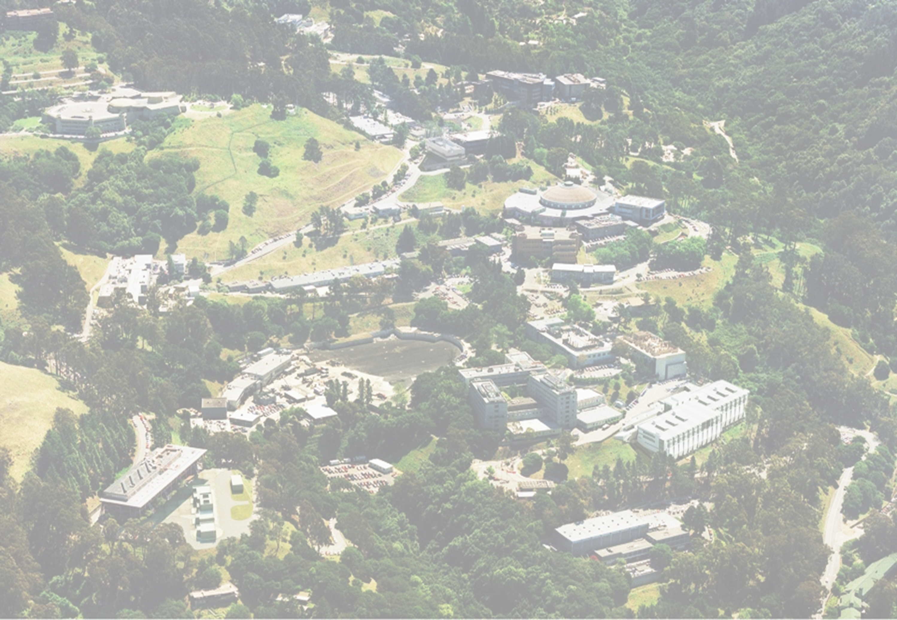
G. Sabbi, LBNL
Integrated Project Team Meeting #5
December 15, 2021
TFD Magnet Updates

Slide 2
Presentation Outline
Technical progress: magnet design
  Specifications/parameters
  Winding tests
  Coil and structure engineering design
Technical progress: wire and cable
  Development cable characterization
  Wire specification review
Prototype and production wire procurements
Schedule updates
Summary

Slide 3
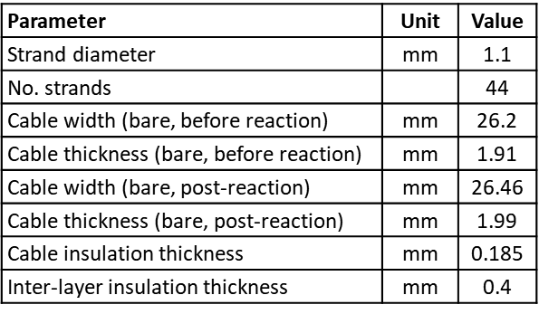
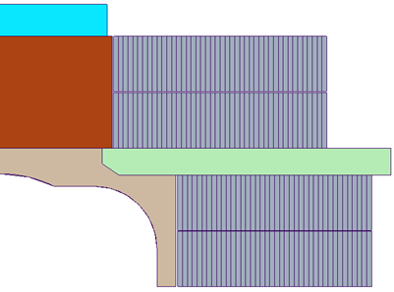
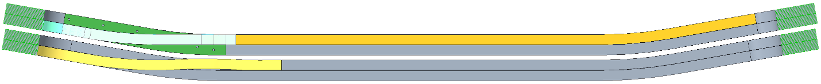
Cable and Coil Parameters
Cable and Insulation
2D Coil geometry
R_{min}:
54 mm
Layer 4: 44 turns
Coil 2
Layer 3: 44 turns
Layer 2: 40 turns
Coil 1
Layer 1: 40 turns
3D Coil geometry
Flare angle: 10 degrees; minimum HW bend radius (layer 4): 1 m
Reference: TFD Coil and Structure Parameters, DF-1000-4369, A.4, 2021-10-22
Note: parameters are still being adjusted as we get feedback from design, analysis and development

Slide 4
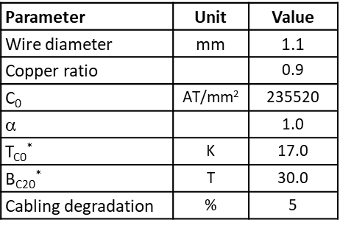
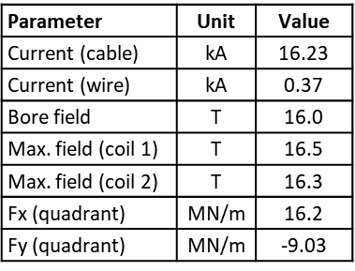
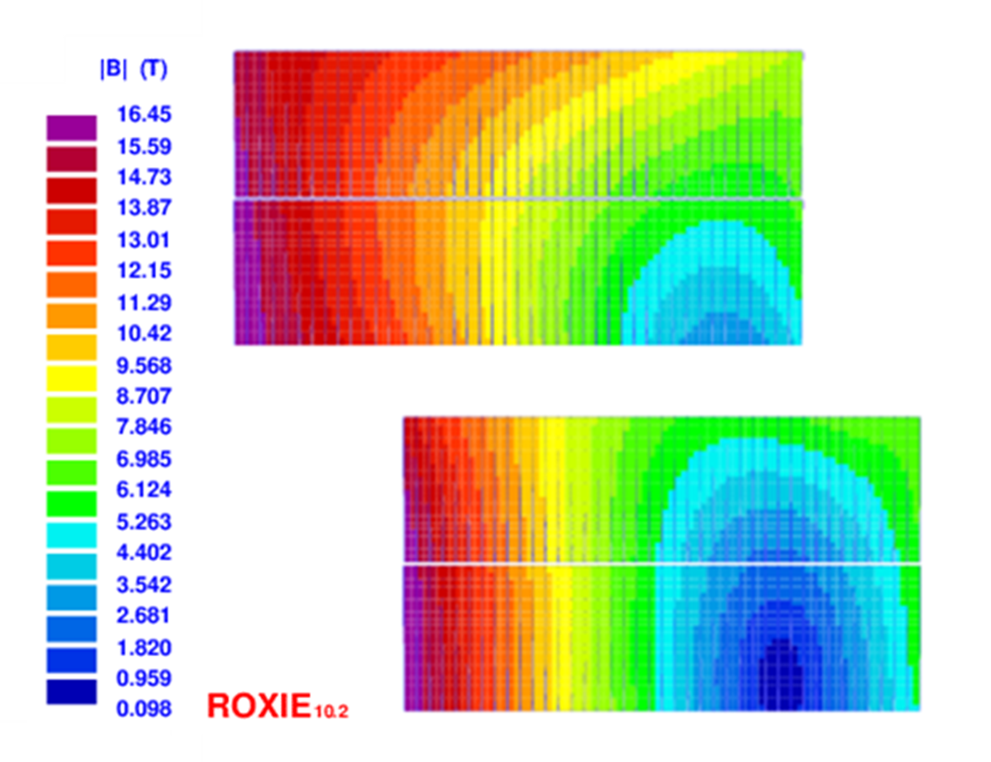
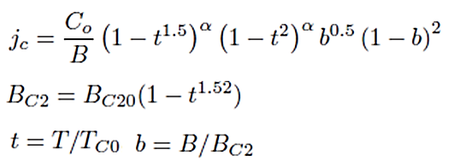
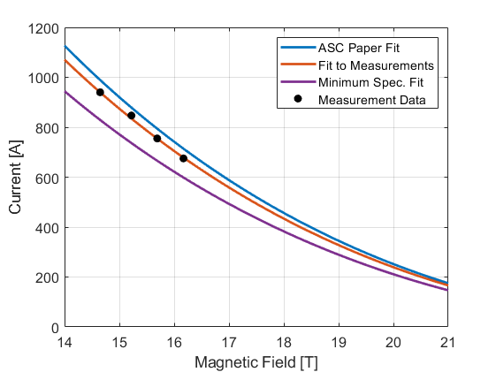
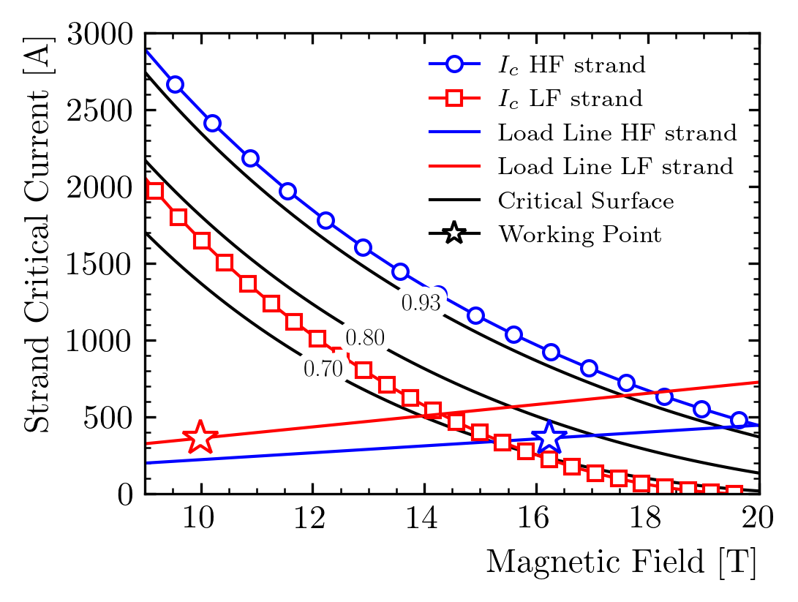
Magnetic Performance
Critical current parametrization
Field map and performance parameters at 16 T
Operating current (16T) vs. SSL current:
Measured I_{c}: 81-82 %
Min. spec I_{c}: < 85 %
Short sample limit calculation w/strain
(G. Vallone, N. Cheggour et al.)
Margin is not impacted by I_{c} degradation due to strain in the reversible regime
At 15 T: 5% additional margin
Cabling degradation:
Assumed: 5%, measured: 2%
Field quality:
< 0.3% at 50 mm radius

Slide 5
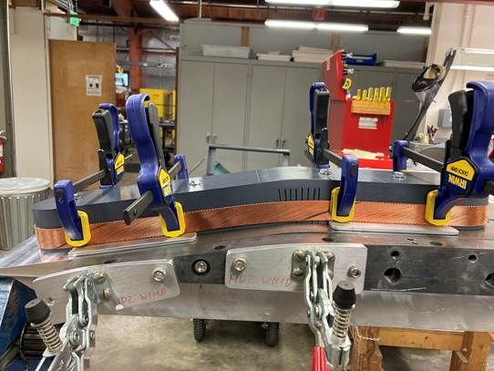
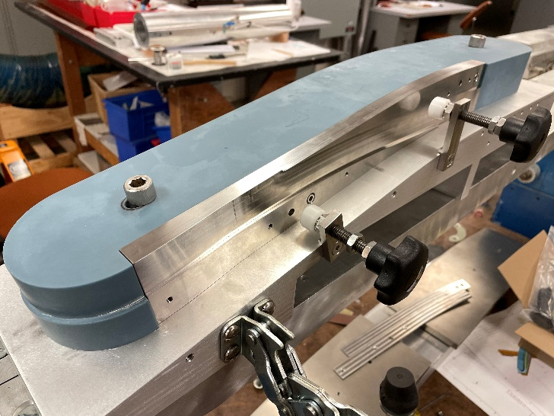
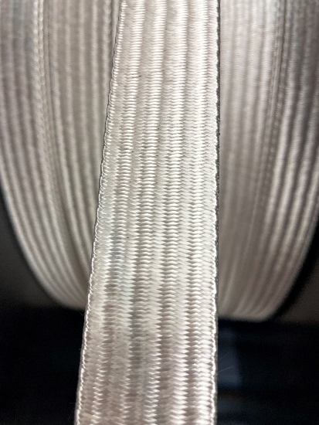
Coil Winding Tests
Several winding tests were performed using (short) sections from the development cable run
  All sections could be wound without any significant issues, independent of compaction
  Even the 43 strand section could be wound (although it is clearly not a viable option)
  Bending radii at the coil ends are very large compared with accelerator magnets
HW bend at the end flares is the most critical – several tests and detailed CMM measurements and analysis were performed to conform the design to the optimal curvature for the cable
Conclusion: cable design can be optimized for minimal I_{c}/RRR degradation
Recently performed double-layer winding test with optimized HW bend and layer transition
Single-layer, ~2 turns
Double-layer, 3+3 turns
Insulated cable
R. Lee, P. Mallon, J. Rudeiros Fernandez, J. Swanson et al.

Slide 6
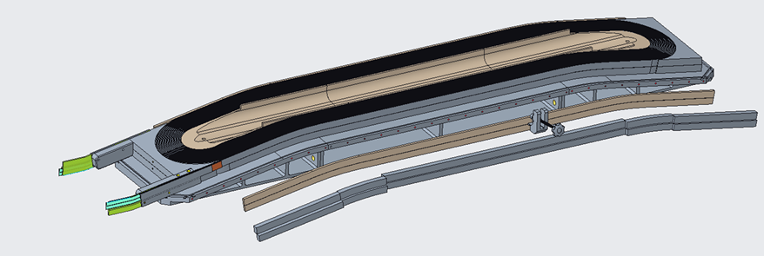
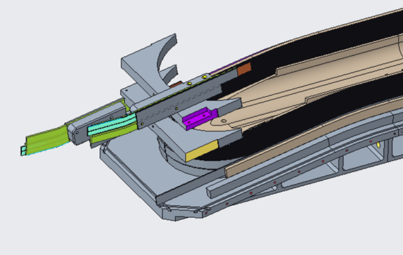
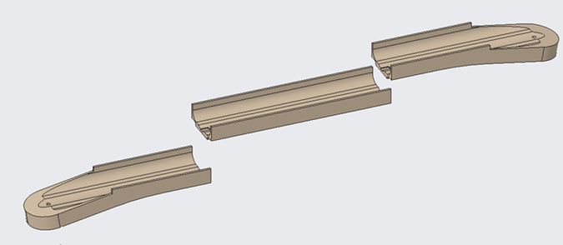
Coil Engineering Design
Detailing of coil parts and tooling
Side rails and shims
Split central pole piece
Coil leads and end parts
D. Arbelaez, P. Ferracin, R. Hafalia, R. Lee, P. Mallon, J. Rudeiros Fernandez, J. Swanson et al.

Slide 7
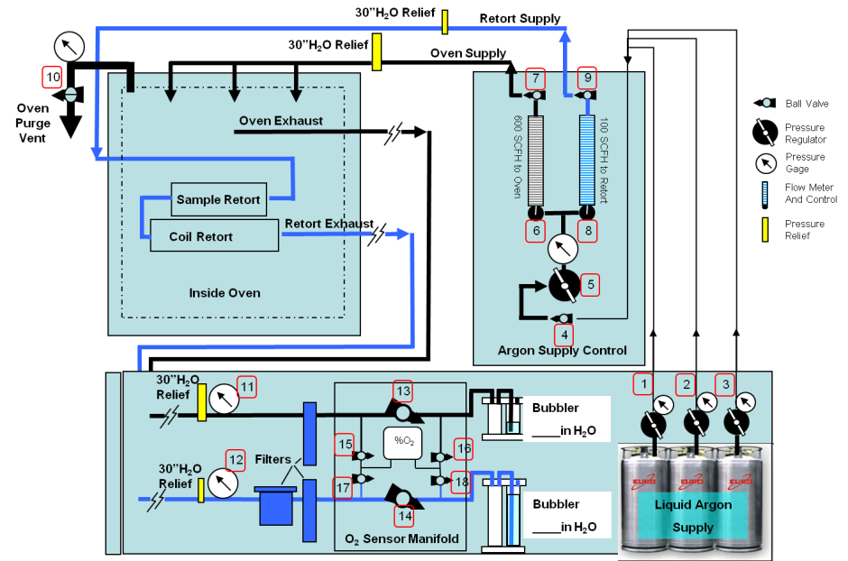
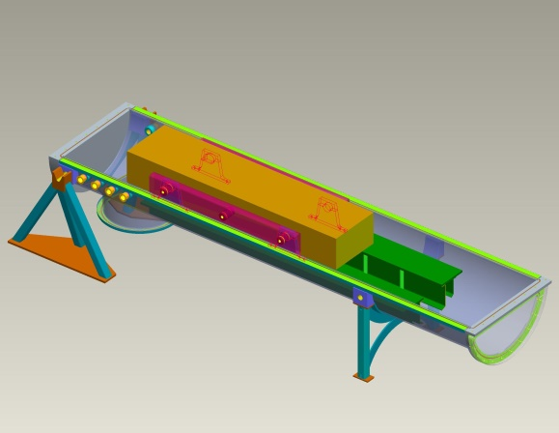
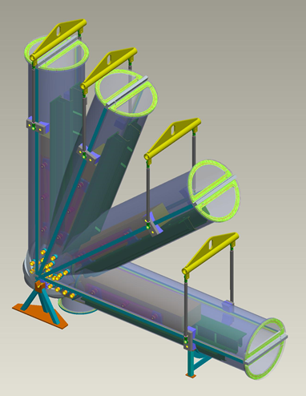
Coil Fabrication Infrastructure Status/Plans
Winding: no major upgrades needed; base plate to be procured as part of the coil tooling
Curing: not required for block-coil
Reaction: LD1 oven available but needs to be moved to a newly commissioned dedicated space
  Paid by LBNL Laboratory funds, budget code available
  Retort: various options under consideration; may be procured from oven supplier
Potting: fixture available from LD1, needs some refurbishing
  Two areas have been identified in B77A one for refurbishing (already started) and one for final installation; both areas are close to the oven; coil handling areas/tables also identified
D. Arbelaez, P. Ferracin, R. Hafalia, T. Lipton, J. Rudeiros Fernandez, J. Swanson T. Tristan, M. Turqueti et al.

Slide 8
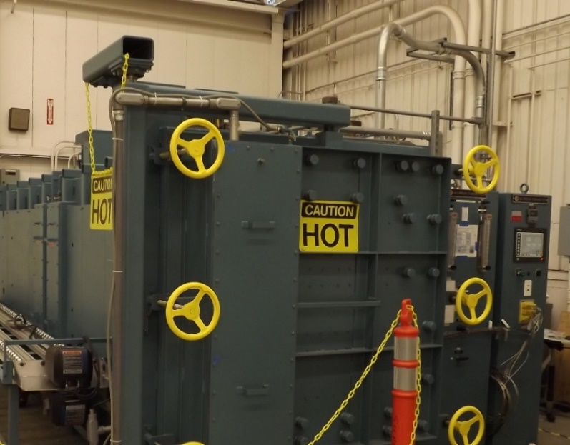
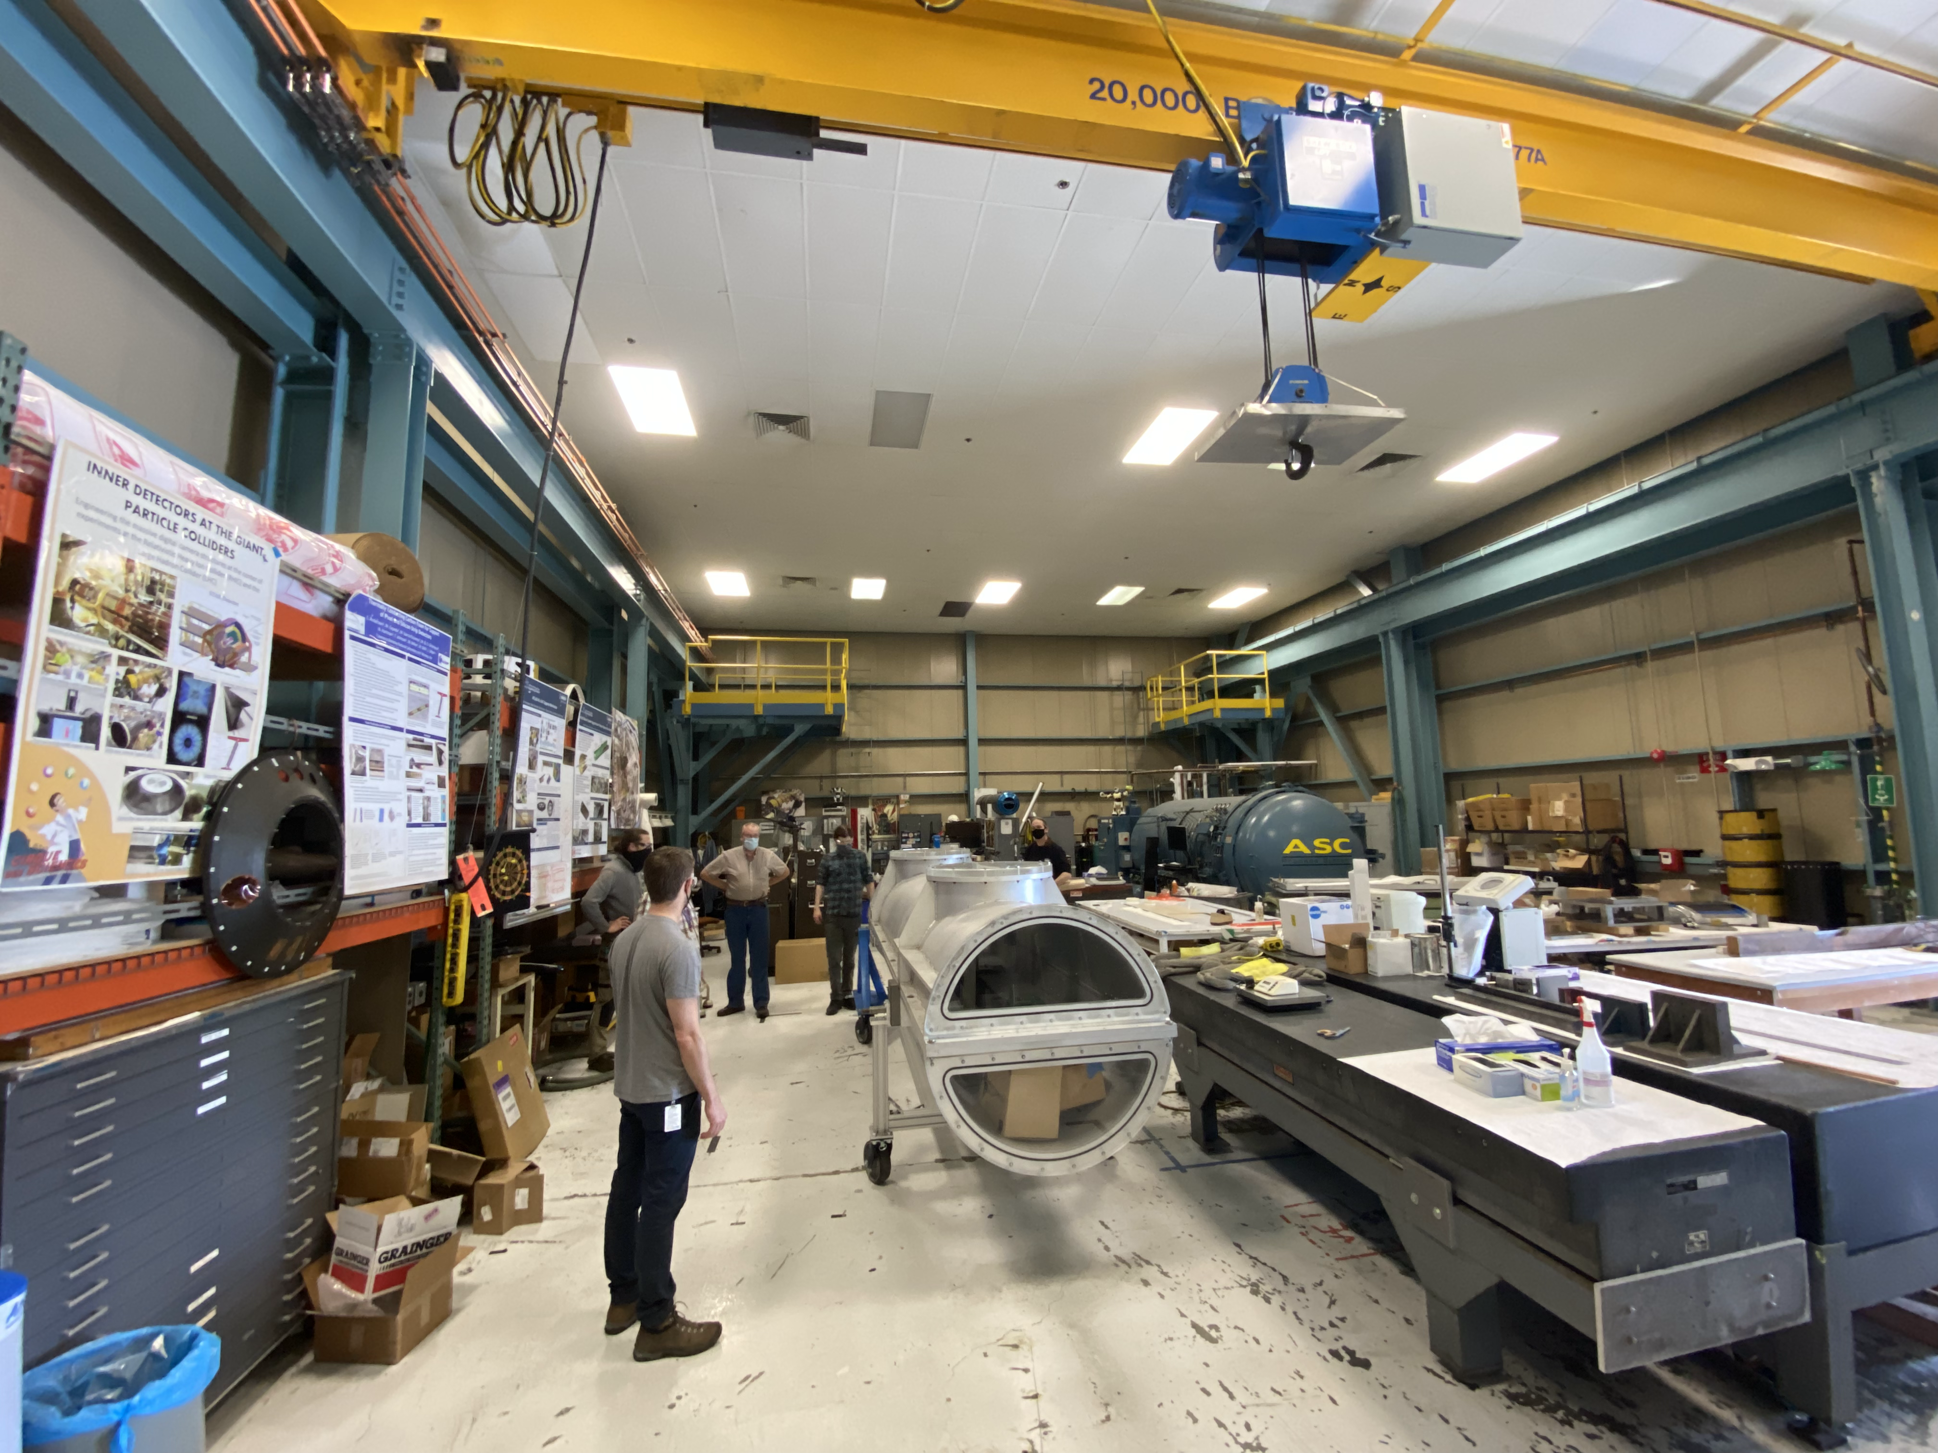
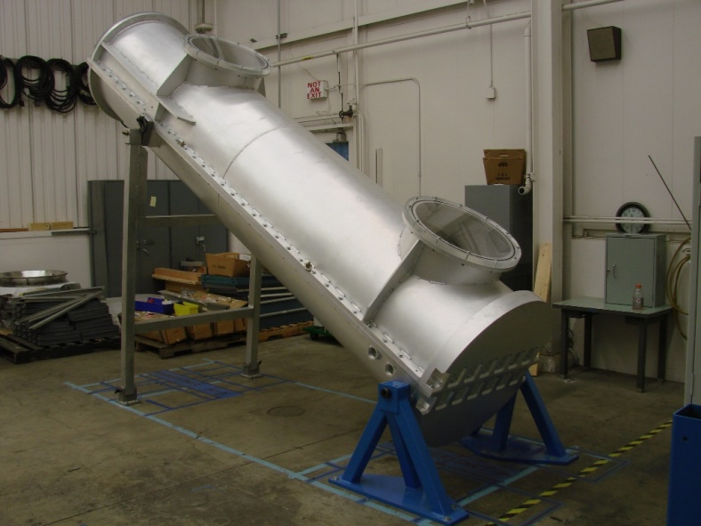
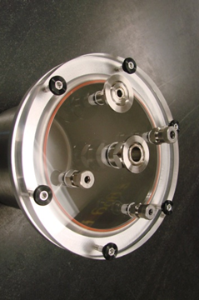
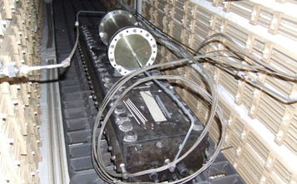
Coil Fabrication Infrastructure Status/Plans

Slide 9
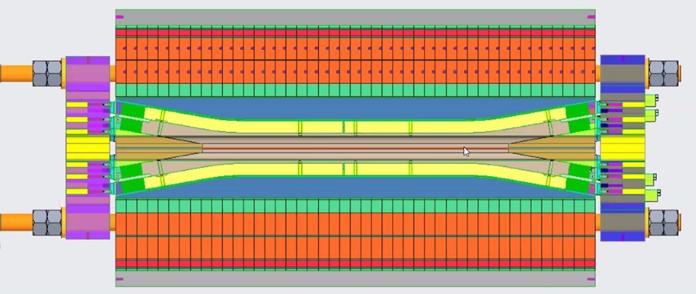
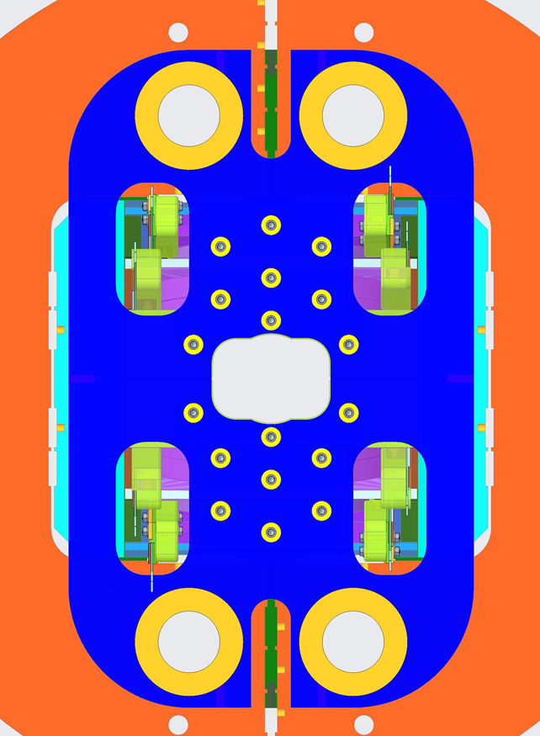
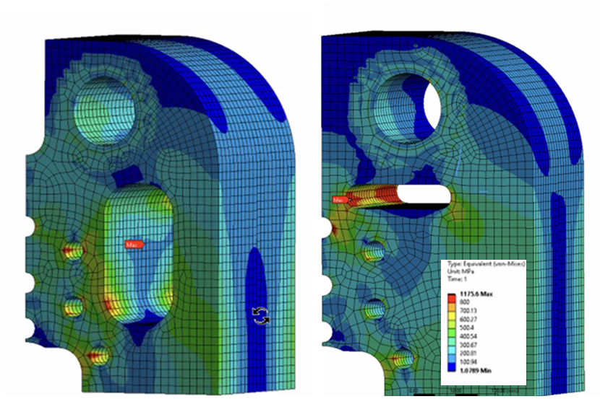
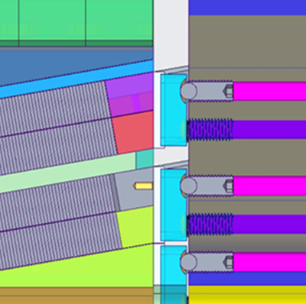
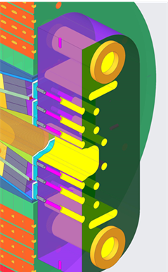
Structure Engineering Design
End plate analysis and optimization
Leads
Bladders
D. Arbelaez, P. Ferracin, R. Hafalia, J. Rudeiros Fernandez, G. Valllone et al.

Slide 10
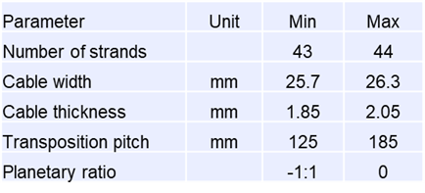
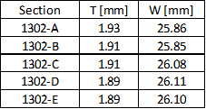
Cable Development
TFD “development cable” run (November 2020) using 3 km of RRP 108/127 wire procured by LBNL, and 3 km of 162/169 wire procured by CERN
108/127 used for initial feedback and broader exploration of parameter space
Tests performed: residual twist, winding properties, micrographs
  Final ~25 m long section was sent for insulation at NEEW
  Cable and parts/tooling ready for a double-layer winding test (8+8 turns)
Followed by 162/169: 4 main sections with different width and thickness
  Used for detailed mechanical and electrical characterization (see next slide)
Parameter ranges considered
162/169 sections
Next step: full-length “prototype cable” for fabrication of TFD “prototype coil”
D. Arbelaez, R. Hafalia, H. Higley, D. Martins Araujo, I. Pong, M. Naus et al.

Slide 11
Wire and Cable Characterization
The following tests were carried out on the development (162/169) wires and cables:
LBNL: winding tests (next slide); metallography of extracted strands
FNAL: I_{c} and RRR of virgin and extracted strands at 4.2K and 2.1K, for 665C and 680C reaction; field sweeps (0-10T-0) at >1kA, 4.2K and 2.1K to check stability
NHMFL: I_{c} and RRR of virgin and extracted strands at 4.2K, 665C reaction
NHMFL: strain characterization for both CERN and LBNL procured wire as a function of reaction temperature
CERN: selected 1.9K tests to confirm scaling of 4.2K/2.1K results
The following tests are planned for the prototype and production wires, cables and coils:
Supplier QC as detailed in the wire specification – results are available for the ~20 km TFD prototype wire order and 50 km CERN order
Verification tests (50% of S, 1/billet) and cable characterization (4 virgin+4 extracted): at FNAL for prototype wire/cable (contract in place); at NHMFL and FNAL for production wires/cables
Mechanical QC: post-production cable samples
  residual twist, 10-stack (bare and insulated) and metallography
I_{c} and RRR of coil witness samples (virgin and extracted) to check reaction

Slide 12
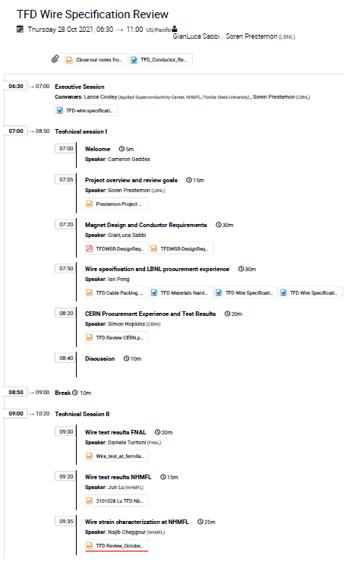
Wire Specification Review

Slide 13
Wire Procurement Status and Next Steps
“Development” wire and cable:
LBNL procured 3 km of “HiLumi” wire (RRP 108/127) at 1.1 mm diameter instead than 0.85 mm
  Order placed in Nov. 2019, received very quickly in a single length. Cost: 14.5 k$/km
CERN provided 3 km of “FCC DEMO 1.1” wire (RRP 162/169) – we sent them half of the cable
“Prototype” wire and cable:
LBNL procured 45 pieces of RRP 162/169, 1.1 mm, with minimum piece length of 425 m
Spec: Sept. 2020; Order placed: March 2021; Wire received: Sept. 2021 Cost: 21.5 k$/km
“Production” wire and cable:
Spec released June 2021 with minimal changes from prototype wire (min length: 410/425 m)
Quote received in Aug. 2021: 110 km, 21.5 k$/km, delivery 30 km Q2/22, 80 km Q1/23
Cost matches prototype wire which was used for our budget estimate
The wire specification review approved the use of these specs with minor changes
A requisition has been approved by ATAP division to start contract award process
However, contract award may take several months and WSR recommended to add an option
It is possible that Brucker-OST may need to requote with possible delay and price increase

Slide 14
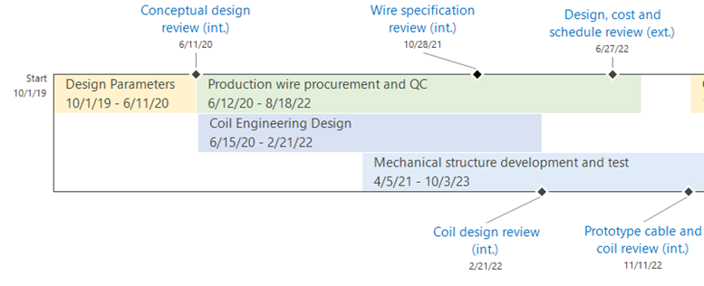
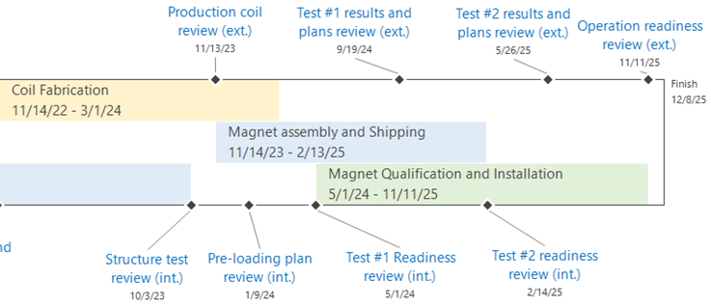
Magnet Schedule and Milestones

Slide 15
Design, Prototype Cable and Coil

Slide 16
Production Wire and Cable

Slide 17
Production Coil Fabrication

Slide 18
Structure, Assembly and Test

Slide 19
Summary
Good technical progress on the magnet design/analysis, coil and structure engineering, conductor characterization and procurement
Magnet design meets targets and building on past development and studies of block-coil dipoles (HD, FRESCA2 and HEPdipo) we have been able to make further improvements in critical areas, in particular to avoid degradation due to coil stress
Three phases of wire procurement, each one building on previous results and detailed characterization
Following a successful Wire Specification Review we are moving forward to place large order for production wire
  Cost is in line with budget and delivery times are compatible with (revised) magnet schedule
Main challenges so far have been on the schedule side due to resource and infrastructure availability relative to other projects, especially AUP
  This however should improve in ~1 year time frame
Next milestones: prototype cable production, coil design review and procurements for prototype coil fabrication, production wire contract award

Slide 20
Backup slides

Slide 21
Response to CDR Recommendations
Requirements and interfaces
Clarify magnet and facility requirements and get stakeholder approval
=> In progress with input of IPT and EOC committees and HEP/FES community
Conductor and cable:
Some preference for higher sub-element design for stability in large diameter wire
=> Selected 162/169 vs. 108/127 (although mainly driven by higher I_{c})
Consider a cable with more strands (48 vs 44) and a smaller wire (1 mm vs. 1.1 mm)
=> Insufficient resources/infrastructure to pursue two alternatives in parallel
=> No issues found cabling the 1.1 mm strand - 44 strand cable is preferred
Magnet design:
Alternatives have been properly considered and selected design minimizes risk
Main elements of the design fully endorsed by the committee: block coil, non-graded layout, shell-based structure
=> Confirmed key design choices and started design optimization
https://conferences.lbl.gov/event/359/

Slide 22
Response to CDR Recommendations
Magnet design (cont.):
Consider increased margin to quench (conductor properties and magnetic design)
=> Significant improvement with 1.1 mm 162/169 wire
=> Magnetic design optimization to balance performance margin and coil size
Consider increased shell thickness for margin (relative to using LD1 shell)
=> Available margin on outer diameter allows to increase shell thickness
Include CLIQ protection system for added robustness and redundancy
=> Detailed protection analysis performed to optimize CLIQ configuration
=> Baseline test facility design and operation plan includes CLIQ
Design tools, resources and collaboration:
Team expertise and analysis capabilities are fully adequate
Continue strong collaboration with FRESCA2/HEPdipo teams and US conductor Labs
=> Conductor characterization at NHMFL, FNAL, CERN (details in next talks)
=> FRESCA2engineering feedback, CAD models from CEA and CERN
https://conferences.lbl.gov/event/359/

Slide 23
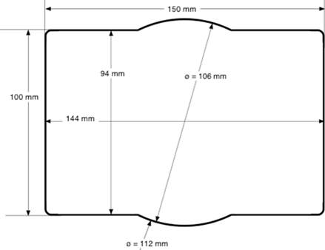
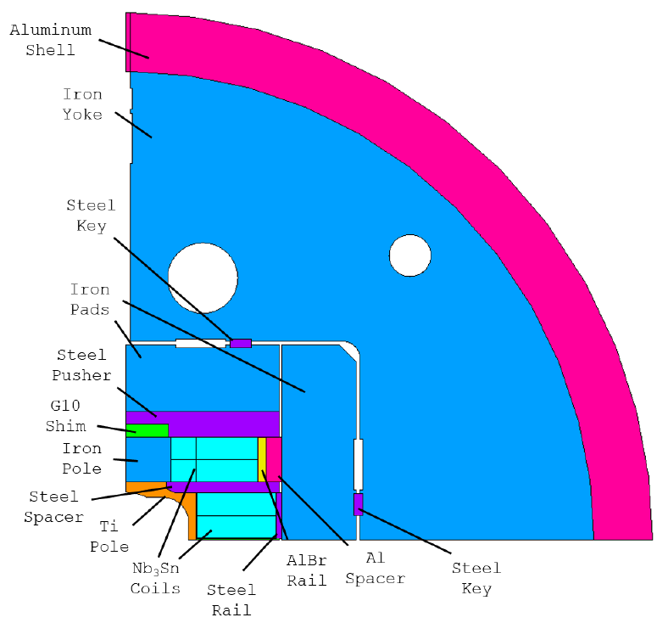
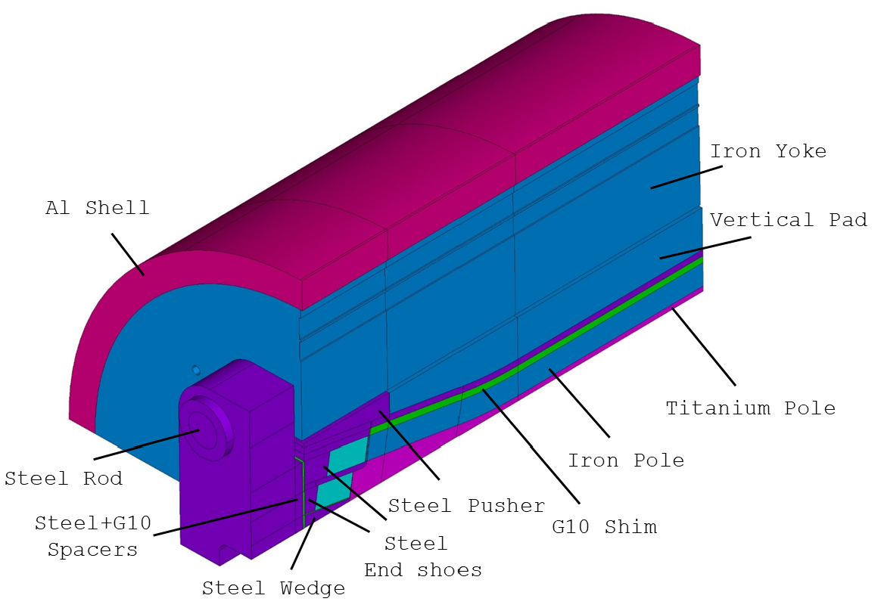
Mechanical Design
Shell-based structure with axial pre-load (HD, LD, FRESCA2, HEPdipo)
Design features introduced to control the coil stress:
Key position defined to limit the max. tension at the pole/coil interface
Al. bronze rail with Al shim
Inner and outer coil individually shimmed
30 mm radius of the inner pole
G10 shim above the pole
Test well profile
D. Arbelaez, P. Ferracin, R. Hafalia, D. Martins Araujo, G. Vallone et al.

Slide 24
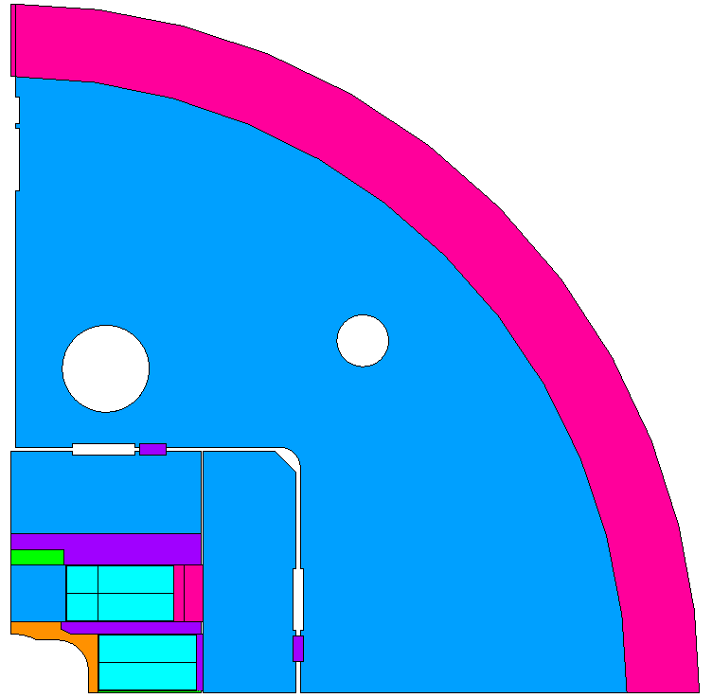
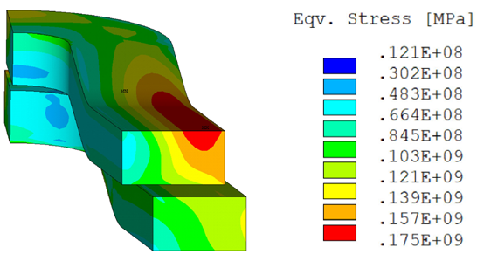
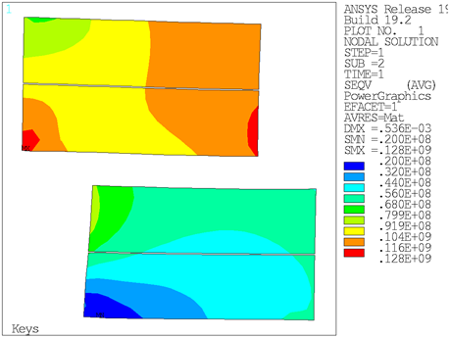
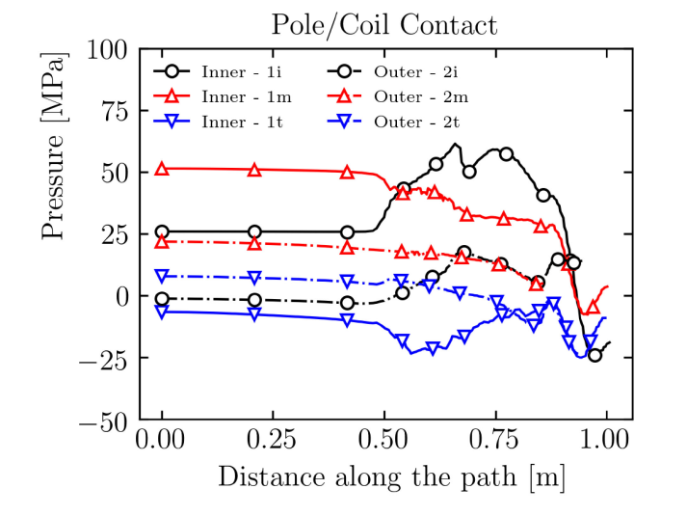
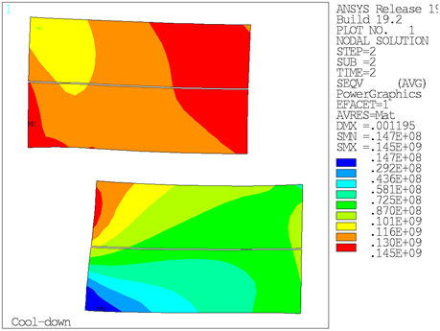
Mechanical Analysis
2D coil stress (assembly, cool-down, 16T)
3D Coil stress and contact pressure at 16 T
Max stress at R.T.: 128 MPa
Max stress at cold: 145 MPa
Max stress at 16 T, in high field region: 131 MPa
Max stress at 16 T, in low field region: 166 MPa
3D Field:
Magnetic length: 1.7 m
Field homogeneity: <1% over 1 m

Slide 25
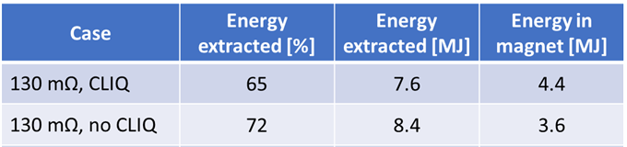
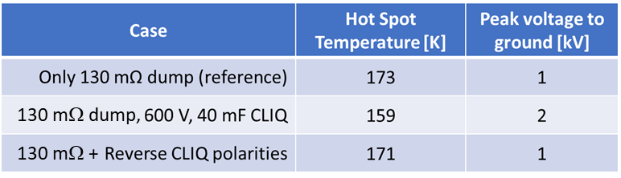
Quench Protection - Reference Case
Protection analysis and parameters:
Magnet design and quench conditions:
  Magnetic length: 1.7 m
  Field and current: 16 T, 15.5 kA
  Stored energy: 12 MJ
  Inductance : 97.2 mH (57.2 mH/m)
Analysis performed with STEAM-LEDET
  Accounts for coupling current effects
Voltage limit: ±1 kV with symmetric ground
  Dump resistor: 130 mΩ (2 kV)
CLIQ parameters: 40 mF, 600 V (AUP unit)
No Quench Heaters
Detection + validation time: 15 ms
Conductor parameters:
  RRR=100
  Copper fraction: 0.8
  Twist pitch (strand/filament): 14 mm
  Cable transposition length: 109 mm
  Matrix cross resistance: 10 µΩ
Main results:
Energy extraction is sufficient to provide a safe discharge
Hot-spot temperature 173K (vs. HiLumi 250K target/350K limit)
However, in case of extraction failure magnet will not survive
Need fully redundant extraction system, or a second system
Baseline plan is to include CLIQ together with extraction
We maintain the same voltage limit of ±1 kV
With this constraint, T_{HS} is not improved when adding CLIQ but CLIQ will protect the magnet in case of extraction failure, although T_{HS} is higher (327 K, similar to HiLumi failure cases)
V. Marinozzi, D. Arbelaez, E. Ravaioli, et al.

Slide 26
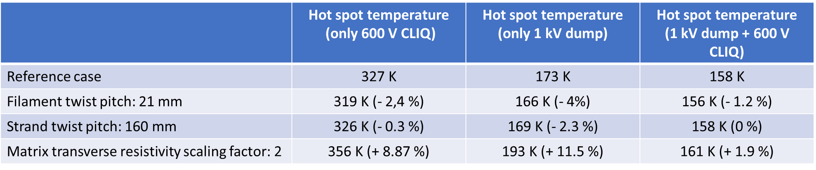
Quench Protection - Sensitivity Analysis
Parameter | Unit | Ref. Analysis | Range studied | Spec | Notes
Copper ratio |  | 0.8 | 0.8-1.2 | 0.9 | T_{HS} about 30-40 K lower for Cu/NCu=1.2 vs 0.8
Detection time | ms | 15 | 15-45 | 15 | T_{HS} about 25-30 K higher for 45 ms
R_{dump} | μΩ | 150 | 75-150 | 150 | Half voltage but T_{HS} may increase up to 50-100K
CLIQ Voltage | V | 600 | 300-1000 | 600 | 300 V insufficient. 1000 V performance is equivalent to dump but increases voltage and requires a special unit
Twist pitch | mm | 14 | 14-21 | 19 ± 3 | Slight improvement in T_{HS} for longer twist pitch
Transp. length | mm | 109 | 109-160 | 155 | Slight improvement in T_{HS} for increased transp. length
RRR |  | 100 | 100-200 | >100 | T_{HS} ~20 K lower for RRR 300 vs.100 (HEPdipo study)
Transv. Res. | µΩ | 10 | 10-20 | 10 | No significant effect for combined dump + CLIQ. 20-30K increase of T_{HS} for dump only or CLIQ only
V. Marinozzi, FNAL

Slide 27
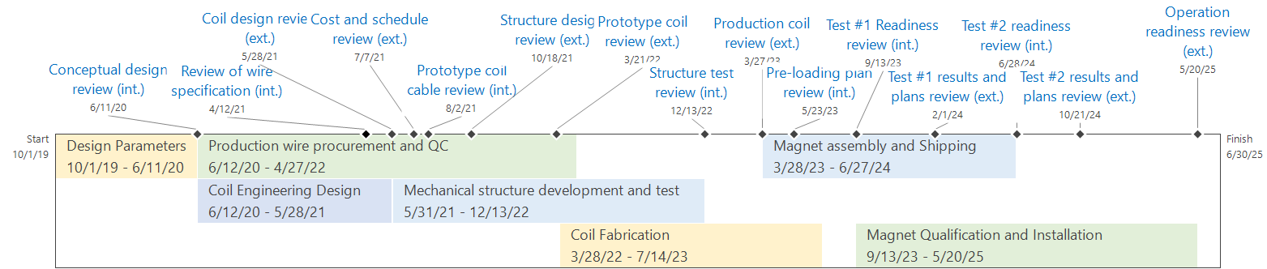
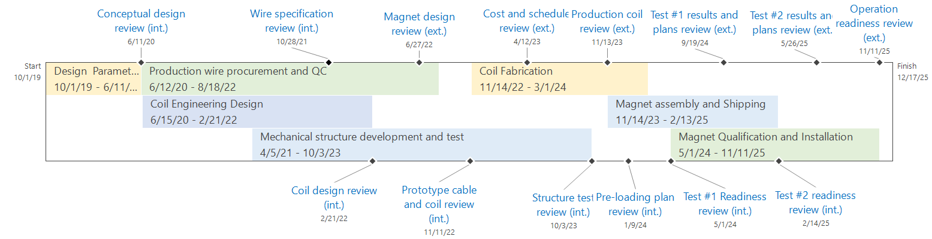
Magnet Schedule and Milestones
EOC
Updated Dec. 2021

