Slide 1
HTS Cable Test Facility Preparations - Status and Plans
G. Velev

Slide 2
Outline
Short Overview
STEP 1: Test Pit construction and cryostat (GPP at Fermilab)
  Current Status
  Plans
STEP 2: Quench Protection and Monitoring systems (QP/QM), Power Supplies, and test insert (cable holder)
  Current Status
  Plans
STEP 3 (it was part of STEP2): Test Facility integration
Funding Status
Schedule update
Summary
Notes:
General Plant Project
Purple

Slide 3
Overview of the Test Facility
The test facility is constructed in Industrial Building 1, APS-TD, Fermilab. The proposed place was selected based on the proximity to the needed base infrastructure, including cryogenic, power, water and cranes.
Minimum operating temperature of the facility is 1.9K for the magnet providing the background field and with min 4.2-4.5 K for the test samples, variable to ~50 K.
The test pit cryostat should accommodate a dipole (cold mass) with maximum dimensions of 1.3 m and length of 3 m
The maximum energy in the test field dipole should be < 20 MJ
The maximum weight of the dipole cold mass should not exceed 20 ton
The test facility should be efficient and safe, minimizing the time for experiment preparation and no helium losses.
Operational lifetime of the facility at least 20 years.

Slide 4
Test Pit and Cryostat – Status
This part of the project includes only the civil (pit) construction, the magnet cryostat and top&lambda plates
It was classified as GPP by Fermilab DOE site office
  Pit design was finalized - Feb 2020
  Bidding process – May 2020
  Construction Contract was awarded in Sep 2020
  Pit construction - started in October 2020 –finished April 2021
Project Execution plan

Slide 5
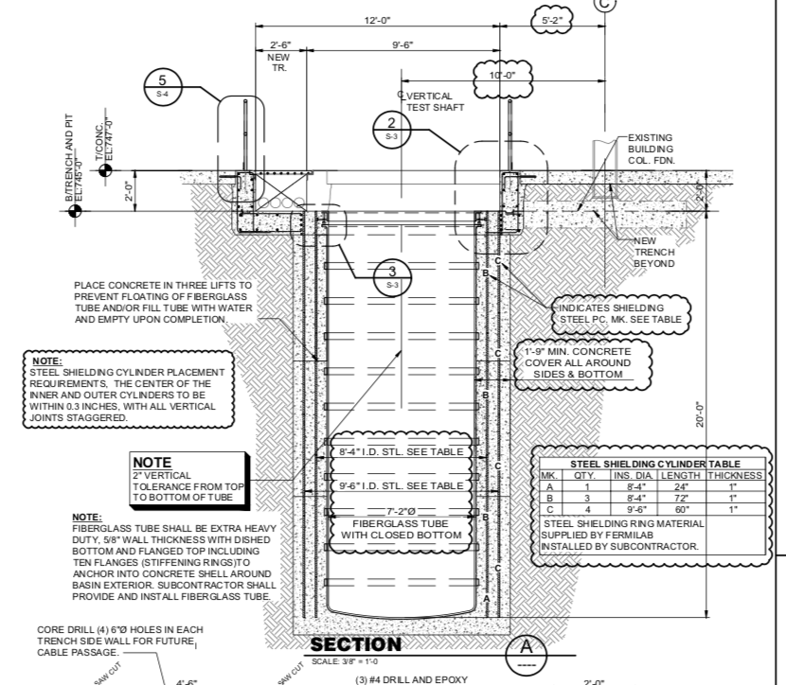
What was changed in the design and execution?
We added two cylindrical steel shields to contain the fringe magnetic field.
  Thickness of the shields is 2’’
  Distance between inner and outer is 5’’
These shields protect the nearby vertical SRF test stands which are very sensitive to any external fields
The shielding was not included in the original bidding package for the construction, this increased the original cost

Slide 6
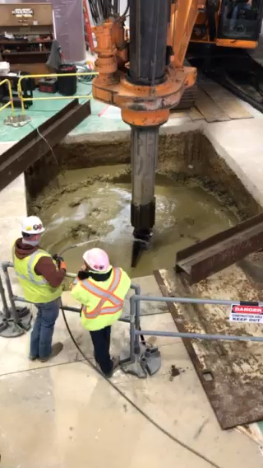
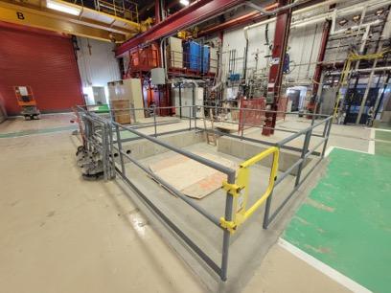
Current status - pit is done
There were some scary moments
  At ~ 5 m the well walls started to collapse
  Concern that building column support was possibly compromised
  Additional concrete was injected
  Column survey before an after construction was showing no significant change of the tilt or position of the column
Several change request were executed
6 m deep pit for the cryostat
HFVMTF pit

Slide 7
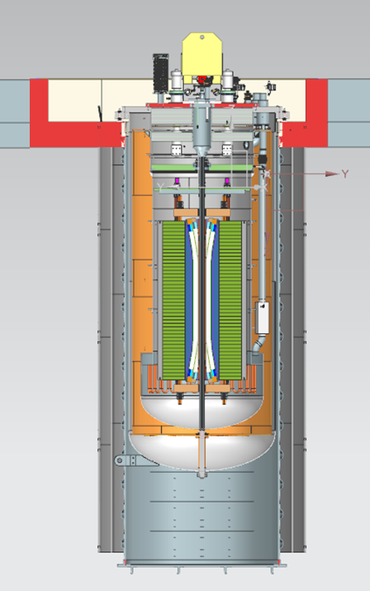
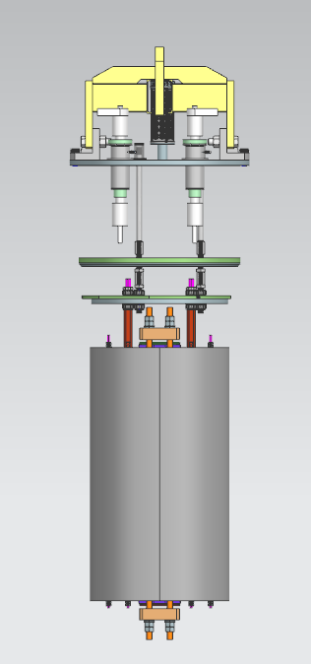
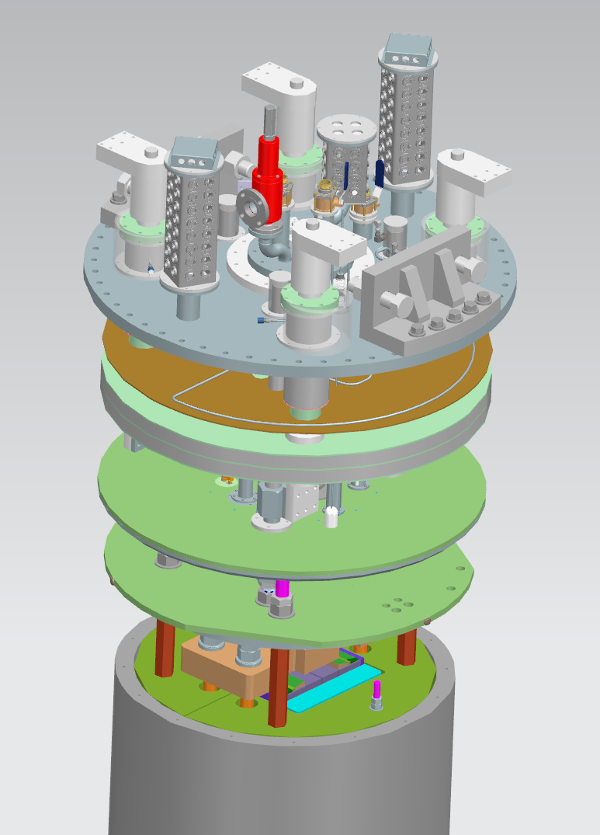
Cryostat and top&lambda plates
Cryostat design is finalized
Bid process is finalized.
Company is selected
Top and lambda plate design is in progress
  We entertained 3 different options for lambda plate sealing - decided on the BNL seal
The goal is to deliver the top and lambda plate in Sep 2022 and to start cold commissioning of the cryostat
Top
Lambda
Top
Lambda

Slide 8
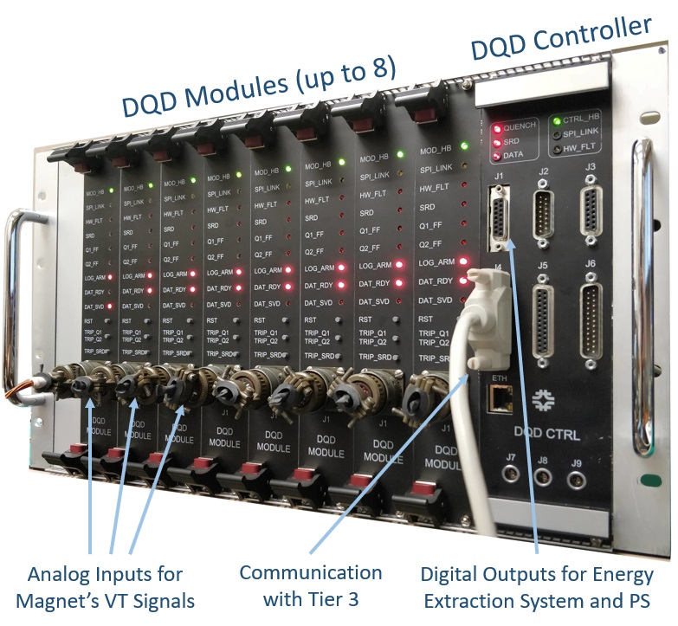
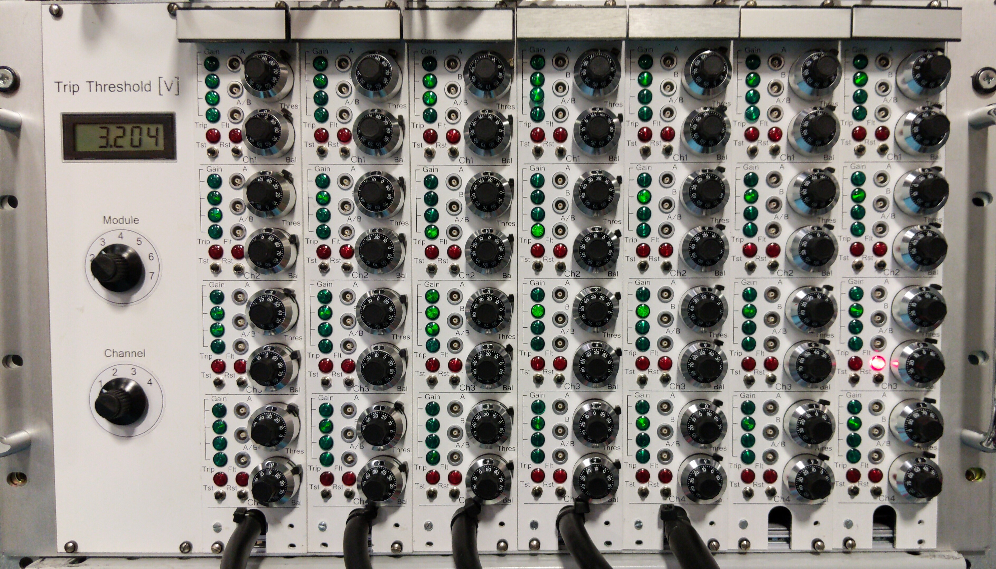
Quench Protection and Quench Monitoring (QP/QC)
Benefiting from the projects, LHC-AUP and mostly Mu2e
Production/Operational grade QM/QC - design is done
AQD system

Slide 9
QP/QC Current Design
Branch 1
Branch 2

Slide 10
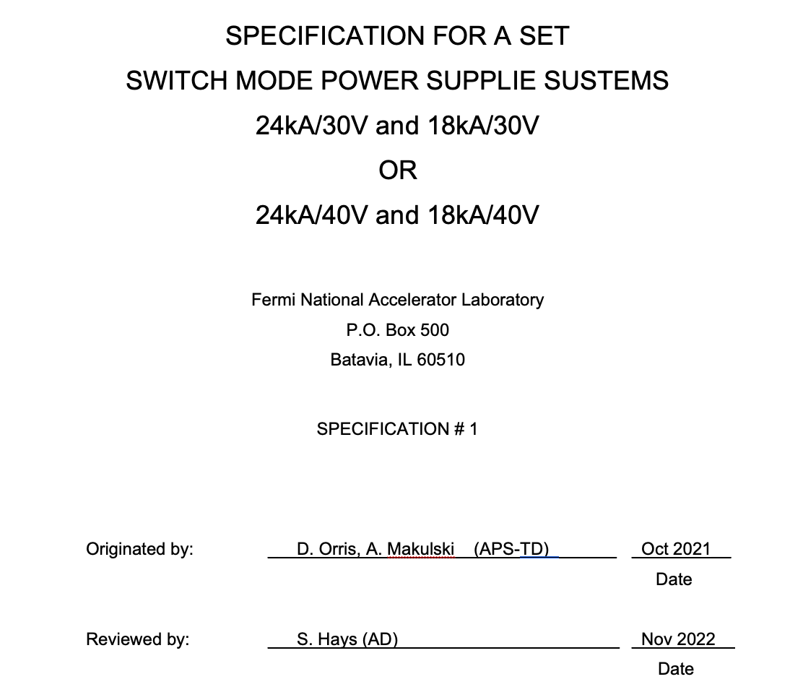
Power Supplies
Specifications are finalized
Power Supply cost is $/per Watt
Looking for possible optimization and cost cut, e.g 20 V units
Prepare to start procurement process after New Year

Slide 11
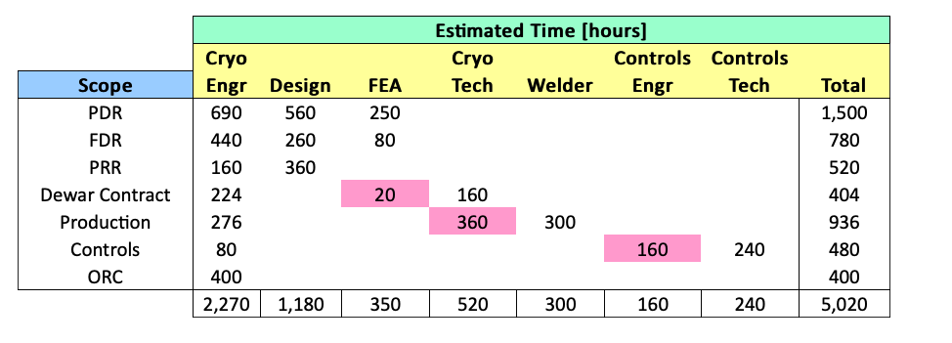
Integration
Documentation for the integration of the pit was started this summer – based on the AUP stand 4 experience
A cryo engineer left the division - the process stopped
A discussion with the cryo sector for optimization of the project resources (mu2e, AUP, PIP II) is in progress. Need to show funding to get engineering support
Aug 2021
3520 h

Slide 12
Funding Status
This project has very low or no contingency (10% were used in GPP estimation and some other task)
 | Funds Planned/Recived/Pending
Cost Estimate (k$) | Step 1 | Step 2 | Step 3 | TPC | Comments
k$ | $1,549.0 | $1,612.5 | $563.5 | $3,725.0 | Total Cost
Year received | FES | HEP | FY total | Steps
FY19 received (GPP-test pit) | $1,299.0 | $250.0 | $1,549.0 | Step 1 | Received in August 2019, $500k is for the civil construction and $1000k for cryostat
FY20 Received (QP/QM) | $0.0 | $650.0 | $650.0 | Step 2 | Received in May 2020, for QP/QM electronics
FY21 Received (Power Supplies) | $0.0 | $962.5 | $962.5 | Step 2 | Received in April 2021, for PSs and supporting electronics
FY22 (Integration) | $563.5 | $0.0 | $563.5 | Step 3 | Needed for Integration (not received)
Total | $1,862.5 | $1,862.5 | $3,725.0

Slide 13
Funding: Step 1 - details
FY19 received (GPP-test pit) | $1,299.0 | $250.0 | $1,549.0 | Step 1 | Received in August 2019, $500k is for the civil construction and $1000k for cryostat
The funding for the test pit was $500k
  Test pit actual cost is $584k - overrun is due to
    adding the steel shielding
    several change request during the construction
The funding for the cryostat and Top&Lambda plates is $1,049k
  the cryostat design is $438k – we planned $473k
  The cryostats manufacturing:
    Planned cost: $428k
    Bids are vendor 1 - $749; Vendor 2 – $936.3k
The top&lambda plates in design process: going RFQ in a 2 months

Slide 14
Funding: Step 1 – Summary
 | STEP 1 - Test Pit, Cryostat, Top&Lambda Plates
Cost Estimate (k$) | Planned | Actual Cost Vendor 1 | Actual Cost Vendor2 | Diff. Vendor 1 | Diff. Vendor 2 | Comments
Test Pit construction | $499 | $584 |  | -$85 | -$85 | Construction is done
Cryostat Design | $473 | $438 |  | $35 | $35 | It is finished
Cryostat procurement | $428 | $749 | $936 | -$321 | -$508 | Bids are in
Top&Lamba plates | $149 | $149 |  | $0 | $0 | Not ordered yet
Summary | $1,549 | $1,920 | $2,107 | -$371 | -$558
As yesterday, Vendor 1 is selected (Ability Metal in IL)

Slide 15
Step 2 - details
For quench Protection and quench monitoring systems we received $650k. The work is in progress. We ordered the log-lead time components (chips) – delivery time 8 months
Power supplies procurement process will start after New Year. For PSs we have received $963k.
 | STEP 2 - QP/QM systems and PSs
Cost Estimate (k$) | Planned | Costed | Balance | Comments
Quench Protection/Monitoring | $650 | $136 | $514 | Work is in progress
Power Supplies | $963 | $15 | $948 | Specifications are in progress
Summary | $1,613 | $151 | $1,462

Slide 16
Step 3 – details
We have planned 3520 h for integration + appropriate M&S
We need to receive $563.5k to start the system integration. We need to have funds to secure resources from cryo-sector
This might be not enough, but I do not have better estimation – need to work on it
 | STEP 3 - System integration
Cost Estimate (k$) | Planned | Costed | Balance | Comments
Integration | $564 | $0 | $564 | Design just started; manpower limited
Summary | $564 | $0 | $564

Slide 17
Schedule Update - GPP
Two major known-unknowns
  Cryostat delivery – Vendor 1 estimate delivery date is Aug 2022
  Getting appropriate resource from Projects which suffer from COVID delays.
  QP/QM system chip delivery – September 2022.
Best estimation of the test facility completion - Aug 2023
Task | Planned Start | Planned End | Start | End | FY20/Q1 | FY20/Q2 | FY20/Q3 | FY20/Q4 | FY21/Q1 | FY21/Q2 | FY21/Q3 | FY21/Q4 | FY22/Q1 | FY22/Q2 | FY22/Q3 | FY22/Q4 | FY23/Q1
Pit Design | Nov-19 | Feb-20 | Nov-19 | Feb-20
Construction Bids | Feb-20 | May-20 | Mar-20 | Jul-20
Pit Costruction | Jun-20 | Oct-20 | Aug-20 | Mar-21
Generate a Preliminary Design | Jan-20 | Apr-20 | Jan-20 | Apr-20
Preliminary Design Review (PDR) | Apr-20 | Apr-20 | Apr-20 | Apr-20
Design Specification (FRS) | Apr-20 | Jul-20 | Apr-20 | Jun-20
Procurement Specification (ESD) | Jun-20 | Sep-20 | Jul-20 | Jan-21
Develop Final Design | Jul-20 | Mar-21 | Jul-20 | Apr-21
Issue RFP/Bid Evaluation | Mar-21 | May-21 | May-21 | Nov-21
Award Contract | May-21 | Jun-21 | Nov-21 | Dec-21
Fabrication | Jun-21 | Mar-22 | Jan-22 | Aug-22
Cryostat Delivery | Aug-22 | Sep-22 | - | -
Acceptance Tests | Sep-22 | Nov-22 | - | -
Top and Lambda Plates Design | May-21 | Jan-22 | May-21 | Jan-22
Procurement Plates | Jan-22 | Apr-22 | - | -
Fabrication Plates | Apr-21 | 22-Sep | - | -

Slide 18
Schedule Update –QP/PS/Integration
The QP/QM schedule is updated
  It incorporates that the system is designed and article (version) 3 is tested
  Indirectly it was affected from the COVID projects’ delays.
  It incorporates the COVID component delay (chips)- min 6 months
Final integration schedule is 8 months which is reasonable
The goal is in Sep 2023 to test the a MDP magnet in the pit as final integration
Shedule
Task | Planned Start | Planned End | Start | End | FY20/Q1 | FY20/Q2 | FY20/Q3 | FY20/Q4 | FY21/Q1 | FY21/Q2 | FY21/Q3 | FY21/Q4 | FY22/Q1 | FY22/Q2 | FY22/Q3 | FY22/Q4 | FY23/Q1 | FY23/Q2 | FY23/Q3 | FY23/Q4
QM/QP design | - | - | - | Sep-21
Order parts | - | - | Oct-21 | Nov-21
Parts Delivered | - | - | Dec-21 | Sep-22
System Assembly | Sep-22 | Jan-23 | - | -
Power supplies procurement | Jan-22 | Mar-22 | - | -
Power supplies delivery | Mar-22 | Dec-22 | - | -
Full Test Integration | Mar-22 | Aug-23 | - | -

Slide 19
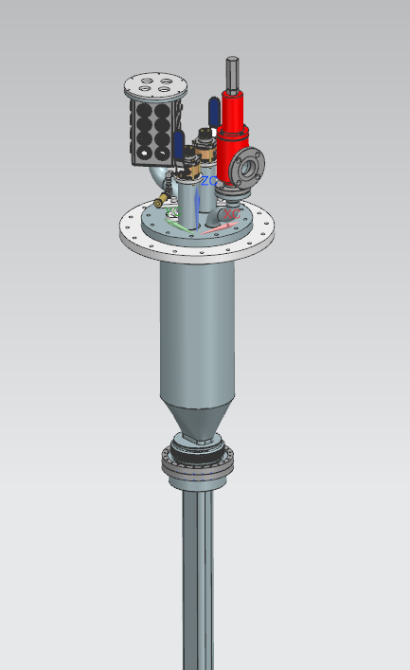
Open questions
There are several questions connected mostly with SC test sample cryostat and test sample well for FES
  Assuming EDIPO type sample cryostat, is this what we need?
  What are sample dimensions? Constant?
  Any limitations on temperature gradient within the sample during testing?
  Sample orientation to the field?
  Are there any requirements for warmup/cooldown?
  SC transformer, what design we should use? Primary and secondary coil turns? Is 100kA what we need?
We need input from users’ community

Slide 20
Summary
The HFVMTF test pit construction is done
The cryostat design is done
Procurement is finalized – we need min $371k (better $400k) urgently to place the order - temporary we can borrow from QP/QM/PS funds or other option(s). The bid expires at the end of January.
Cryostat is expected not early than Sep 2022 – depending on the vendor
The QP/QM system is copy of the mu2e/AUP production systems
  No design is needed
  Main electronic parts are ordered in Sep –Nov; expecting delivery in Sep 2022 (Covid delays)
Power supplies procurement specifications are finalized. Expecting to start the procurement process in Jan-Feb 2021.
Integration of the stand needs additional cryo effort – expect to get resources after first AUP cryomodule test, Summer 2022.
Current estimation of the stand completion is Aug 2023.

Slide 21
Backup Slides

Slide 22
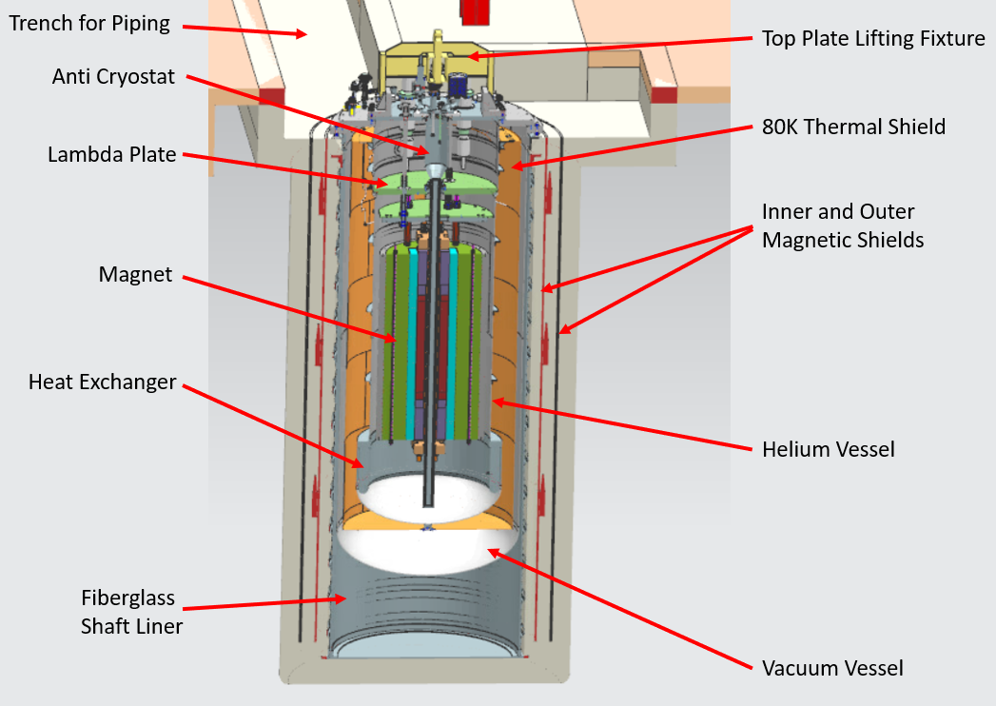
Civil Construction Design
Current VMTF
HFVMTF

Slide 23
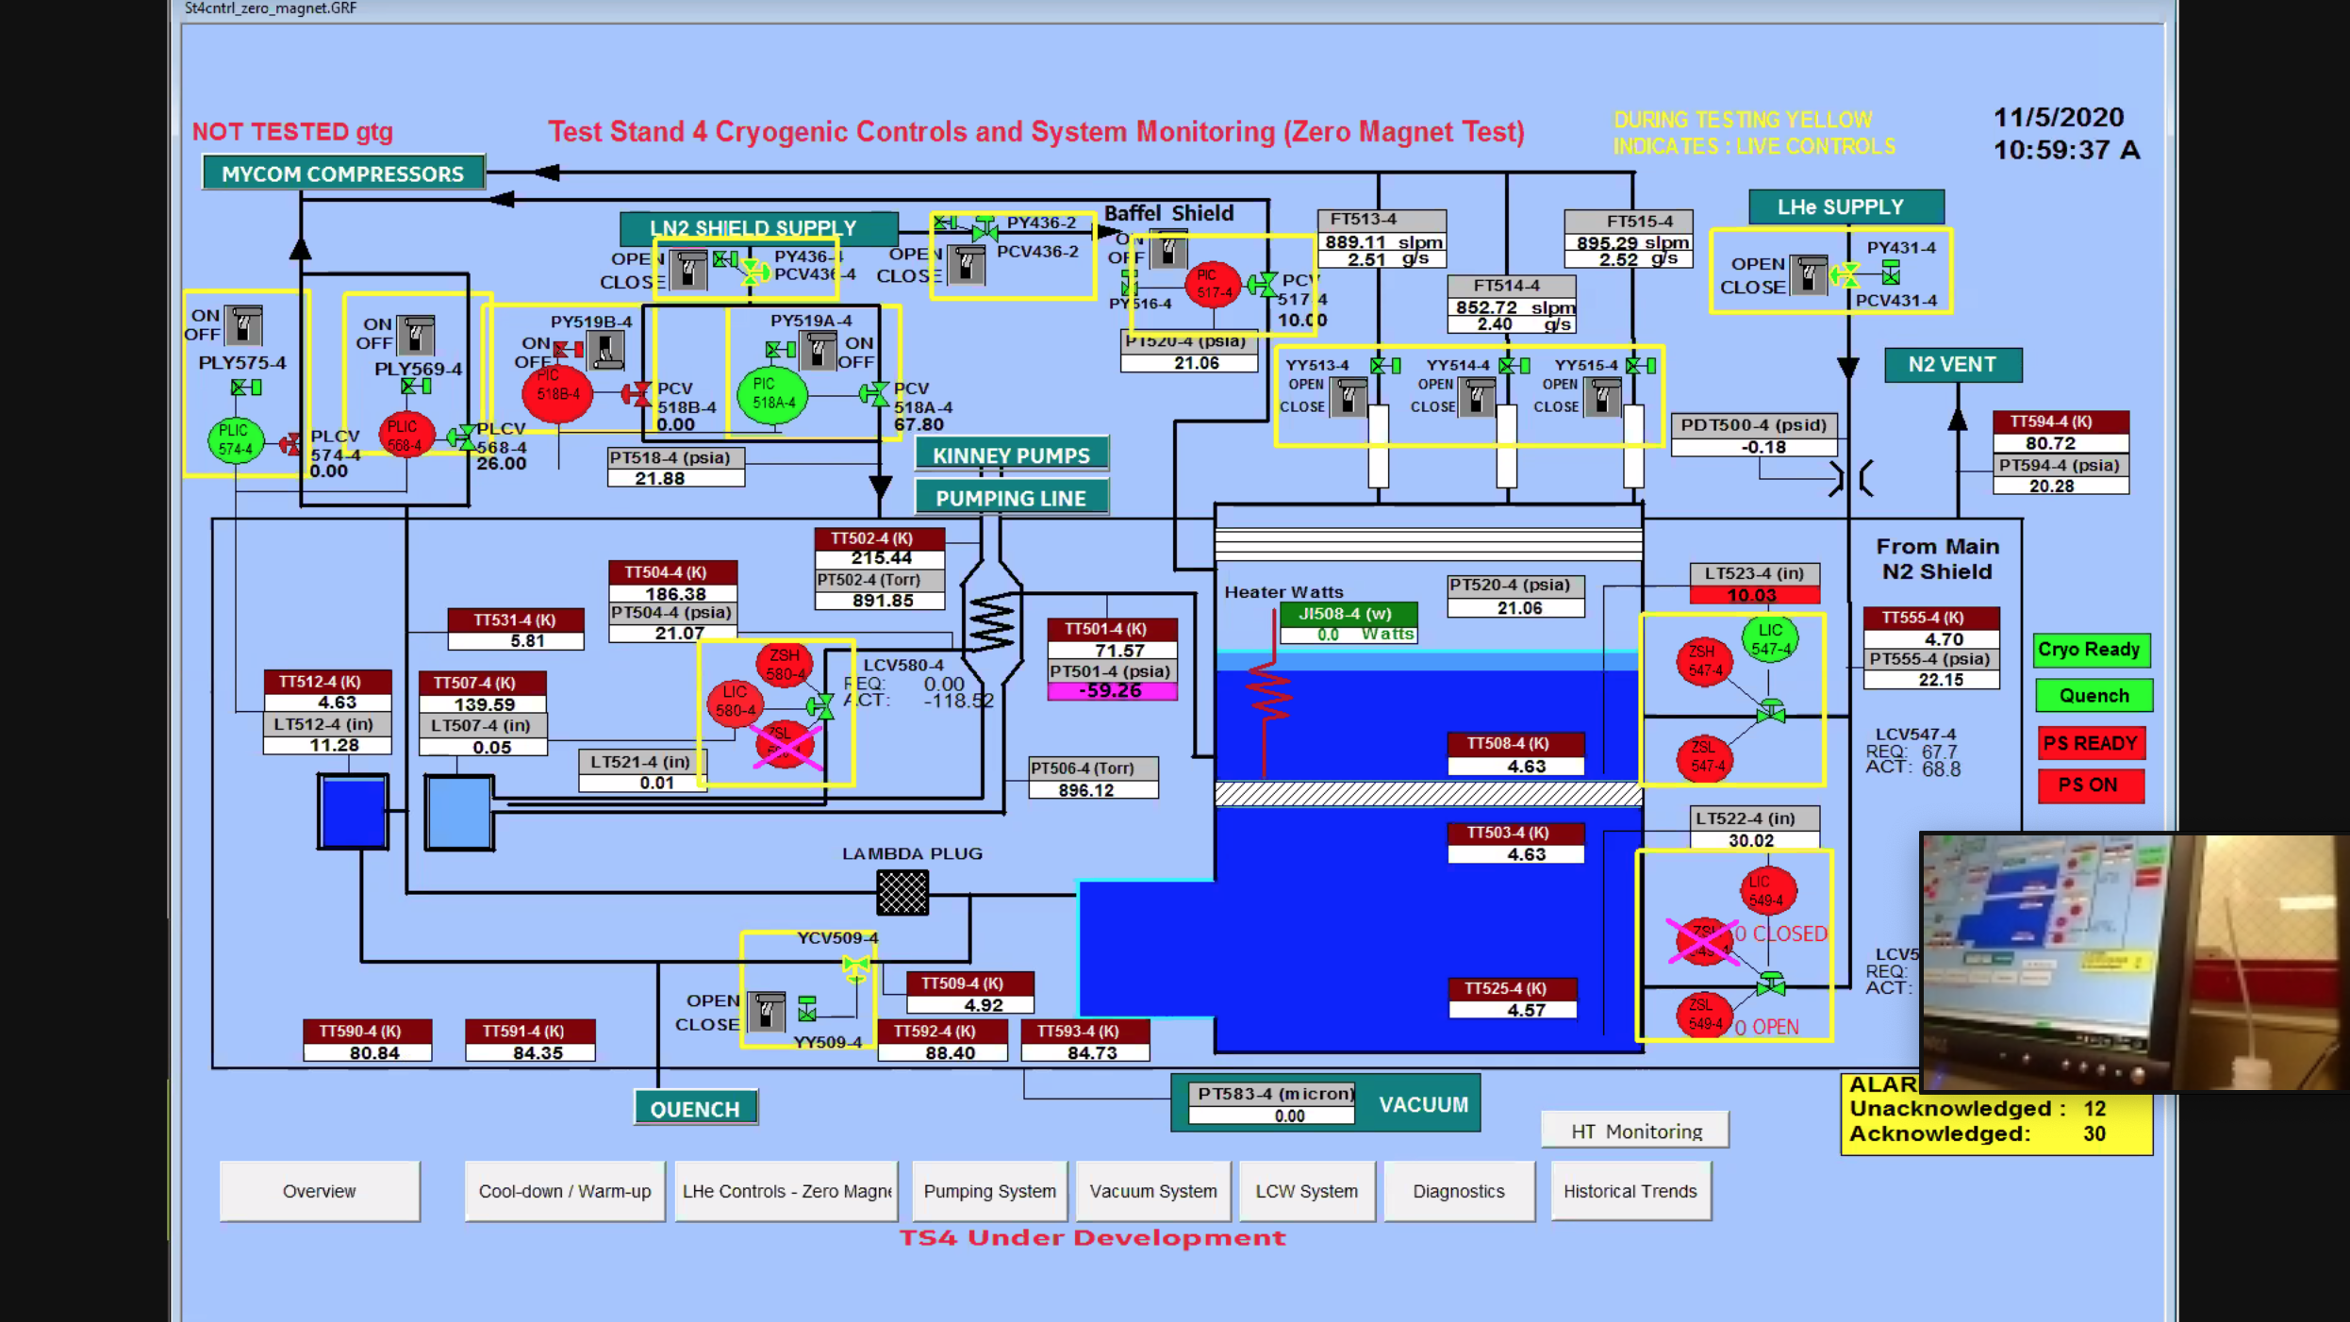
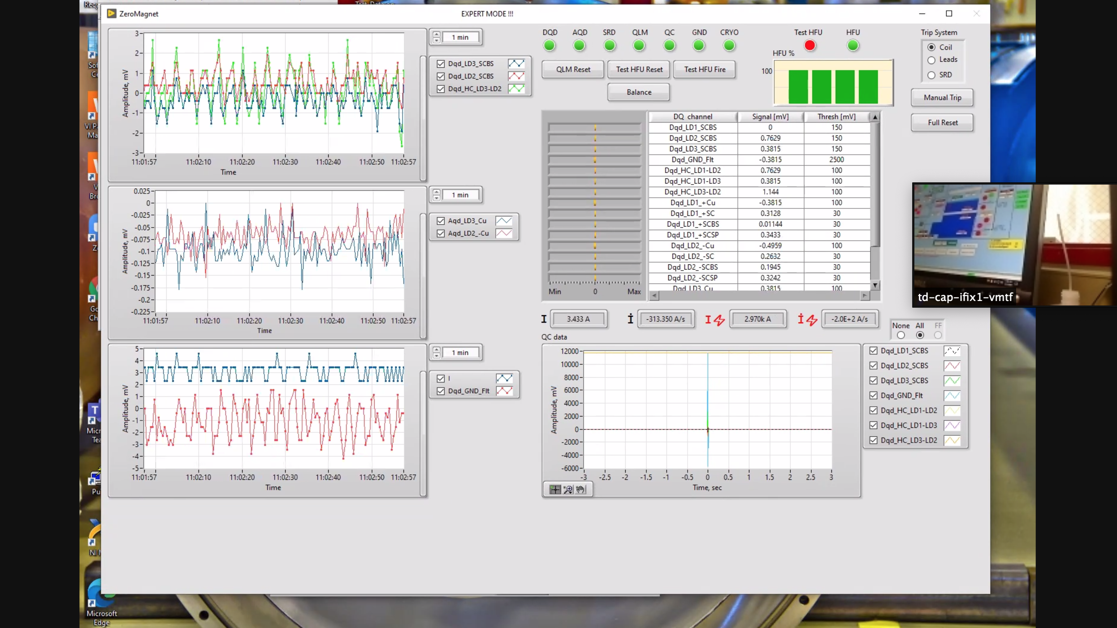
Mu2e 1st Article Quench Protection
Hi-Lumi ZMT Cold Test
ZOOM Power Test side note:
The test was carried out in the control room, which has a limited capacity due to COVID-19
Zoom meetings were set up so all the subject matter experts could participate
The relevant test GUIs were shared with audio – worked great!
Darryl Orris

