Slide 1
US MDP
Organization overview
Soren Prestemon
Director, Berkeley Center for Magnet Technology
Lawrence Berkeley National Laboratory

Slide 2
Challenges from an accelerator magnet perspective
MDP Management Group
S. Prestemon, LBNL
G. Velev, FNAL (Deputy)
L. Cooley, FNAL
S. Gourlay, LBNL
D. Larbalestier, FSU
A. Zlobin, FNAL
Technical Advisory Committee
Andy Lankford, UCI (Chair)
Davide Tommasini, CERN
Mark Palmer, BNL
Akira Yamamoto, KEK/CERN
Giorgio Apollinari, FNAL
Joe Minervini, MIT
(Being formed)
Soren Prestemon

Slide 3
MDP structure designed to foster communication while maintaining focus
Magnets:
Cos-theta 15T lead: Sasha Zlobin
CCT lead: Diego Arbelaez
REBCO lead: Xiaorong Wang
Bi2212 lead: Tengming Shen
Design Teams:
16 T Dipole design
Leads: Sasha Zlobin and GianLuca Sabbi
Utility Structure design:
Lead: Mariusz Juchno
Conductor Procurement and R&D
Lead: Lance Cooley

Slide 4
Roles of leads: mainly communication, coordination and planning
Responsibilities of Leads:
• Develop prioritized tasks, budgets, and milestones/schedules
• Identify expertise and infrastructure that can be applied to the tasks
• Communicate and defend the prioritized tasks to the broader MDP group
Keep a focus on our program goals:
GOAL 1:
Explore the performance limits of Nb₃Sn accelerator magnets with a focus on minimizing the required operating margin and significantly reducing or eliminating training.
GOAL 2:
Develop and demonstrate an HTS accelerator magnet with a self-field of 5 T or greater compatible with operation in a hybrid LTS/HTS magnet for fields beyond 16 T.
GOAL 3:
Support the above efforts by addressing fundamental aspects of magnet design and technology that can lead to substantial performance improvements and magnet cost reduction.
GOAL 4:
Pursue Nb₃Sn and HTS conductor R&D with clear targets to increase performance and reduce the cost of accelerator magnets.

Slide 5
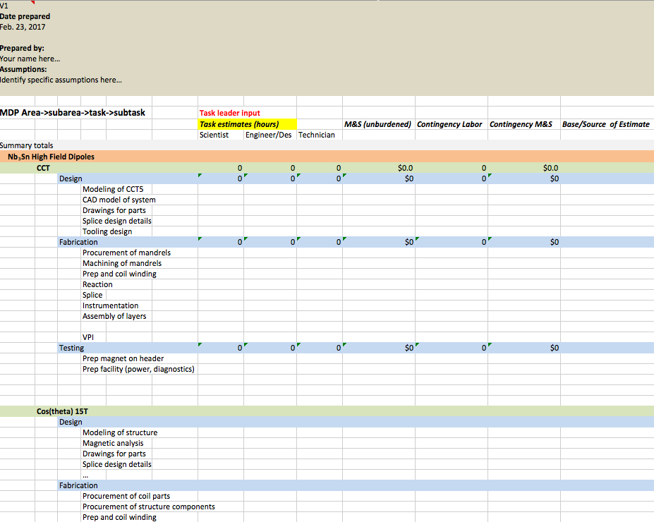
A spreadsheet for scope and budget planning will be provided to leads
Goal is to develop a bottoms-up scope and budget for FY18
  We will work together to prioritize scope

Slide 6
Near term planning
– presentations and reviews
The MDP General meetings have an Indico site: https://conferences.lbl.gov/event/84/
Today: Focus on 15T and discussion on target parameters for a 16+T magnet design
April 5th MDP General Meeting:
  update on Utility Structure design progress (Mariusz Juchno)
  Proposals for additional topics welcome (email SP and GV)
April 12th MDP General Meeting:
  Update on CCT: status of CCT4, general plans of CCT program
  …Proposals for additional topics welcome (email SP and GV)
May 1st [tentative]: Review of CCT program
…

