Slide 1
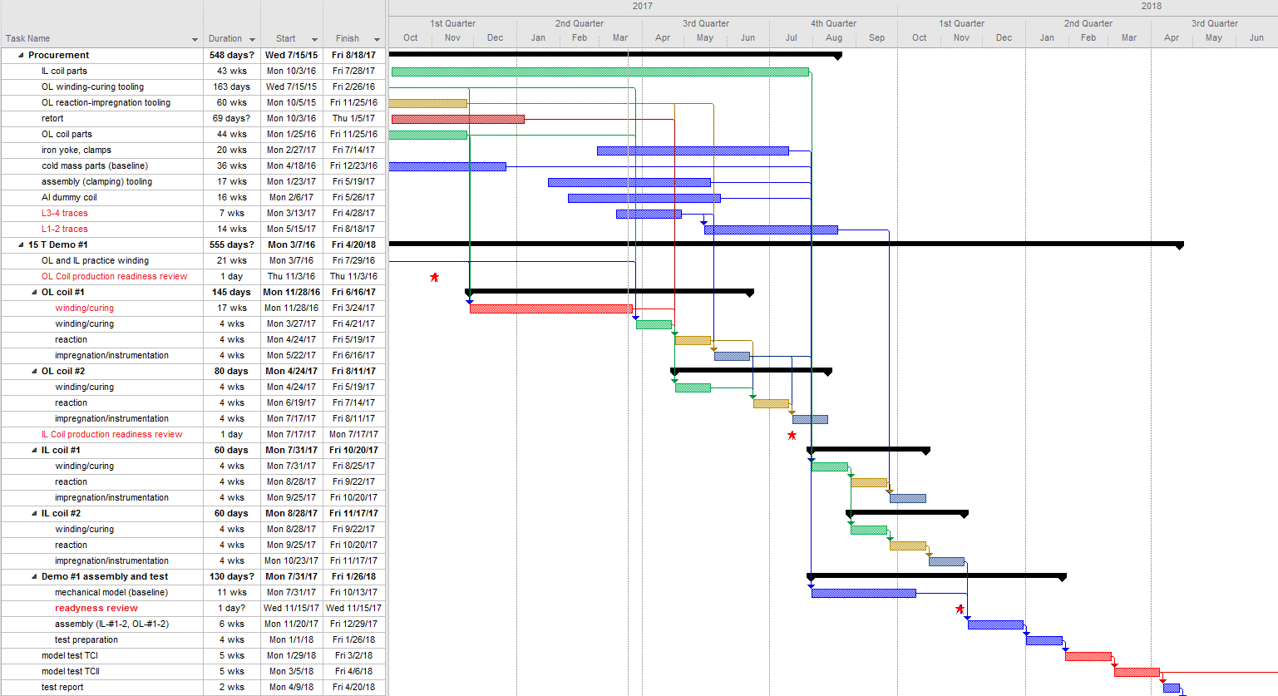
Status of the 15 T dipole demonstrator

