Slide 1
US Magnet Development Program
Current status of a shell-based utility structure
Mariusz Juchno
US Magnet Development Program
Lawrence Berkeley National Laboratory

Slide 2
The goal
Shell-based Utility Structure
Pre-stress for ~17T operation (Nominal 16T, design target 17T)
Tunable via key shimming
Peak stress of 180 (?) MPa (150 MPa assembly)
Requirement on pole separation or tensile stress
Rapid and reproducible assembly/disassembly
Compatible with existing 4-layer Cos-theta coil design
Adjustable to variety of coil designs with minimum modifications
Design limits and sensitivity
Magnet outer diameter
Coil design compatibility and combined mechanical/magnetic design
Sensitivity of mechanical performance
Dimensions, tolerances, friction, etc.

Slide 3
Current 4-layer Cos-theta coil

Slide 4
Magnetic forces vs cable width
Quantities
Horizontal magnetic force
Azimuthal stress on the mid-plane based purely on magnetic force accumulation and cable width
Cable width
15.10 mm (solid line)
21.13 mm (dashed line)
Coil ID fixed
Only radial coil dimensions changed
Azimuthal coordinates of each block are not changed
Number of turns not changed
Bigger coil not optimized
What do we get
L2 shows higher stress than L1 ?
High azimuthal stress in L3 ?
Wider tape seems to reduce stress by <30MPa ?
What we are missing
Layers impregnated together
Friction between coils
Coil deformation and bending
Horizontal force accumulation
Structure…

Slide 5
Forces per block 15.1 mm cable
In the coil L1+L2 block B5 shows highest vertical force and contributes to a high peak stress in block B1
L1+L2 compress L3+L4 against structure and high vertical force in L3+L4 does not deform the coil and stress is not high

Slide 6
Fixed structure No pre-load
Structure and poles infinitely rigid with fixed displacement
Not contracting due to cool-down
Contact with friction
Coil not bonded to the pole
Not contracting due to cool-down
Properties for 4.3K
Layers 1&2 bonded together
Layers 3&4 bonded together
Layers 2&3 in contact with friction
Conclusions
Stress concentration in mid-plane of layer 1
135 MPa at 15 T
174 MPa at 17 T
Stress in layers 2-4 < 90MPa contrary to magnetic analysis estimate
Bonded coils
Interaction between layers and structure
135MPa

Slide 7
Fixed structure, No pre-load Comparison with previous estimation
L1 and L2 potted
Average stress in 1st block similar to average stress from L1 and L2 magnetic forces
Peak stress ~20MPa higher due to bending
17T shows stress ~30MPa higher than 15T
Requires ~30MPa more pre-load at CD and MF

Slide 8
Fixed structure Pre-load for 15 T
Rigid structure
Shrinkage modeled by contact element offset (-365um)
Structure does not deform due to MF
Coil and pole shrink during cool-down
Coil can separate from the pole
Horizontal magnetic force: 7 MN/m
Total pole reaction force at cool-down: -8.7 MN/m
Reaction force in each pole at 15T:
-0.3, -0.8, -1.6, -1.5 MN/m

Slide 9
Fixed structure Pre-load for 17 T
Rigid structure
Shrinkage modeled by contact element offset (-385um)
Structure does not deform due to MF
Coil and pole shrink during cool-down
Coil can separate from the pole
Horizontal magnetic force: 9 MN/m
Total pole reaction force at cool-down: -10.7 MN/m
Reaction force in each pole at 17T:
-0.2, -0.8, -2.0, -1.6 MN/m

Slide 10
Exploration of shell parameters
Two types of yoke configurations investigated
Dipole yokes
Quad yokes
Shell parameter space
OD range: 600-800 mm
TH range: 55-75 mm
Pre-load target
Pole reaction force 2MN/m higher than magnetic forces
Adjusted using key shim
Quantities
Shell and pole reaction forces (RT, CD)
Shell stress
Pre-load key shim
Bladder pressure
Dipole yokes bladder surface D/2
Quad yokes bladder surface 0.7D/2

Slide 11
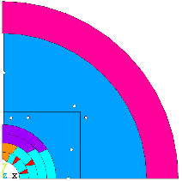
Dipole yokes Forces, Shell stress
15T
17T
RT key adjusted to the same pre-load after cool-down (2MN/m more than magnetic forces)
Reaction force in the shell equal to the reaction force in the pole

Slide 12
Dipole yokes Horizontal key, bladder pressure
15T
17T
RT key adjusted required to reach the pre-load
Only half of diameter used for the bladders
$$S= \frac{D}{2}$$

Slide 13
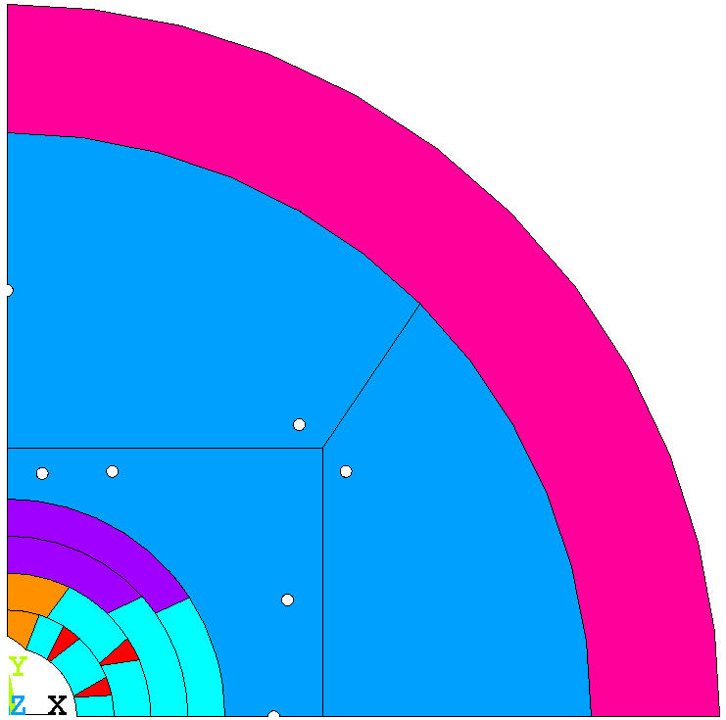
Quad yokes Forces, Shell stress
15T
17T
RT key adjusted to the same pre-load after cool-down (2MN/m more than magnetic forces)
Reaction force in the shell higher due to pre-load locked by the top/bottom yoke

Slide 14
Quad yokes Horizontal key, bladder pressure
15T
17T
Thicker shim required due to intercepted force
Usable bladder space smaller than in dipole yokes structure
$$S= \frac{D}{2}\frac{\sqrt{2}}{2}$$

Slide 15
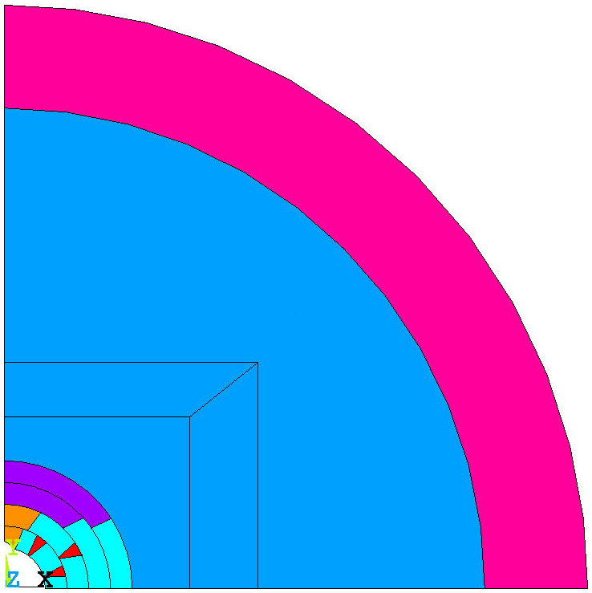
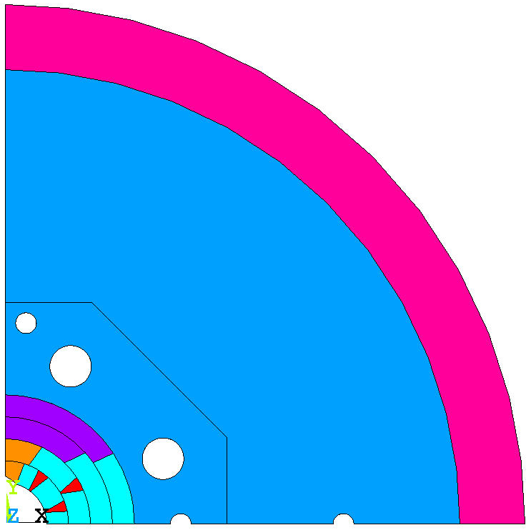
Summary Other structure types
Dipole yokes
Sufficient bladder space
Full reaction force from the shell goes to coil pre-load
Vertical corner keys increase stress in the structure
Low number of components
Adjustment with 2 key types
Quad yokes
Limited bladder space, bladders less efficient
Top/bottom yoke limits vertical and intercepts part of the pre-load
Vertical corner keys increase stress in the structure
Quad yokes assembly
Adjustment with 2 key types
Dipole yokes, quad pads
Sufficient bladder space
Top/bottom pad limits vertical and intercepts part of the pre-load
Vertical corner keys increase stress in the structure
Simple yoke assembly, more components in the coil-pack, bigger OD required
Adjustment with 2 key types
Dipole yokes, octagonal coil-pack
Sufficient bladder space, diagonal bladders less efficient but increase total surface
Full reaction force from the shell goes to coil pre-load
Force transfer radially, low stress in the structure
Low number of components
Adjustment with 3 key types

Slide 16
Shell based structure – example 1 Dipole yokes
Structure configuration:
2 yokes (iron)
2 “collars” (iron)
Shell OD/TH: 610/55 mm
Hor. Mag. forces at 15T: 6.7MN/m
Shell force at CD: 8.7 MN/m
Pole force at CD: 8.7MN/m
Pole force at 15T: 2.0 MN/m

Slide 17
Shell based structure – example 2 Quad yokes
Structure configuration:
4 yokes (iron)
2 “collars” (iron)
Shell OD/TH: 610/55 mm
Hor. Mag. forces at 15T: 6.7MN/m
Shell force at CD: 12.4 MN/m
Pole force at CD: 8.4 MN/m
Pole force at 15T: 2.1 MN/m

Slide 18
Shell based structure – example 3 Dipole yokes, Quad pads
Structure configuration:
2 yokes (iron)
4 pads (iron)
2 “collars” (iron)
Shell OD/TH: 850/75 mm
Hor. Mag. forces at 15T: 6.9MN/m
Shell force at CD: 12.7 MN/m
Pole force at CD: 8.5 MN/m
Pole force at 15T: 2.3 MN/m

Slide 19
Shell based structure – example 4 Dipole yokes, Octagon coil-pack
Structure configuration:
2 yokes (iron)
2 “collars” (iron)
Octagon coil-pack
Shell OD/TH: 750/47 mm
Hor. Mag. forces at 15T: 7.0MN/m
Shell force at CD: 8.7 MN/m
Pole force at CD: 8.7 MN/m
Pole force at 15T: 1.7 MN/m

Slide 20
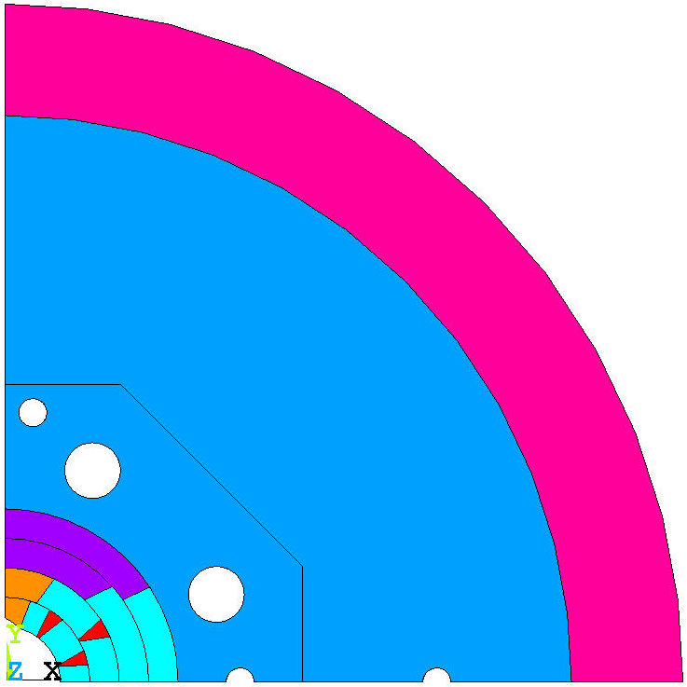
Structure concept optimized for 16T
Shell OD: 730 mm, TH: 60 mm
Bladder pressure < 45 MPa
Coil stress < 80 MPa @ RT
Structure stress
< 180 MPa @ RT
< 360 MPa @ CD & 16 T
17 T with stress ~230 MPa
<200MPa
4.3 K
<2um
<200MPa
16 T

Slide 21
Conclusions
Integrated magnetic and mechanical design is crucial
Even simplified mechanical models with fixed OD pre-load can give a good overview of the coil stress limits
Mechanical limitations of the coil design
Wider cable might not solve the problem for CT
Stress management in CT coils is an interesting concept
Optimization of the coil blocks to minimize the peak stress
Other coil designs
Utility structure
Minimum OD limited by space available for bladders (~700mm)
Dipole yoke type structures more efficient
Structure with octagonal coil-pack
Compatible with existing CT design (~180 MPa @ 15T after quick optimization)
Shlomo! Let’s put CCT inside!
Minimum time for engineering design, procurement and parts fabrication
6-8 months

Slide 22
Structure with octagonal coil-pack

