Slide 1
CCT3 magnet test highlights
M. Marchevsky - LBNL

Slide 2
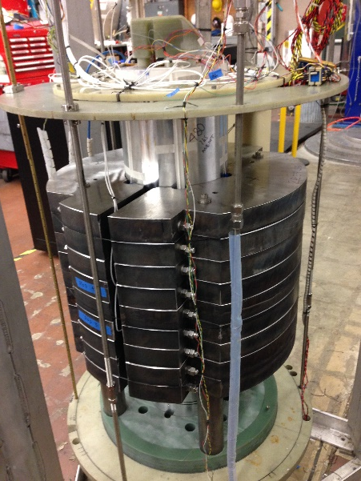
Vtap layout
A1
Sn-Ti
A2
(A2-A3), (A4-A5), (B2-B3), (B4-B7): ∼4.5 turns each.
(B7,B6): 27 cm
(B6,B5): 11.4 cm-heater-50.8 cm
(B5,B4): ∼4 turns
A3
IL
A4
A5
Sn-Ti
A6
SpA
Ti-Ti
SpB
Sn-Ti
B8
H1a
↑
B7
heater
B6
H1b
B5
OL
B4
B3
↓
Sn-Ti
B2
Each layer was sub-divided in three basic parts: two 4-turn sections at the ends and a larger middle section
B1

Slide 3
Electrical QA
Magnet QA included sequential resistance measurement, resistances coil-to mandrel, and impulse test. Prior to test, hipot of coil to ground (1000 V) was done.
Impulse tests were conducted at 100, 200 and 300 V for each layer. Impulse waveforms are complex (but consistent with CCT2) and reproducible.
Winding to mandrel resistances were ∼100 Ω and ∼140 Ω respectively (due to partly carbonized cable insulation). These changed to “open” and ∼ 10 kΩ at cold, and returned to approximately same values as prior to test upon warming up. During test, resistance between coil and mandrel was monitored continuously for several ramps and through quench; no major resistance variation or insulation breakdown was seen.

Slide 4
RRR measurement
RRR was measured on cooldown. Temperature T_{mid} was
measured by the sensor attached to the steel yoke in the middle of the magnet
383.4 mV
RRR = 238

Slide 5
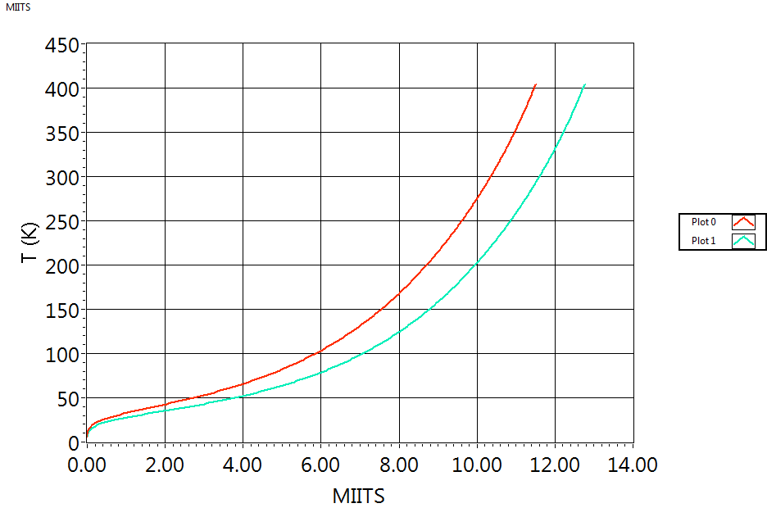
MIITs / hot spot temperature
d_{str} = 0.80 mm
# of strands = 23
Non-copper fraction: 54.6% => r_{Cu/Sc} ∼ 0.83
$ρ(T$) follows Gruneisen-Bloch with $ρ_{0}$= 1.2 x 10⁻¹⁰ Ωm
10.34
$$\int_{0}^{T}{\frac{c(T)}{ρ(T)}}dT=\frac{1+r}{r}\int_{0}^{∞}{J^{2}}dt$$
11.60
RRR=130
Current decay in CCT3 with 30 mΩ dump resistor, when extrapolated to 18 kA would yield 9.56 MIITS. Higher dump (40 mΩ) was used above 10.6 kA to further reduce hot spot temperature.
RRR=250
In the highest current quench A53 (13147 A, 40 mΩ dump) the MIITs were only 2.86 (=> ∼ 50 K hot spot)
Last (unprotected) quench in A23 segment was at 12475 A, resulting in 11.8 MIITs. It should have yielded ∼ 350 K (or less) hot spot given the measured RRR value.

Slide 6
Training summary
56 current extractions conducted; 30 were natural quenches and the rest was triggered by flux jumps
The highest quench current was 13147 A, yielding 7.4 T dipole field in the bore and 8.3 T at the conductor
The absolute majority of quenches occurred within the first four turns of the inner layer (A23), counting from the lead end.
CCT3 reached 74% of short sample current after 28 quenches
I_{ss}= 17700 A
OL
A41
A44
A53
A40
A42
A62
A37
A38
A49
A29
A43
A25
A28
A33
A16
A17
A18
A30
A10
A27
A54
A09
A19
A20
Unusual “inverse” ramp-rate dependence of quench current
A11
A15
A06
A24
A08
A02

Slide 7
Ramp-rate dependence
“Inverse” dependence of “saturated” quench current from ramp rate.
At around 120 A/s flattening of the dependence is seen.

Slide 8
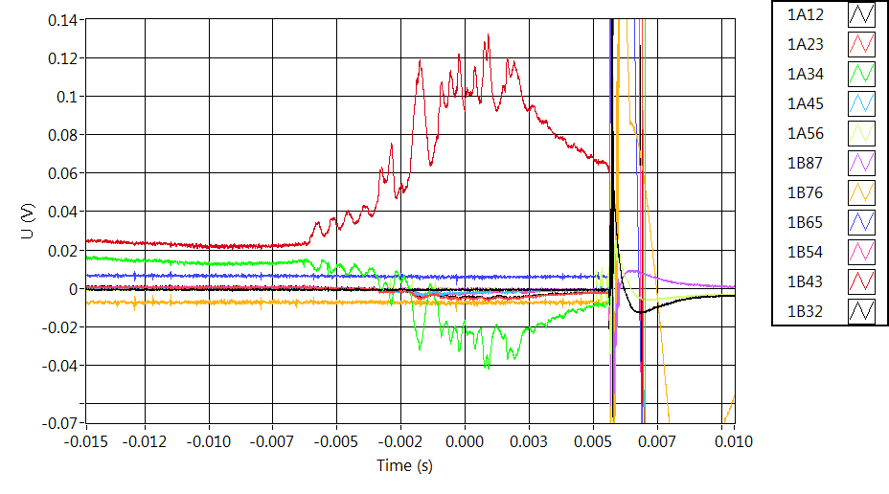
Voltage spikes
“Giant” voltage spikes were observed during ramping; they persisted up to ∼10 kA
- Largest amplitude of spikes is seen in the outer layer (12 “trips” due to voltage spikes in excess of 0.1 V in the central “B3-B4” section, and 2 “trips” due to spikes in the end sections “B2-B3” and “B4-B5”.
“False trip” example: voltage rises in multiple spikes in the B43 segment, and then starts to recover. It is “mirrored” by inductive response in the underlying inner layer (A34)
A07

Slide 9
First and second ramps to quench (A02 and A06)
Significant mechanical activity in the first ramp; mostly quiet in the second
A02
I_{mag}
Acoustic
A06
*same vertical scales in both plots

Slide 10
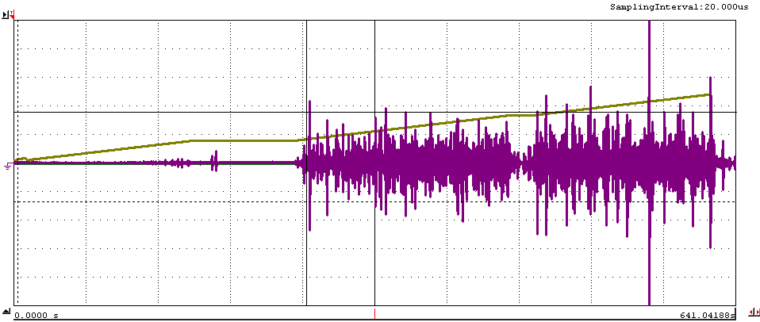
First ramp to quench (A02)
Magnet current
Acoustic
Magnet is very noisy in the first ramp to quench
A spike indicative of some very large mechanical event was detected during the ramp, ∼ 60 s prior to a quench
An “extreme” mechanical event?
Quench at 9605 A

Slide 11
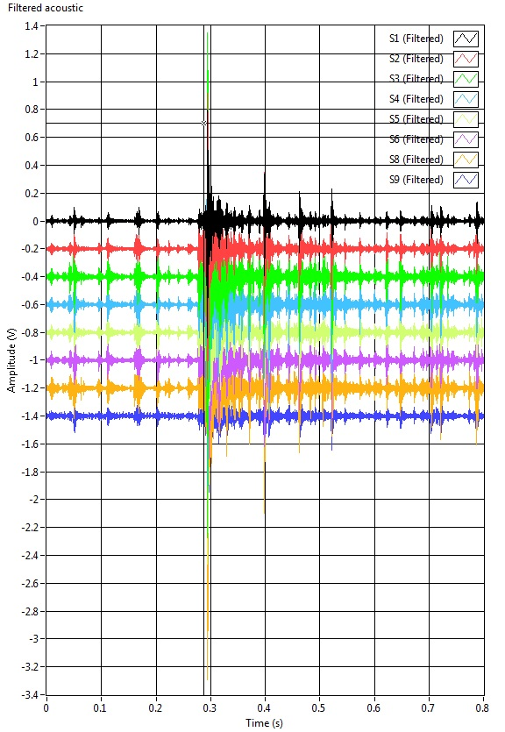
First ramp to quench (A02)
Multiple mechanical events are detected prior to the quench, they are triangulated to the pole locations; axially close to the magnet center.
CCT3 quench #1 (A02) at 9605 A occurs in the A23 segment.

Slide 12
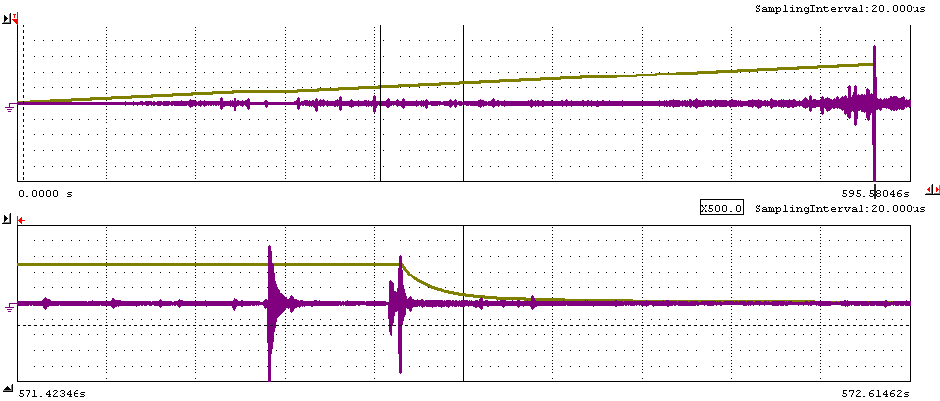
CCT3 second ramp to quench (A06)
Magnet current
Acoustic
Magnet current
Quench at 10000 A
Acoustic
Magnet is much quieter in the second ramp to quench
Another large mechanical event (a precursor?) is detected at ∼ 0.16 s prior to the quench. Falls within our high-res time window; can be triangulated.
Quenches after this one were mostly quiet in acoustics; with only occasional smaller amplitude events (Except for a single OL quench).

Slide 13
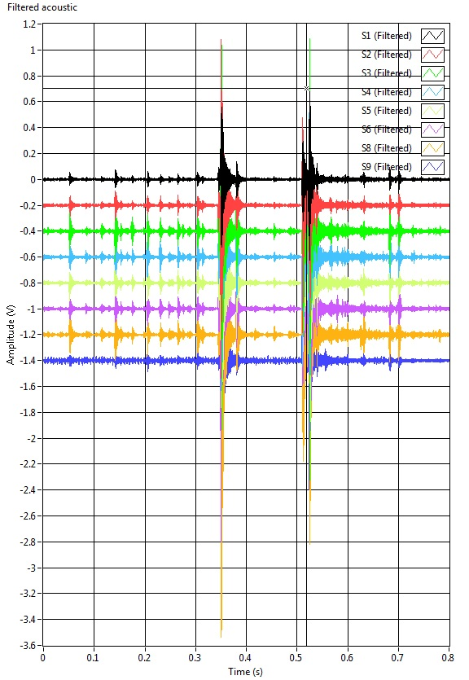
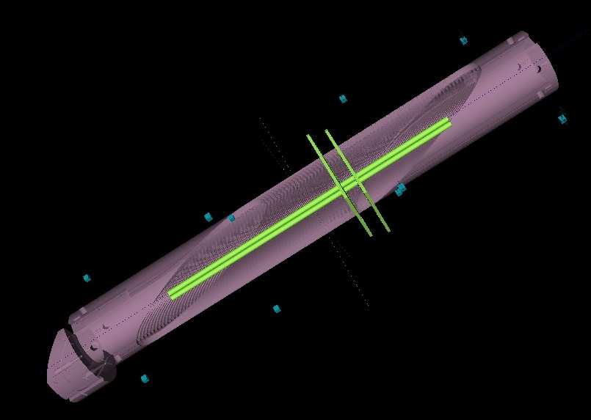
Quench precursor in A06
Quench (2) is triangulated to the mid-plane location closer to the lead (bottom) end of the magnet. The disturbance (1) occurs in the proximity of it, along the same azimuthal line.
Voltage spike in A23 (resistive) is simultaneous with the spike in B34 (inductive), followed by the resistive spike propagating in A34
B34
A34
A23
2
1
2
1
A34 segment (4 turns)
A06

Slide 14
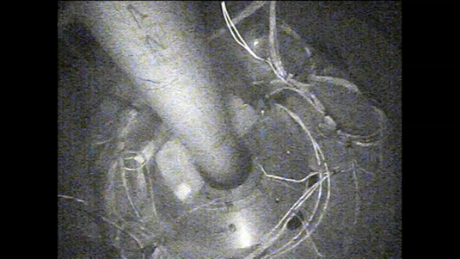
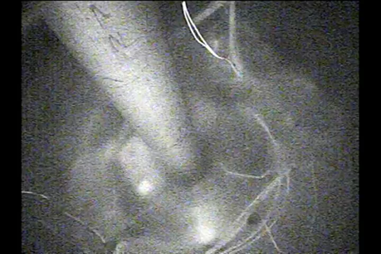
Current holding
No quenches observed at 12 kA current held steady for 20 min
12 kA held steady
Ramping to quench
Very minor boiling of helium during current hold (compared to ramping)

Slide 15
Summary
Electrical QA prior to the test, and checks past test did not reveal any insulation breakdowns.
First and second quenches exhibited a significant amount of mechanical activity and singular precursor “spikes” in acoustics; one of those largest spikes was also matched to the quench location
CCT3 magnet showed a performance limitation seen as absence of training past the initial ∼5 quenches
“Inverse” ramp rate dependence of quench current is observed up to ∼ 120 A/s; it allowed to reach higher quench currents in the test
Magnet is stable when held for 20 min at 12 kA (92% of the highest quench current)
We believe that local conductor damage could have been responsible for the observed limitation, causing instabilities during ramping and quench localization at the same spot within A34 segment. It could have occurred during assembly or during first ramping to quench, that exhibited significant structural motion and “extreme” mechanical events seen by the acoustics.

Slide 16
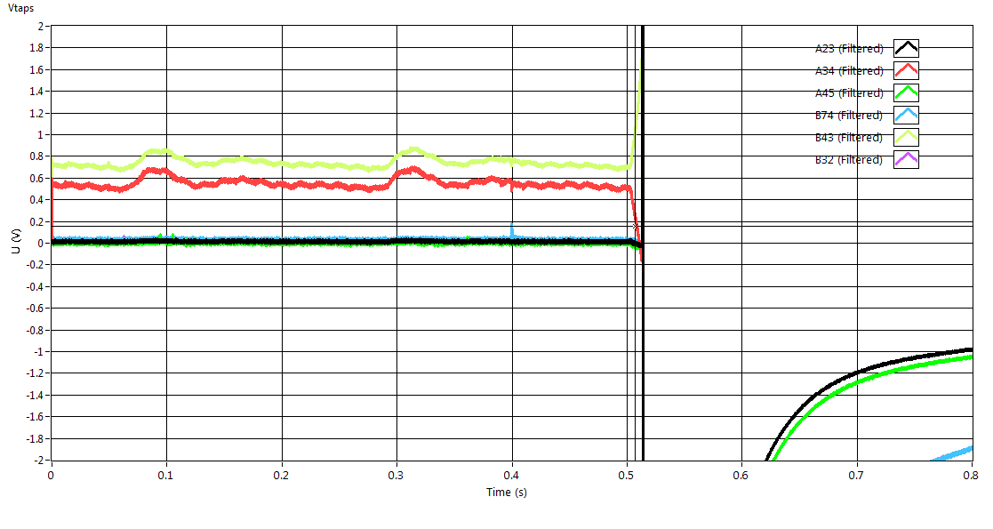
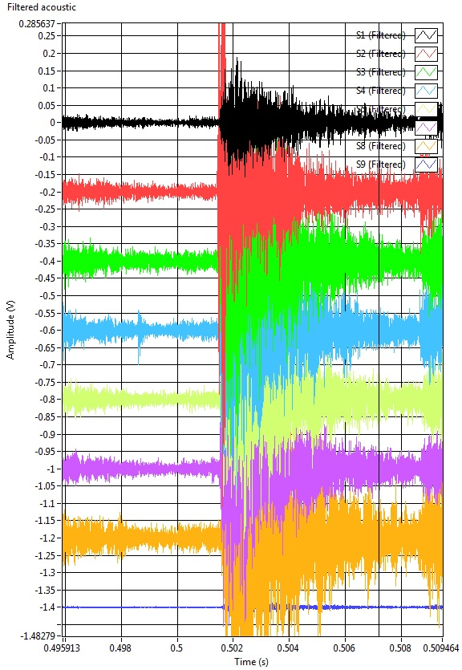
Quench at 13147 A (B34)
OL quench in in the central portion of the magnet

