Slide 1
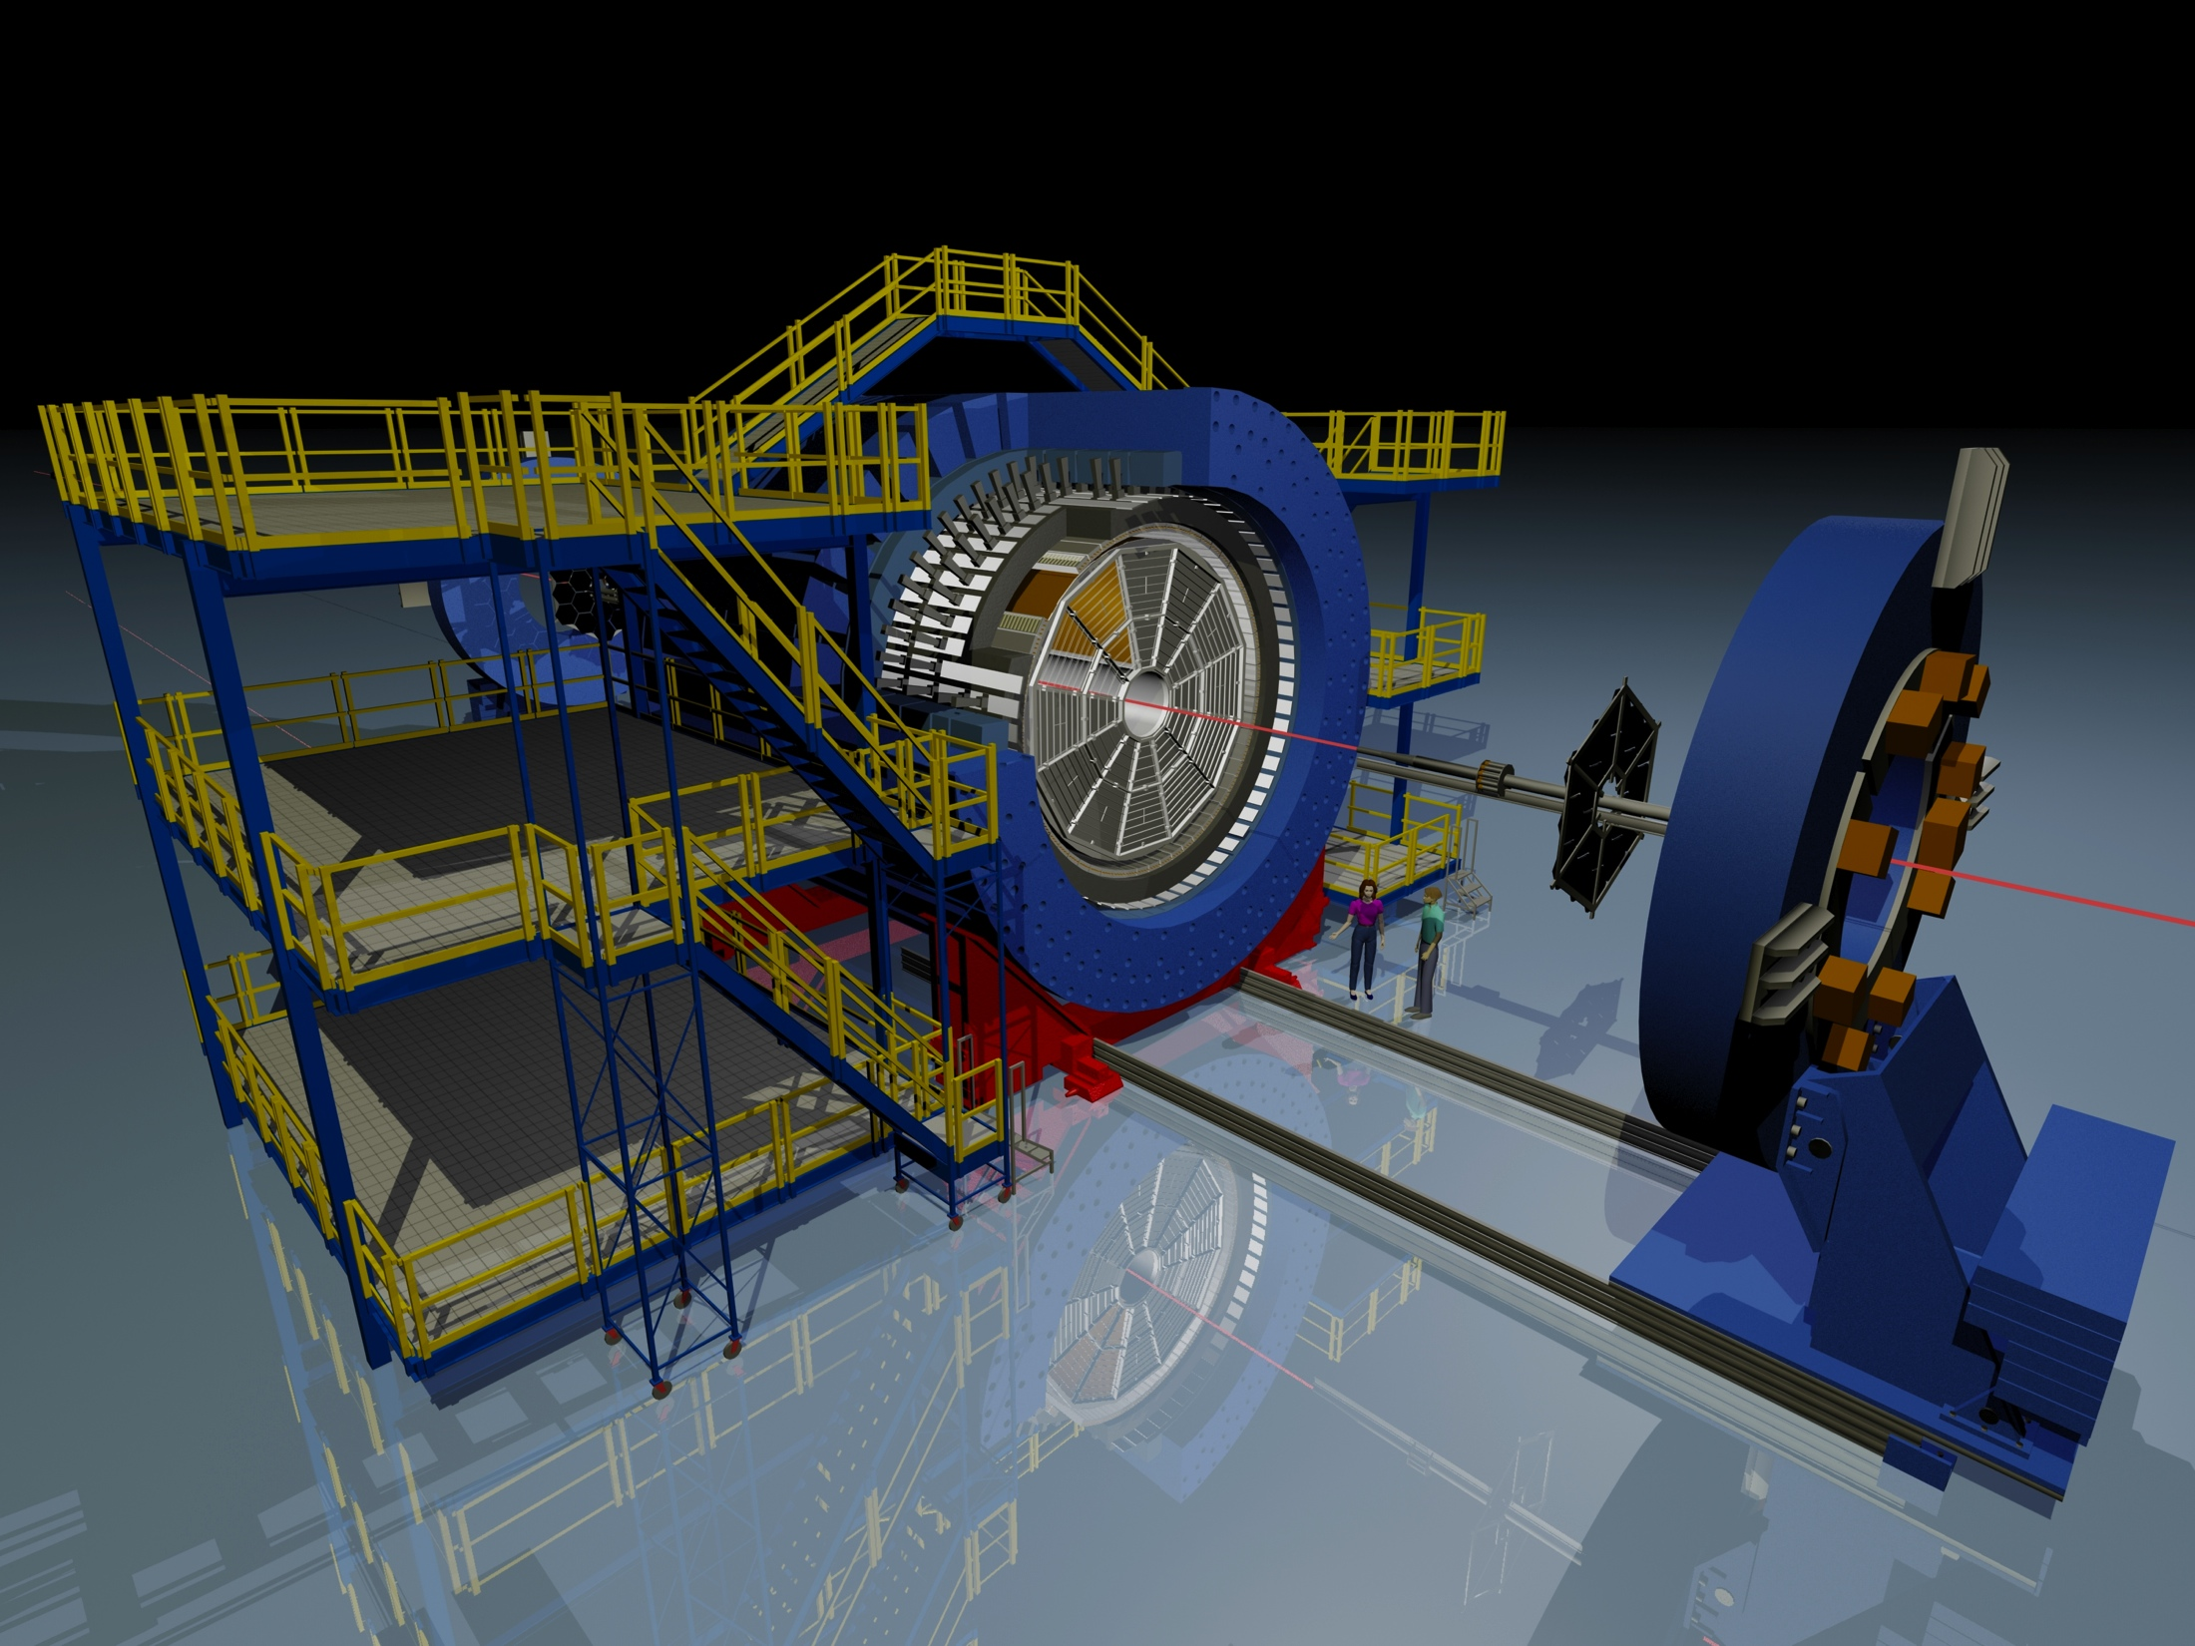
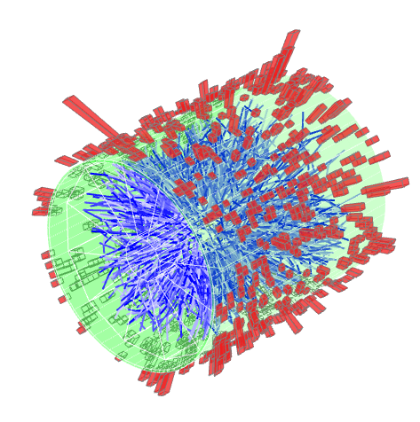
The discovery of jet quenching by STAR
Xin-Nian’s role in
^
Peter Jacobs
Lawrence Berkeley National Laboratory

Slide 2
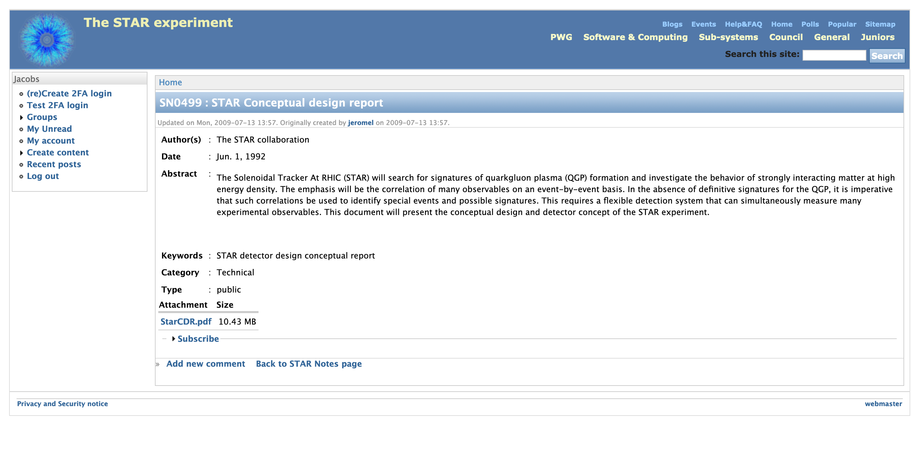
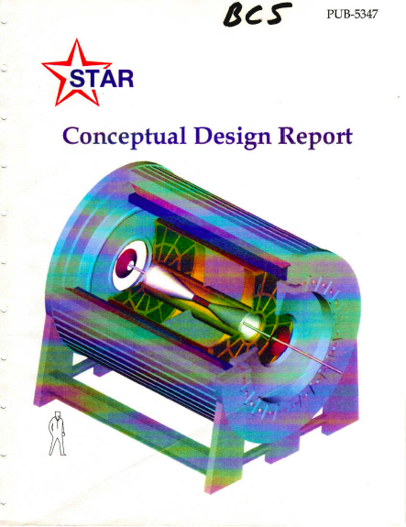

Slide 5
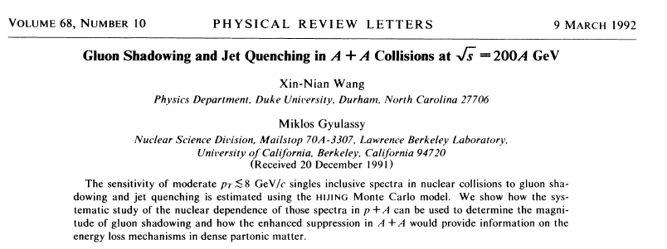
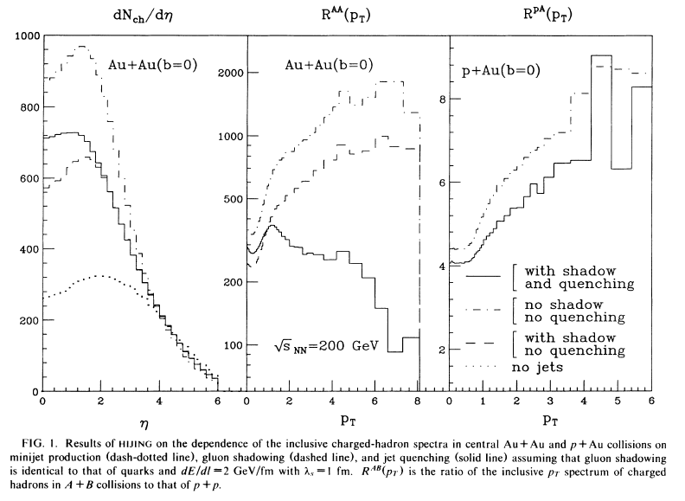
Defines R_{AA}
Proposes p+A to calibrate non-quenching effects
Shadowing effects are modest
Quenching effects are much larger than shadowing – predict factor 5!

Slide 6
How we described this in the STAR CDR:

Slide 7
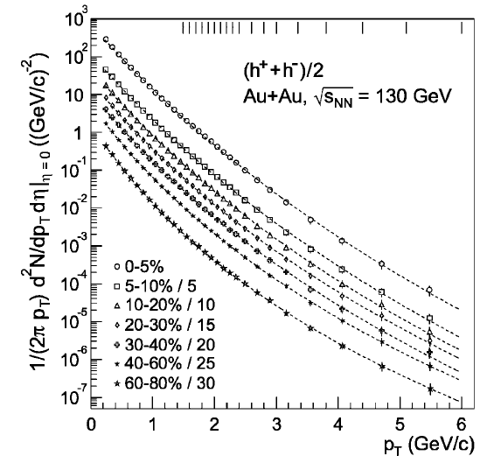
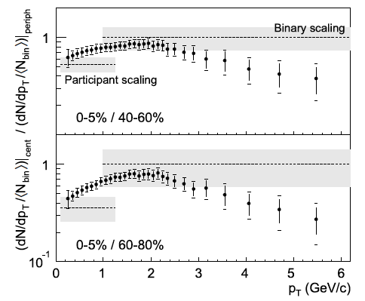
Fast-forward 10 years….
Factor ~5 suppression!

Slide 8
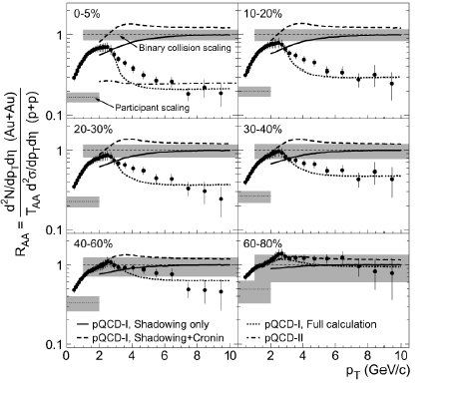
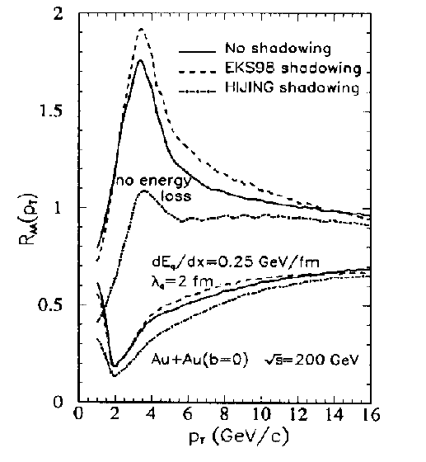
√s_{NN}=200 GeV;
R_{AA} with measured pp reference
XNW,
Last Call for RHIC Predictions,
Nucl Phys A661 (1999) 205c

Slide 9
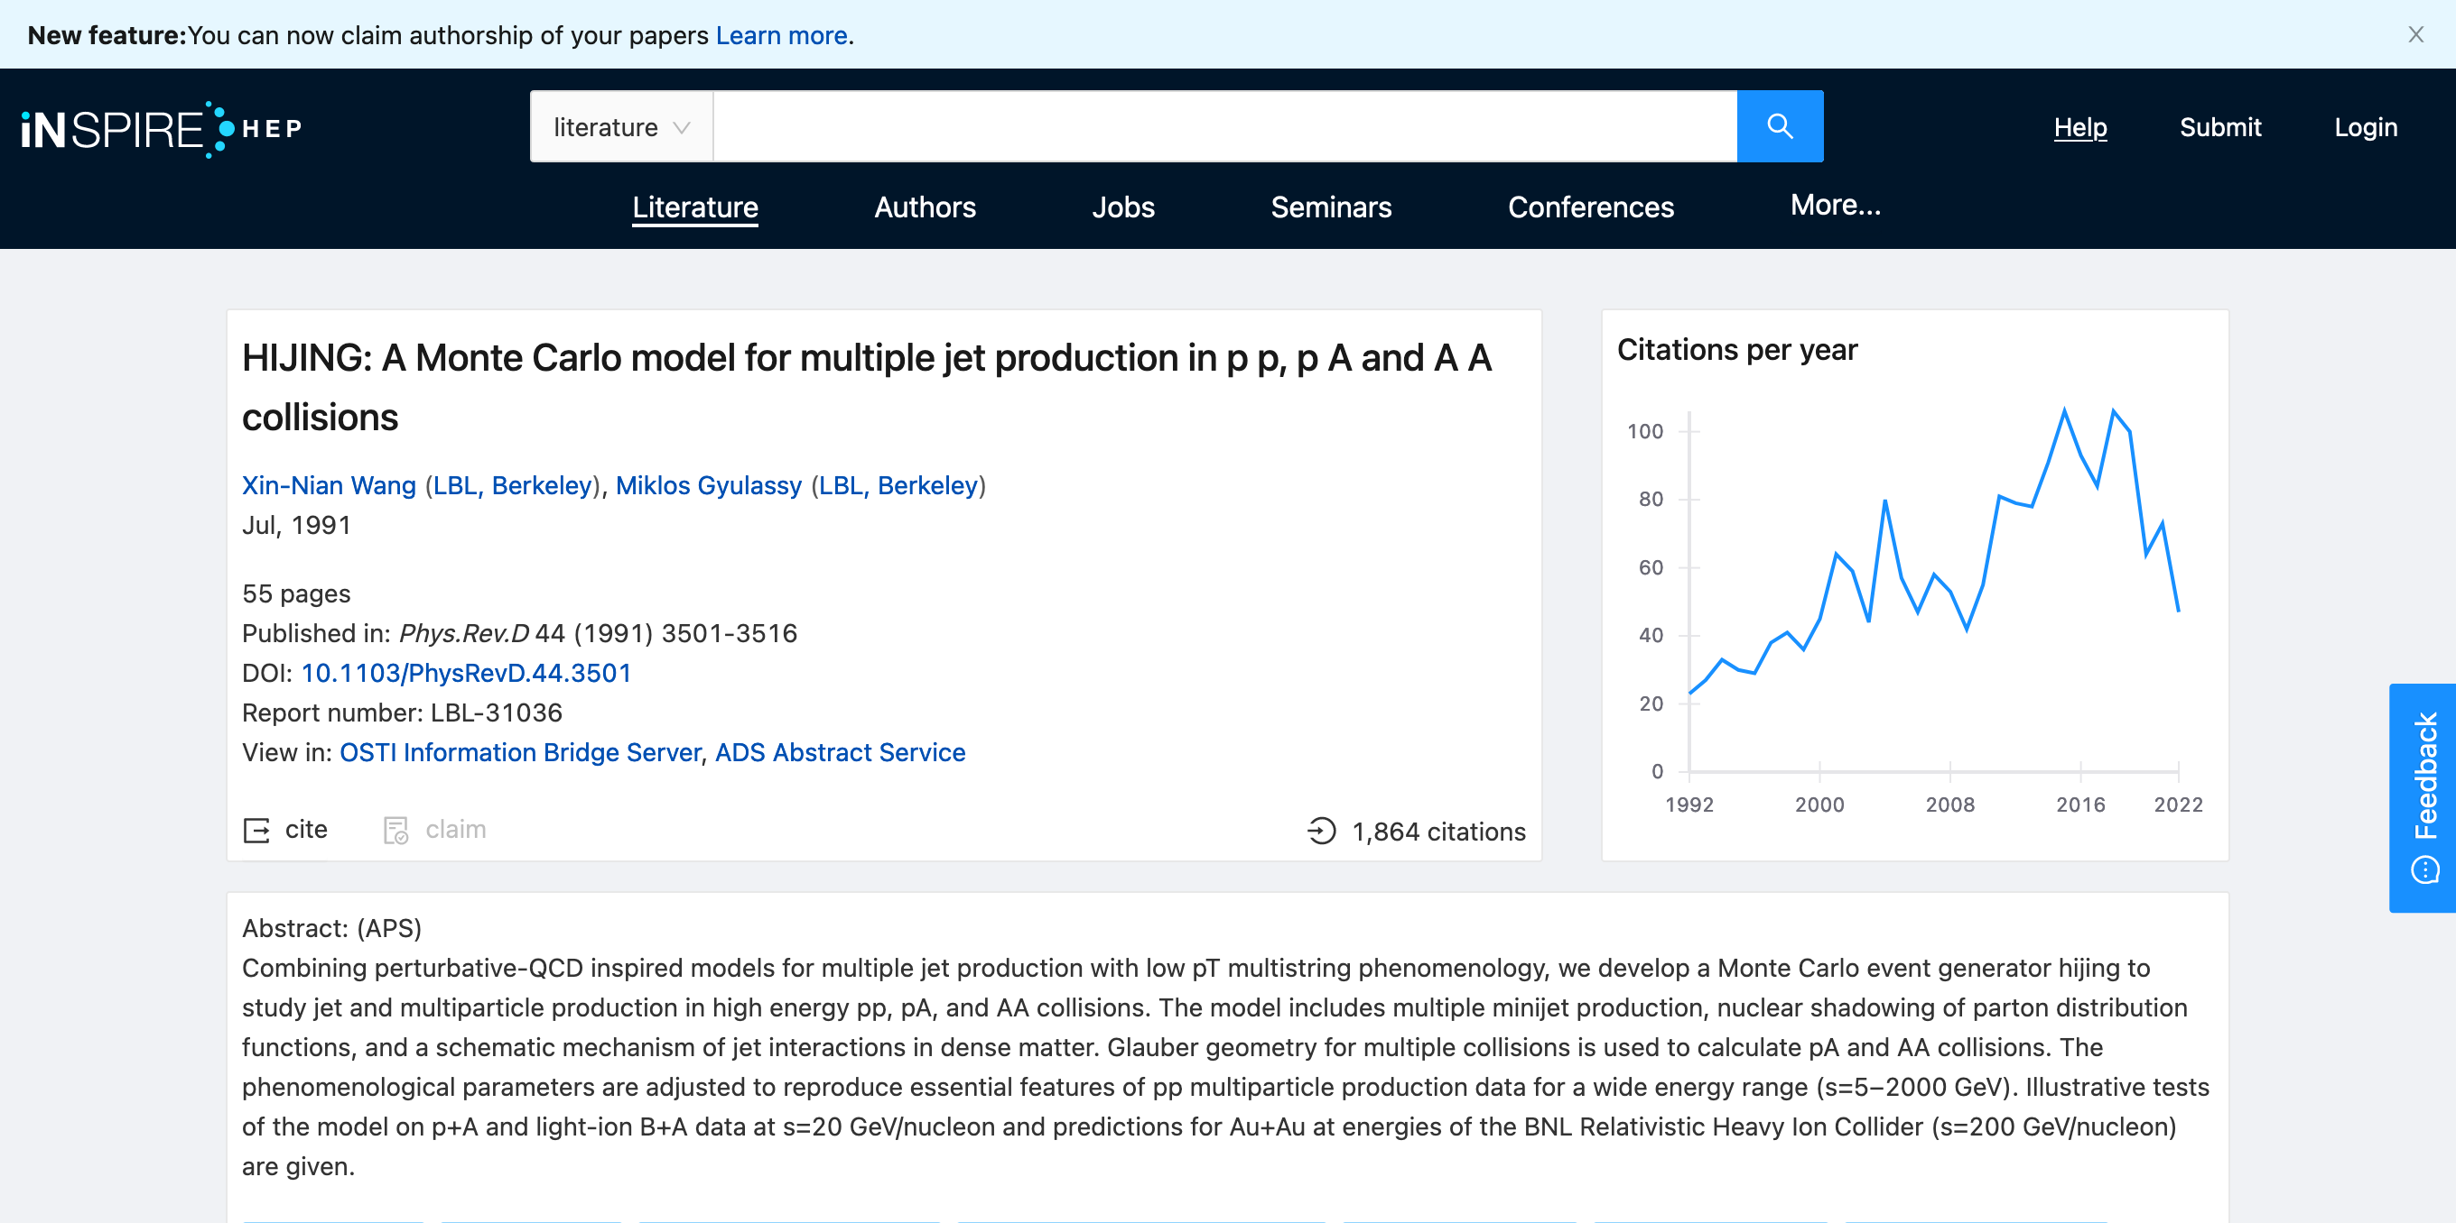
HIJING today
Published 31 years ago:
> 1800 citations
no indication that citation rate is slowing down
The only competition in our field:
Bjorken hydrodynamics
Matsui+Satz quarkonium dissociation
Good company!

Slide 10
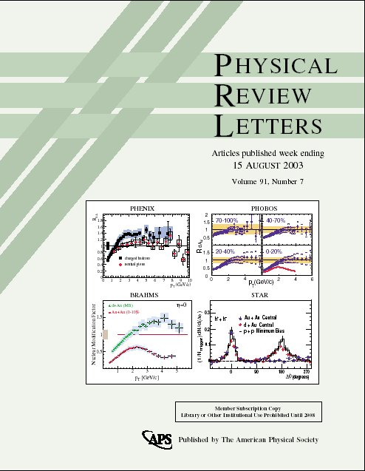
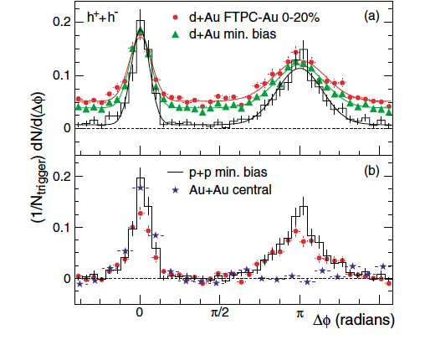
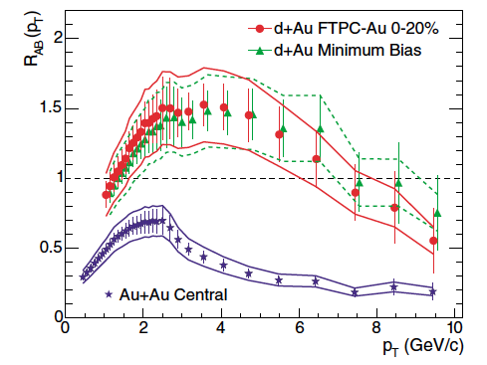
d+Au run ’03: discovery of jet quenching
Xin-Nian and Miklos ’92: proposed p+A for data-driven calibration of non-quenching effects

Slide 11
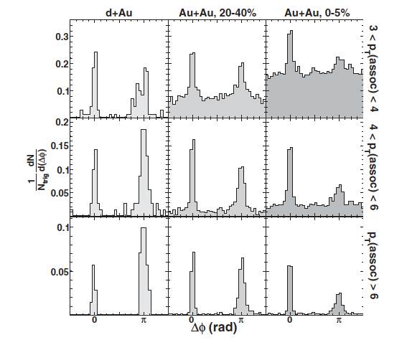
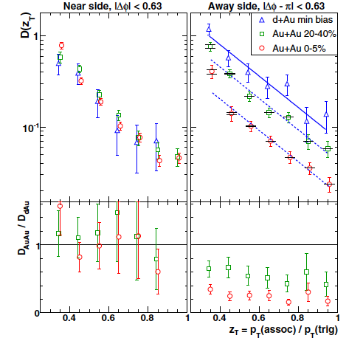
First positive observation of suppressed recoil yield due to quenching

Slide 12
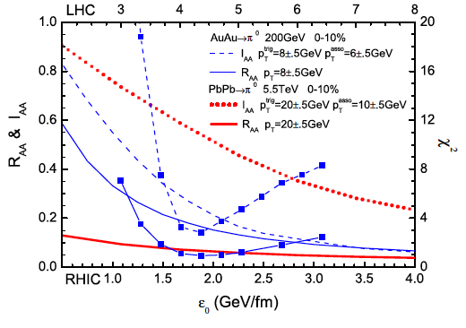
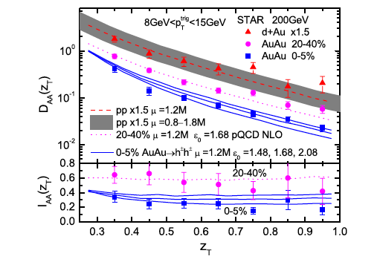
First indication that coincidence measurements provide independent – and possibly more sensitive – probes of quenching than inclusive observables

Slide 13
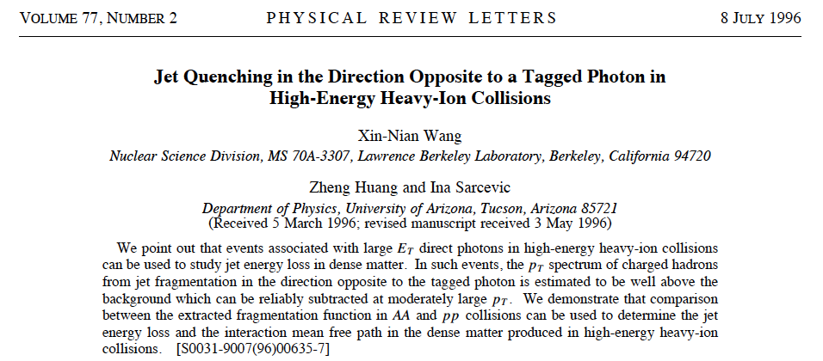

Slide 14
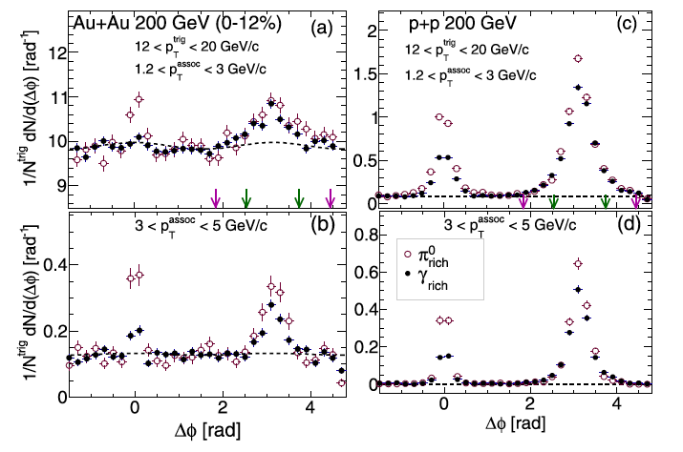
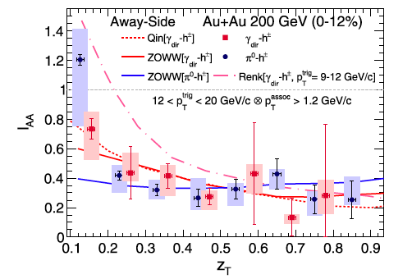

Slide 15
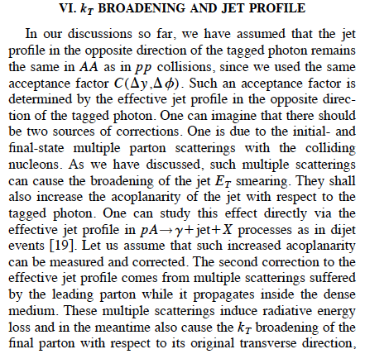
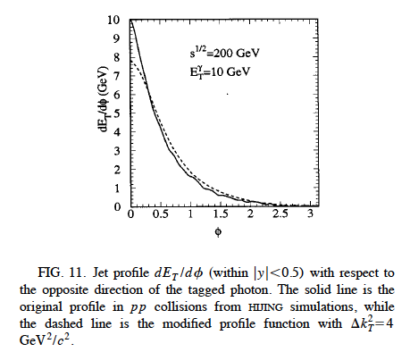

Slide 16
Quark Matter ‘22 (!)

Slide 17
Many of the key tools that we use to study jet quenching were invented by Xin-Nian and collaborators:
R_{AA}
p/d+A as data-driven calibration of non-quenching effects
Importance of coincidence channels
γ+h, γ+jet
This is only a partial list.

Slide 18
We aren’t ancient history…yet…
Looking forward to many more years of wonderful collaboration!

