Slide 1

Xin-Nian’s Influence on me
Jet Physics at the EIC
@ZhongboK
Berkeley Symposium on Hard Probes and Beyond
August 19, 2022

Slide 2
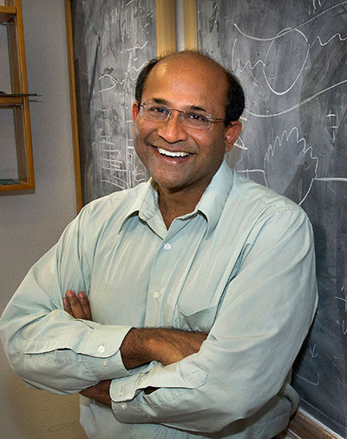


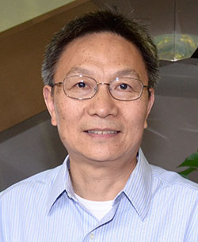

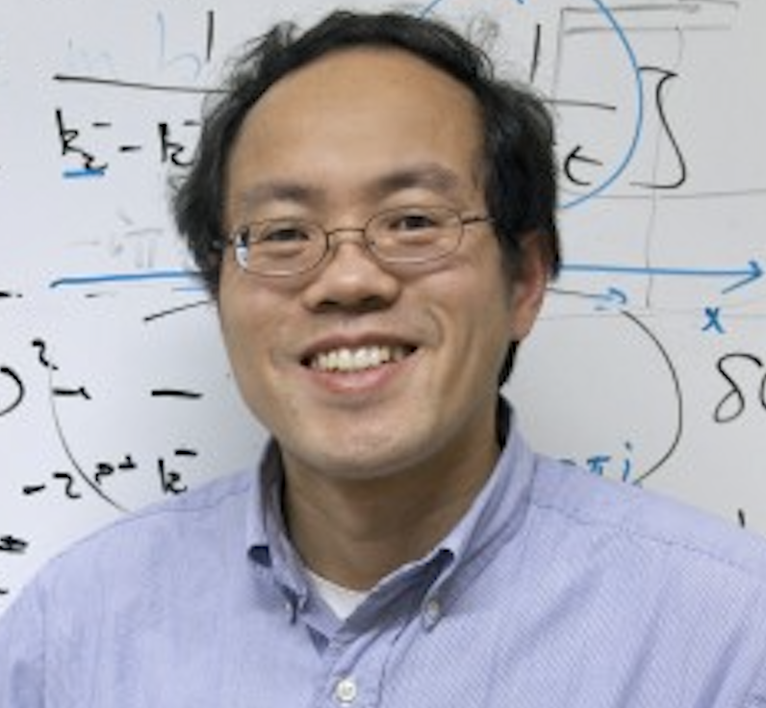


Unbelievable symposium: all my mentors are here
LANL
UCLA
BNL
Iowa State
IOPP Wuhan
2001 - 03
Undergrad + Master Degree
2009
Ph.D.
2016
Associate Professor
Joint training postdoc
Research associate
RIKEN BNL Center
Director’s + Oppenheimer fellow

Slide 3

Xin-Nian’s influence on me
Xin-Nian initiated my interests and motivated me to the field of high-energy nuclear physics, supported critical steps in my career
My family are big fans of Xin-Nian’s annual Christmas movie
Happy Birthday, Xin-Nian!

Slide 4
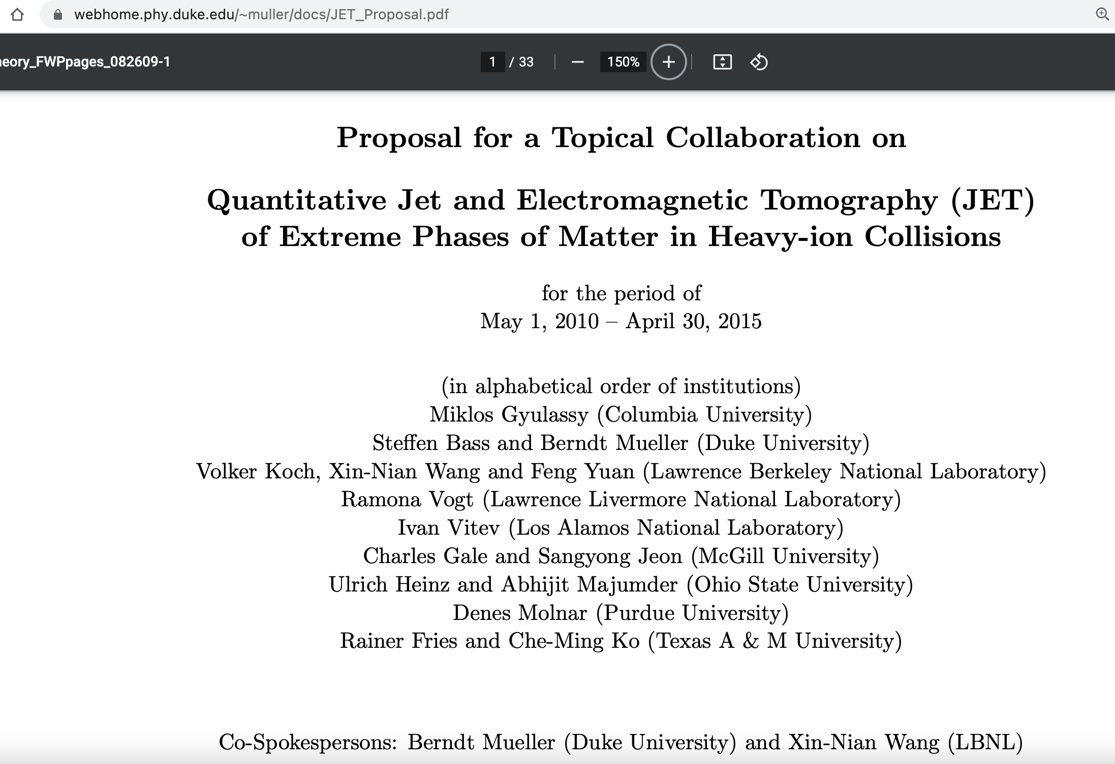
Interesting story in 2010
During a workshop held at BNL in 2010, DOE notified Xin-Nian and collaborators that JET collaboration would be selected for funding
  He was in my office checking the email on the phone, super exciting time
  It was then when I started to look at what key questions JET collaboration would address
  Publicly available via Berndt Mueller’s website

Slide 5
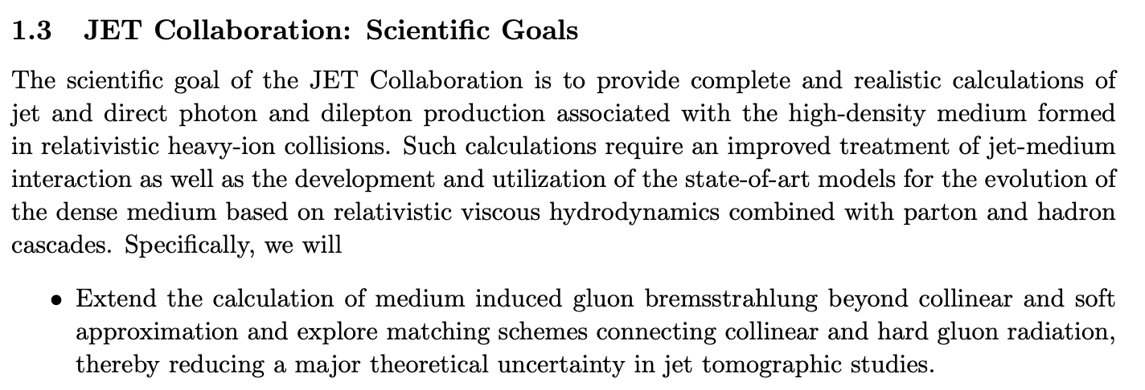
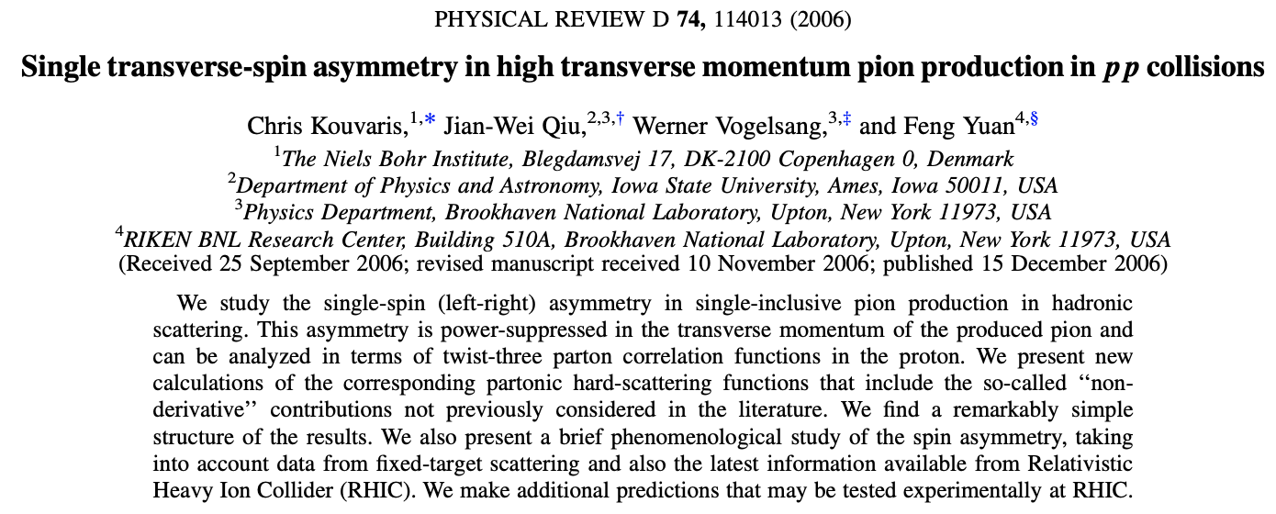
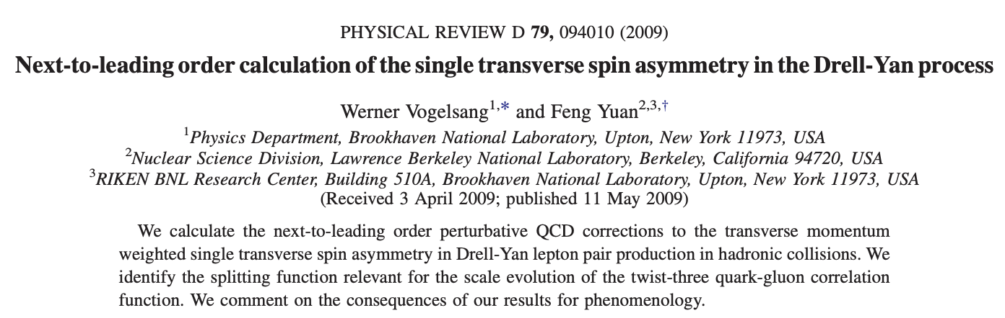
I know how to compute one of them
So exciting
Within high-twist formalism, some major progress was made by Jian-Wei, Feng and collaborators

Slide 6
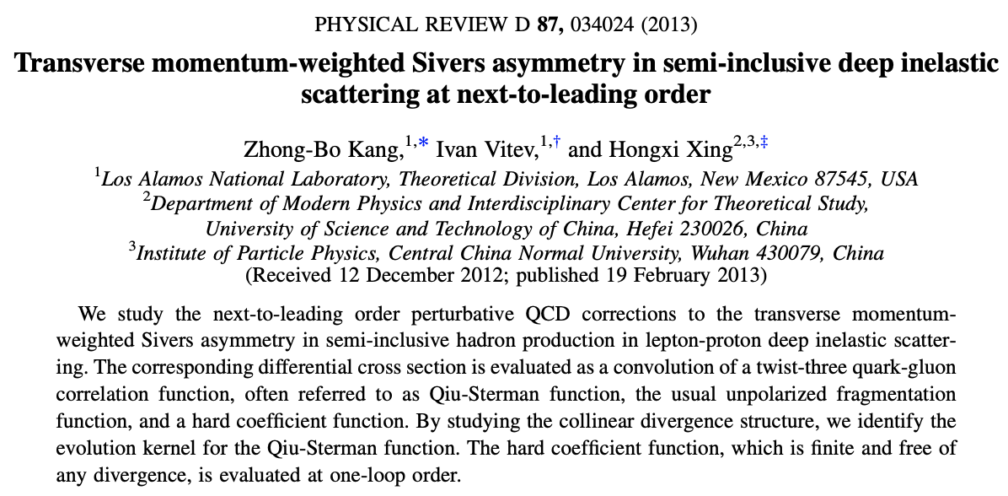
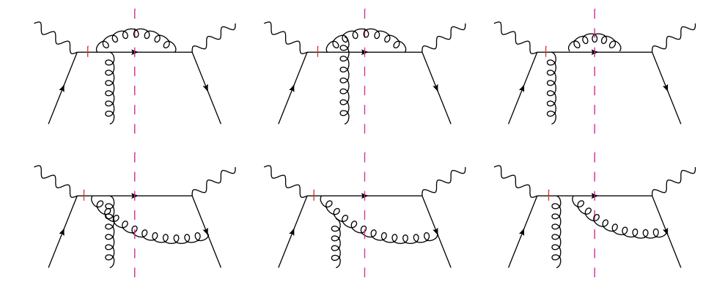
First do a spin computation
Work with Ivan Vitev and Hongxi Xing

Slide 7
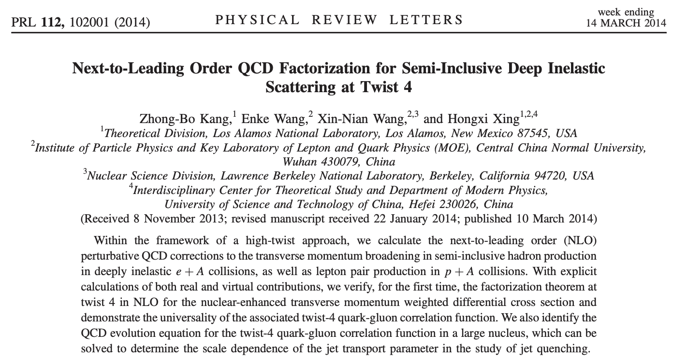
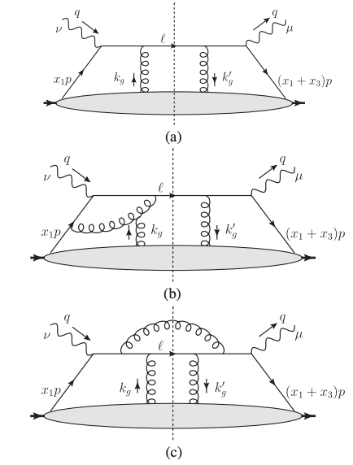
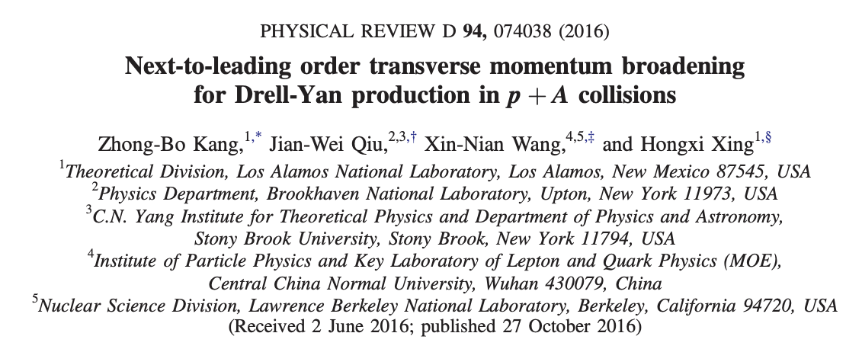
Work with Xin-Nian
Performed NLO computation at double scattering within the high-twist formalism (twist-4) for SIDIS and DY

Slide 8
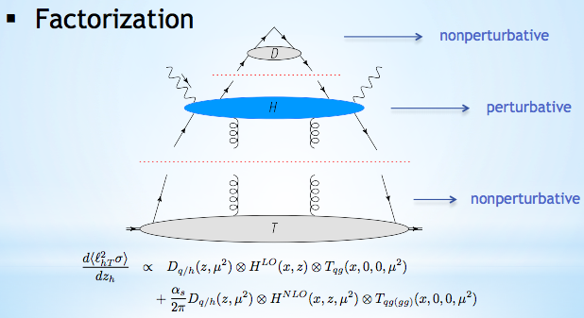
A full NLO calculation
Though quite involved, (1) the evolution equation can be derived; at the same time, (2) multiple scattering hard part (short-distance physics) can be rigorously computed

Slide 9
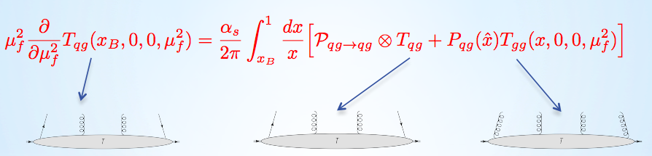
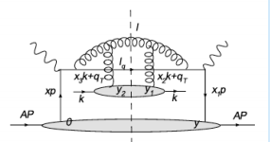
Evolution equation
Evolution equation
RG running for jet quenching parameter
  In the intermediate x region
Casalderrey-Solana, Wang, 08

Slide 10
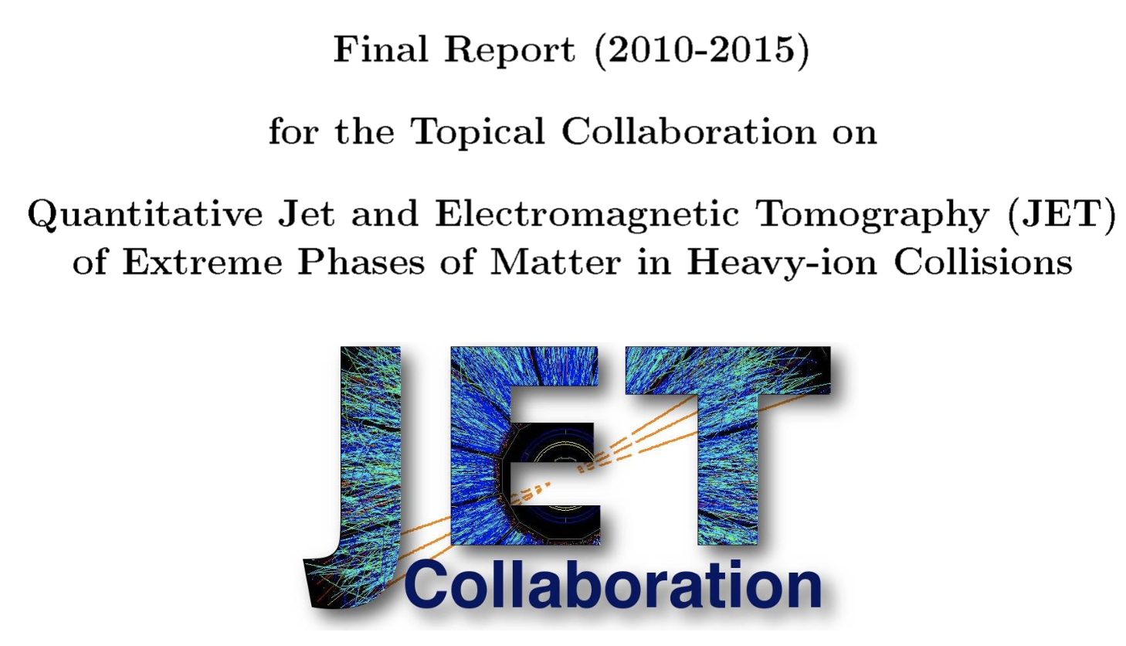
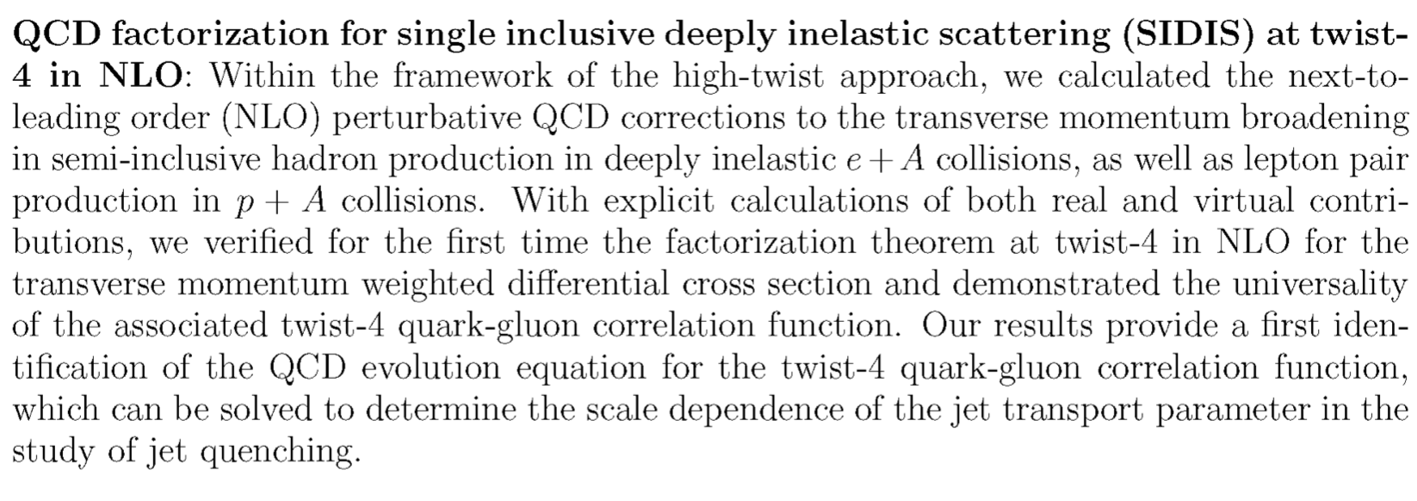
DOE final report
Happy that this was written as a milestone in the JET collaboration final report

Slide 11
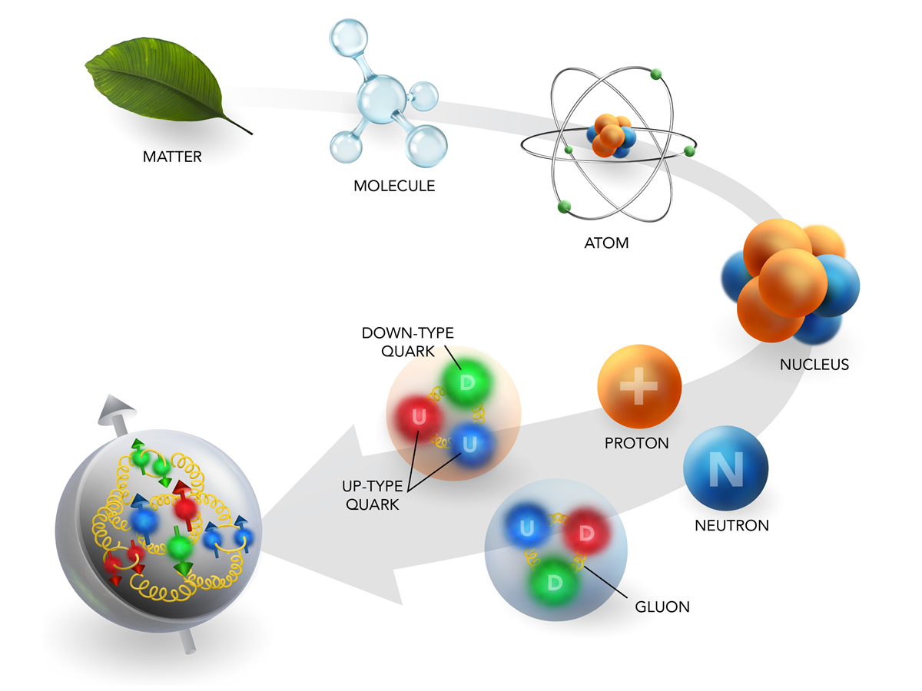
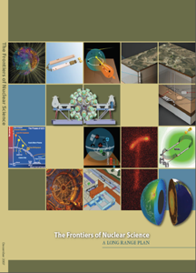
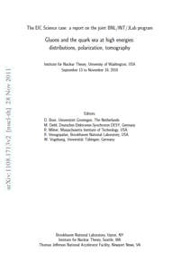



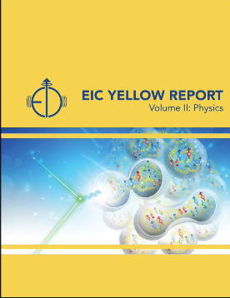
EIC era: Imaging of proton and nucleus
Studying the fundamental structure of matter
Looking into the EIC era, 3D imaging of proton and nucleus has become a central theme
…
…
arXiv:2103.05419

Slide 12
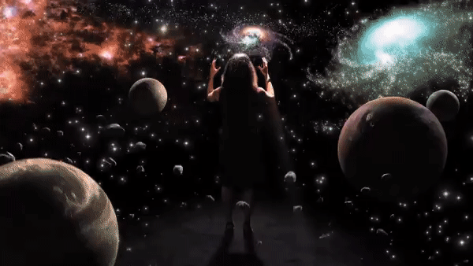

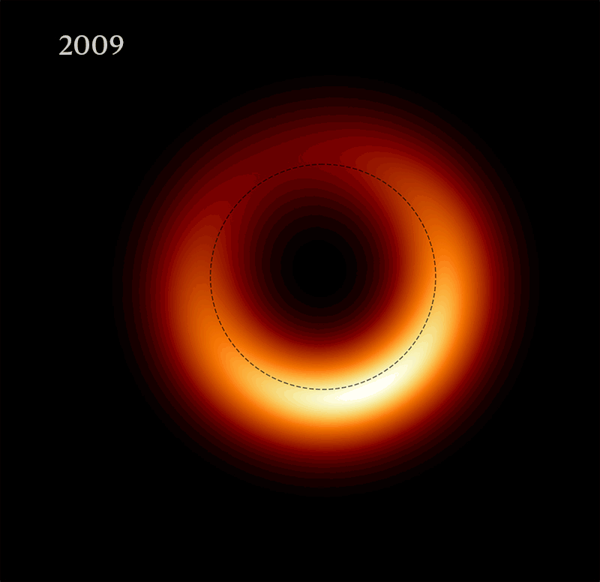
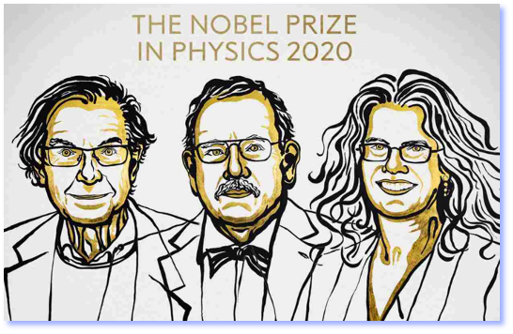
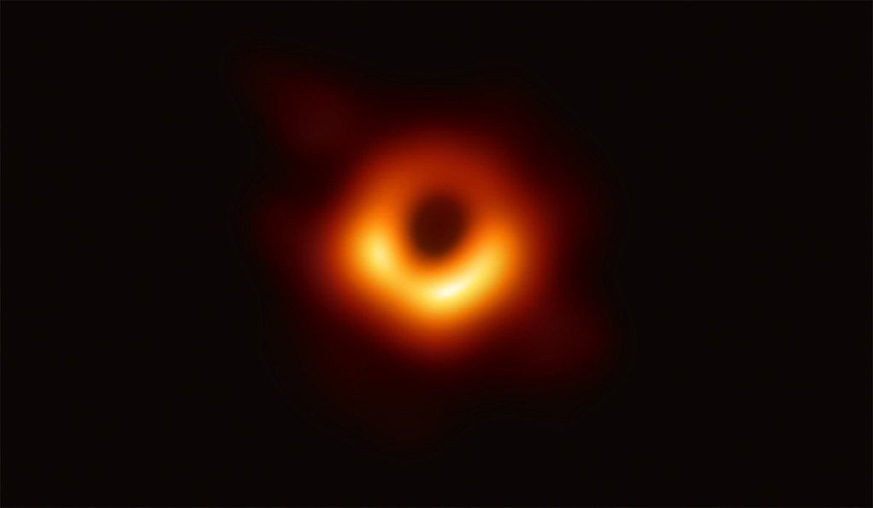
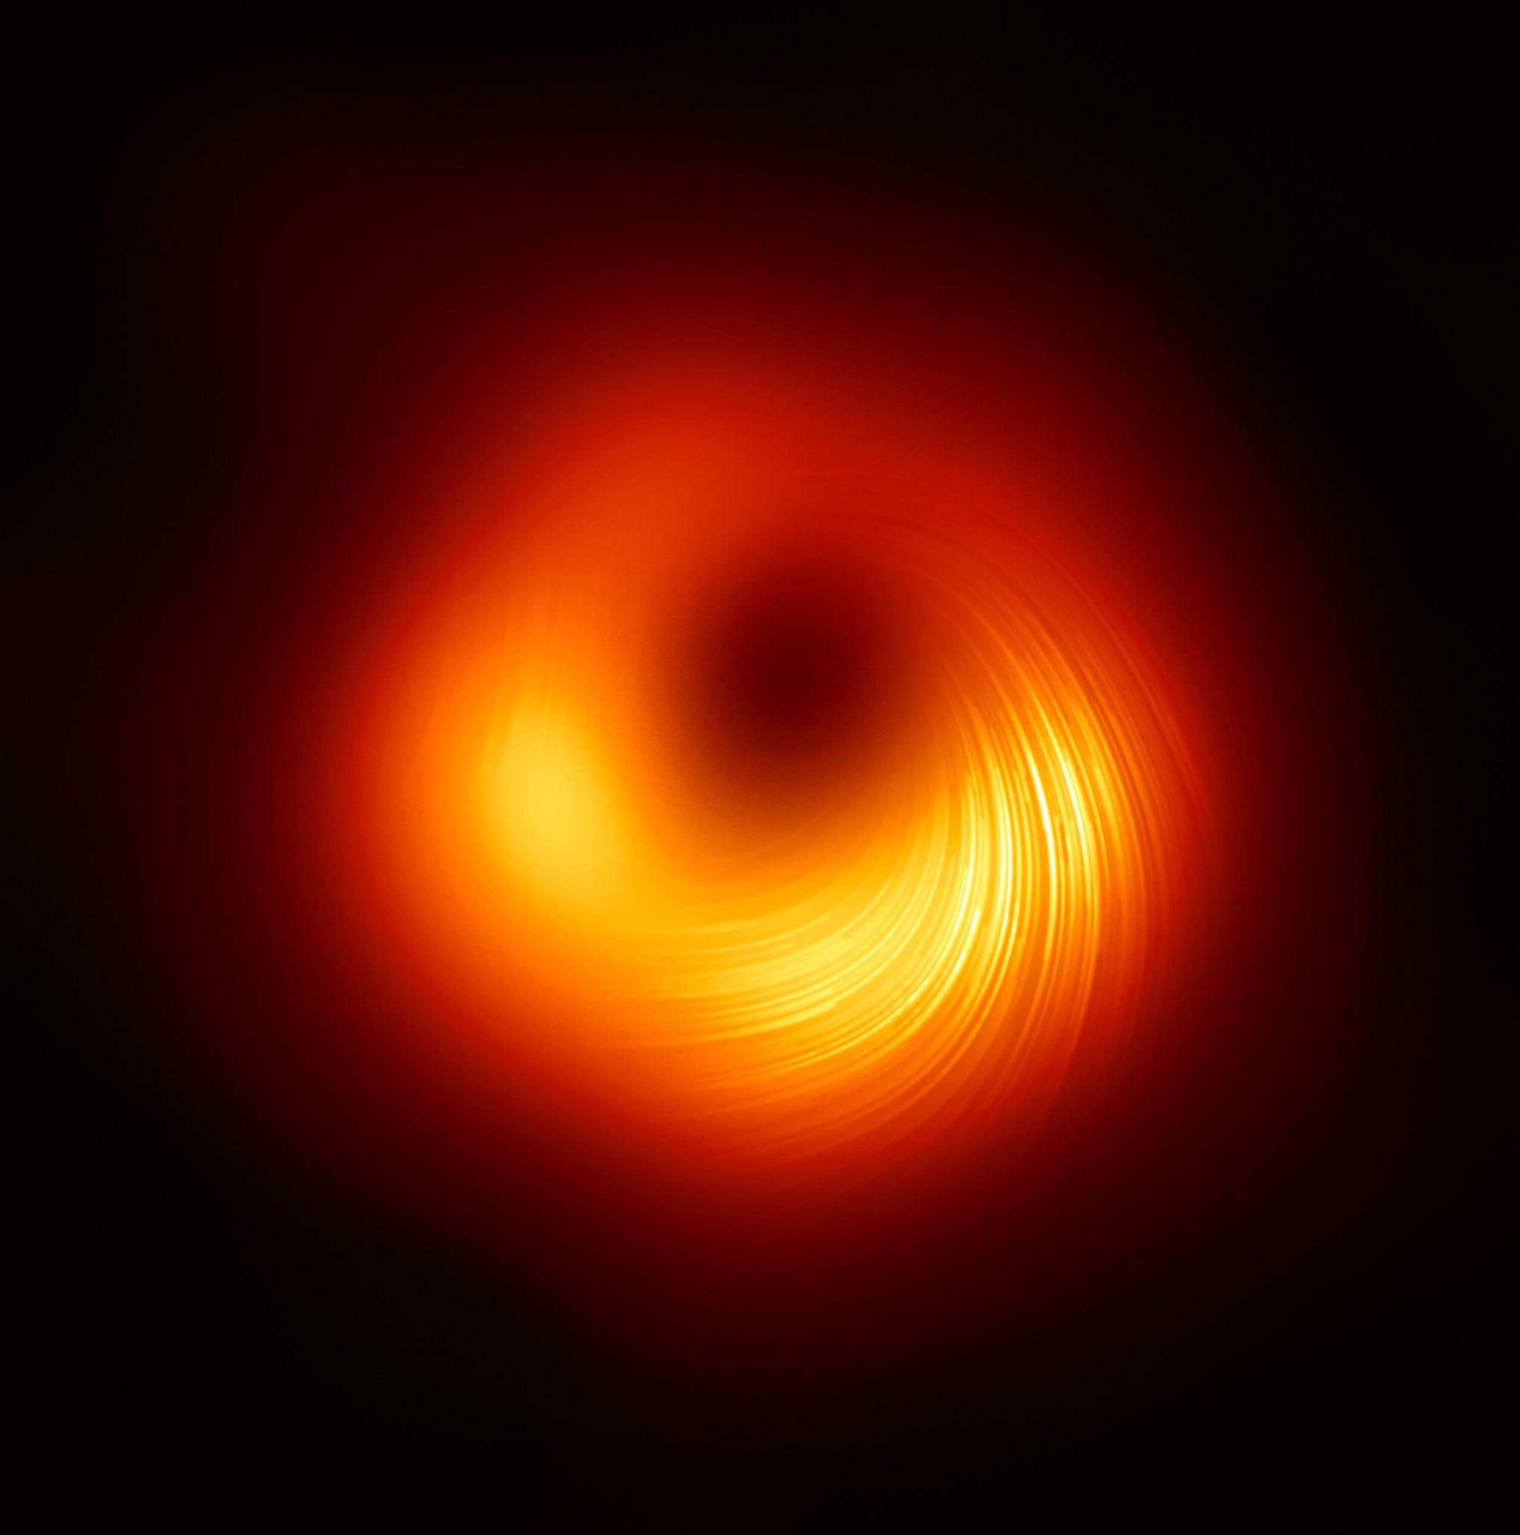
Analogy: imaging a black hole
Remarkable similarity in terms of research approach
  First images, second evolution, then spin correlation
Evolution of the image
[over time], 2020
First-ever image captured, 2019
Polarized view of the black hole, 2021
Ⓒ Event Horizon Telescope

Slide 13

Imaging a proton
Looking to the stars improves the humanity … looking into the atoms is the same
  Just like imaging a black hole shows dynamics of the gravitational force, imaging a proton would provide insights on strong interaction [in particular at the momentum scale corresponding to proton size]
Profound questions in nuclear physics
  How do the properties of the nucleon, such as mass and spin, arise from the fundamental quarks/gluons?
  What are the quantum correlations between the motion of the quarks/gluons, their spin and the spin of the proton?
©twitter CMS collaboration at LHC
©JLab

Slide 14
Transverse Momentum Dependent distributions (TMDs)
3D imaging of the proton in momentum space
  Both longitudinal and transverse motion
  Large Lorentz boost in longitudinal direction ( ), but not in transverse momentum ( ), mapping out the small is not easy
  Transverse spin comes to the rescue
    spin and transverse momentum correlates
Proton spin

Slide 15
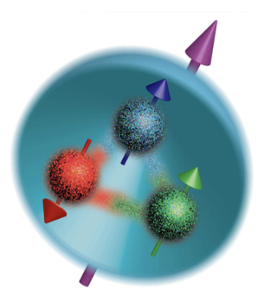
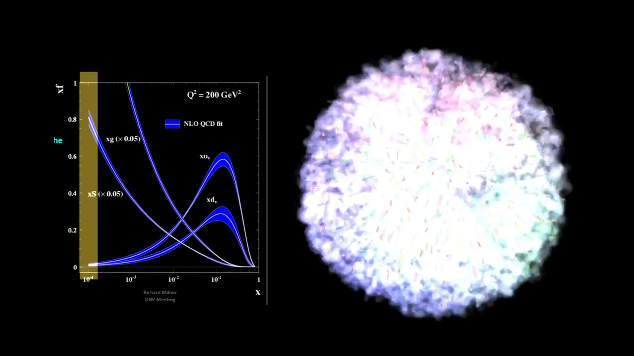
Fundamental structure of proton
Longitudinal motion
Physicist: Milner (MIT), Ent-Yoshida (Jlab), 04/2022
Documentary Filmmaker: Boebel-McMaster (MIT), LaPlante (Sputnik Animation)

Slide 16

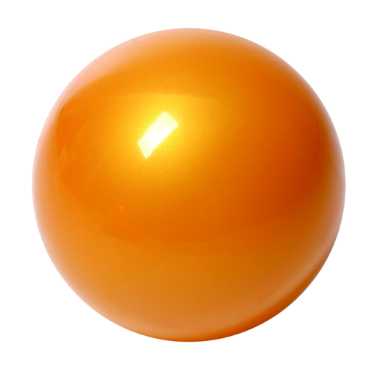
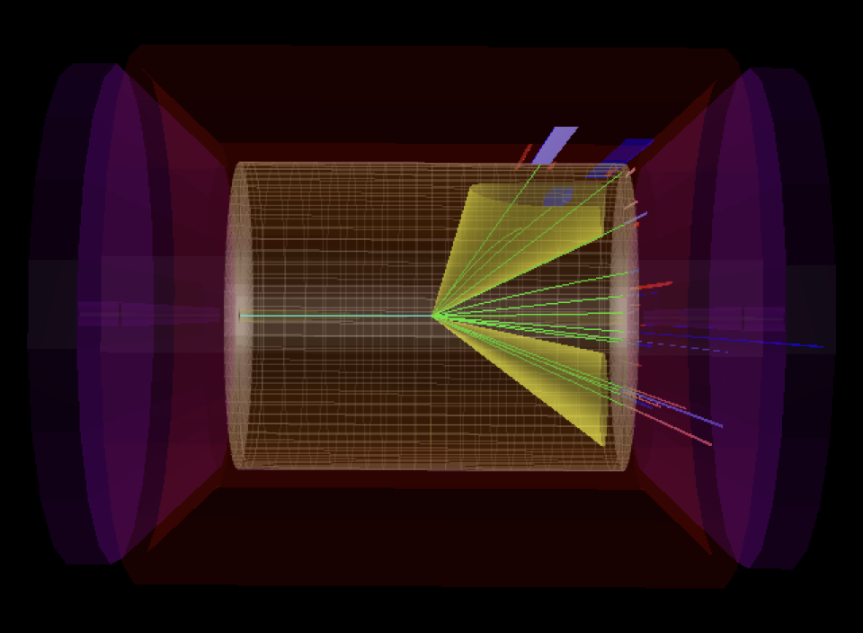

Standard processes to extract TMDs
SIDIS, Drell-Yan, dihadron in e⁺e⁻
New opportunities: jets for 3D imaging
h₁
electron
p
p
p
h
h₂
SIDIS
DY
e⁺e⁻
Beyond
EIC

Slide 17
Standard TMD factorization
Drell-Yan:
Factorized form and mimic “parton model”
Factorization of regions:
(1) k//P₁, (2) k//P₂, (3) k soft, (4) k hard
mimic “parton model”

Slide 18
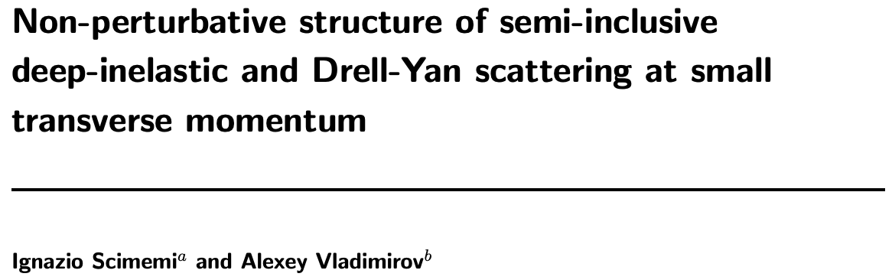
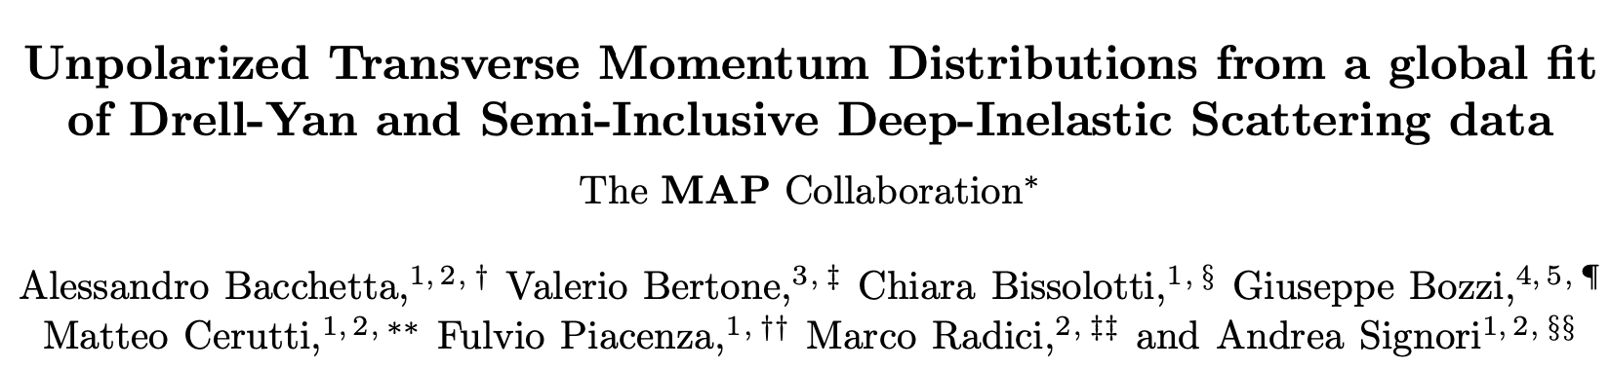
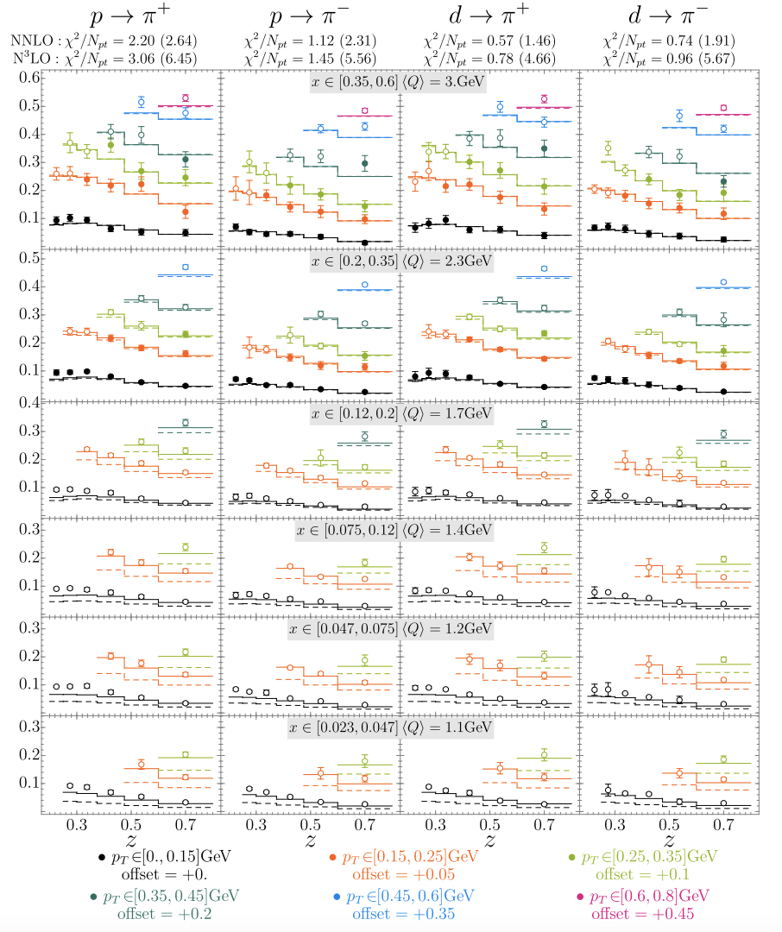
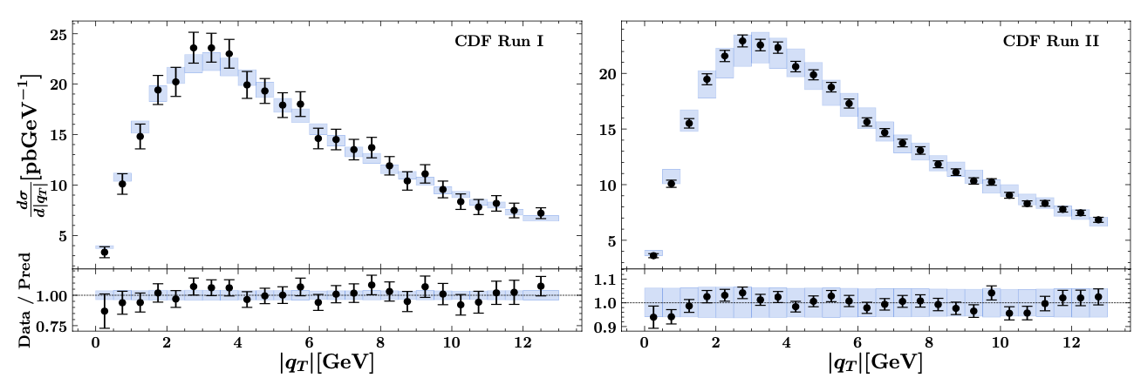
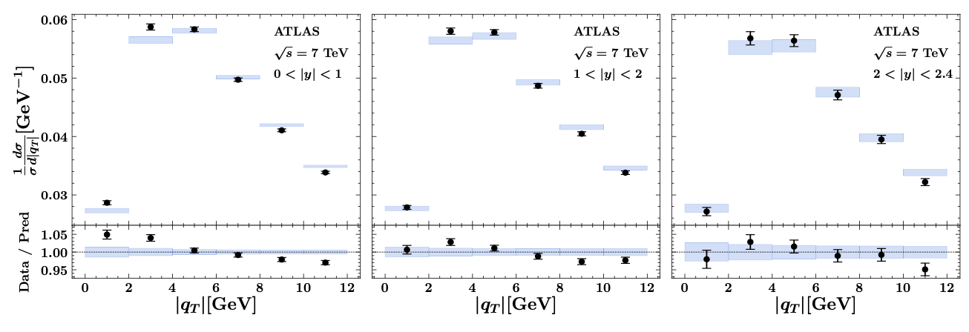
Unpolarized cross sections
Good fit achieved in the “TMD region” (N³LL)
JHEP (2020)
2206.07598
SIDIS
Drell-Yan

Slide 19
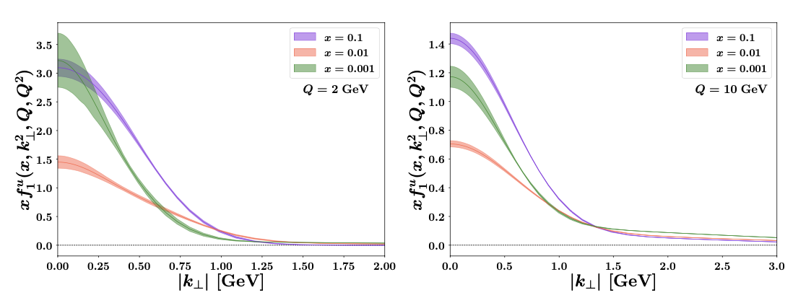

Unpolarized TMDs
Extracted unpolarized TMD PDFs and FFs
Useful tools
2206.07598
2103.09741

Slide 20
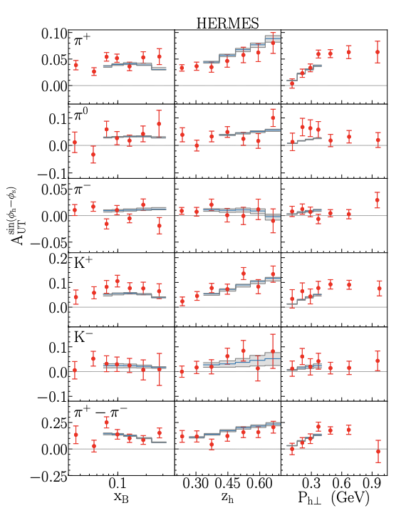
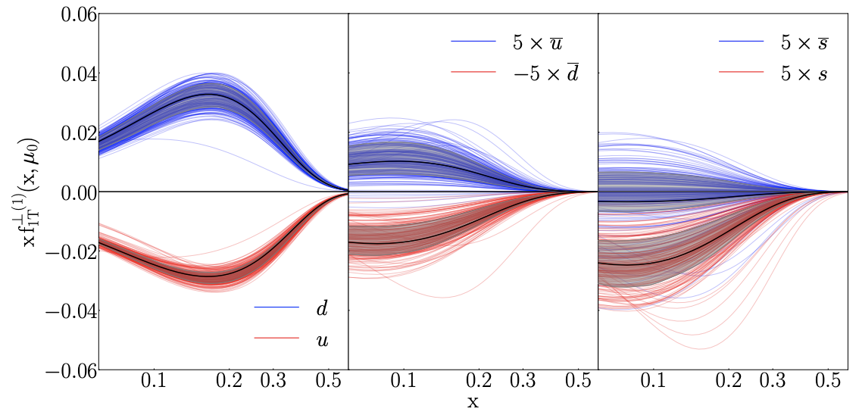
Progress from standard processes
Take an example: Sivers function
Echevarria, Kang, Terry, JHEP (2021)

Slide 21
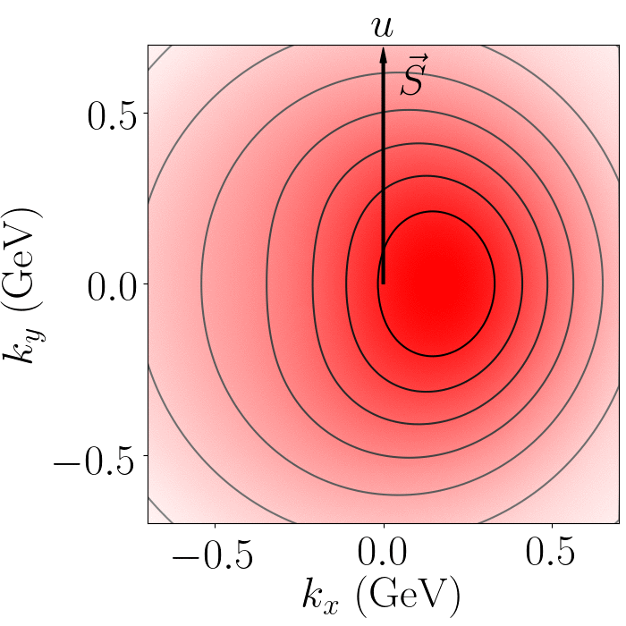
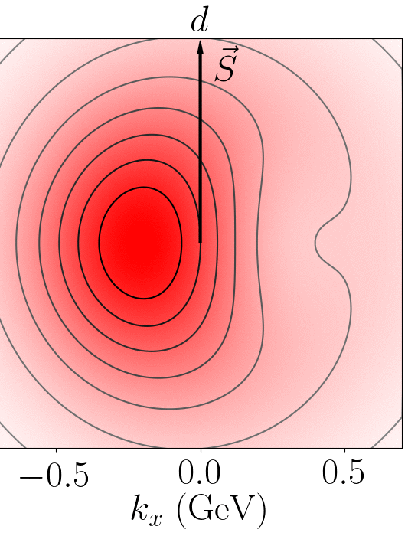
Distorted distribution
Sivers correlation leads to a distortion in the u/d quark distribution
  Left or right shift

Slide 22
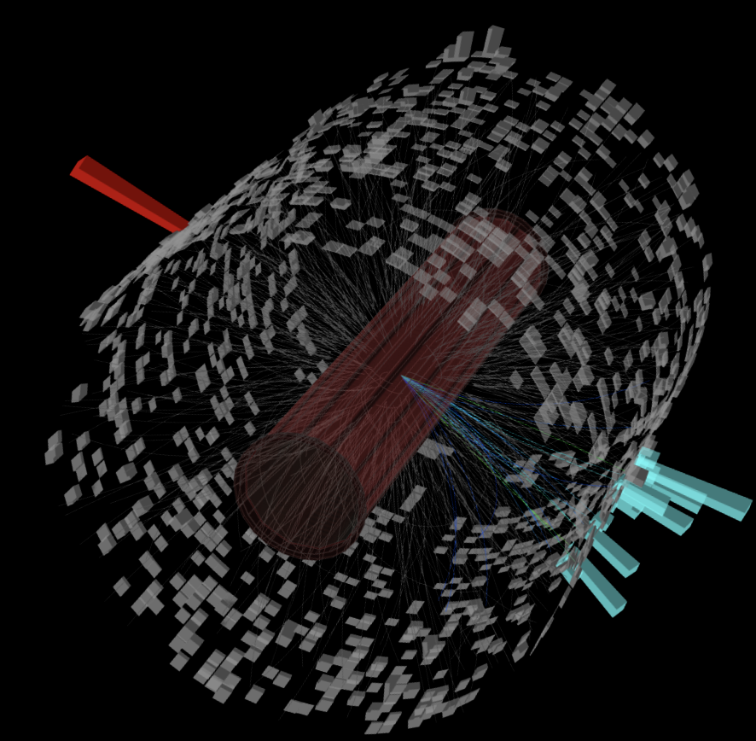
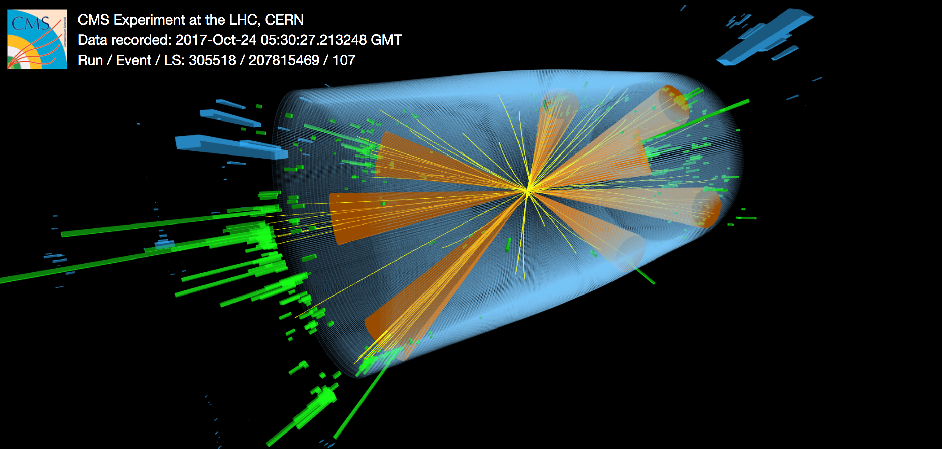
Jets: dominant phenomenon
Jets are something that happen in high energy events
Jets: collimated spray of particles flying roughly in the same direction
  Sometimes, we could even eyeball the collimated sprays
  They reflect configurations of quarks and gluons produced in the collisions
RHIC
EIC
LHC

Slide 23

Jets for 3D imaging

Slide 24
Renaissance of jet physics
LHC: 60% of ATLAS & CMS papers use jets in their analysis!
CERN Document Server
EIC: jet papers grow exponentially

Slide 25
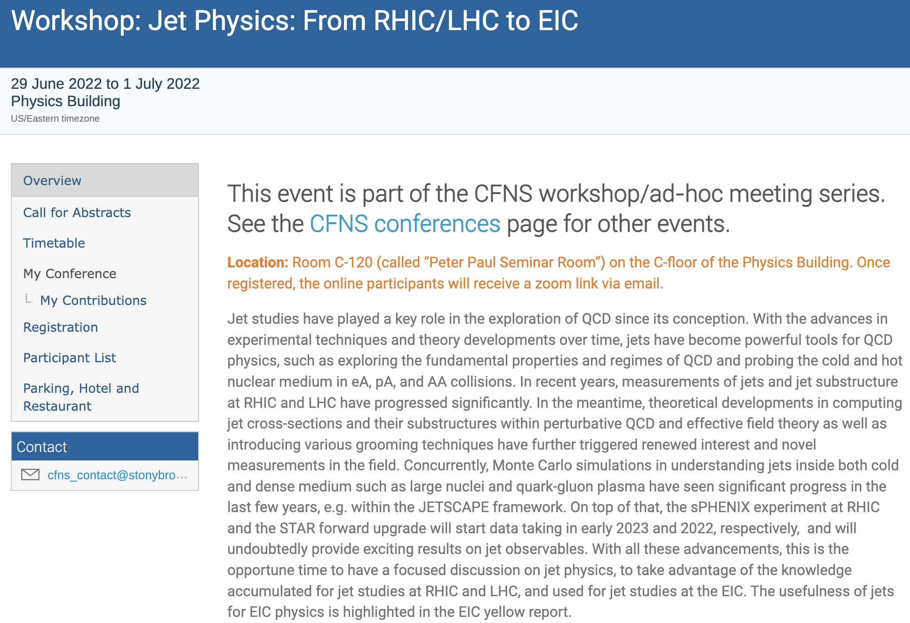
A recent CFNS jet workshop

Slide 26
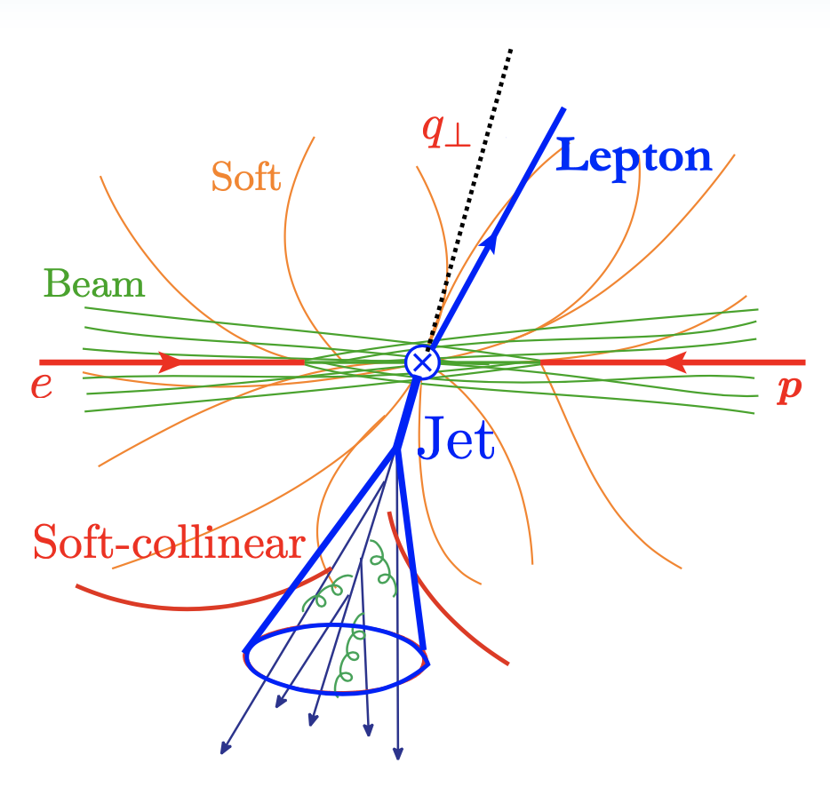
Jet production in e+p collisions
Back-to-back lepton+jet production at ep collisions
  One probes the small imbalance region
Factorization formalism
Two soft functions
    Global: can radiate everywhere
    Collinear-soft: soft radiation inside jet does not affect imbalance
  Because of small imbalance, we are sensitive to small transverse momentum
  We now have TMD PDFs + soft function
Arratia, Kang, Prokudin, Ringer, 2007.07281
Kang, Lee, Shao, Zhao, 2106.15624
Liu, Ringer, Vogelsang, Yuan, 18, 20, …

Slide 27
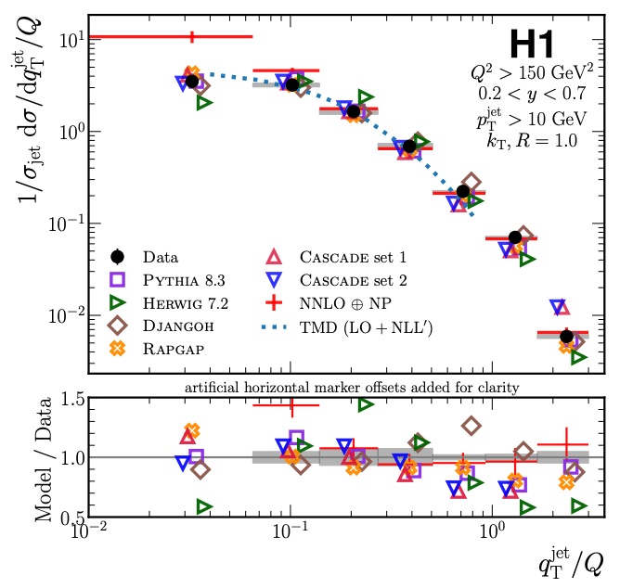
Jets for 3D imaging
Constrain TMDs (without fragmentation function)
  Unpolarized scattering: recent HERA measurement
  Transversely polarized proton scattering: Sivers function (right plot)
HERA, arXiv:2108.12376, PRL 22
Arratia, Kang, Prokudin, Ringer, 2007.07281, PRD

Slide 28
Jet charge
Jet charge is much more useful for polarized scattering
  Because spin-dependent functions tend to flavor dependent, e.g. Sivers function
Echevarria, Kang, Terry, 2009.10710, JHEP (2021)

Slide 29
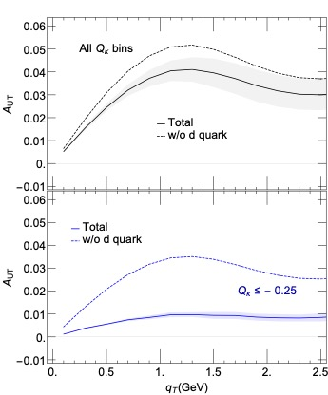
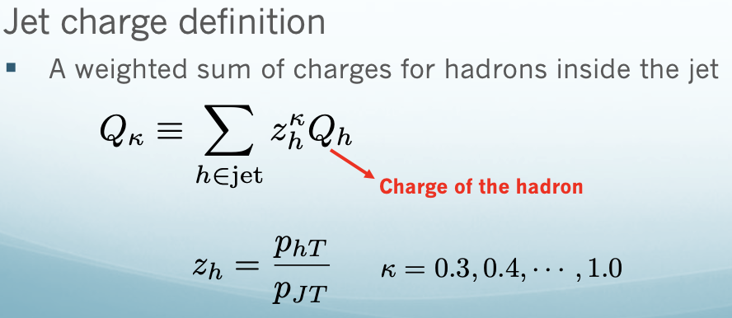
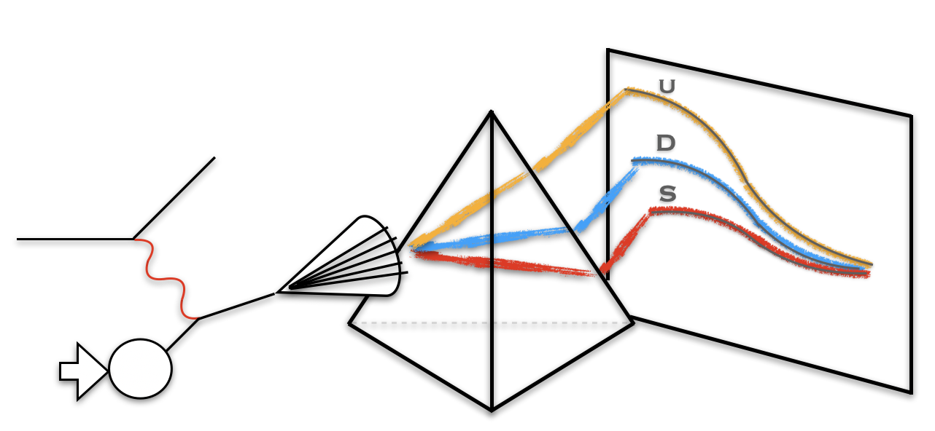
Enhanced sensitivity for d quark
Spin asymmetry in e+p collisions
  No jet charge selection: taking out d quark, small change, thus no sensitivity
  With negative jet charge bin selection: dramatic change, much greater sensitivity
Kang, Liu, Mantry, Shao, PRL, 20

Slide 30
Jet substructure: polarized jet fragmentation function
One can further measure distribution of hadrons inside the jet
  Two axes: imbalance controls TMD PDFs, while the hadron transverse momentum w.r.t jet axis controls TMD FFs
  Advantage over hadron production SIDIS
Kang, Lee, Zhao, PLB 20
Kang, Lee, Shao, Zhao, JHEP 21
quark

Slide 31
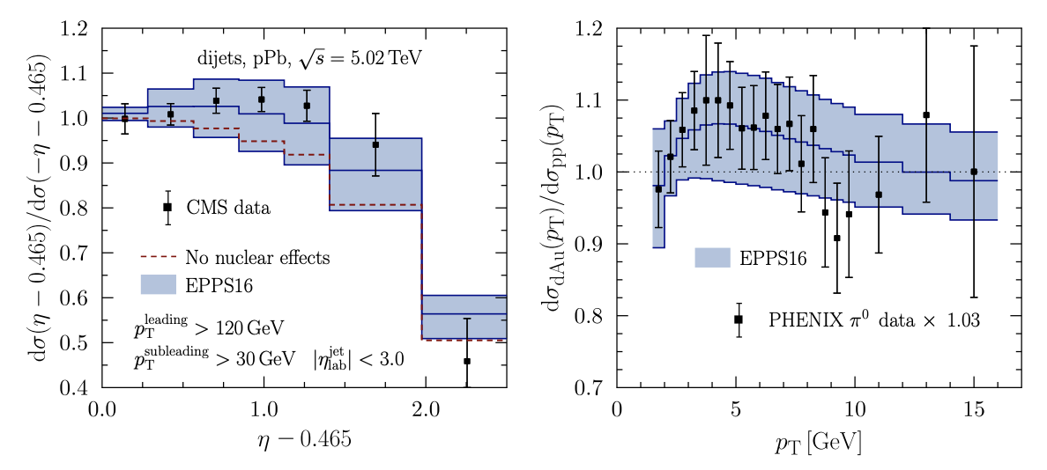
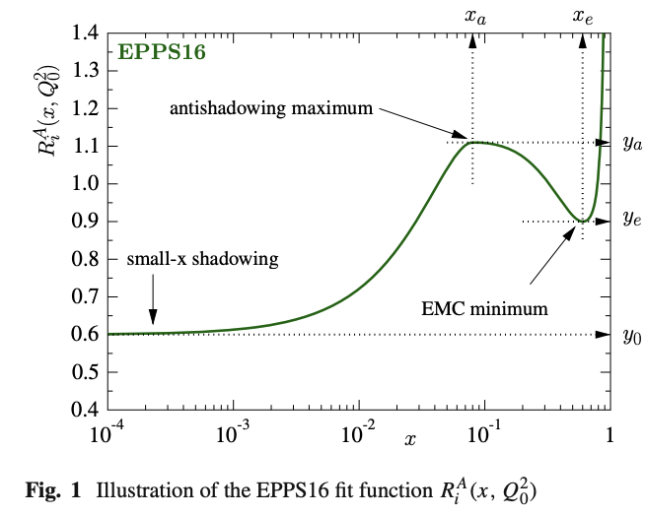
Nuclear PDFs to nuclear TMDs: it’s time
These days, it is a standard exercise to quantify the cold nuclear matter effect via collinear nuclear PDFs
  However, collinear PDFs are only for relatively inclusive process, e.g. pT spectrum of single inclusive hadron or jet production
  Moving into the future, it is time for us to quantify the modification of 3D structure in the nucleus vs proton

Slide 32


Global fits of nuclear TMDs
Nuclear TMD PDFs and TMD FFs
  Use the same spirit of nuclear PDFs, i.e., assume perturbative TMD evolution is the same, only modify non-perturbative component
Alrashed, Anderle, Kang, Terry, Xing, 2107.12401

Slide 33

Looking forward to the great collaborations
Thank you, Xin-Nian, for all your guidance and support all these years!
Happy birthday!

